Slide 1
PHY1012F
MOMENTUM
Gregor Leigh
gregor.leigh@uct.ac.za

Slide 2
CONSERVATION LAWS
  During the processes of change, certain physical quantities in fact remain constant.
  For example…
    The total mass in a closed system is constant:
    M_{f} = M_{i} – Law of conservation of mass
    The total momentum of an isolated system is constant.
    – Law of conservation of momentum
    The total energy of an isolated system cannot change.
    ΔE_{sys} = 0 – Law of conservation of energy

Slide 3
CONSERVATION LAWS
  During the processes of change, certain physical quantities in fact remain constant.
  The goals of Part II, Conservation Laws, are to…
    Recognise conservation laws (momentum and energy) as a different way of describing motion.
    Learn to use these conservation laws in alternative techniques for solving mechanics problems.
    Develop an ability to choose appropriately between the perspectives of laws of motion and laws of conservation for the solving of different problem types.

Slide 4
IMPULSE and MOMENTUM
Learning outcomes:
At the end of this chapter you should be able to…
    Apply new pictorial representations useful for before-and-after situations.
    Use the concepts of impulse and momentum and the law of conservation of linear momentum to visualise and solve problems involving velocities before and after collisions and explosions.
    Apply the law of conservation of angular momentum to solve problems involving orbiting and rotating bodies.

Slide 5
MOMENTUM
  The product of a particle’s mass and velocity is called the (linear) momentum of the particle:
  Notes:
    and have the same direction.
    . is more usefully resolved into…
    p_{x} = mv_{x} and p_{y} = mv_{y}
    Units: [kg m/s]
  Newton II reformulated:
  i.e. Force is the rate of change of momentum.

Slide 6
COLLISIONS
  Newton I reformulated:
  The momentum of a particle will not change unless a net external force acts on it.
  External force is applied during a collision – a short-duration interaction between two objects…
    The duration of the collision depends on the rigidity of the objects. (The more rigid, the shorter the duration.)
    Interaction involves an action-reaction pair of forces.
    A large force acting over the short time interval of a collision is called an impulsive force.

Slide 7
IMPULSE,
The magnitude of an impulsive force varies with time during a collision [F(t)].
Newton II reformulated:
  F_{x}
  Force curve
  F_{max}
  expansion
  compression
  duration
  t
Hence: Δp_{x} = J_{x} (impulse-momentum theorem)

Slide 8
IMPULSE
  Instead of a force which varies in a complicated way, we can instead use that constant average force, F_{avg}, which produces the same area under the force curve (i.e. impulse) during the same time interval:
  F_{x}
  F_{max}
  F_{avg}
  duration
  t
  J_{x} = F_{avg}Δt
  F_{avg}Δt = Δmv
An impulse delivered to a body changes its momentum:
  p_{fx} = p_{ix} + J_{x} = p_{ix} + area under force curve

Slide 9
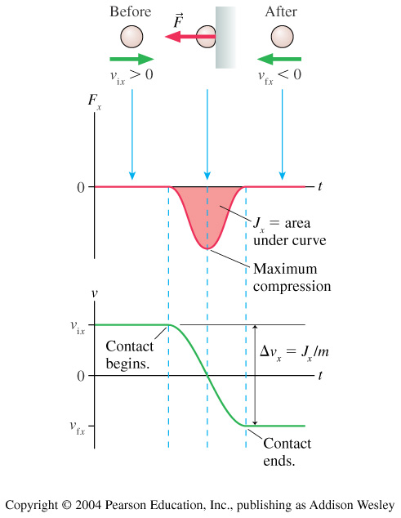
IMPULSE
  A rubber ball bounces
  off a wall… (Knight p242/3)
  Note the use of the
  impulse approximation:
  During short-duration collisions (and explosions) we ignore other forces
  (e.g. weight) since they are generally much smaller than the impulsive forces.

Slide 10
MOMENTUM DURING COLLISIONS
A
  Two objects approach and collide head-on…
  F_{B on A}
  F_{y}
  F_{B on A}
  and
A
  t
  According to Newton III:
B
  F_{B on A} = –F_{A on B}
  F_{A on B}
  ∴ Δp_{A} = –Δp_{B}
  F_{A on B}
  ∴ Δp_{A} + Δp_{B} = 0
  ∴ p_{total} = p_{A} + p_{B} = constant
  or p_{Ai} + p_{Bi} = p_{Af} + p_{Bf}
B

Slide 11
CONSERVATION OF MOMENTUM
  Total momentum of a system, , or :
  The vector sum of all the individual momenta of the particles in the system.
  Isolated system:
  System for which the net external force is zero: .
  Law of conservation of momentum:
  The total momentum of an isolated system is a constant.
  Mathematically, or
  (Note how this equation is independent of F(t)!)

Slide 12
IMPULSE and MOMENTUM
  Problem-solving strategy:
  If possible, choose an isolated system. (Otherwise divide the problem into parts so that momentum is conserved during at least one part.)
  Sketch the situation, using two drawings labelled “Before” and “After”.
  Establish a coordinate system to match the motion.
  Define symbols for initial and final masses and velocities, and list known information, identify desired unknowns.
  Apply the law of conservation of momentum, or other appropriate mathematical representations (e.g. Δp_{x} = J_{x}).

Slide 13
TYPES OF COLLISION
  Provided the system is isolated ( ), momentum is conserved in all types of collision.
  Collisions are categorised according to whether kinetic energy is conserved or not:
    Elastic collision: Kinetic energy is conserved.
    (e.g. two billiard balls colliding.)
    Inelastic collision: Kinetic energy is lost.
    (e.g. a soccer ball bouncing on sand.)
    Perfectly inelastic collision: Two objects stick together
    and move on with a common final velocity.
    (e.g. two railway trucks coupling.)

Slide 14
MOMENTUM IN TWO DIMENSIONS
  If the motion of colliding or exploding bodies does not take place along a single axis, the problem is two-dimensional.
p_{blue f}
Before:
p_{red i}
After:
p_{blue i}
p_{red f}
  Not only does the total momentum, , remain the same, but each component is also conserved:
  i.e. Σp_{fx} = Σp_{ix}
  and Σp_{fy} = Σp_{iy}

Slide 15

A coconut of mass M, at rest on a frictionless floor, explodes into three pieces. Piece C, with mass 0.30M, has final speed
v_{fC} = 5.0 m/s. Determine the speeds of…
(a) piece B with mass 0.20M, and (b) piece A.
  y
100°
Σp_{fy} = Σp_{iy}
C
∴ p_{fAy} + p_{fBy} + p_{fCy} = 0
80°
A
∴ 0 – (0.20M)(v_{fB} sin50°) + (0.30M)(5.0 sin80°) = 0
B
130°
∴ v_{fB} = 9.6 m/s
50°
  x
Σp_{fx} = Σp_{ix}
∴ p_{fAx} + p_{fBx} + p_{fCx} = 0
∴ –(0.50M)v_{fA} + (0.20M)(9.6 cos50°) + (0.30M)(5.0 cos80°) = 0
∴ v_{fA} = 3.0 m/s

Slide 16
ANGULAR MOMENTUM
  The momentum, , of a particle in circular motion is NOT conserved (since its velocity changes continuously).
  Nevertheless, an orbiting or rotating body does have a tendency to “keep going”
  – due to its angular momentum, L:
  v_{t}
  L = mrv_{t}
  Units: [kg m²/s]
  L = Iω
  Law of conservation of angular momentum:
  The angular momentum of a system remains constant – provided the net external torque on it is zero.
  i.e. L_{f} = L_{i} (if τ_{t} = 0)

Slide 17
  A student sits on a stool which can rotate freely about a vertical axis. Initially at rest, the student holds vertically the axle of a bicycle wheel which has a rotational inertia I_{W} = 1.2 kg m² and which is rotating anticlockwise (viewed from above) at ω_{iW} = 3.9 rev/s.
  The student and the stool together have a combined rotational inertia I_{B} = 6.8 kg m² (and ω_{iB} = 0 rev/s).
  The student now inverts the wheel so that (viewed from above) it is now rotating clockwise…
  Determine the student’s final angular velocity.

Slide 18
  Determine the student’s final angular velocity.
  I_{W} = 1.2 kg m² ω_{iW} = 3.9 rev/s
  I_{B} = 6.8 kg m² ω_{iB} = 0 rev/s
  ω_{fW} = −3.9 rev/s ω_{fB} = ?
  (L_{f})_{B} + (L_{f})_{W} = (L_{i})_{B} + (L_{i})_{W}
  (L_{f})_{B} + (–L_{i})_{W} = 0 + (L_{i})_{W}
  ∴ (L_{f})_{B} = 2(L_{i})_{W}
  ∴ (Iω_{f})_{B} = 2(Iω_{i})_{W}
  ∴
  = 1.4 rev/s
  , anticlockwise

Slide 19
PHY1012F
IMPULSE and MOMENTUM
  A projectile of mass m and velocity v₀ is fired at a stationary solid cylinder of mass M and radius R, which is mounted on an axle through its centre of mass. The projectile approaches the cylinder at right angles to the axle, at a distance d from the centre, and sticks to the surface.
  At what angular speed does the cylinder begin rotating?
L_{f} = L_{i}
m
v₀
M
∴ Iω = mv₀d
R
d
∴ (½ MR² + mR²)ω = mv₀d
19
Notes:
19

Slide 20
IMPULSE and MOMENTUM
Learning outcomes:
At the end of this chapter you should be able to…
    Apply new pictorial representations useful for before-and-after situations.
    Use the concepts of impulse and momentum and the law of conservation of linear momentum to visualise and solve problems involving velocities before and after collisions and explosions.
    Apply the law of conservation of angular momentum to solve problems involving orbiting and rotating bodies.

