Slide 1


Visibility, impact & online presence for the developing science researcher
☺
!
?
Sarah Goodier – OpenUCT
1 August 2013

Slide 2
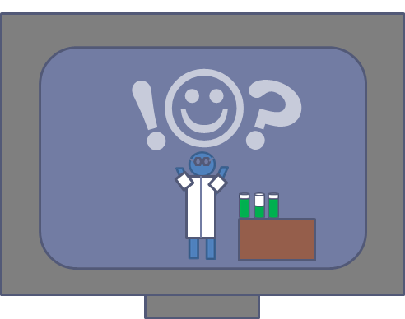
? Web/Online Presence ?
What does
Online Presence
mean to you?
Notes:
STUDENT PARTICIPATION: What does online presence mean to you??? (One/two words to neighbor – then share)

Slide 3
Your Online Presence
Online discussions
Chat
Curation
Journal article(s)
Profiles
Blog
Content
Photo sharing
Notes:
(What it could be made up of) - Focus on Personal, professional, research work, etc

Slide 4







Your Online Presence
Online discussions
Chat
Curation
Journal article(s)
Profiles
Blog
Content
Photo sharing
Notes:
(What it could be made up of) - Focus on Personal, professional, research work, etc

Slide 5
Your Online Presence
Notes:
All these pieces of your online presence present a picture of you online

Slide 6
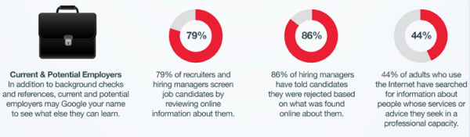
And people are searching…
7 out of 10 people who use the internet have searched for information about other people
(Pew study results available at: http://pewinternet.org/)
(From: Google y la reputación en línea del usuario; available at:
http://blogs.eset-la.com/laboratorio/2012/08/13/google-reputacion-linea-usuario/)
Notes:
EVERYONE has an online presence!
7/10 people who use the internet have searched for information about others.
Current and potential employers can Google you to see what they can find. 86% of hiring managers have rejected candidates based on online information..

Slide 7


Your online presence
Image
  Project the image of yourself online that best represents you (both personally and professionally)
Showcase
  Highlight your talents, outputs and achievements
Network
  Build up a (academic) network
  Comment, connect and contribute
Reputation barometer
  Be aware of what is online about you
Notes:
Your online presence can be used to project your image online, showcase your talents and outputs, help you build your network and act as a type of ‘reputation barometer’

Slide 8
Online tools & services
CV
Network
Impact
Notes:
Broad categories of online tools and service that could be useful in building an online presence

Slide 9
Online tools & services
CV
Network
Impact
LinkedIn
Academia.edu
ResearchGate
About.me
Google scholar
Notes:
Online CV and bio information tools:
LinkedIn
Academia.edu
ResearchGate
About.me
Google scholar

Slide 10
Online tools & services
CV
Network
Impact
LinkedIn
Academia.edu
ResearchGate
About.me
Google scholar
LinkedIn
Academia.edu
ResearchGate
Mendeley
Twitter
Facebook (?)
Notes:
Online network building tools:
LinkedIn
Academia.edu
ResearchGate
Mendeley
Twitter
Facebook (?)

Slide 11
Online tools & services
CV
Network
Impact
LinkedIn
Academia.edu
ResearchGate
About.me
Google scholar
LinkedIn
Academia.edu
ResearchGate
Mendeley
Twitter
Facebook (?)
Web of Science
Scopus
ImpactStory
Altmetric.com
Notes:
Tools that you can use to measure your impact online:
Web of Science
Scopus
ImpactStory
Altmetric.com

Slide 12
Some steps to consider going forward…

Slide 13


1) Plan
Consider how you want to appear online
Think about what you would like a recruiter/potential employer/supervisor/collaborator/co-author to find out about you
Think about what you could add to your online presence to enhance your online image & build your network
Notes:
Plan! How do you want to appear online? What could you add to your online presence to attract the attention of recruiters/highlight your skills?

Slide 14
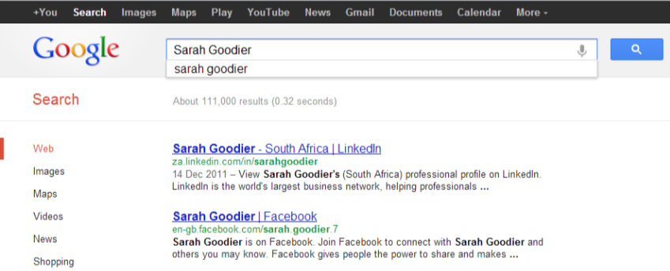
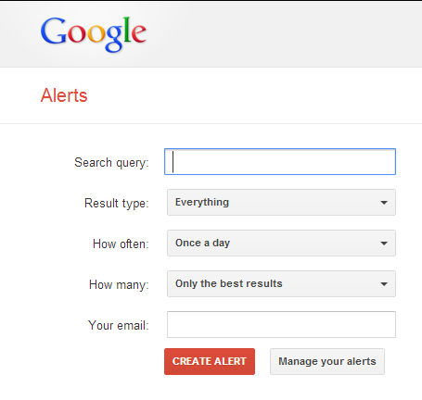
2) Monitor
Regular Google searches
On-going Google alerts of your name
Measure your digital footprint
Notes:
To check what is already online about you & monitor your presence: You can search yourself on Google – see what results come up in the top 10, the top 20, as far back as you want to look. If you do these searches regularly, you can see how the results change over time. You can automate this somewhat by also setting up Google alerts for your name so you’ll get an email when your name is mentioned, say, on a blog. Both of these help you to measure your digital footprint.

Slide 15

3) Maintain, update & improve
Keep your profile(s) up to date
Add new qualifications/projects/research interests as they come up
If you are no longer using an online profile, consider closing it/deleting it
Notes:
So, once you’re planned what you would like to appear and check what is already out there, you should add to and maintain your online presence regularly.

Slide 16
Tips
Think before you post…
Be aware of your privacy settings!
Even with privacy settings in place, be aware of what you are posting online (it may be reposted/made public)
Notes:
Even with privacy settings in place, be aware of what you are posting online (it may be reposted/made public)

Slide 17

Do you know how you appear online?
?
Notes:
So, do you know how you appear online?
Start with a simple google search to find out.

Slide 18



Thank you
Excluding images, screenshots and logos and/or unless otherwise indicated on content
For more resources:
  Try the OpenUCT Delicious bookmarks tagged ‘onlinepresence’: http://www.delicious.com/openuct/onlinepresence
  Check out OpenUCT’s Online Presence guide for academics: http://openuct.uct.ac.za/article/academics-online-presence-guidelines
All screenshots used purely for illustrative purposes
Some slides used and/or adapted from: Laura Czerniewicz’s presentation ‘Academics' online presence - assessing & shaping visibility 2012’: http://www.slideshare.net/laura_Cz/academics-online-presence-assessing-shaping-visibility-2012,
Notes:
So, I hope this has helped you start to think about how you appear online and encourage you to start taking control of your online presence. Remember that a strong online presence can help put yourself out there as you want to be seen.
For a growing collection of resources on online presence, check out OpenUCT’s Delicious bookmarks tagged “Onlinepresence”
Thank you!

Slide 19
Excluding images, screenshots and logos and/or unless otherwise indicated on content
Contact OpenUCT:
http://openuct.uct.ac.za
@OpenUCT
Contact Sarah:
sarah.goodier@uct.ac.za
@SarahGoodier
@OpenExpl
Notes:
OpenUCT’s guide to assist academics in this area which will cover all the points I’ve raised today and more. So keep an eye out for it on our site. As well as any UCT seminars and workshops that could help you along the way.
Feel free to contact either OpenUCT or myself if you need any further information or would like assistance with sharing your research outputs on UCT’s OpenContent site.

