Slide 1



The Changing
Scholarly Communication and Content Landscape
Presentation to CHEC Board
Laura Czerniewicz
3 May 2012

Slide 2
Scholarship
The knowledge creation & dissemination cycle
Conceptualisation
Data Collection
Findings
Engagement
Translation
Data Analysis
Discipline- specific forms

Slide 3
Scholarly content: the way we have been
Student
Literature Reviews
Conceptual Frameworks
Bibliographies
Conceptualisation
Data Collection
Findings
Engagement
Translation
Data Analysis
Proposals
Notes
Recorded interviews
Lectures
Data sets
Presentations
Images
Reports
Audio records
Community
Interviews
Books
Conference papers
Journal articles
Technical papers
Scholar

Slide 4
Scholarly content:
the way we have been
Individual
Private
Student
Literature Reviews
Conceptual Frameworks
Bibliographies
Conceptualisation
Data Collection
Findings
Engagement
Translation
Data Analysis
Proposals
Notes
Recorded interviews
Lectures
Data sets
Presentations
Images
Reports
Audio records
Community
Interviews
Books
Conference papers
Journal articles
Technical papers
Scholar

Slide 5
Scholarly content:
the way we have been
Individual
Private
Student
Literature Reviews
Conceptual Frameworks
Bibliographies
Conceptualisation
Data Collection
Findings
Engagement
Translation
Data Analysis
Proposals
Notes
Recorded interviews
Lectures
Data sets
Presentations
Images
Reports
Audio records
Not in a shareable form
Possibly not digitised
Community
Interviews
Books
Conference papers
Journal articles
Technical papers
Scholar

Slide 6
Scholarly content: the way we have been
Individual
Private
Student
Literature Reviews
Conceptual Frameworks
Bibliographies
Conceptualisation
Data Collection
Findings
Engagement
Translation
Data Analysis
Proposals
Notes
Recorded interviews
Lectures
Data sets
Presentations
Images
Reports
Audio records
Not in a shareable form
Possibly not digitised
Community
Interviews
Books
Conference papers
Journal articles
Technical papers
Scholar
Stable authoritative text-based versions

Slide 7
Scholarly content: the way we have been
Individual
Private
Student
Literature Reviews
Conceptual Frameworks
Bibliographies
Conceptualisation
Data Collection
Findings
Engagement
Translation
Data Analysis
Proposals
Notes
Recorded interviews
Lectures
Data sets
Presentations
Images
Reports
Audio records
Not in a shareable form
Possibly not digitised
Community
Interviews
Books
Conference papers
Journal articles
Technical papers
Scholar
Stable authoritative text versions
Clearly defined audiences

Slide 8
Scholarship: the way we have been
Individual
Private
Student
Literature Reviews
Conceptual Frameworks
Bibliographies
Conceptualisation
Data Collection
Findings
Engagement
Translation
Data Analysis
Expensive textbooks
Online resources access limited to course students only
Proposals
Notes
Recorded interviews
Lectures
Data sets
Presentations
Images
Reports
Audio records
Not shareable
Possibly not digitised
Community
Interviews
Books
Conference papers
Journal articles
Technical papers
Scholar
Stable authoritative versions
Clearly demarcated audiences

Slide 9
The nature of digital content
Principles of online content
  granularity
  hyper/links
  disaggregation & aggregation
  integration
  inter-operability
Notes:
In essence, components can be taken apart and reconstituted in multiple forms and across many platforms, and this can be repeatedly and in innovative configurations.

Slide 10
Nature of digital content
Digital components can be taken apart and reconstituted
  in multiple forms
  across many platforms
  can be done repeatedly
  in innovative configurations
Can be analysed and mined by technology

Slide 11
Digital content
Copying content is easy and free
Sharing means multiplying (not dividing) & broadcasting
Changes in content
  creation
  communication & collaboration
  dissemination

Slide 12
Digital content
Content is no longer static
Content can be made available
  speedily (immediately)
Content can be
  changed
  annotated
  commented on
  updated
  interacted with

Slide 13
Changing communication
Literature Reviews
Conceptual Frameworks
Bibliographies
Conceptualisation
Data Collection
Findings
Engagement
Translation
Data Analysis
Proposals
Conversations
Comments
Annotations
Blogs
Tweets
etc
Notes
Recorded interviews
Lectures
Data sets
Presentations
Images
Reports
Audio records
Interviews
Books
Conference papers
Journal articles
Technical papers
Communication goes online and becomes visible

Slide 14
Changing communication
Communication becomes visible
The rise of the read –write web
Communication becomes content
Content becomes dynamic
Social media changes content and communication

Slide 15
Scholarly content:
what is happening
Individual
Private
Literature Reviews
Conceptual Frameworks
Bibliographies
Shared and shareable
Eg social bookmarking,
Mendeley
Conceptualisation
Data Collection
Findings
Engagement
Translation
Data Analysis
Proposals
Notes
Recorded interviews
Lectures
Data sets
Presentations
Images
Reports
Audio records
Interviews
Books
Conference papers
Journal articles
Technical papers

Slide 16
Scholarly content:
what is happening
Shared and shareable
Eg social bookmarking,
Mendeley
Literature Reviews
Conceptual Frameworks
Bibliographies
Conceptualisation
Data Collection
Findings
Engagement
Translation
Data Analysis
Proposals
Not in a shareable form
Possibly not digitised
Data not curated
Notes
Recorded interviews
Lectures
Data sets
Presentations
Images
Reports
Audio records
Interviews
Books
Conference papers
Linked data
Curated data
Shareable data
Text mining
Big data
Digital humanities
Journal articles
Technical papers

Slide 17
Scholarly content:
what is happening
Shared and shareable
Eg social bookmarking,
Mendeley
Literature Reviews
Conceptual Frameworks
Bibliographies
Conceptualisation
Data Collection
Findings
Engagement
Translation
Data Analysis
Proposals
Linked data
Curated data
Shareable data
Text mining
Big data
Digital humanities
Notes
Recorded interviews
Lectures
Data sets
Presentations
Images
Reports
Audio records
Interviews
Books
Conference papers
Stable authoritative text-based versions
Journal articles
Technical papers
The “enhanced publication”
Rise of open access
Journal publishing changing
Eg PLOS One model
Dynamic multimodal versions, the rise of rich media
Notes:
http://survivingmyphd.blogspot.co.uk/2012/04/post-journal-era.html
The PLoS One model
PLoS One is an open access journal which publishes work not according to what the editors and reviewers consider significant, but consider only the paper's methodological quality. They decoupled the significant approval from the methodological approval. PLoS One also decoupled copy-editing: they warn in advance that they don't copy-edit in details, and instead provide a list of services which do just that. This model has proven to be profitable: PLoS One published more than 5,000 papers in 2010 at 1350$ each (and the other PLoS journals charge even more). The flaws here, beyond the price, are the exclusivity: authors publish only in one journal, and the danger of a future with only a few mega-journals.
Post-publication review services
There are a few existing post-publication peer review services, the best-known of them are Faculty of 1000 (F1000) and Mathematical Reviews. F1000 "...identifies and evaluates the most important articles in biology and medical research publication." F1000 is supposed to function as additional help for researchers in managing their reading. It has actually been shown to identify quality papers which were overlooked by leading journals (Allen et al., 2009).
scholarly journal Frontiers in Computational Neuroscience, 6 DOI: 10.3389/fncom.2012.00019

Slide 18
Scholarly content:
what is happening now
Shared and shareable
Eg social bookmarking,
Mendeley
Expensive textbooks
Online resources access limited to course students only
Literature Reviews
Conceptual Frameworks
Bibliographies
Conceptualisation
Data Collection
Findings
Engagement
Translation
Data Analysis
Proposals
Linked data
Curated data
Shareable data
Notes
Recorded interviews
Lectures
Data sets
Presentations
Images
The rise of open education resources, open etextbooks
Reports
Audio records
Interviews
Dynamic multimodal versions, the rise of rich media
Books
Conference papers
Journal articles
Technical papers
The “enhanced publication”
Rise of open access
Journal publishing changing
Eg PLOS One model

Slide 19
Scholarly content:
what is happening
The rise of open education resources, open etextbooks
Shared and shareable
Eg social bookmarking
Literature Reviews
Conceptual Frameworks
Bibliographies
Conceptualisation
Data Collection
Findings
Engagement
Translation
Data Analysis
Changing audiences (eg life long learners, global reach)
Access to all types of resources
Proposals
Linked data
Curated data
Shareable data
Text mining
Big data
Digital humanities
Notes
Recorded interviews
Lectures
Data sets
Presentations
Images
Reports
Audio records
Interviews
Dynamic multimodal versions, the rise of rich media
Books
Conference papers
Journal articles
Technical papers
The “enhanced publication”
Rise of open access
Journal publishing changing
Eg PLOS One model
Clearly defined audiences

Slide 20
Scholarly content:
what is happening
Shared and shareable
Eg social bookmarking,
Mendeley
Emergence of ALT metrics
(use, downloads, citations etc)
Literature Reviews
Conceptual Frameworks
Bibliographies
The rise of open education resources, open etextbooks
Conceptualisation
Data Collection
Findings
Engagement
Translation
Data Analysis
Linked data
Curated data
Shareable data
Text mining
Big data
Digital humanities
Proposals
Notes
Recorded interviews
Lectures
Data sets
Presentations
Images
Changing audiences (eg life long learners, global reach)
Two way process (eg citizen science)
Access to all types of resources
Reports
Audio records
Interviews
Books
Conference papers
Dynamic multimodal versions, the rise of rich media
Journal articles
Technical papers
The “enhanced publication”
Rise of open access
Journal publishing changing
Eg PLOS One model

Slide 21
Scholarly content:
what is happening
Shared and shareable
Eg social bookmarking,
Mendeley
Emergence of ALT metrics
(use, downloads, citations etc)
Literature Reviews
Conceptual Frameworks
Bibliographies
The rise of open education resources, open etextbooks
Conceptualisation
Data Collection
Findings
Engagement
Translation
Data Analysis
Linked data
Curated data
Shareable data
Text mining
Big data
Digital humanities
Proposals
Notes
Recorded interviews
Lectures
Data sets
Presentations
Images
Changing audiences (eg life long learners, global reach)
Two way process (eg citizen science)
Access to all types of resources
Reports
Audio records
Interviews
Books
Conference papers
Dynamic multimodal versions, the rise of rich media
Journal articles
Technical papers
The “enhanced publication”
Rise of open access
Journal publishing changing
Eg PLOS One model

Slide 22
Scholarly processes the emergence of open research
Conceptualisation
Data Collection
Findings
Engagement
Translation
Data Analysis
Discipline- specific forms

Slide 23
Open Research
Replicable (transparency - method)
Reusable (results free for re-use and appropriation)
Replayable (tools available for appropriation)
Collaborative
Interdisciplinary
Granular
Immediacy factor

Slide 24
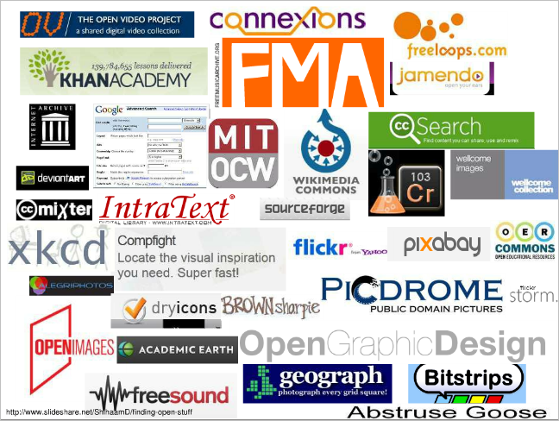
Openness is a serious consideration
The academic “spring” momentum

Slide 25
Changes in online academic sphere
Content
  online , discoverable, can be interacted with, role of repositories (institutional & disciplinary)
Communication
  part of disciplinary communities, eresearch virtual environments, blur with content
Process
  transparent, visible as content, new research processes,
Presence
  Academics’ digital identities (personal, professional, organisational)

Slide 26
Emerging roles & skills’ sets
Academics’ “reputation management”
Changing research dissemination strategies
Changing libraries
Curation
  expert curation
  disciplinary-based curation
Enabling a “culture of contribution”
New technical areas
  aggregration
  analytics etc
Changing research itself (eg digital humanities, data mining etc)

Slide 27
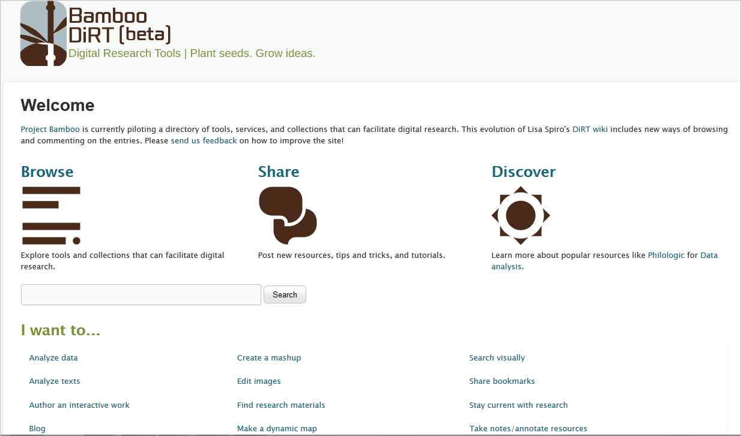
New tools

Slide 28
What needs to be done?

Slide 29
An enabling environment
Policy regulation and infrastructure
  national, regional and institutional
Support for Open Access and Open Education
Attention to structures and business models
Protection and support for Intellectual Property in digital environment
  open licensing
Training in new skills’ sets

Slide 30
e-Infrastructure
Investment in systems for curation
- Data centres
- Repositories
Investment in systems, processes & tools
  to track impact
  to enhance discoverability
  to undertake research (text mining etc)
Harmonised regional collaborative approach
  Grid services
  Bandwidth
  Storage

Slide 31
Enabling the “global networked scholar”
Reward and incentives for sharing content
Support for online presence / digital identity
  the use of social software for scholarly purposes
Awareness about open licensing
Enabling Open Access and Open Education
Funding for and acknowledgement of scholarly communication & research dissemination activities

Slide 32
What can be done collaboratively?

Slide 33

Laura.czerniewicz@uct.ac.za
http://lauraczerniewicz.uct.ac.za
Twitter:Czernie

