Slide 1




A Framework for Analysing
Research Types and Practices
Laura Czerniewicz & Cathy Kell
April 2014

Slide 2
Geopolitics of knowledge production and dissemination are skewed
Legitimacy accorded to scholarship from the centre, exclusion of periphery
Networks offer opportunities for new forms of engagement and changed power relations in knowledge production and dissemination

Slide 3
The research terrain is changing
  Potential to be more open (&closed)
The ways that scholars create, communicate about and disseminate knowledge is changing
The scholarly communication ecosystem is changing
Research to date
  The system
  The objects produced
  NOT the actual practices of researchers
Notes:
Research by higher education and communications scholars provides growing evidence of the changes taking place in the field of scholarly communication, both as result of changes in research activity in higher education systems globally (Etzkowitz 2004; Cooper 2009, 2011; Gibbons et al 1994) as well as those offered by the affordances of web 2.0 technologies (Tenopir 2003; Palmer 2005; Thorin 2006; Procter et al 2010; Weller 2011). There is also growing evidence that the research terrain is becoming more open (Van den Bart et al 2013). While attention has been paid to how scholarly communication and libraries are changing as part of a larger ecosystem (Pendleton-Jullian, 2013), it is less clear how the changing scholarly communication system plays out in actual research practices, as scholars go about their academic work. It is important that academics’ research communication practices are explored to complement these system approaches. How do we think about these issues in order to investigate and illuminate changing forms of knowledge creation and communication?

Slide 4
Questions
A framework designed to answer:
  How can academics’ research projects be categorised?
  What are the research communication practices of academics?
  How closed or open are academics’ scholarly communication practices?

Slide 5
Broader study
Part of a broader programme The Scholarly Communication in Africa Programme (SCAP)
in four African universities
  Department of Library and Information Studies at the University of Botswana (UB)
  The Economics Department/ South African Labour and Development Research Unit (SALDRU) at the University of Cape Town (UCT)
  the Faculty of Humanities at the University of Namibia (UNam)
  the Faculty of Science at University of Mauritius (UM

Slide 6
SCAP aims
  to help raise the visibility of African scholarship by mapping current research and communication practices in four southern African universities
  to recommend technical and administrative innovations based on experiences gained in implementation initiatives piloted at these universities
Notes:
SCAP was founded on the assumption that open, collaborative approaches to conducting research, open access models of publishing, and open, trans-national pooling of resources are essential for African research to flourish locally and globally.
Openness is also a prerequisite for African research reaching the audiences that can best leverage it for the sake of national development (Chan et al. 2011:1). SCAP was therefore established to help raise the visibility of African scholarship by firstly, mapping current research and communication practices in four Southern African universities and secondly, recommending technical and administrative solutions based on experiences gained in implementation initiatives piloted at these universities.

Slide 7
Data collection
Data collection methods
  a survey
  in-depth, semi-structured interviews with a selection of academics
  day-recall interviews with a small number of those interviewed
Academics narrated three recent research projects they had undertaken
  thus descriptions of a total of 72 research projects
“thick’ descriptions of lived practices
  as is, not as “ought to be”
Notes:
Data collection methods included quantitative and qualitative methods and aimed to produce “thick descriptions” of research communication practices with “insider accounts” of day-to-day practices of African scholars as they go about producing, accessing and sharing research. The research methods included a survey , in-depth, semi-structured interviews with a selection of academics, and day-recall interviews with a small number of those interviewed. In each of the interviews, we asked academics to narrate three recent research projects they had undertaken; this provided descriptions of a total of 72 research projects.
The survey was prepared with reference to a number of recent international studies undertaken on scholarly communication (Houghton, Steele & Henty 2004; Rowlands, Nicholas & Huntingdon 2004; Rowlands & Nicholas 2006; Proctor et al 2010, Palmer, Teffeau & Pirmann 2009; Maron & Smith 2008). In particular, we drew on Houghton, Steele and Henty’s 2004 study, which focused on three key areas of research activity: communication and collaboration; information search and access and dissemination and publication. We adapted these three however, to take account of what we called “stages in the research cycle” (Czerniewicz, 2013).
Several methods of data collection were used including four change laboratory workshops (in which academics, librarians and university managers analysed the scholarly communication ecosystem), a focus group interview with 18 academics, a series of ethnographic observations, a survey for academics (n=50), in-depth, semi-structured individual interviews with academics, managers and librarians (18 in total), and day-recall interviews with three of the academics interviewed. During interviews, we asked six individuals to narrate stories of three recent research projects, from beginning to end, ending up with narratives of 18 research projects. These methods aimed to produce “thick descriptions” of research communication practices of Namibian scholars as they go about producing, accessing and sharing research. All quotes in what follows are sourced from the academics, librarians and managers interviewed as part of this case study.
The survey was prepared with reference to a number of recent international studies undertaken on scholarly communication which are discussed in Trotter et al. (2013) but in particular, Houghton, Steele and Henty’s 2004 study, which focused on three key areas of research activity: communication and collaboration; information search and access and dissemination and publication. We adapted these three however, to take account of what we called “stages in the research cycle”.

Slide 8
Framework
Needed a framework to describe research projects
  Across sites
  Across disciplines
  Without pre-set ideas of what should be happening
  Allowing for local context, conditions, history
Notes:
Given that these projects came from different universities in different countries and were based in different disciplines we needed to develop a framework, which would enable us to gain an overview of what is happening in scholarly communication in Southern Africa, without imposing generic models about what should be happening, and without being unduly constrained by discipline or context. The analytical framework which we discuss below was developed in order to deal with the range of projects and related communication practices.

Slide 9
Framework: Key Choices
Focus on practices
A typology that cut across disciplines and the pure / applied distinction
The heuristic of the research cycle
Notes:
The basis of the framework lies in three choices: the first was the decision to focus on “practices’; the second was to develop a typology of research projects in a way that cut across disciplines and the pure/applied distinction. And the third was to focus on a heuristic of the scholarly communication cycle and how that is changing as a result of the affordances of web 2.0 technologies. This would allow for a closer analysis of the cycle’s stages and dimensions, as well as considering degrees of openness.

Slide 10
Practices
The “practice turn”
  “arrays of human activity that are materially mediated”
  “organised around shared practical understanding’
  Schatzki 2001: 2
Contrasts with other approaches
  text, technical channels
Aligned with studies on everyday activities of academics
  Eg other studies consider enablements & constraints
Notes:
Practices
In brief, the framework is premised on a practice-based understanding of research communication, with practices defined as “arrays of human activity that are materially mediated” and “organised around shared practical understanding” (Schatzki 2001: 2, quoted in Palmer & Craigin 2008: 169). We opted for this approach since earlier models of scholarly communication (see Trotter et al. 2014a for a discussion of these) are highly technical and based on heuristics around the flow of academic texts and which groups of people (in addition to academics) take charge of processing and curating material. Texts along a trajectory of dissemination and curation are therefore the key unit in these models, as are the technical channels through which they flow and the spaces in which they are both deposited and communicated. In our approach the text and its movements were less important than the activities undertaken by the academics and what enabled or constrained their choices in these activities in the wider research culture of each institution. In addition, we agree with Palmer (2005) that while undertaking research, scholars are both consumers and producers of knowledge, thus their practices would include both access to content as well as its production, dissemination and uptake.

Slide 11
Research project Types
Drew on
  Boyer – forms of scholarship
  Griffith- modes of knowledge production
  Cooper - research
Notes:
We settled on Griffiths’ (2004:14) typology of five types of research projects, each a general type of knowledge production, which may then ‘lend themselves’ to greater or lesser extents to forms of scholarly communication. But we adapted this, drawing on Cooper (2009 and 2011). All quotes in the following section are from Griffiths (2004: 715 – 717). Griffiths calls these “modes of knowledge production” (ibid p13). However, since the work of Gibbons et al (1994, 1997) on shifts from mode 1 to mode 2 knowledge production has been widely used in Souht Africa, and because we refer to modes of communication as one of our three elements to consider in our cycle, we use the term “type” rather than “mode” when referring to Griffiths’ (and our own) work in order to avoid confusion.

Slide 12
Type: Discovery
The discovery of “generalizable explanations or theories”.
  Often thought about as curiosity-driven research & as “pure basic research” (Cooper, 2009 and 2010),
  “characterised by a high degree of codification of the knowledge base”, a high degree of “consensus about appropriate questions, methods and analytical frameworks”.
  specialised narrow forms
  often undertaken by teams with specialised disciplinary expertise.
  often known as empirical research.
In southern African universities it is very difficult to this kind of high-level research because of lack of capacity and funding.
Notes:
Discovery
The discovery of “generalizable explanations or theories”. Often thought about as curiosity-driven research and mainly thought about as “pure basic research” (Cooper, 2009 and 2010), this type is “characterised by a high degree of codification of the knowledge base”, a high degree of “consensus about appropriate questions, methods and analytical frameworks”. Programmes of inquiry can take quite specialised narrow forms and are often undertaken by teams with specialised disciplinary expertise. This type is what is often known as empirical research. In southern African universities it is very difficult to this kind of high-level research because of lack of capacity and funding.
Interpretive
This type focuses on the “interpretation of phenomena rather than the search for generalizable explanations”. Here, the “knowledge base is less settled… knowledge advance is not necessarily progressive and may even have the appearance of being cyclical in nature”, “methodological principles at work here might be described as hermeneutic or subjectivist” and such projects are often undertaken by individuals or pairs.
As Griffiths notes that while the above two coincide with Boyer’s (1990, 1994; Boyer Commission, 1998) scholarship of discovery, a third maps more neatly onto Boyer’s scholarship of application and his later concept of the scholarship of engagement:

Slide 13
Type: Interpretive
Focuses on the “interpretation of phenomena rather than the search for generalizable explanations”.
  , the “knowledge base is less settled… knowledge advance is not necessarily progressive and may even have the appearance of being cyclical in nature”
  “methodological principles at work here might be described as hermeneutic or subjectivist” and such projects are often undertaken by individuals or pairs.
Boyer would include this in “discovery”
Notes:
Interpretive
This type focuses on the “interpretation of phenomena rather than the search for generalizable explanations”. Here, the “knowledge base is less settled… knowledge advance is not necessarily progressive and may even have the appearance of being cyclical in nature”, “methodological principles at work here might be described as hermeneutic or subjectivist” and such projects are often undertaken by individuals or pairs.
As Griffiths notes that while the above two coincide with Boyer’s (1990, 1994; Boyer Commission, 1998) scholarship of discovery, a third maps more neatly onto Boyer’s scholarship of application and his later concept of the scholarship of engagement:

Slide 14
Type: Applied research
Applied enquiry
  characteristic of vocational or applied fields like engineering, education, social policy, health care and built environment
Derivative of earlier types
  Rigour is derived from relatively direct feedback loops that generally apply when knowledge is being tested in the context of application
Consultancy research (debated)
Notes:
Third: This type can be called ‘applied inquiry’ and is characteristic of vocational or applied fields like engineering, education, social policy, health care and built environment. Such knowledge production is understood to be useful in addressing conflicts, tackling problems as well as meeting the needs of client groups. Research in this type makes use of knowledge derived from the first two and is therefore sometimes viewed as eclectic or derivative. Griffiths argues that these are potentially distinct ways of making knowledge with their own methods and tests of validity. Rigour is derived from relatively direct feedback loops that generally apply when knowledge is being tested in the context of application.
While Griffiths does not outline a type specifically related to consultancy research, which involves the provision of expert advice to clients, he explores how the third type outlined above, applied inquiry, overlaps with consultancy work. Work of this nature is often a source of friction amongst academics and managers, with part of the tension “revolving around whether consultancy generates ‘new knowledge’ or is applying accepted ideas and principles to particular cases”: (Griffiths, ibid: 717; see also Mamdani, 2011). Griffiths (2004:718) argues: “While the legitimacy of the former is widely accepted, many academics are much more suspicious of the latter within the university setting, especially if the public availability of the findings is restricted by the terms of the contract with the clients.” However, Griffiths argues that “the clarification and reworking of basic concepts, the testing out of ideas and methods and the application of accepted principles to new contexts” may well “constitute valid new knowledge production of this third, applied kind.” (p718)
In fact Cooper (2010) states strongly that consultancy work does not involve the production of new knowledge.

Slide 15
Type: Integrative
Discovery in a wider context
  Draws from discovery & applied
Cooper’s use-inspired basic research
  Primacy of discipline
  Embedded in use orientation
Cooper- the 4th helix
  from Etzkowithz, triple helix of university-industry –government
  4th- development, including social, economic, cultural development
Notes:
This type draws on Boyer’s idea of integration, which involved placing discoveries in a wider context, synthesising knowledge from both ‘discovery’ research and aspects of applied inquiry. We suggest that Cooper’s (2009; 2010) work is a useful elaboration of the integration type with the concept of use-inspired basic research (UIBR), emphasising the primacy of basic disciplinary work, but seeing it as “embedded in use-orientation” (p104). Another useful concept relevant to this type of research that Cooper offers is that of the fourth helix, following Etzkowitz’s (2004) triple helix of university-industry-government or U-I-G engagements. This helix extends those aspects of universities’ missions which refer to development beyond the traditional and narrow dimension of economic development to one which includes social-economic-cultural development. It is particularly useful to African universities which emphasise social development as do the governments of the countries in which they are located (Gray, Trotter & Willmers 2012).

Slide 16
Teaching and learning
Boyer- SOTL
Griffith suggests it is a type of applied knowledge
Notes:
A further and fifth type relates to Boyer’s scholarship of teaching and involves critical inquiry into how learning can be promoted. The scholarship of teaching and learning (SOTL) has burgeoned in the past decade in the global North, as well as in many parts of the South, including the universities SCAP worked in. Griffiths argues that the value of this work is not in doubt, more in question is whether it can be regarded as a distinct type of knowledge production or whether it is better seen as a particular form of applied knowledge production.
* While the focus of this paper is on the framework rather than its use, it is of note that the taxonomy worked reasonably well in practice but the categorisation required using two categories for one project at times, as well as the addition of a new category, which we called research infrastructure projects.
We were able to categorise ten projects as discovery inquiry, sixteen as interpretive; ten as applied with an additional related four as direct consultancies; fourteen as integrated and four as SOTL. There were also five which straddled interpretive/applied; five which straddled applied/consultancy; and six which straddled other combinations. There were two infrastructural projects .

Slide 17
This study: Types of projects
Discovery inquiry -10
Interpretive -16
Applied -10
  Direct consultancies -4
Integrated -14
SOTL-4
Also
  interpretive/applied; - 5
  five which straddled applied/consultancy – 5
  other combinations – 6

Slide 18
Research Cycle Approach
Key premise
  Research communication occurs throughout the research cycle not at end
Drew on Czerniewicz core elements
  Conceptualisation
  Data collection and analysis
  Articulation of findings
  Translation and engagement
Also Whyte and Prior 2011
  Continuum of openness
Notes:
We understand research communication to take place throughout the research process, rather than only being part of the formal outputs stage, where traditionally results are published as journal articles. Therefore it was necessary to build a “research cycle approach” into our data collection instruments and into the analytical framework (Czerniewicz 2013, Whyte and Pryor 2011). Czerniewicz identifies key features of “the changing digitally-mediated scholarship landscape” through a “knowledge creation and dissemination cycle” model, which takes the perspective of the research and dissemination activities of academics. The model outlines firstly what she calls “core elements” in the traditional knowledge creation and dissemination cycle as: Conceptualisation; Data collection and analysis; Articulation of findings; Translation and engagement

Slide 19
Traditional Scholarship
Student
Literature Reviews
Conceptual Frameworks
Bibliographies
Conceptualisation
Data Collection
Findings
Engagement
Translation
Data Analysis
Proposals
Notes
Recorded interviews
Lectures
Data sets
Presentations
Images
Reports
Audio records
Community
Interviews
Books
Conference papers
Journal articles
Technical papers
Scholar

Slide 20
Changing scholarship:
conceptualisation
Individual
Private
Literature Reviews
Conceptual Frameworks
Bibliographies
Shared and shareable
Eg social bookmarking,)
Conceptualisation
Data Collection
Findings
Engagement
Translation
Data Analysis
Proposals
Notes
Recorded interviews
Lectures
Data sets
Presentations
Images
Reports
Audio records
Interviews
Books
Conference papers
Journal articles
Technical papers

Slide 21
Changing scholarship:
data collection & analysis
Not in a shareable form
Possibly not digitised
Data not curated
Scholars collect data
Literature Reviews
Conceptual Frameworks
Bibliographies
Conceptualisation
Data Collection
Findings
Engagement
Translation
Data Analysis
Proposals
Notes
Recorded interviews
Lectures
Data sets
Presentations
Images
Reports
Audio records
Interviews
Books
Conference papers
Linked, curated, shareable data
Text mining
Digital humanities
Crowd sourcing
Journal articles
Technical papers

Slide 22
Changing scholarship:
findings
Literature Reviews
Conceptual Frameworks
Bibliographies
Conceptualisation
Data Collection
Findings
Engagement
Translation
Data Analysis
Proposals
Notes
Recorded interviews
Lectures
Data sets
Presentations
Images
Reports
Audio records
Interviews
Books
Conference papers
Stable authoritative text-based versions
Journal articles
Technical papers
Dynamic multimodal versions, the rise of rich media, new types of journals

Slide 23
Changing scholarship:
engagement & translation
Expensive static
one to many
textbooks
Online resources limited to course students only
Literature Reviews
Conceptual Frameworks
Bibliographies
Conceptualisation
Data Collection
Findings
Engagement
Translation
Data Analysis
Proposals
Notes
Recorded interviews
Lectures
Data sets
Presentations
Images
The rise of open education resources (OERs), open etextbooks, open lectures etc
Dynamic content
One to many
Many to many engagement
Reports
Audio records
Interviews
Books
Conference papers
Journal articles
Technical papers

Slide 24
Changing scholarship audiences & dissemination
Literature Reviews
Conceptual Frameworks
Bibliographies
Conceptualisation
Data Collection
Findings
Engagement
Translation
Data Analysis
Proposals
Notes
Recorded interviews
Lectures
Data sets
Presentations
Images
Reports
Audio records
Interviews
Books
Conference papers
Journal articles
Technical papers
Online content
available to all
Scholar
Clearly demarcated audiences
Community
Student

Slide 25
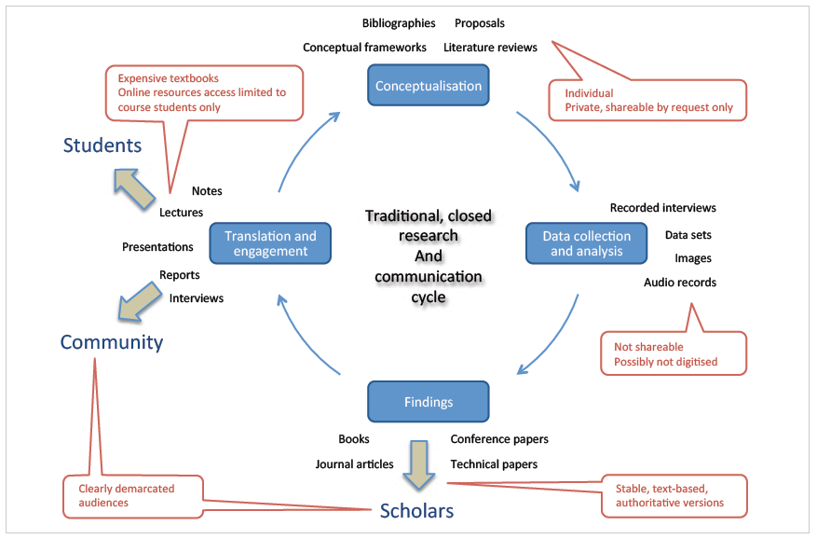
Traditional Research Communication Cycle

Slide 26
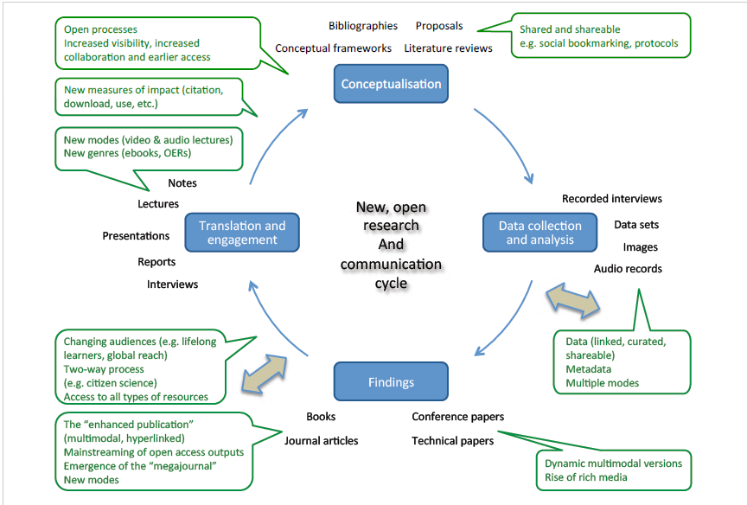
Changing Research Communication Cycle

Slide 27
Stages
Elements that come into play at each stage of the cycle
  Social relations
  Audiences/users
  Forms of communication
Notes:
The research cycle: dimensions
We fine-tune our framework by elaborating on the three elements that come into play at each stage of the research cycle: social relations, audiences/users and forms of communication.

Slide 28
Social Relations
Social relations
  North-south networks
  Social networks
    Nature
    Positioning in networks
    Control
    Role of online networks
    Role of social media
    Openness of networks
Notes:
In our framework social relations within the stages of the research cycle involves exploring at each point: power relations, including north/south relations; networks, including social networks; the nature of relationships, including positioning as recipients or as contributors.
Power relations in research projects are relevant for knowledge production in terms of who speaks and who is silent, whose voice is heard and in what form. These are deeply shaped within the histories and cultures of the institutions and countries within which the universities are situated. Bourdieu (1998), for example, describes how in France, academic gate-keeping occurs through for example the control of junior scholars' time in study and acceptance of papers for publication. Halbert (1998) uses Bourdieu’s concepts of capital and habitus to explain how knowledge is produced and legitimised as well as to explore the changing dynamics and tensions within the scholarly communication system.
Power relations are also to be considered in terms of north/south relations, especially relevant in this study where many of the academics collaborate with colleagues from the global north, and where the potential exists for global inequalities to be replicated. Social relations in the realm of communication practices must touch on these relationships, as well as on who is able to publish where (see for example Chan et al 2011 and Czerniewicz & Wiens 2013).
These relations extend to the kinds of networks academics have access to, from the most limited within their own departments or universities, extending nationally and regionally, and beyond to global networks. What role do these networks play in their research communication possibilities and practices? Inter-twined with this is the role of social media networks, whether they exist at all and what role they play. These digitally mediated social networks allow individuals to construct a public or semi-public profile within a bounded system, articulate a list of other users with whom they share a connection, and view and traverse their list of connections and those made by others within the system (Boyd and Ellison, 2007).
The element of social relations in our framework therefore refer to relationships of power and control in how research is done, and rather than focusing on products it focuses more on processes, interaction and relationships. How open these relations are is of particular relevance, as described later.

Slide 29
Users/audience
Dynamic approach
Audiences
  Scholar—scholar; Scholar-student; Scholar-community
    Scholar -industry, government, community
  One-to-one; one-to-many
Local contexts
  Funding determines
  Tensions in agendas (development, scholarly)
Notes:
Users/audiences
We need to consider to whom scholars communicate their research and what the nature is of the uptake. We are therefore seeking a more dynamic notion of scholarly communication than the simple sender-receiver model and one which is more closely aligned with the notion of practices, one in which audiences do not simply receive research but are actively involved in ‘uptake’. Traditionally scholars’ main audiences have been other scholars, and their publishing decisions and outputs have been based on this, with print-based technologies affording this relationship. The Internet opens up and extends the concept of both users and audiences. In the narrowest sense the most conventional way this happens is through the publishing of findings in toll- access journals, reaching only those who have the resources to pay for access to them. Through open access publishing (either green or gold) all outputs are available to those who have Internet, and can extending the potential audience to society at large and meaning that research can be taken up in ways not anticipated by academics.
This framework categorises the following audiences for scholarly communication: scholar to scholar; scholar to student; scholar to community; scholar to government, scholar to industry and scholar to civil society. (See more of this at Gray et al 2009). Audiences in each case may be singular or multiple. Critical to this notion of user-group/audience is the way in which the rewards and incentive systems of universities globally function in ensuring that scholar to scholar forms of communication are valued. These are mapped onto the two diagrams above in the form of the blue arrows in the first diagram, which can be seen to happen only in the final stages of the traditional cycle.
In addition, the notion of audience in a digitally mediated “read-write” milieu is challenged to mean a two-way conversation with the audience “talking back” in the form of comments and discussions, and indeed even circumventing the scholars entirely (Gillmore 2004). Seely Brown (2008) suggests that such a culture of participation involves tinkering, building, remixing and sharing, terms not generally appropriated by the academe.
Each of these groups is related to what Etzkowitz (ref) calls the triple helix (scholar – industry – government) and Cooper elaborates further by introducing a fourth helix (community). This, of course, is very relevant in the Southern African context when universities tend to be viewed as needing to play significant and strategic roles in national development.

Slide 30
Users/audience
Dynamic approach
Read-write
  Comments
  Revisions
  Tinkering, building, remixing, sharing
Engagement with social media
Notes:
Users/audiences
We need to consider to whom scholars communicate their research and what the nature is of the uptake. We are therefore seeking a more dynamic notion of scholarly communication than the simple sender-receiver model and one which is more closely aligned with the notion of practices, one in which audiences do not simply receive research but are actively involved in ‘uptake’. Traditionally scholars’ main audiences have been other scholars, and their publishing decisions and outputs have been based on this, with print-based technologies affording this relationship. The Internet opens up and extends the concept of both users and audiences. In the narrowest sense the most conventional way this happens is through the publishing of findings in toll- access journals, reaching only those who have the resources to pay for access to them. Through open access publishing (either green or gold) all outputs are available to those who have Internet, and can extending the potential audience to society at large and meaning that research can be taken up in ways not anticipated by academics.
This framework categorises the following audiences for scholarly communication: scholar to scholar; scholar to student; scholar to community; scholar to government, scholar to industry and scholar to civil society. (See more of this at Gray et al 2009). Audiences in each case may be singular or multiple. Critical to this notion of user-group/audience is the way in which the rewards and incentive systems of universities globally function in ensuring that scholar to scholar forms of communication are valued. These are mapped onto the two diagrams above in the form of the blue arrows in the first diagram, which can be seen to happen only in the final stages of the traditional cycle.
In addition, the notion of audience in a digitally mediated “read-write” milieu is challenged to mean a two-way conversation with the audience “talking back” in the form of comments and discussions, and indeed even circumventing the scholars entirely (Gillmore 2004). Seely Brown (2008) suggests that such a culture of participation involves tinkering, building, remixing and sharing, terms not generally appropriated by the academe.
Each of these groups is related to what Etzkowitz (ref) calls the triple helix (scholar – industry – government) and Cooper elaborates further by introducing a fourth helix (community). This, of course, is very relevant in the Southern African context when universities tend to be viewed as needing to play significant and strategic roles in national development.

Slide 31
Forms of communication
Mode
  Written, visual, audio, iconic, oral
Privileging of the written text
Notes:
Forms of communication
With this element of our framework we take into account the forms in which scholars communicate their research. First, we consider the fact that almost the total output of the currently highly valued academic research communication worldwide takes place through the linguistic mode of communication, largely through the written word, and to a lesser extent through speech. There are however, other modes of communication and some theorists are arguing that these are challenging the privileged status of the written word (Kress and van Leeuwen 2001) These include visual, iconic, aural, gestural and embodied and spatial modes of communication, amongst others, as well as the multimodal in which these modes of communication mix.
Second, we need to consider the genres through which research is communicated. Most simply genres refer to the specific academic outputs which are produced and which are valued. Halbert (1998) notes that the most highly regarded in the scholarly communication system are the dissertation which provides entry to an academic field, and the documents (journal articles) which are relevant for promotion, with others being more peripheral. Yet each genre has different roles and legitimacy which are being challenged as the environment changes. It becomes relevant then to consider whether these are working papers pre-prints, final authoritative versions and so on. These are mapped on the diagrams above as the first ring of terms written in blue and associated with the six stages of the cycle, for example, literature reviews, journal articles, reports, interviews.
Third, the concept of means of communication in our framework links closely with our second element of users/audiences and enables us to refer to types of platforms and technologies for communicating and their affordances of commentary and engagement. They may indicate the affordances of the technology expressed as modes of representation. These afford different relationships, and in effect, different types of openness. These may be: One to one – one writer, one reader, no affordance of commenting or changing (eg printed journal article or conference proceedings); One to many /many to one - enables commentary and conversation (blog, Facebook etc); Many to many - Both readers and writers are contributors and participants (eg wiki) .

Slide 32
[Another] area that I did some research on was the role of archives in shaping up national identity, how archives can be used to identify a people. In most cases, especially our African archives, they are not complete or they are one-sided. They only tell the story of administrators and not the ordinary, common people. So the extent to which these archives can be relied on to document national identity is really very limited. One has to combine it with other sources like oral traditions. So that is an aspect that we have been working on.
UnAM academic

Slide 33
Forms of communication
Genre
  Working papers, articles, briefs etc
Reward systems
Agendas
Notes:
Forms of communication
With this element of our framework we take into account the forms in which scholars communicate their research. First, we consider the fact that almost the total output of the currently highly valued academic research communication worldwide takes place through the linguistic mode of communication, largely through the written word, and to a lesser extent through speech. There are however, other modes of communication and some theorists are arguing that these are challenging the privileged status of the written word (Kress and van Leeuwen 2001) These include visual, iconic, aural, gestural and embodied and spatial modes of communication, amongst others, as well as the multimodal in which these modes of communication mix.
Second, we need to consider the genres through which research is communicated. Most simply genres refer to the specific academic outputs which are produced and which are valued. Halbert (1998) notes that the most highly regarded in the scholarly communication system are the dissertation which provides entry to an academic field, and the documents (journal articles) which are relevant for promotion, with others being more peripheral. Yet each genre has different roles and legitimacy which are being challenged as the environment changes. It becomes relevant then to consider whether these are working papers pre-prints, final authoritative versions and so on. These are mapped on the diagrams above as the first ring of terms written in blue and associated with the six stages of the cycle, for example, literature reviews, journal articles, reports, interviews.
Third, the concept of means of communication in our framework links closely with our second element of users/audiences and enables us to refer to types of platforms and technologies for communicating and their affordances of commentary and engagement. They may indicate the affordances of the technology expressed as modes of representation. These afford different relationships, and in effect, different types of openness. These may be: One to one – one writer, one reader, no affordance of commenting or changing (eg printed journal article or conference proceedings); One to many /many to one - enables commentary and conversation (blog, Facebook etc); Many to many - Both readers and writers are contributors and participants (eg wiki) .

Slide 34
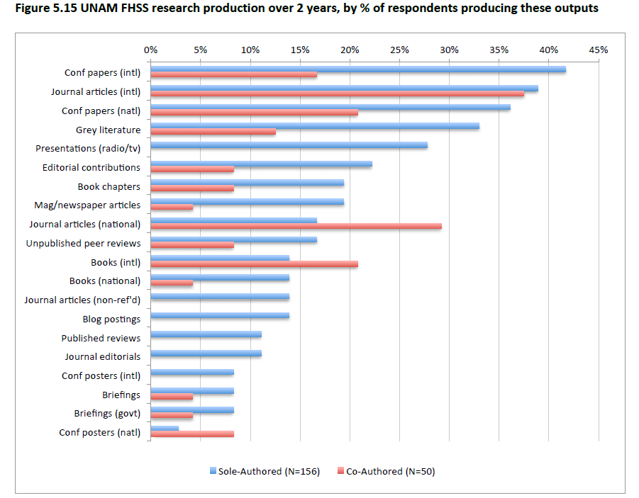

Slide 35
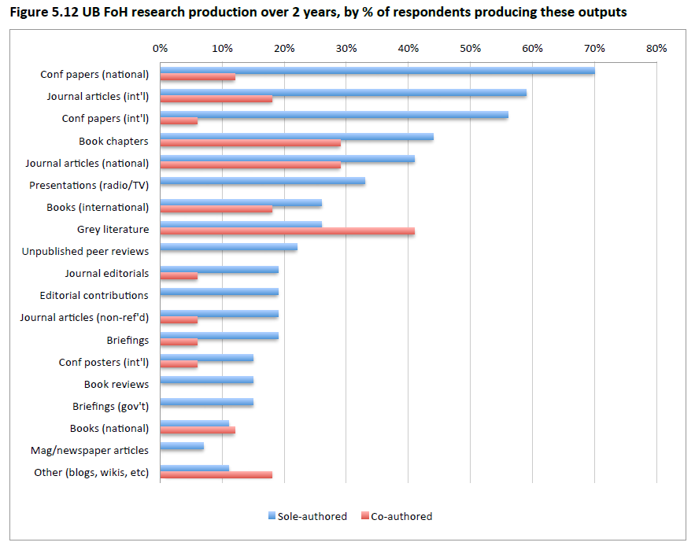

Slide 36
Forms of communication
Means
  Platforms (&associated affordances)
Access
Social media
  Shadows & footprints
  Types of social media
  Traditional networking
Notes:
Forms of communication
With this element of our framework we take into account the forms in which scholars communicate their research. First, we consider the fact that almost the total output of the currently highly valued academic research communication worldwide takes place through the linguistic mode of communication, largely through the written word, and to a lesser extent through speech. There are however, other modes of communication and some theorists are arguing that these are challenging the privileged status of the written word (Kress and van Leeuwen 2001) These include visual, iconic, aural, gestural and embodied and spatial modes of communication, amongst others, as well as the multimodal in which these modes of communication mix.
Second, we need to consider the genres through which research is communicated. Most simply genres refer to the specific academic outputs which are produced and which are valued. Halbert (1998) notes that the most highly regarded in the scholarly communication system are the dissertation which provides entry to an academic field, and the documents (journal articles) which are relevant for promotion, with others being more peripheral. Yet each genre has different roles and legitimacy which are being challenged as the environment changes. It becomes relevant then to consider whether these are working papers pre-prints, final authoritative versions and so on. These are mapped on the diagrams above as the first ring of terms written in blue and associated with the six stages of the cycle, for example, literature reviews, journal articles, reports, interviews.
Third, the concept of means of communication in our framework links closely with our second element of users/audiences and enables us to refer to types of platforms and technologies for communicating and their affordances of commentary and engagement. They may indicate the affordances of the technology expressed as modes of representation. These afford different relationships, and in effect, different types of openness. These may be: One to one – one writer, one reader, no affordance of commenting or changing (eg printed journal article or conference proceedings); One to many /many to one - enables commentary and conversation (blog, Facebook etc); Many to many - Both readers and writers are contributors and participants (eg wiki) .

Slide 37
Degrees of openness
Complexity of degrees of openness
  Access
    To literature, data, students
  IP
    Ownership of research
  Audience
    Partial
  Technological
    Platforms
Attitudes to sharing online
Notes:
Degrees of openness
Each of the dimensions can be considered in terms of their degrees of openness, bearing in mind that openness is a widely used concept appropriated for many discourses, with some authors such as Mulder & Jansen (2013) developing schema for differentiating and describing forms of openness in education. the purposes of our analysis, it is important not to take a doctrinaire position on openness by referring to closed practices pejoratively and open practices approvingly. Closed may connote private, and may be appropriate for specific disciplines, at the same time the digital can close down and limit in ways that the analogue does not. Open can connote invasive or exposed, while of course it can also connote collaboration, transparency and inclusiveness.
Furthermore, practices can rarely be categorised in a binary way as closed or open, it is useful to analyse them along a continuum. The concept of degrees of openness is not new; it has been used in relation to open educational resources by Hodgkinson-Williams and Gray (2009) who note too that it has been used for open economies and open source software. It has also been used for open research (RIN 2010), open science (Whyte and Pryor 2011) and most recently for open data (Acuna 2013) and for massive open online courses (MOOCs) (Totschnig, 2013)
Degrees of openness for social relations in research therefore refer to the extent of collaboration on a research project: the continuum therefore extends from: no collaboration – some collaboration - much collaboration. Whyte and Pryor (2011, P.207) referring to the sharing of resources in their study of researcher perspectives of open science, suggest that this continuum moves from most closed - Private management (sharing within a research group) to Collaborative sharing ( sharing between members of a consortium) to Peer exchange (sharing on the understanding that disclosure or reuse have conditions attached, between members of a researchers’ network of peers) to Transparent governance (disclosure to an external party according to a publicly accountable code) to Community sharing (access or reuse limited to identifiable members of a research community) to Public sharing (sharing where resources are made available for access by any member of the public), with this last being the most open.
The collaboration may refer to both scholars and non-scholars, with one way and two way communication. Also relevant is when in the research cycle research is shared: early in the cycle or later in the cycle (While the current system is set up for late disclosure, studies have shown greater openness leads to larger number of related studies, including by researchers who came from outside the initial area of study. They have also found that open studies have more commercial benefits in the long term, COED 2009). Some of these ideas, suggesting change, are mapped in the green boxes on the second diagram above.
Genres, platforms and technologies include IP provision and rights. A consideration of genres in an open scholarship terrain would evaluate how openly available the research output was, in terms of its legal status. This would mean an assessment along a continuum from most closed or restrictive (with full copyright all rights reserved, to increasingly accommodating through the various forms of creative commons - or similar license - to CC- BY, CC-0 and public domain with no rights reserved).
Finally, we note that much of the work on changing research relationships is being undertaken under the auspices of open research or open science. Open research generally refers to openness in the sense of increased visibility and transparency. Open research, enabled by digital content and ease of online collaboration, is characterised by greater collaboration among researchers and by content being shared throughout the research cycle (from proposal, to data sets, to early sharing of findings etc). By making research available, it supposes increased and increasingly distributed collaboration, and more opportunities for participation.

Slide 38
I was really struggling [to get access to information]; there were people who didn’t want to give it to me. It’s government data but they didn’t want to give it to me; it’s really, really a struggle.
Uni Namibia Academic

Slide 39
Only at masters level do the students get the training to do rigorous work with this dataset. One of the conditions of the contract with the Presidency is to create training programmes to increase capacity of institutions and individuals to use the data. So I run a number of training courses; however, the level of mathematics needed to participate is very high. That is why I am working to develop an open educational resource on this training, so that it can be easily available on the internet.
UCT Academic

Slide 40
Attitudes to Openness online
a culturally informed sense of personal modesty (not wanting to call attention to themselves)
an ambivalence about the quality of their research (“being exposed”)
an anxiety about having no control over how they might be represented on the internet
a worry that others may steal their ideas/data (especially if still in gestational form).
a fear of offending their research subjects, many of whom they might continue to encounter on the small island
a concern for damaging one’s own reputation in a small country where “everyone knows each other” and can influence your future prospects
a minimalist communications strategy
a teaching- rather than research-oriented approach to scholarship (which speaks to one’s sense of academic identity, as a “teacher” rather than a “researcher”)

Slide 41
Analysis
Czerniewicz, L; Kell, C; Willmers, M; King, T (2014), “Changing Research Communication Practices and Open Scholarship: A Framework for Analysis”, available http://openuct.uct.ac.za/article/scap-outputs-changing-research-communication-practices

Slide 42


Thank you
Laura Czerniewicz
@czernie
http://openuct.ac.za
laura.czerniewicz@uct.ac.za
http://lauraczerniewicz.uct.ac.za

