Slide 1
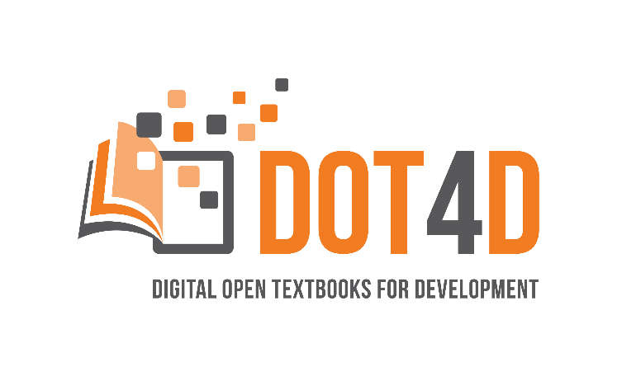





Student co-creation of open textbooks to address sense of belonging and student success
SIYAPHUMELELA NATIONAL SERVICE WORKSHOP
Glenda Cox, Michelle Willmers & Bianca Masuku
Centre for Innovation in Learning and Teaching, University of Cape Town
28 July 2023

Slide 2
Workshop outline
Introduction
Part 1: Open education practice as a means to address social (in)justice in the classroom
Activity 1 students’ sense of belonging
Part 2: Co-creation and building students’ sense belonging
Activity 2
Part 3: The importance of attribution and recognition in (open) education practice
Activity 3
Closing comments

Slide 3
Understanding of the relationship between open education and open textbooks
In the course of this workshop …
You will be building the foundation of a framework for student co-creation activity.
Use this guide to capture details relating to your context as we progress: https://bit.ly/3Y2U7Vi

Slide 4

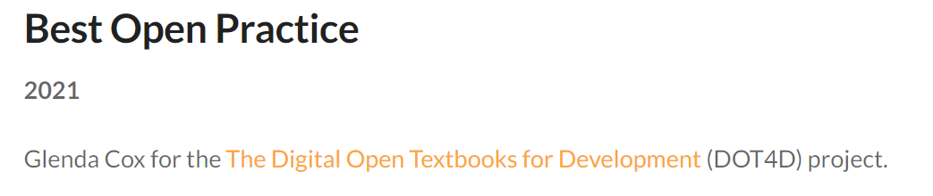
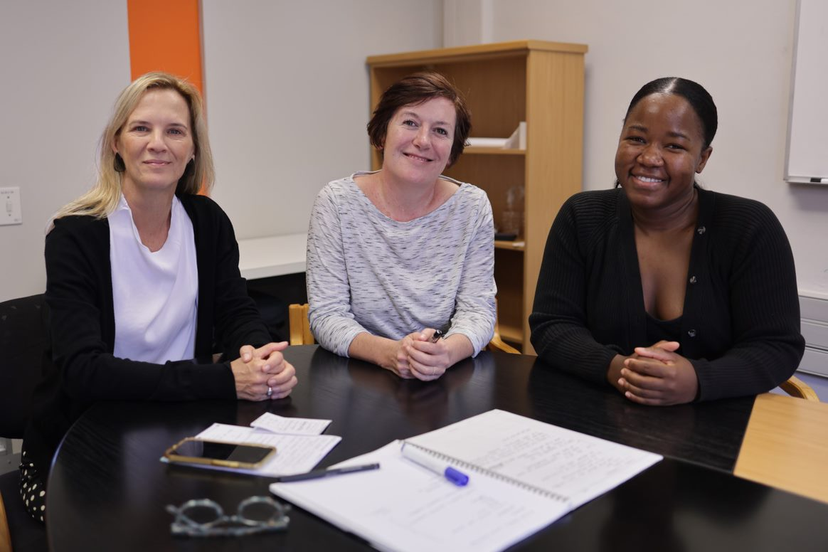
Digital Open Textbooks for Development (DOT4D)
Disclaimer
Glenda Cox
Principal Investigator
Michelle Willmers Publishing & Implementation Manager
Bianca Masuku Researcher
Initiated as a three-year (2018–2021) research, advocacy and implementation project funded by the Canadian IDRC, following in wake of Research on Open Educational Resources for Development (ROER4D) and other CILT open education initiatives.
Now an institutionally funded UCT initiative.

Slide 5
DOT4D objective
To contribute to improving inclusion in South African higher education by addressing equitable access to relevant learning resources.
Operating against backdrop of widening inequity, exacerbating crisis in access and representation.

Slide 6
Part 1:
Open education practice as a means to address social (in)justice in the classroom and build students’ sense of belonging

Slide 7

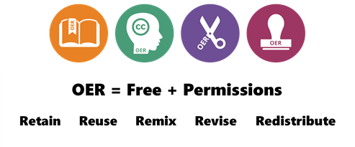
What is Open Education?
Open Education encompasses resources, tools and practices that are free of legal, financial and technical barriers and can be fully used, shared and adapted in the digital environment. It maximises the power of the Internet to make education more affordable, accessible and effective.
(Source: SPARC)

Slide 8
What is an open textbook?
An open textbook is a digital, freely available collection of scaffolded teaching and learning content.
An open textbook is published under an open licence.
An open textbook has affordances for engaging students in collaborative, inclusive authorship, quality assurance and publishing approaches.
An open textbook has affordances for integrating multimedia and third-party content, thereby enabling a wide range of epistemic representation.

Slide 9
Open educational practices
“Open educational practices (OEP) is a broad descriptor of practices that include the creation, use, and reuse of open educational resources (OER) as well as open pedagogies and open sharing of teaching practices.”
(Cronin, 2017)
Notes:
http://www.irrodl.org/index.php/irrodl/article/view/3096/4301

Slide 10
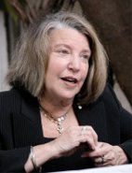
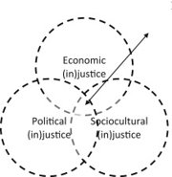
What is social justice?
Nancy Fraser considers social justice as ‘participatory parity’ –
economically, culturally and politically
"Social justice is a concept that requires the organisation of social arrangements that make it possible for everyone to participate equally in society.”
(Fraser, 2005)

Slide 11
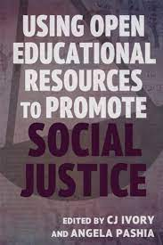
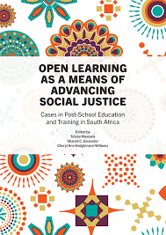
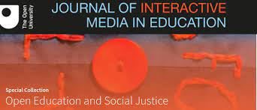
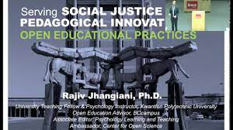
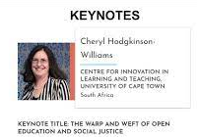

Social justice imperative

Slide 12

Social justice as a framework to understand the potential of open education
“At the heart of the open educational resource movement is the intention to provide affordable access to culturally relevant education to all … in a manner consistent with social justice.”
(Hodgkinson-Williams & Trotter, 2018)

Slide 13



Social justice
A. Economic ‘distribution’​
B. Cultural ‘recognition’​
C. Political ‘representation’​
Open textbooks
A. Free
B. Digital affordances for adaptability
C. Co-creation
Open education
A. Open licensing
B. Localisation
C. Voices of collaborators and students

Slide 14
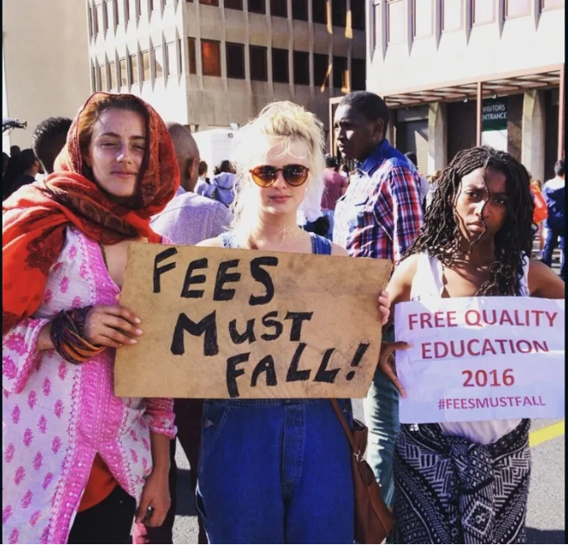
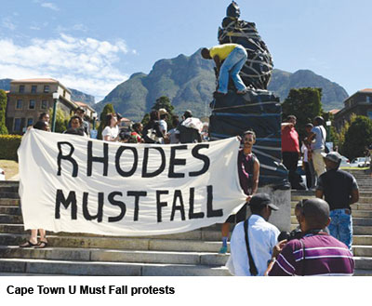
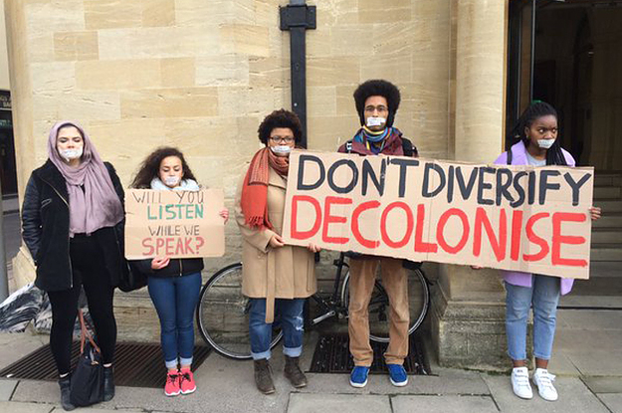
Open textbooks as a means to address economic distribution, cultural recognition and political representation
Economic distribution
Cultural recognition
Political representation
https://edition.cnn.com/2015/10/27/africa/fees-must-fall-student-protest-south-africa-explainer/index.html
https://africanarguments.org/2021/06/fallisms-faultlines-the-paradoxes-of-fees-must-fall/
https://www.buzzfeed.com/husseinkesvani/oxford-campaign-rhodes-must-fall
Notes:
The open textbook has the affordances to serve as a platform or mechanism through which to save money for students to incorporate the voices of collaborators and students and politically challenge the status quo, shift power dynamics and address issues of relevance, decolonising where necessary, and countering existing publishing models
https://theconversation.com/free-higher-education-in-south-africa-cutting-through-the-lies-and-statistics-90474 (

Slide 15
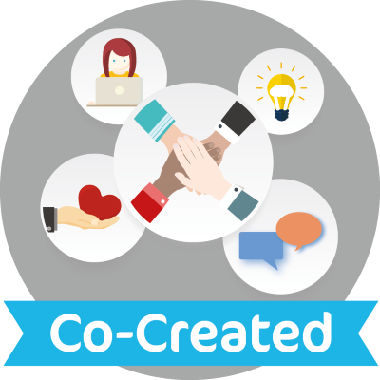
Student co-creation of open textbooks

Slide 16
Class involvement approach in co-creation
Whole class
Part of the class
  Selectively invited
  Open invitation
Before the textbook production process
In the textbook production process
After the textbook production process

Slide 17
Student roles in open textbook co-creation initiatives at UCT
Propose
  Propose relevant material to be used in the textbook
Test
  Test content to make the textbook more understandable and accessible
Review
  Review to eliminate expert blind spots
Design
  Design quizzes and multiple choice questions
  Design book concept and approach to layout
Typeset
  Typeset pages for the textbook
Author
Proofread
  Proofread text to ensure consistency, correct grammatical errors and format references
Co-editor
Assist
  Assist with editorial, technical, curatorial and administrative aspects
Translator
Collaborate
  Collaborate with staff and peers to bring their culture into the content

Slide 18
Activity 1: Reflection
Open textbook creators
What is your approach in terms of:
Purpose of open textbook co-creation
Context
Class involvement approach
Possible roles students could play
Open textbook advocates
What are the obstacles or opportunities you envision around different class involvement approaches?
See the Open Textbook Student Co-Creation Guide for pointers to aid your reflection: https://bit.ly/3Y2U7Vi

Slide 19
Part 2:
Co-creation and building students’ sense of belonging

Slide 20
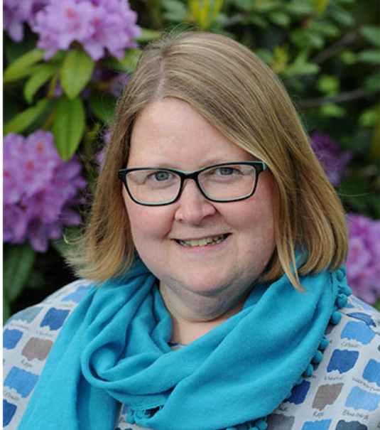
A synthesised framework to illustrate student partnership projects
(adapted from Bovill, 2019)
Catherine Bovill from the University of Edinburgh has written extensively on co-creation in teaching and learning.
We used her categorisation to think about co-creation and to develop models of co-creation with students to produce open textbooks.

Slide 21
Bovill (2019) terms of inclusion
(adapted by Cox et al. 2022)
Participatory design | Stakeholders contribute to the design and development of initiatives. including curriculum; students are “testers or informants” and don’t have a high level of agency
Engagement | Activities to motivate and interest students; can include engagement in teaching and learning
 | Terms of inclusion: Colleagues |  |  | Terms of inclusion: Students
 | Authorship | Quality assurance | Publishing | Authorship | Quality assurance | Publishing
Mechanical engineering | Engagement | Participatory design | None | Engagement | Participatory design | None
General surgery | Participatory design | Participatory design | None | Participatory design | Participatory design | None

Slide 22
Bovill terms of inclusion (cont.)
Co-creation | Contribute new pedagogical ideas; empowerment; meaningful engagement; students construct understanding and learning resources
Representative | Elected role, small group representing whole group
Consultant | Students selected and paid to collaborate
Co-researcher | Collaborating meaningfully on teaching and learning research or subject based research
Co-designer | Sharing responsibility for designing learning, teaching and assessment
 | Terms of inclusion: Colleagues |  |  | Terms of inclusion: Students
 | Authorship | Quality assurance | Publishing | Authorship | Quality assurance | Publishing
Marketing to SA consumers | Co-creation: co-design | Participatory design | Participatory design | Co-creation: co-design | [Ongoing: Engagement] | None

Slide 23
Bovill terms of inclusion (cont.)
Partnership​ | Collaborative; contribute equally; some pedagogical conceptualisation and decision-making; implementation and analysis​
 | Terms of inclusion: Colleagues |  |  | Terms of inclusion: Students
 | Authorship | Quality assurance | Publishing | Authorship | Quality assurance | Publishing
Complex numbers | Partnership | Partnership | Participatory design | Co-creation: co-researcher Co-designer, representative, consultant | Participatory design | None
Computer science | Partnership | Partnership | Participatory design | Engagement Co-creation: consultant | [Ongoing engagement] | None
Chemistry | Partnership | Partnership | Participatory design | Co-creation: co-researcher | Co-creation: representative | None

Slide 24
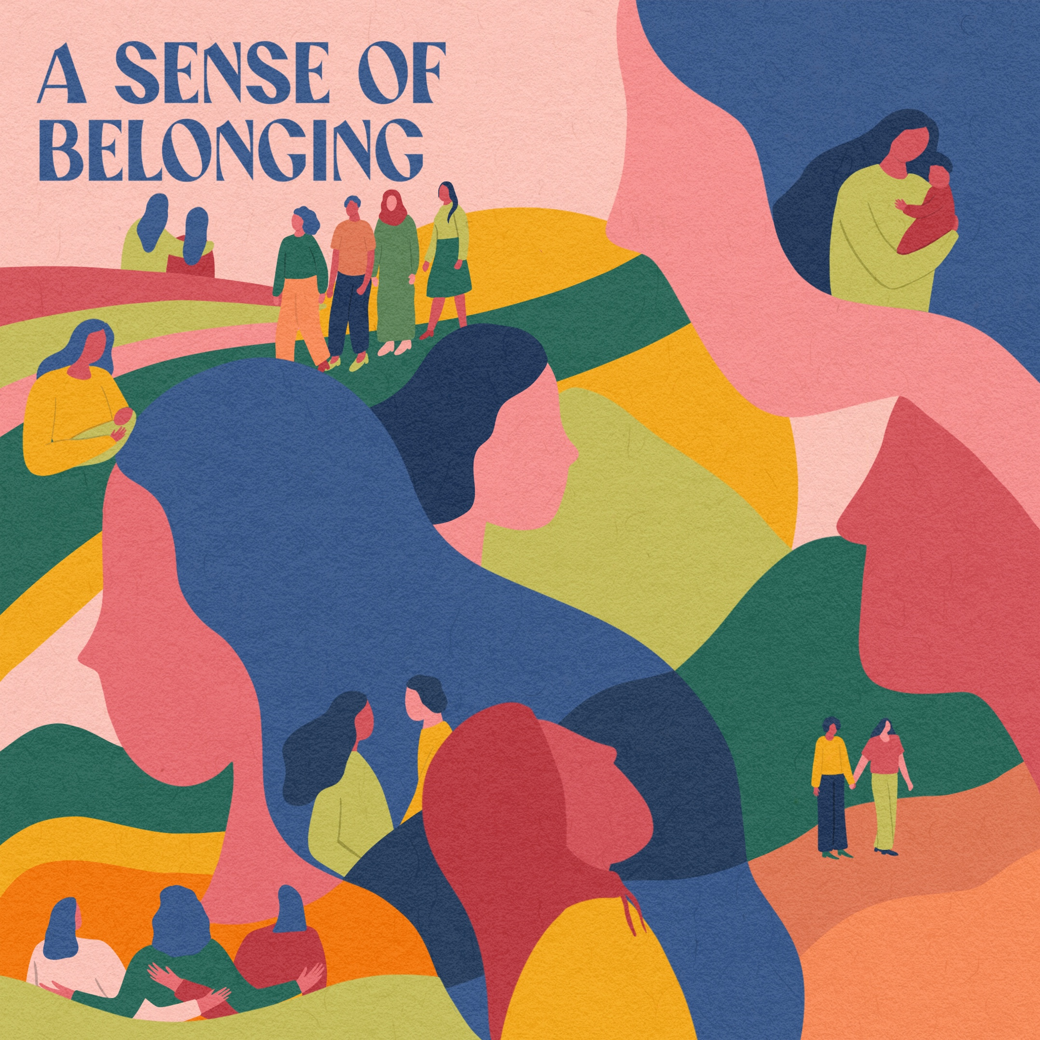
Belonging
Belonging is about an emotional attachment, feeling-at-home, in a safe space (Yuval-Davis, 2011, p. 4)
Principles based on an ethics of care, mutual trust and respect.
In HE it would mean being an intrinsic part of the system, with social connections, interactions with peers, staff and curriculum and breaking down barriers to foster student's emotional engagement with their learning (Le Roux & Groenewald, 2021).
AT UCT co-creation of open textbooks gave students a sense of value and being part of a department
Image by Buru Koleli for OBIx Fine Arts

Slide 25
Power dynamics
Aspects of (in)justice and (un)belonging cannot be discussed without the recognition of traditional power dynamics.
Parity is difficult to achieve and traditional power differences between lecturers and students still exist and are difficult to resist without a culture of partnership and ambitions of being equal members within the university.

Slide 26
Co-creation and the student/lecturer power balance (from Cox & Masuku, in press)
Tilting of power
Author 1 included the whole class but admits that there was 'structure'. Students were given a template that was edited. Students had little agency to be creative or make decisions about their curriculum.
Author 2 had selected excellent students. His approach was 'free form' but they had specific roles. Bovill argues that these few students are already super-engaged and this results in exclusion.
Shifting of power:
Author 3 approach was to invite students into co-creation, getting 'buy-in' and have students move between categories (Bovil's-we showed him) towards co-creation as being the ultimate. He was humbled by the student's expertise and gave them agency

Slide 27
Activity 2: Group discussion on power dynamics
Sharing power is an important aspect of belonging. And that belonging is important in terms of student success.
How do you feel about giving students power in the co-creation of education materials?
What are your thoughts on what this means for their sense of belonging?
See the Open Textbook Student Co-Creation Guide for pointers to aid your reflection: https://bit.ly/3Y2U7Vi

Slide 28
Part 3:
Recognition and attribution in co-creation

Slide 29
Why is attribution important?
It is a fundamental aspect of scholarly practice and an evolving skill.
It tells the readers where information is taken from.
It provides perspective and credibility to the work.
Through attribution, the creator can receive credit for their work.
Paying attention to attribution contributes to a virtuous cycle which is based on respect for the creator. (“The currency of recognition.”)

Slide 30
Why is recognition important in terms of student success?
> Recognition correlates strongly with a sense of belonging
> A sense of belonging correlates with student success
The lecturers profiled in Cox & Masuku (forthcoming) all strive to create enabling environments which are conducive to building students’ sense of agency, recognition and mutual trust – all of which are key aspects of belonging.
The ultimate end goal of all this work is student success.

Slide 31
Ways of recognising and/or rewarding student participation
Marks for coursework
Financial compensation
Other compensation
(e.g. food, t-shirts, paraphernalia)
> Consequence: Status (“fame”)
> Consequence: Belonging and a sense of agency > academic success

Slide 32
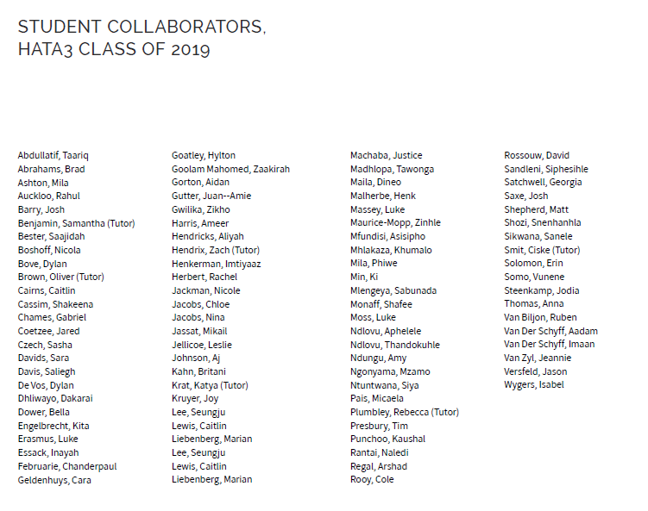
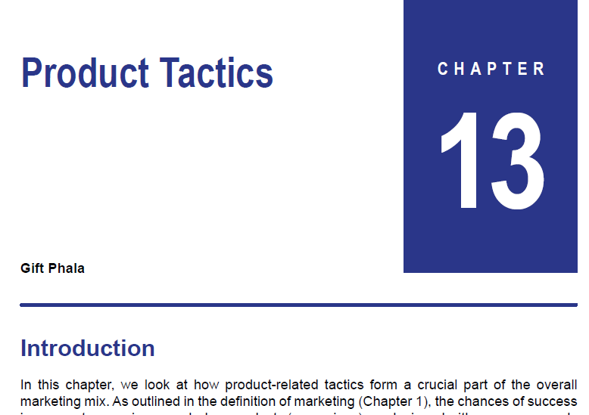

Attributing student contributions

Slide 33
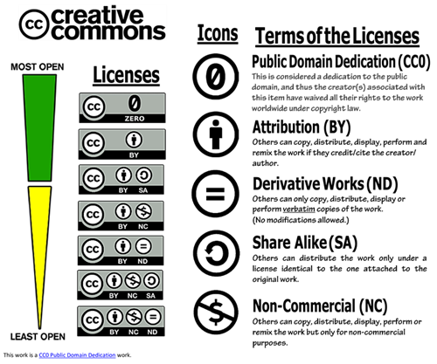












In a world where so much content is openly accessible on the internet, attribution (source) remains the one of the most powerful forms of acknowledgement … and reputation/brand is everything.

Slide 34
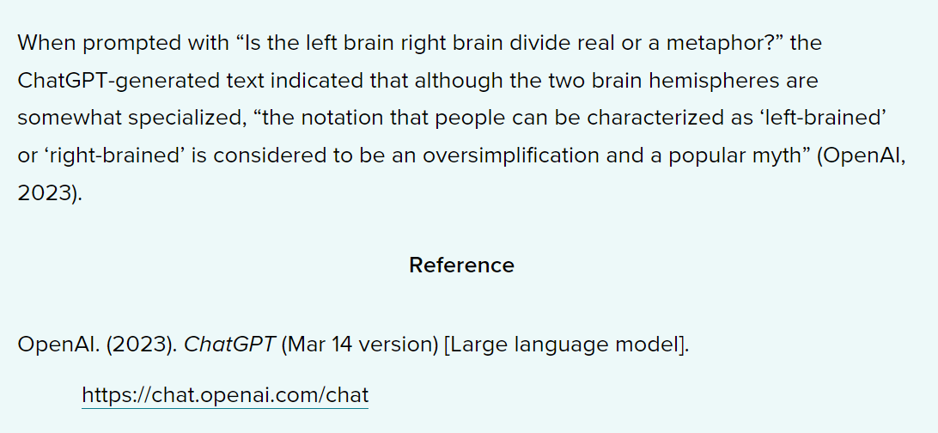
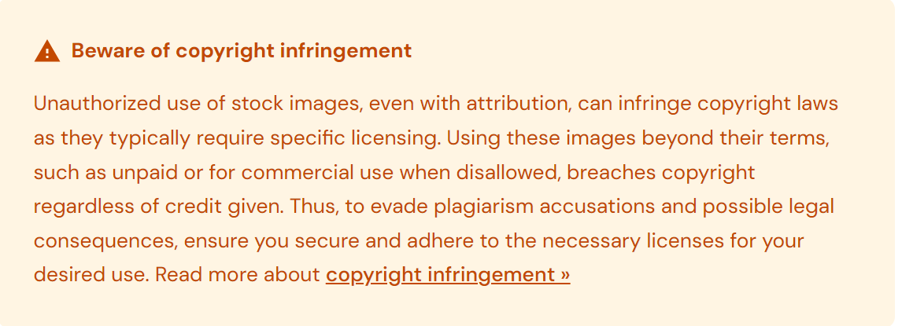
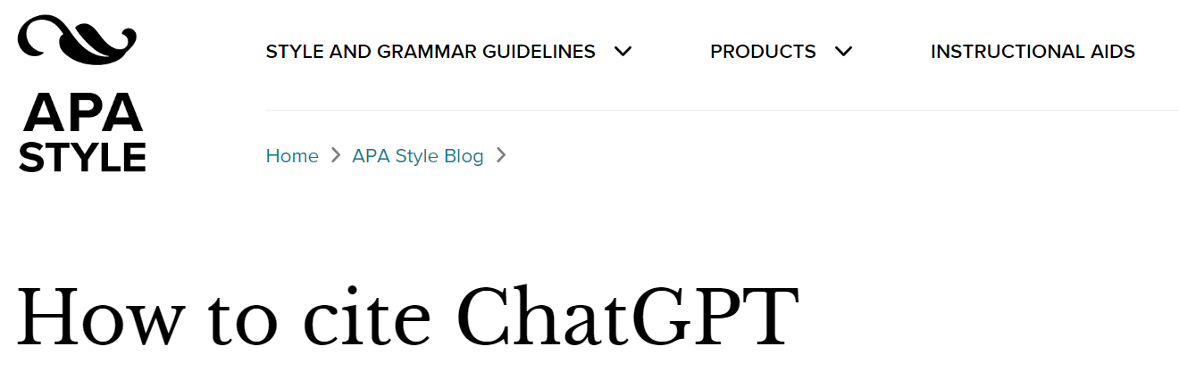
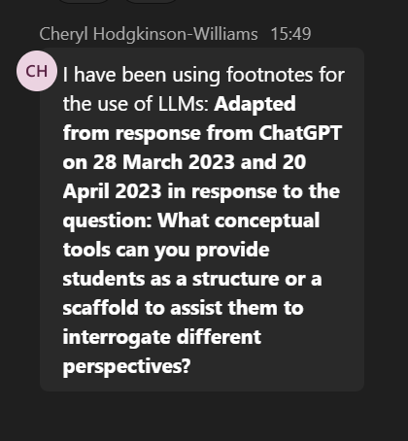

Citation and attribution front and centre in working with LLM-generated content

Slide 35
Activity 3: Discussion
What are your concerns?
What are you excited about?
What kind of help does the institution need to provide?
See the Open Textbook Student Co-Creation Guide for pointers to aid your reflection: https://bit.ly/3Y2U7Vi

Slide 36

Closing comments
and ideas?
Part 4:
Creative Commons, attributing student contributions and engaging with citation and attribution of LLM-generated content

