Slide 1
Introduction to Multimodal Pedagogy for English Teachers
Lecturer: Ed Campbell
E-mail: CMPEDU001@myuct.ac.za
March 2017
This work by Eduard Campbell is licensed under a Creative Commons Attribution-ShareAlike 4.0 International License.

Slide 2
Question to be answered at the END of the class: Why change the name of a “digital literacies” class to the “multimodal pedagogy” class?

Slide 3
In Groups: How did the average teacher teach in your high school? How did you wish you were taught?

Slide 4
Write down on a piece of paper and keep until later: How do you learn best?

Slide 5
Show of hands: Who is “tech savvy” among you?

Slide 6
Show of hands: Who can learn to be “tech savvy”?

Slide 7
Show of hands: Who is creative? What is creativity in the classroom context?
CC0 Public Domain

Slide 8
Show of hands: Who can learn to be creative?

Slide 9
What is literacy?
How has the way we view “literacy” changed over the years?

Slide 10
Towards ‘new’ literacy/ies:
“Literacies are socially recognized ways in which people generate, communicate, and negotiate meaning,…, through the medium of encoded texts” (Reckwitz, 2002)
“literacy includes various types of modalities and it these ‘literacies’ are ‘multiple, multimodal, and multifaceted’” (Alverman, 2013)
“traditionally, meaning is made once, but multimodal texts can be seen as making meaning in multiple articulations” (Kress & Van Leewen, 2001)

Slide 11
Video time… What is multimodality? Find a video on YouTube that explains it the best according to you.
Prompt: Write down one question you would ask a class about the video (please write it below how you learn best). BTW: Please be VERY critical of all resources used in this classroom.
For a deeper understanding: http://newlearningonline.com/literacies/chapter-8

Slide 12
How could the use of multiple modes (visual, aural, gestural, spatial, tactile, text etc.) be good/bad for the classroom?

Slide 13
To find at home… What does a multimodal resource look like?
Prompt: Write down one question you would ask a class about the video (bring it to the next class)

Slide 14
Moving towards the digital… what is your perception of the use of digital resources in SA schools?

Slide 15
Some common challenges in South Africa:
Lack of resources in schools… or rather unequal access… or is it unequal uptake in schools? Think...
Teachers’ “fear” of technology
Varying levels of technology proficiency among students
Lack of evaluative and critical skills when using internet sources
Time…
When and where?

Slide 16
What do you think is the situation in this classroom concerning the use of digital “stuff”?

Slide 17
The existence of the “Digital Stranger” in Higher Education classroom…

Slide 18
What are “digital literacies”?
“there is a need for teaching methodological approaches and not simply technological skills” (CHED, 2013)
“…an umbrella framework for a number of complex and integrated sub-disciplines – comprised of skill, knowledge, ethics and creative output in the digital network environment” (CHED, 2013)
“students have to become proficient in a range of literacies (computer, information, media, communication, visual and technology skills) that are integral to disciplinary ways of knowing and reading and writing” (CHED, 2013)
21st Century skills…

Slide 19
“it is fruitful to think of the [English] classroom as a place where the ‘content’ to be learned is vitally connected to the learning to think, act, react, debate, deliberate, problem solve, innovate and collaborate in a networked world” (Jenkins, 2013)
“important to the learners in our classes is the issue of literacy and what form it takes; literacy today is composed by not only the four skills, but also newly emerging fifth skill – computer literacy” (Barbieri, 2013)

Slide 20
So… why did the focus move from “digital literacies” to “multimodal pedagogy”?

Slide 21
Focus of these classes:
Multimodal literacy teaching
“Digital” <-> “non-digital” literacies for the English teacher
Creativity, adaptability/innovation and identity
You…
Sharing of resources
The classroom outside the classroom (the Edmodo site)

Slide 22
Swap and engage!
Swap what you’ve written in this class with the person next to you
Go to Edmodo and answer the two questions I posted there
Have a look at Resource Bundle 1 in the “Folders” tab (at the top of the page)

Slide 23
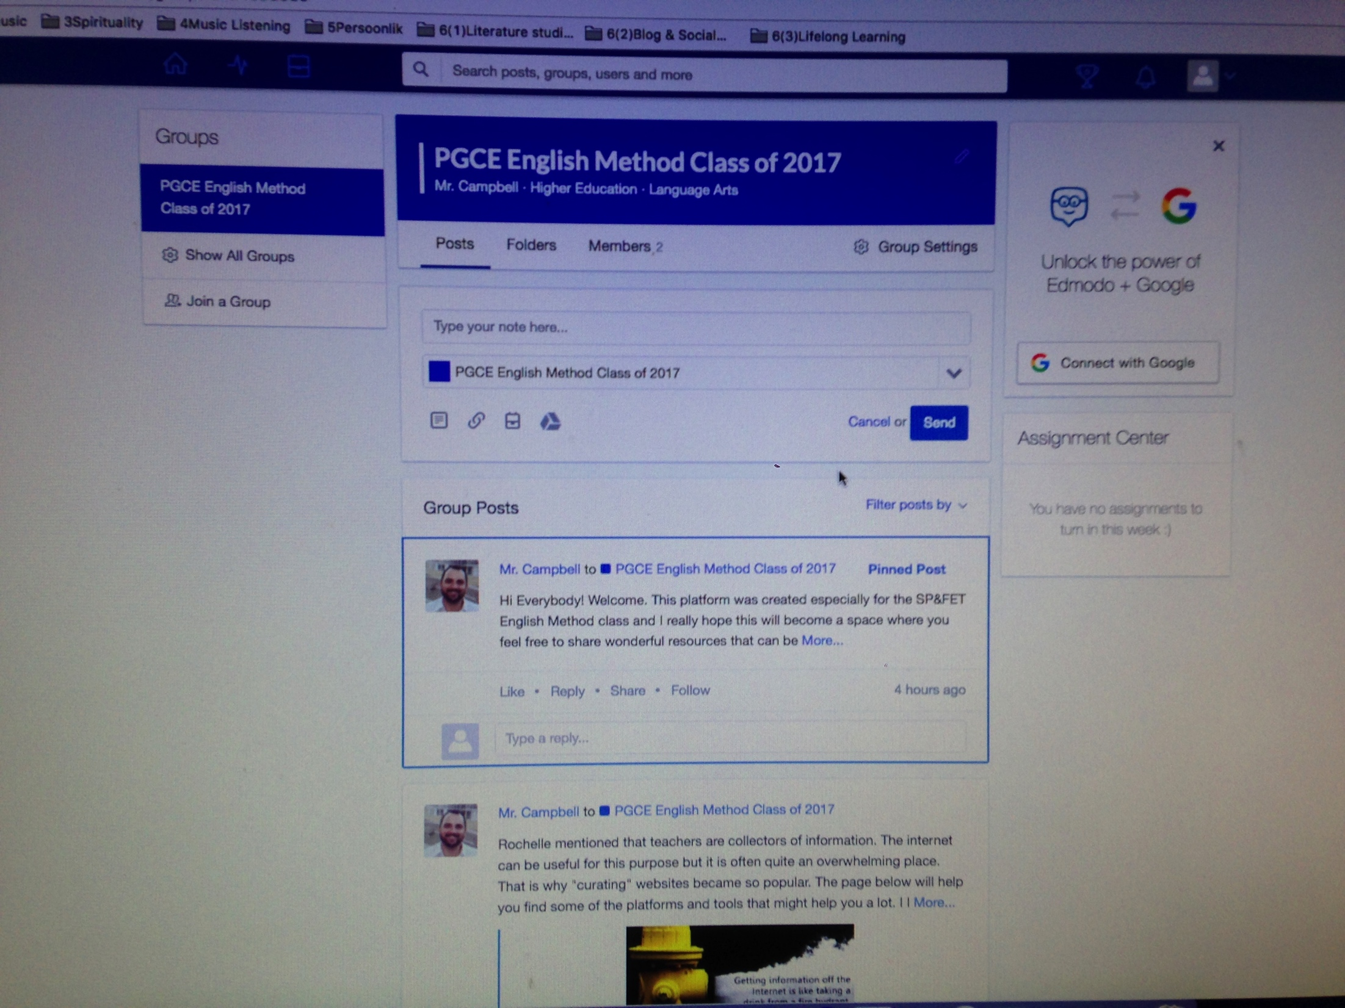

Slide 24
Challenge yourself!

Slide 25
References
Alverman, D.E. Unrau, N.J. Ruddell, R.B. (ed) 2013, Theoretical models and processes of reading, 6th edn, International Reading Association, Newark.
Barbieri, B. 2013, , Technology in the ESL: an emerging paradigm [Homepage of academia.edu], [Online]. Available: http://www.academia.edu/2030045/Technology_in_the_ESL_Classroom_An_emerging_paradigm [2014, 18 July 2014].
Centre of Higher Education Development 2013, First-Year Experience Plan and report, The University of Cape Town, Cape Town.
Jenkins, H. & Kelley, W. (eds) 2013, Reading in a participatory culture, Teachers College Press, New York.
Hirsch, B.D. (ed) 2012, Digital Humanities Pedagogy. Practices, Principles and Politics, First Edition edn, Open Book Publishers, United Kingdom and United States.
Hutchison, A. & Woodward, L. (2014). A Planning Cycle for Integrating Technology into Literacy Instruction. Reading Teacher, 67(6), 455-464. DOI: 10.1002/trtr.1225.
Kress, G. Van Leeuwen, T. 2001, Multimodal Discourse: The modes and media of contemporary communication, Arnold, London.
Reckwitz, A. 2002, “Toward a theory of social practices: a development in social theorizing”, European Journal of Social Theory, vol. 5, no. 2, pp. 245-246.

