Slide 1





Demystifying
Laura Czerniewicz & Eve Gray
27 October 2011

Slide 2
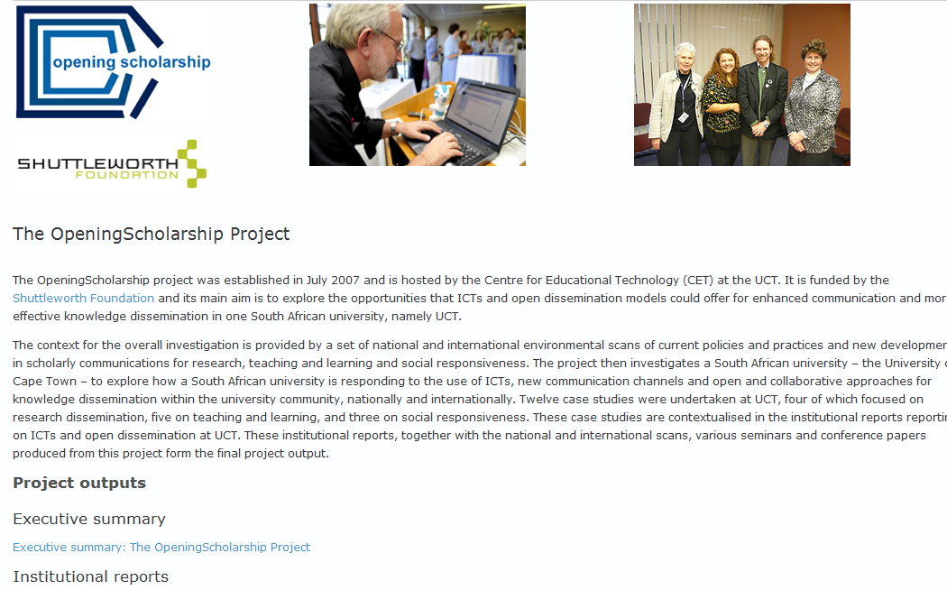
Notes:
Acknowledging the work done previously - http://www.cet.uct.ac.za/OpeningScholarship

Slide 3
Open scholarship
Open content
Open research
Open licenses
Open data
Open practices
Open access
Notes:
Open content refers to both teaching and research resources (with the term „open education resources‟ referring specifically to teaching resources).
• Open access refers to the form of online publishing where access is free for the user.
• Open research is about making transparent all aspects of the research process, including data, methodology, analysis and outputs.
• Open licensing is a mechanism of intellectual property rights protection which enables access and/or re-use under varying conditions while attributing the original author.

Slide 4
What is open access?
Open Access (OA) literature is online and free of charge
OA often refers to journals, can apply to all content
OA is supported by open licensing
OA provides free access to the user
OA refers to data as well

Slide 5
2001
2001
 | An old tradition and a new technology have converged to make possible an unprecedented public good. The old tradition is the willingness of scientists and scholars to publish the fruits of their research in scholarly journals without payment, for the sake of inquiry and knowledge. The new technology is the internet. The public good they make possible is the world-wide electronic distribution of the peer-reviewed journal literature and completely free and unrestricted access to it by all scientists, scholars, teachers, students, and other curious minds. Removing access barriers to this literature will accelerate research, enrich education, share the learning of the rich with the poor and the poor with the rich, make this literature as useful as it can be, and lay the foundation for uniting humanity in a common intellectual conversation and quest for knowledge. For various reasons, this kind of free and unrestricted online availability, which we will call open access, has so far been limited to small portions of the journal literature….
Notes:
Open Access was defined in the Budapest Open Access Initiative, 2002.
http://www.soros.org/openaccess

Slide 6
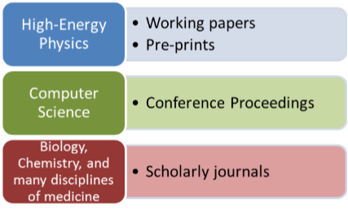
Content types
Articles (pre-print / post-print/official published version, depending on publishers’ agreements)
Conference proceedings
Reports
Books
Book chapters
Research data
Podcasts
Multimedia
Publication outputs by discipline
Research Information Network Report, (2009) Communicating Knowledge
Notes:
Research Information Network Report, (2009), Communicating Knowledge: How and why UK researchers publish and disseminate their finding, [Online] Available at: http://www.rin.ac.uk/system/files/attachments/Communicating-knowledge-report.pdf

Slide 7
Open Access The Green Route
Self archiving
  Institutional Repositories
  Subject Repositories
  Departmental, research project, individual websites
Archiving of a version
Check Sherpa Romeo for publisher agreements
Notes:
RePEc (Economic science)
E-LIS (Library and information Sciences & documentation)

Slide 8
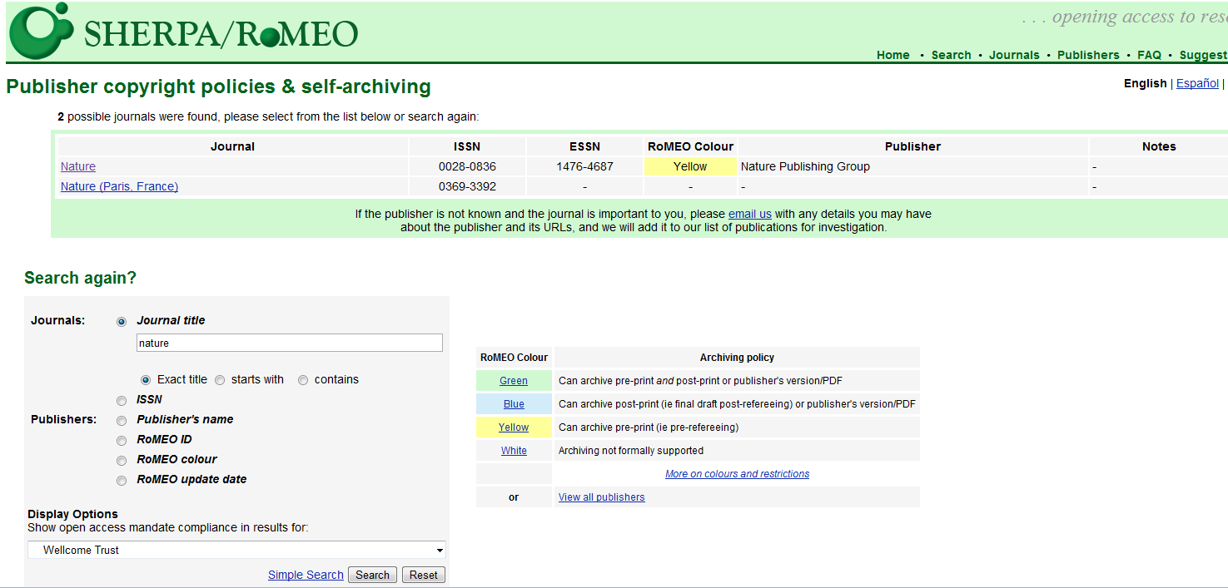

Slide 9
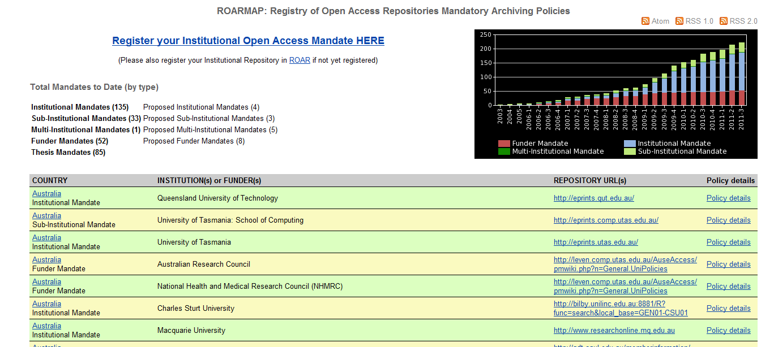

Slide 10
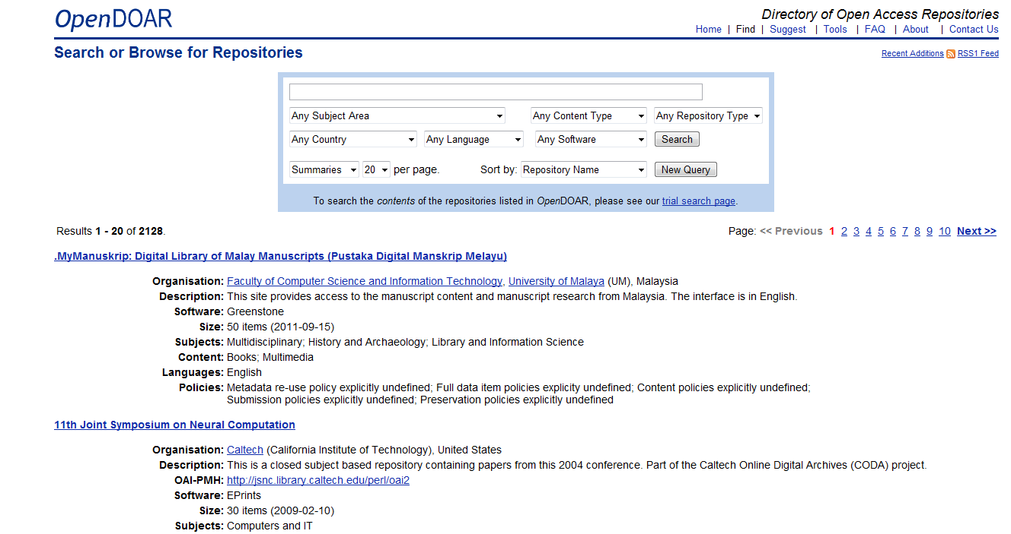
Notes:
The Directory of Open Access Repositories (DOAR) now lists 2,085 repositories globally, of which 51 repositories are found in 15 African countries.
Insert image of DOAR

Slide 11
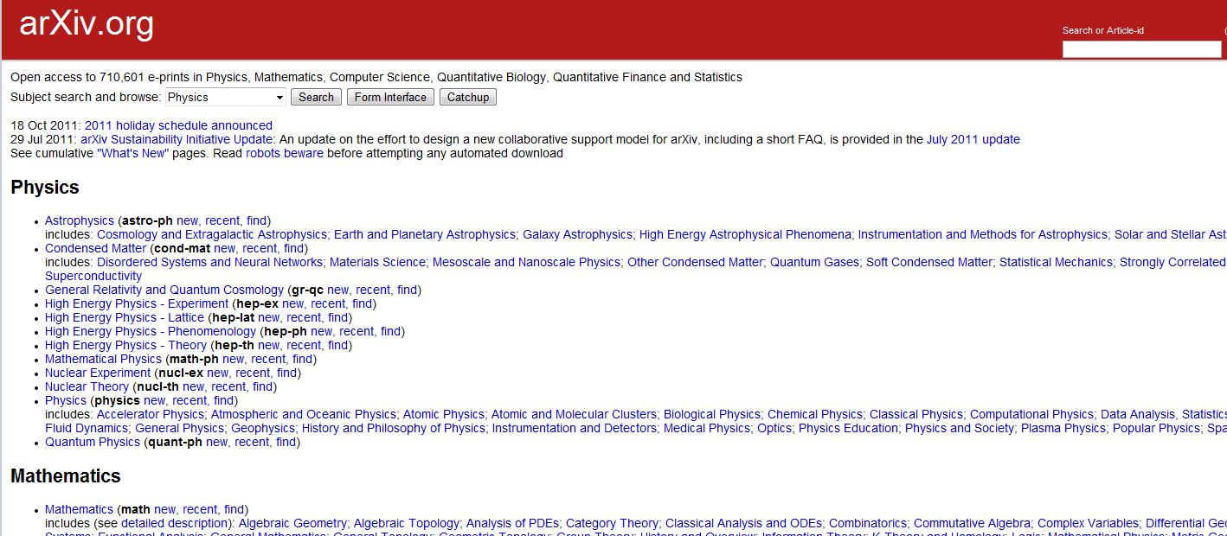
Notes:
ArXiv has been self archiving since 1980s (CS and physics, computational mathematics) 100k articles in physics, 10k in maths, 1k in CS

Slide 12
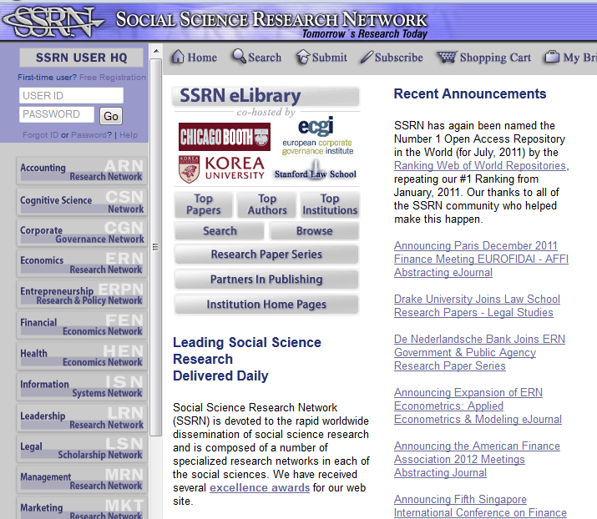

Slide 13
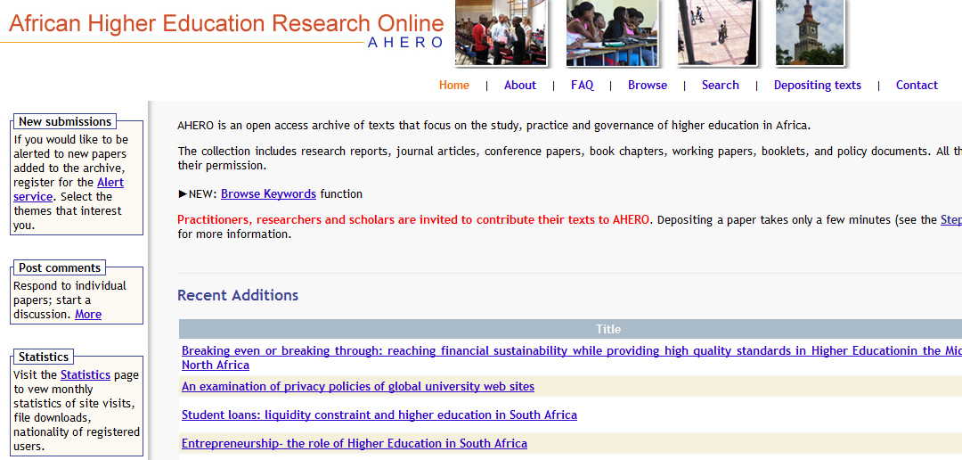

Slide 14
Open Access The Gold Route
Publishing in OA journals
  Commercial (PLOS, Biomed Central)
  Society (numerous)
  Universities
Rapid growth of open access publishing - now 7,000 journals listed and 600,000 articles
Notes:
Traditional journal increased by 3% year for the past 300 years (hardly at all until the late 19th C mostly in the 20th C)
OA journals been around for the last decade, growth 30% in numbers of journals since inception; 38% for articles ;2009, 120k articles;
8% of yearly article production

Slide 15
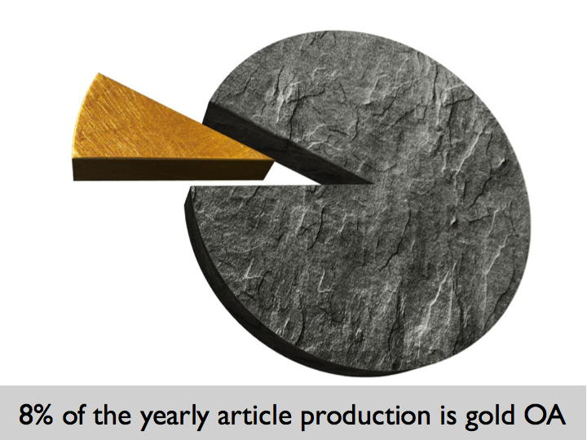
Salvatore Miele CERN OAI17 2011

Slide 16
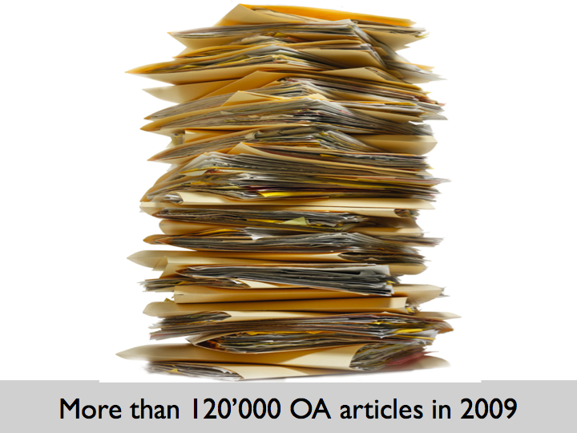
Salvatore Miele CERN OAI17 2011

Slide 17
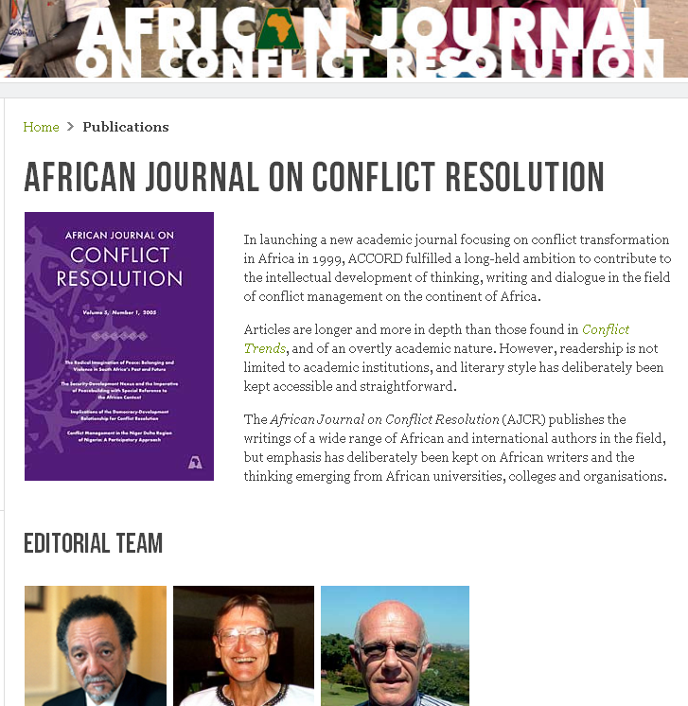
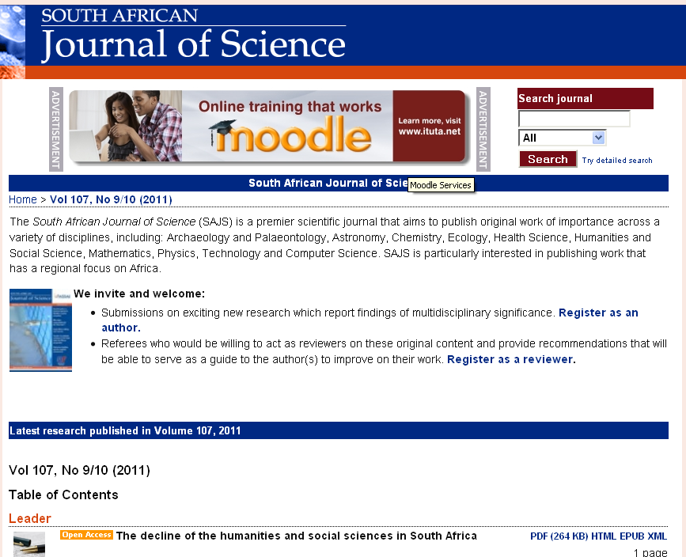
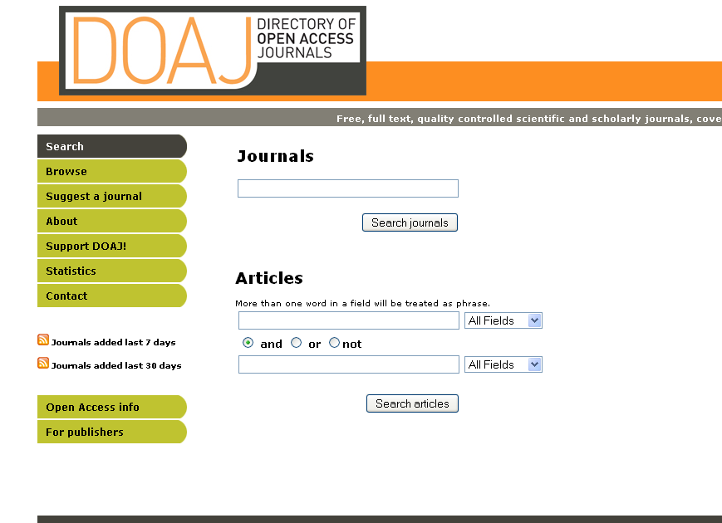
7070 journals in 2011
Notes:
Gold Route
- Primary publication in open-access journals.
- 7 070 journals (DOAJ 2011)

Slide 18
African Journals
Over the last five years there has been an increase of 543%
40 African journals listed in 2007 to 217 in 2011
In the last year countries such as Kenya, Ethiopia and Ghana have appeared on the list or substantially increased their presence

Slide 19
OA- the developing world
SciELO in Latin America - 800 journals, 300,000 articles
SCiELO South Africa, supported by the DST, run by the Academy of Science of SA
Bioline International provides a platform for developing country journals
Swan, A 2011, http://www.wsis-community.org/mod/file/download.php?file_guid=37146

Slide 20
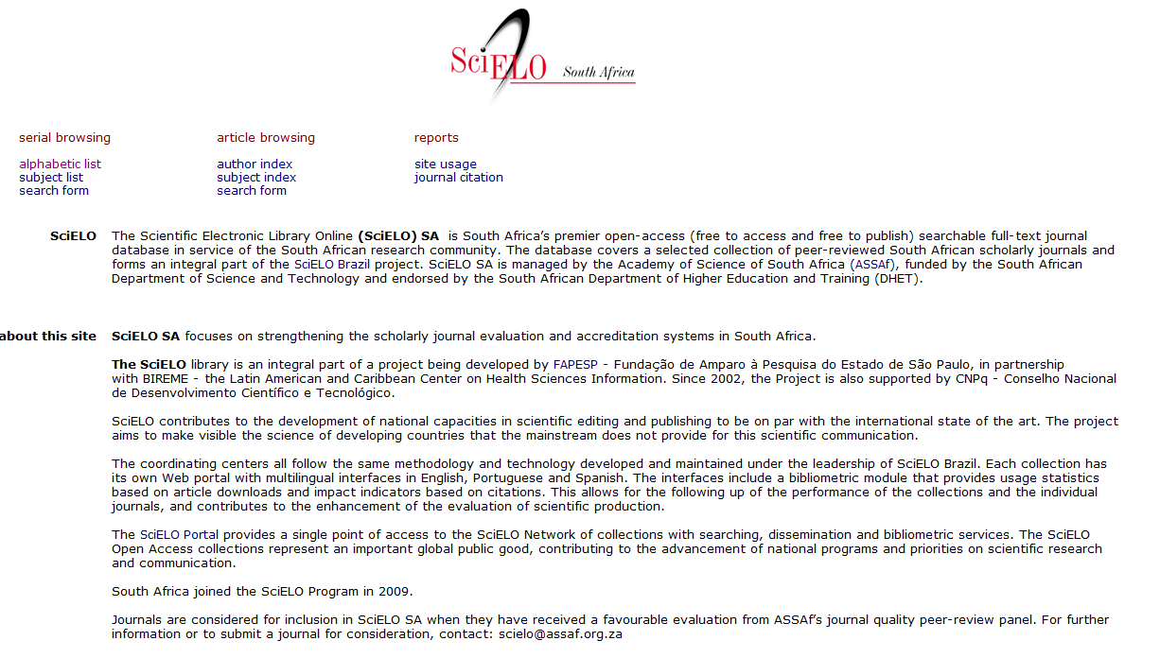

Slide 21
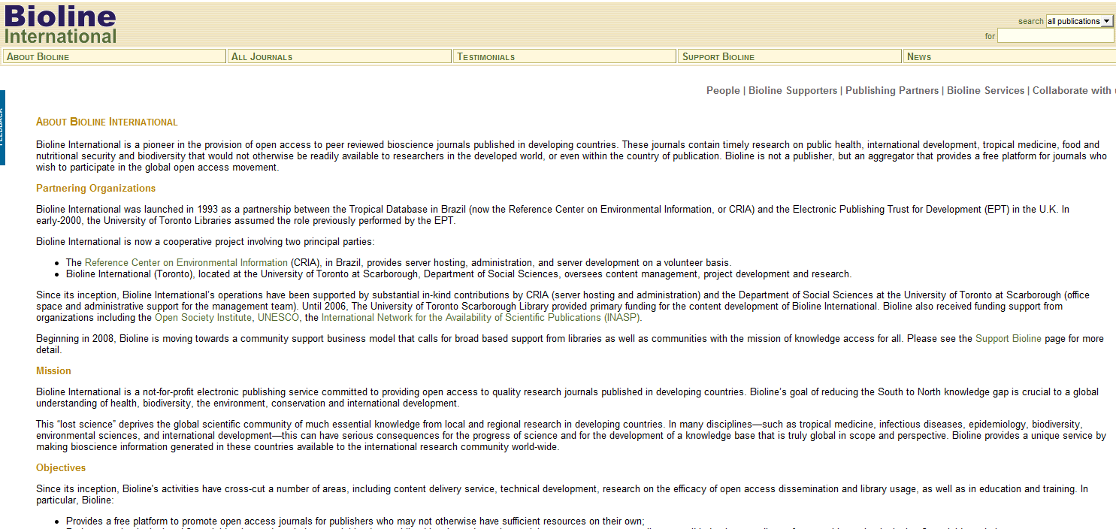
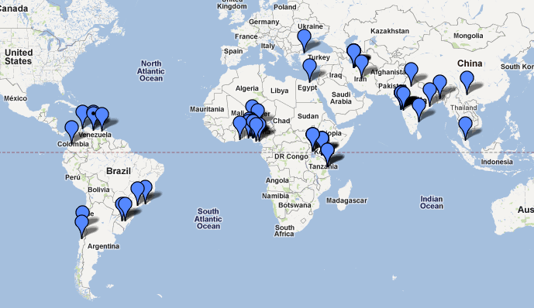

Slide 22
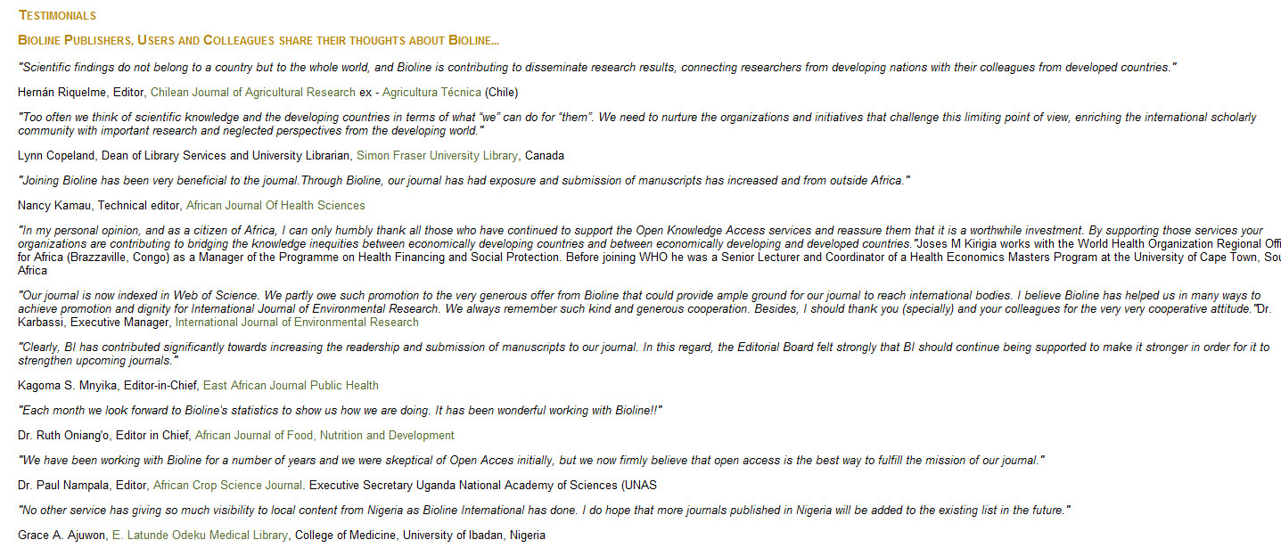

Slide 23
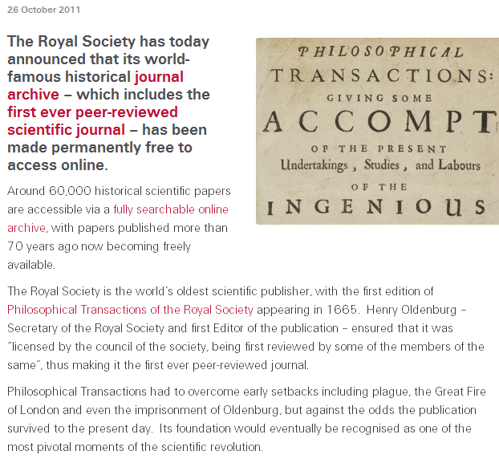
Full circle?

Slide 24
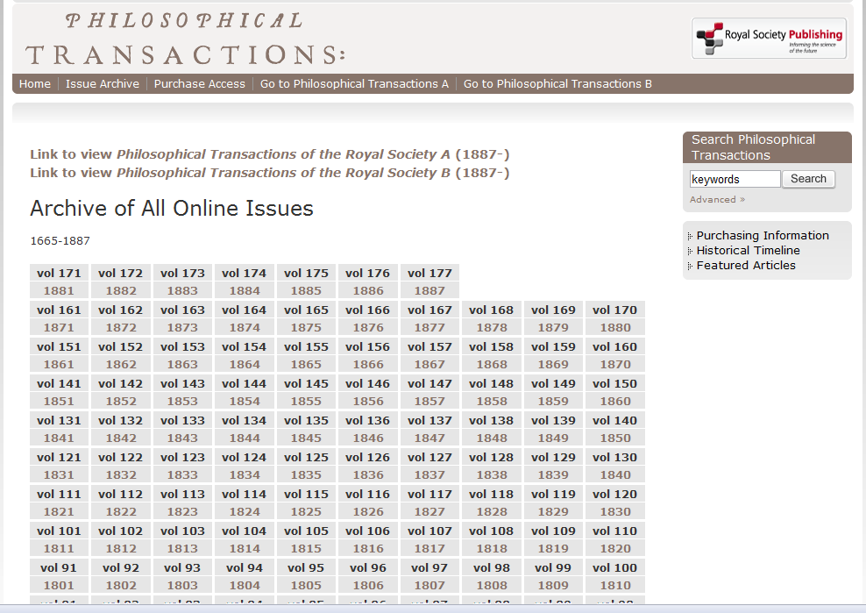

Slide 25
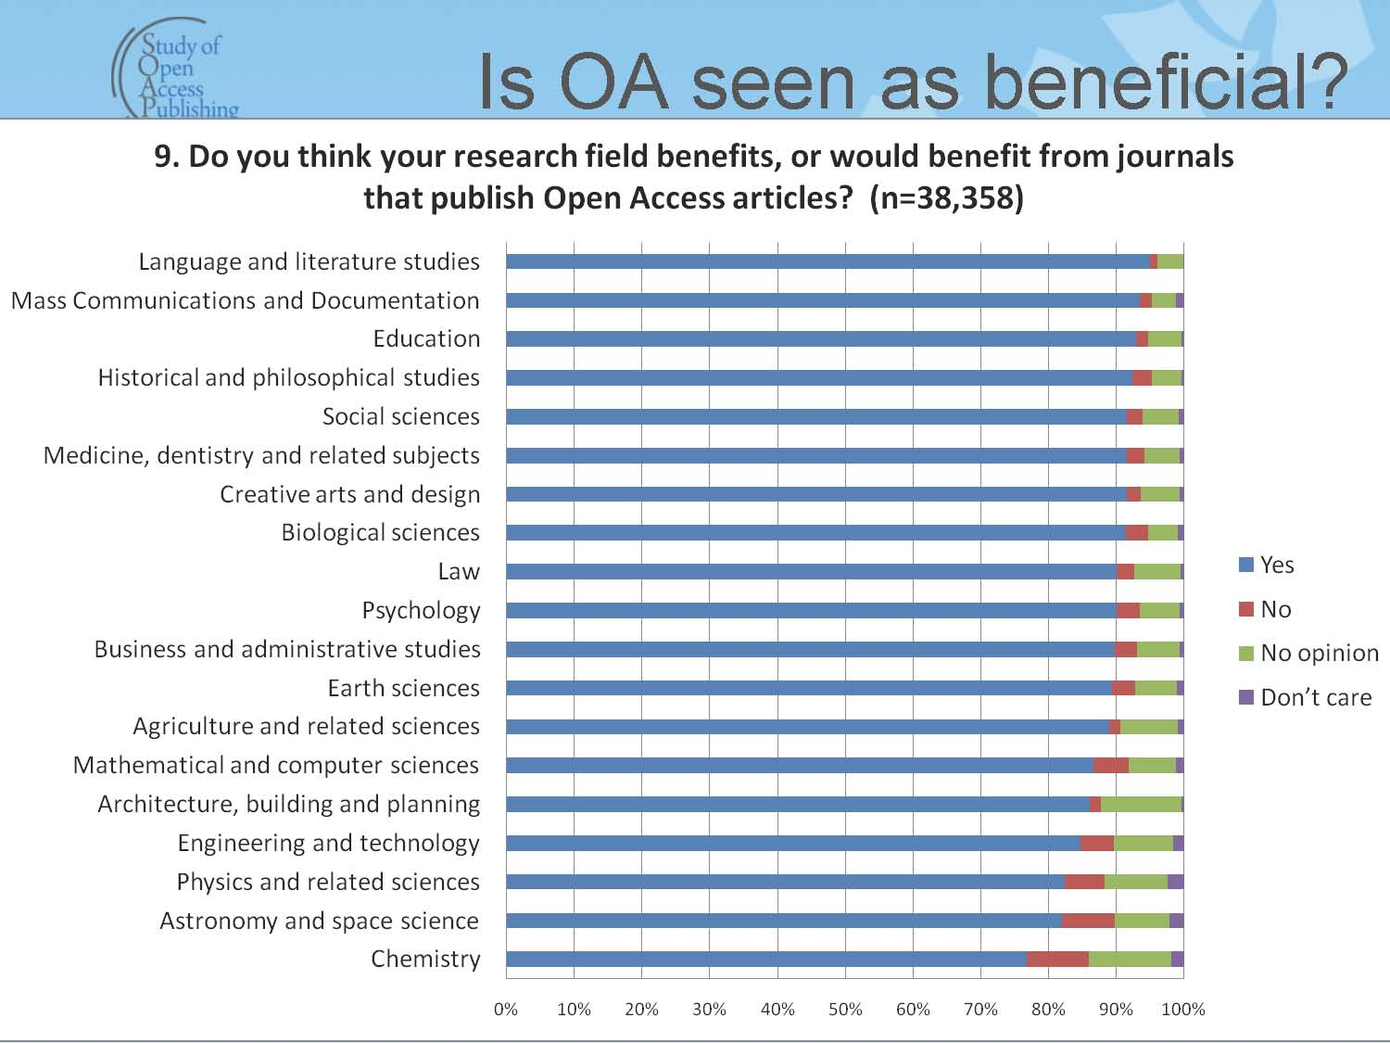
From Study of Open Access Publishing Report, 2011, What Scientists Think
Notes:
SOAP project survey - II What Scientists Think about Open Access Publishing, Talk given at the SOAP (Study of Open Access Publishing) Symposium in January 2011. arXiv:1101.5260v2 [cs.DL].

Slide 26
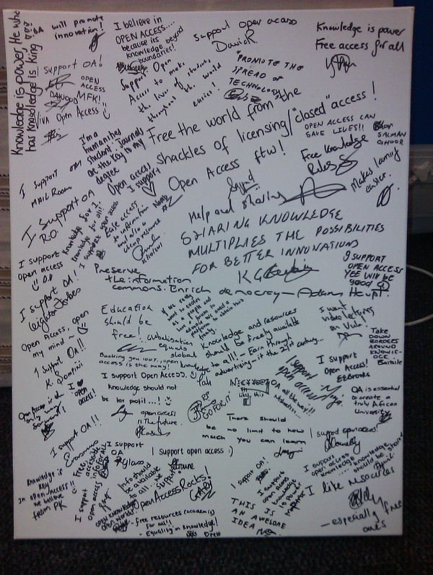
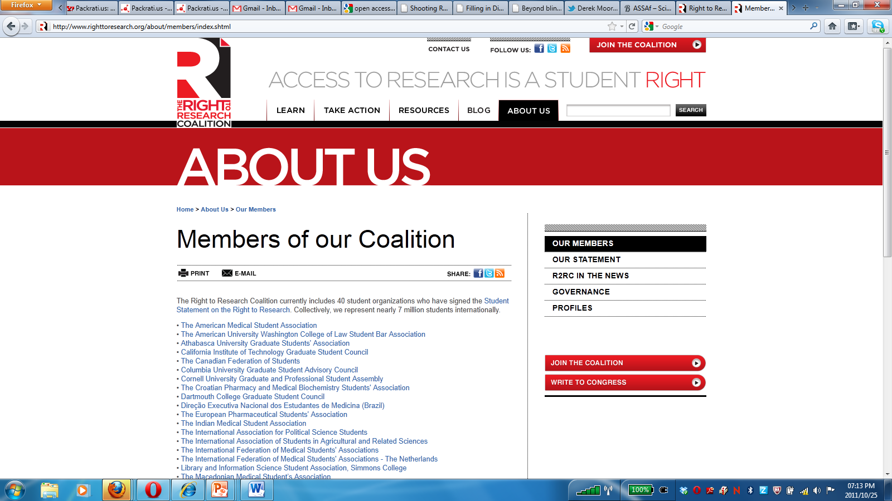
Student support
Notes:
7 million students internationally, canvas on right University of Cape Town students during Open Access Week October 2011

Slide 27
OA and impact
31 studies in a wide range of disciplines on OA and citations advantage
    27 studies show up to 600% increase in impact
    4 studies show no difference
Swan A (2010) The Open Access Citation Advantage: Studies and Results to Date.
Available at http://eprints.ecs.soton.ac.uk/18516/
Notes:
Of the 35 studies surveyed, 27 have shown a citations advantage (the % increase ranges from 45% increase to as high as 600%), with only 4 showing no advantage

Slide 28
The OA advantage
(a) A General OA Advantage: the advantage that comes from citable articles becoming available to audiences that had not had access to them before, and who would find them citable
(b) An Early Advantage: the earlier an article is put before its worldwide potential audience may affect subsequent citation patters
(c) A Selection Bias: authors make their better articles Open Access more readily than their poorer articles
(d) A Quality Advantage: better articles gain more from the General OA Advantage because they are by definition more citable than poorer articles
Swan A (2010) The Open Access Citation Advantage: Studies and Results to Date. Available at http://eprints.ecs.soton.ac.uk/18516/

Slide 29
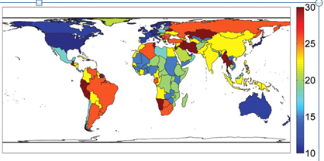
OA impact: developing countries
The influence of free access on citations is twice as large for the poorer countries in the developing world compared to richer countries as measured by per capita GNI (Evans and Reimer 2009).
Notes:
(C) Global projection of percentage increase in citations for GNI country deciles of the poorest country hosting a citing author after free online availability.
Evans and Reimer
J A Evans, J Reimer Science 2009; 323:1025-1025

Slide 30
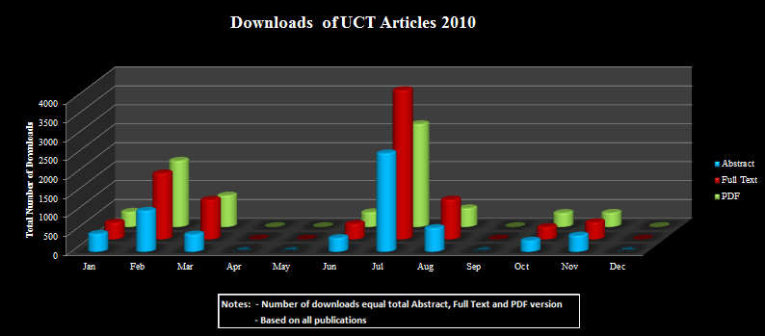
UCT
UCT already publishing in OA journals
Example: 61 articles in Biomed 2007-May ‘11

Slide 31
Concerns

Slide 32
Concern: quality
OA= peer review
Peer review = editorial processes
Quality varies in usual way
Not vanity publishing
  No quality control in VP

Slide 33
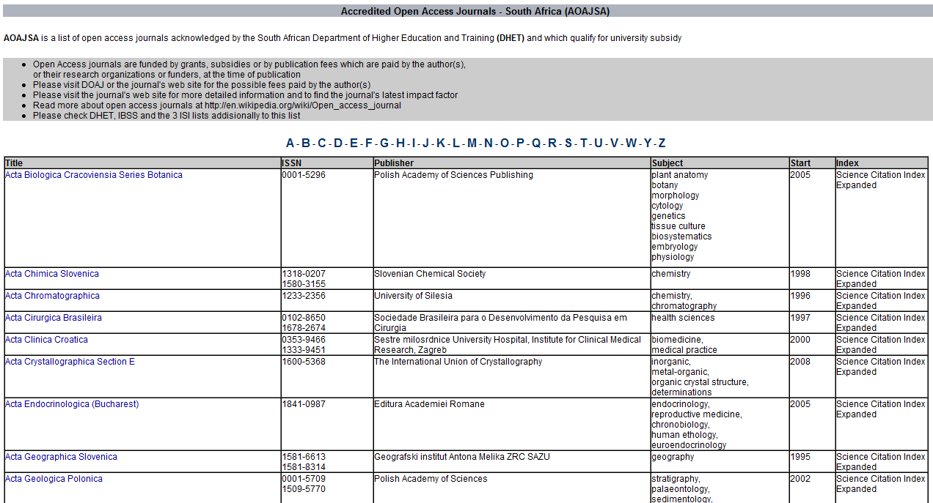

Slide 35
Concerns: not in my discipline
All disciplines
See DOAJ
But
The distribution of open access journals over disciplines is rather even. Grouped together, however, two thirds of the journals and three quarters of the articles are in STM
Dallmeier-Tiessen et al 2010
Notes:
OPEN ACCESS PUBLISHING -
MODELS AND ATTRIBUTES
July 8th, 2010
Suenje Dallmeier-Tiessen a, Bettina Goerner b, Robert Darby c Jenni Hyppoelae a,
Peter Igo-Kemenes a #, Deborah Kahn d, Simon Lambert c, Anja Lengenfelder e,
Chris Leonard c, Salvatore Mele a,*, Panayiota Polydoratou e, David Ross f,
Sergio Ruiz-Perez a, Ralf Schimmer e, Mark Swaisland g and Wim van der Stelt h

Slide 36
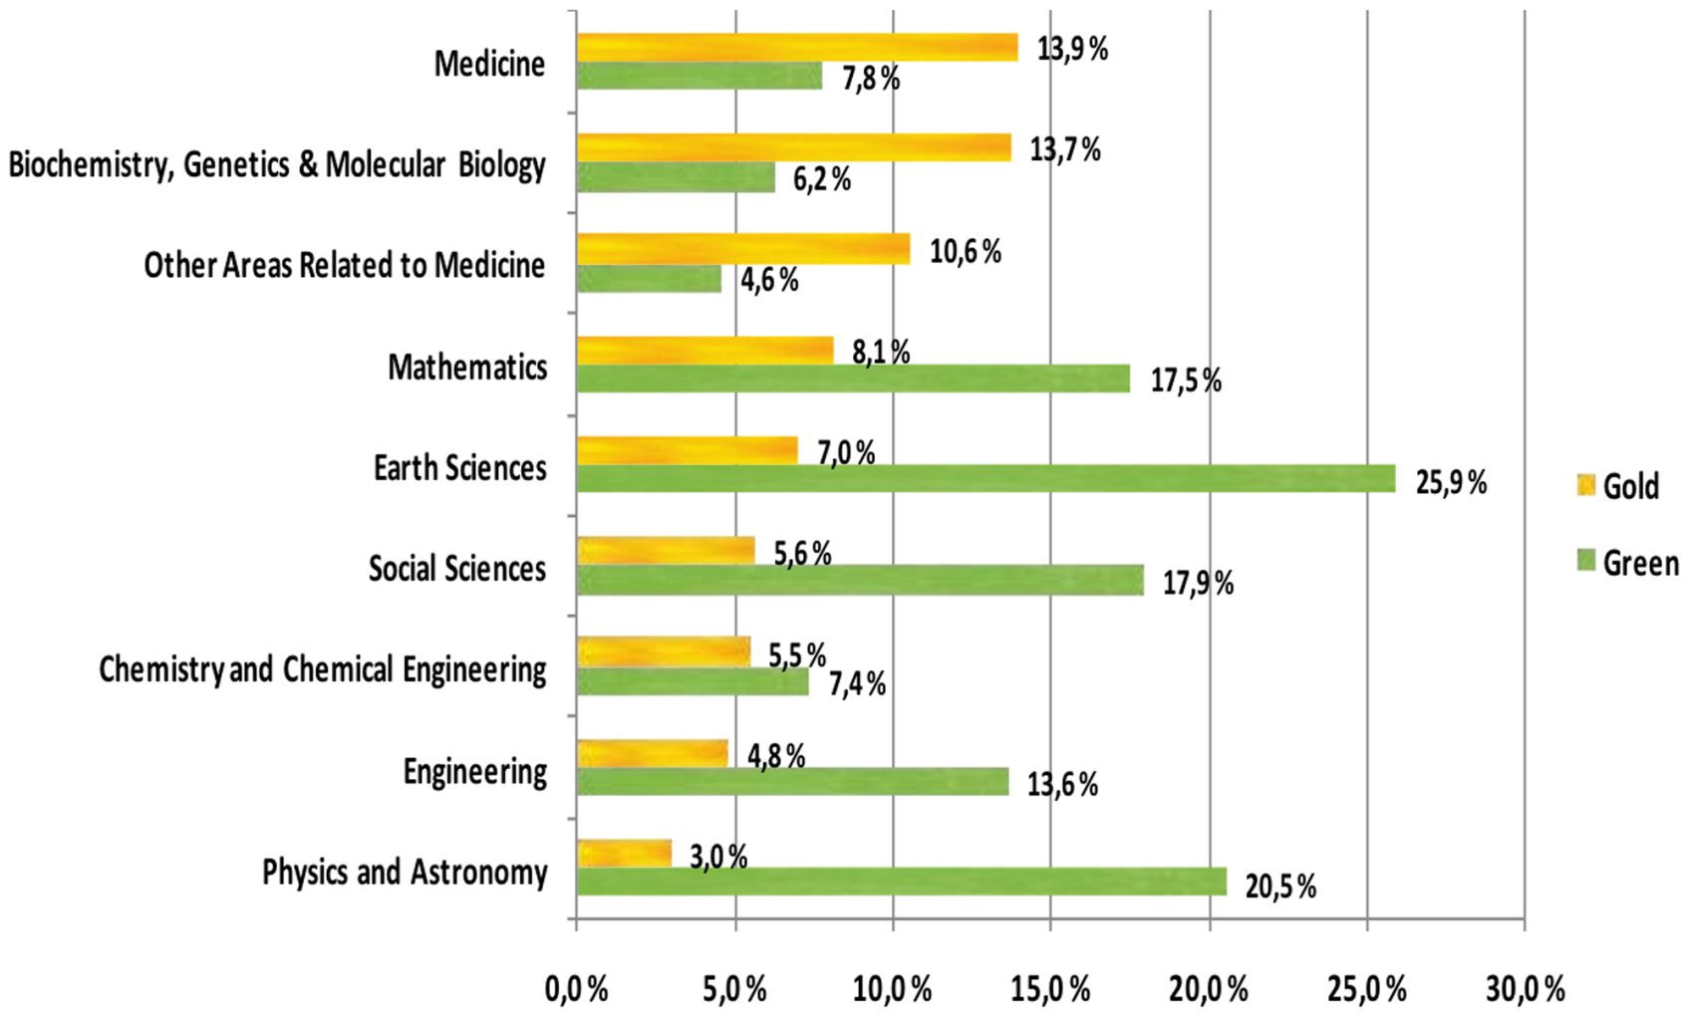
OA availability (by discipline)
An example of analyses of 2008 figures
Source: Open Access to the Scientific Journal Literature: Situation 2009. Björk B-C, Welling P, Laakso M, Majlender P, Hedlund T, et al. PLoS ONE 5(6): e11273. doi:10.1371/journal.pone.0011273 (2010)
Notes:
OA availability by scientific discipline
Based on the research conducted by Bjork et al., the availability of gold and green OA copies by scientific discipline are shown in the figure. The disciplines are shown by the gold ratio in descending order, rather than in alphabetical order. There is a clear pattern to the internal distribution between green and gold in the different disciplines studied. In all the life sciences, gold is the dominating OA access channel. The picture is reversed in the other disciplines where green dominated. The lowest overall OA share is in chemistry with 13% and the highest in earth sciences with 33%.

Slide 37
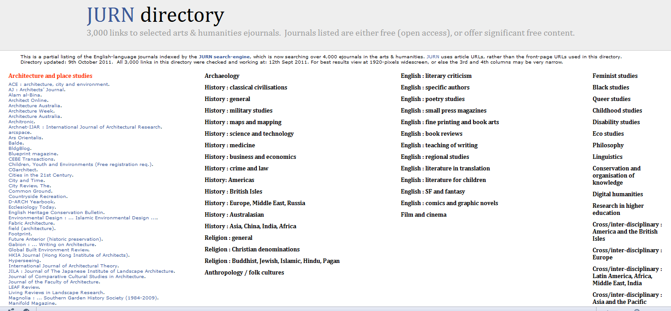

Slide 38
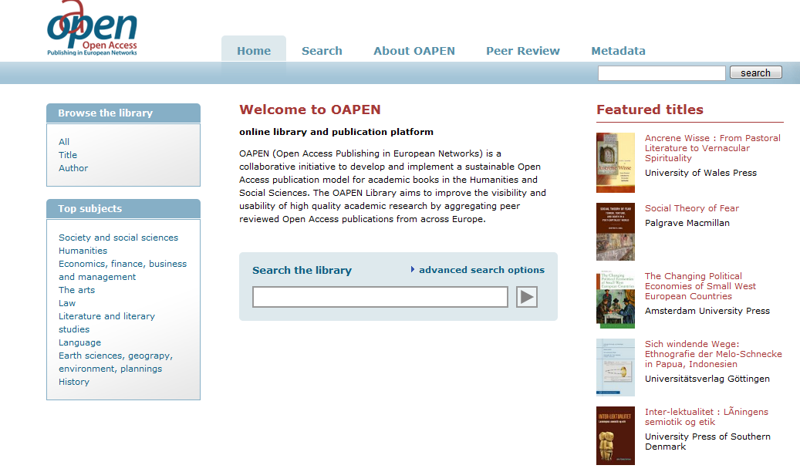
Open Access The Gold Route
Publishing in OA books
  OAPEN www.oapen.org
  Re-press www.re-press.org/
  Open Humanities Press www.openhumanitiespress.org
  HSRC Press and image
  Rapid growth of open access publishing - now 7,000 journals listed and 600,000 articles

Slide 39

HSRC Press distributes in 11 countries
Downloads in 184 countries
Online titles visited 22.5 times more often than copies bought

Slide 40
Concern: lose control
Belief that open access = copyright, loss of ownership
But OA = public domain
Instead with OA scholars gain control
Open licensing

Slide 41
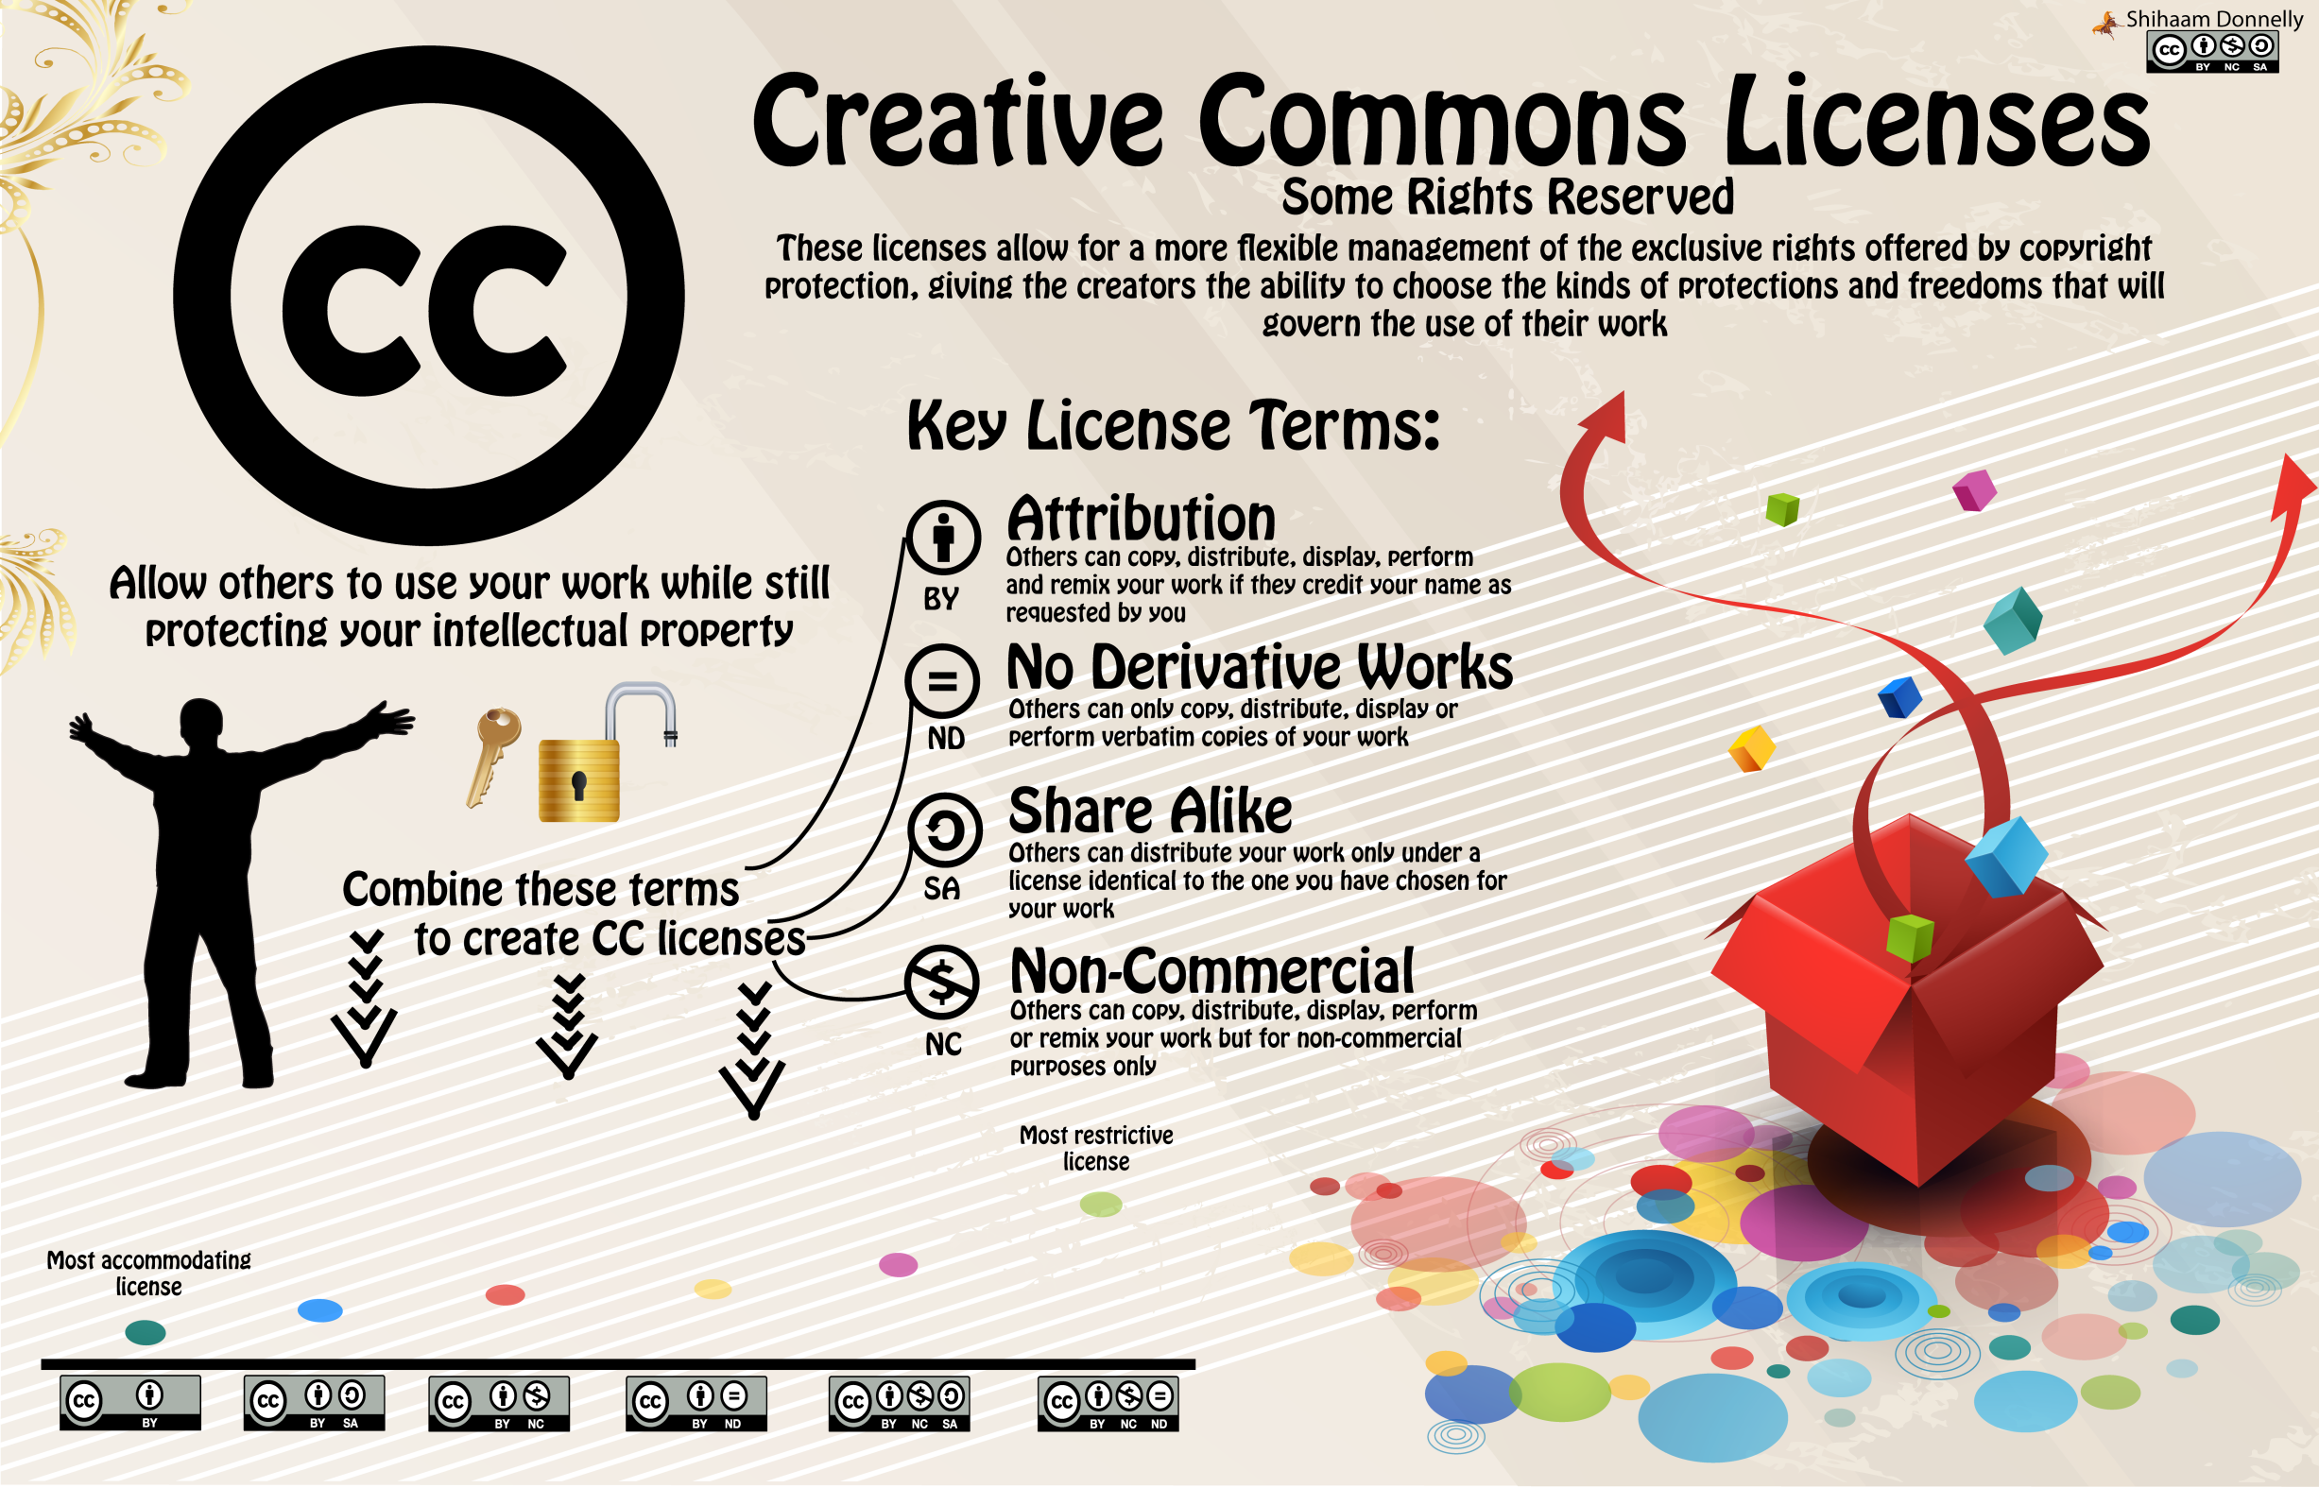

http://opencontent.uct.ac.za/Centre-for-Higher-Education-Development/Centre-for-Educational-Technology/Creative-Commons-Infographic
Notes:
http://opencontent.uct.ac.za/Centre-for-Higher-Education-Development/Centre-for-Educational-Technology/Creative-Commons-Infographic

Slide 42
Concern: Funding &costs
Free to the user
But
Costs to produce
Who pays?

Slide 43
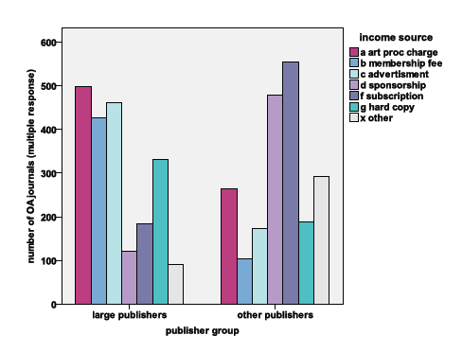
Dallmeier-Tiessen et al 2010
Notes:
Article Processing Charges (APC)
Funding agencies provide money to the author or establish agreements with publisher
Via Open Access funds
Via institutional membership
APC waved by publisher
OPEN ACCESS PUBLISHING -
MODELS AND ATTRIBUTES
July 8th, 2010
Suenje Dallmeier-Tiessen a, Bettina Goerner b, Robert Darby c Jenni Hyppoelae a,
Peter Igo-Kemenes a #, Deborah Kahn d, Simon Lambert c, Anja Lengenfelder e,
Chris Leonard c, Salvatore Mele a,*, Panayiota Polydoratou e, David Ross f,
Sergio Ruiz-Perez a, Ralf Schimmer e, Mark Swaisland g and Wim van der Stelt

Slide 44
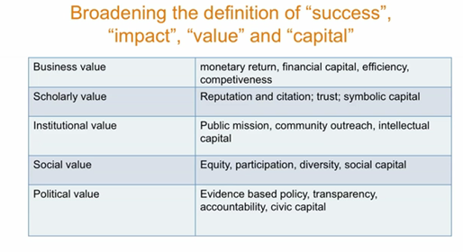
Costs & benefits
Chan, L 24 October 2011 Opportunities for Scholarly Communications in Africa www.vimeo.com/30922669

Slide 45
Costs
Expected reductions
    …high-volume OA publishing seems structurally inescapable prices for OA publishing should start trending down as the number of outlets increases
    Kent Anderson 26 October 2011
Notes:
Between Jan 2008 and May 2011 124 articles were published in Biomed journals authored or co-authored by UCT researchers
Of these 99 were paid by UCT researchers
Content as Commodity — Price Elasticity and New Business Models
Posted by Kent Anderson ⋅ Oct 26, 2011 ⋅ 6 Comments
http://scholarlykitchen.sspnet.org/2011/10/26/content-as-commodity-price-elasticity-and-new-business-models/

Slide 46
Why it is important
Access to knowledge
  Access to world knowledge
  Contribution
Participation
Visibility
  Prestige
  Impact
  Reputation

Slide 47
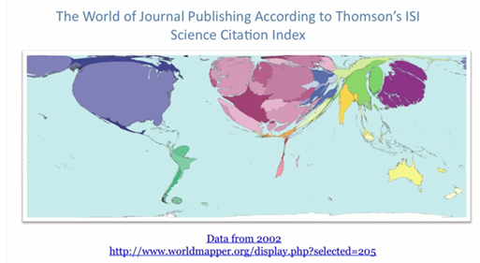
Contribution
Notes:
Chan, L 24 October 2011 Opportunities for Scholarly Communications in Africa www.vimeo.com/30922669

Slide 48
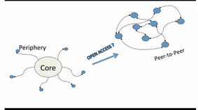
Participation
Notes:
Developing countries move from the periphery to participation in the network society
Chan, L 24 October 2011 Opportunities for Scholarly Communications in Africa www.vimeo.com/30922669

Slide 49
Beyond Open Access
OA is one element in a broader changing scholarly communication landscape
Changing research communication
Changing nature of the “publication”
New types of journals

Slide 50
Research communication now
Literature review
Bibliography
Conceptual framework
Conceptualise
Discussion
Comments
Documents
Review, evaluation, feedback
Data gathering
Data banks
Replication
The issue/ problem/ question
Interviews
Data analysis
Findings
Journal articles
Lectures
Blogs
Presentations

Slide 51
Open research
Literature review
Bibliography
Conceptual framework
Conceptualise
Discussion
Comments
Documents
Review, evaluation, feedback
Data gathering
Data banks
Replication
The issue/ question
Interviews
Data analysis
Data
Findings
Journal articles
Blogs
Enabled by:
storage
metadata
Standards
licenses
Lectures
Presentations
Notes:
Open research, open content of all kinds, linkage of different types of content through the research cycle
Processes of research itself become visible

Slide 52
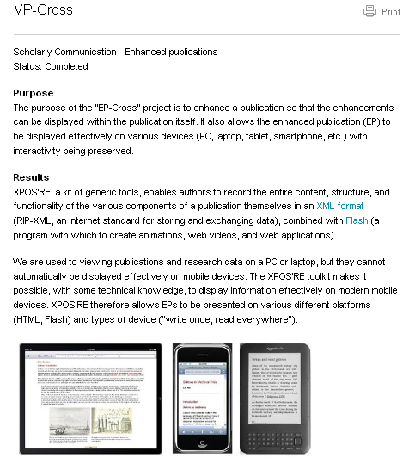
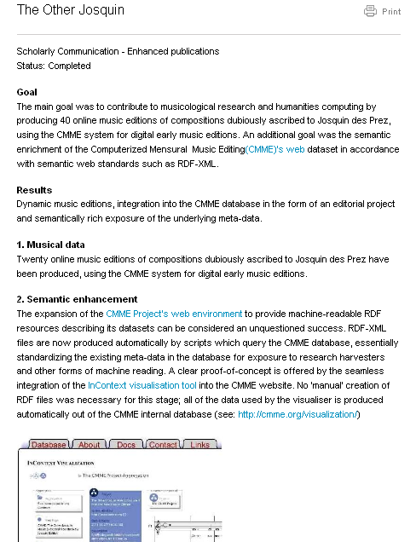
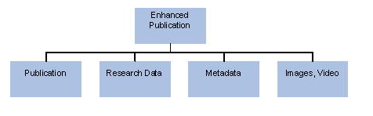
Emergence of the enhanced publication
http://www.surffoundation.nl/en/themas/openonderzoek/verrijktepublicaties/Pages/default.aspx

Slide 53
“Open access advocates might centre their vision on integrating open access with a new type of digital and global infrastructure that includes all results in real time … Therefore, the question that policy makers should be making is how to articulate open access as an essential part of the new infrastructure that merits institutional investment.”
Armbruster, C (2010)
Notes:
Armbruster, C (2010), Implementing Open Access
Chinese Journal of Library and Information Science, Vol. 3, No. 4, pp.1-22, 2010

Slide 54
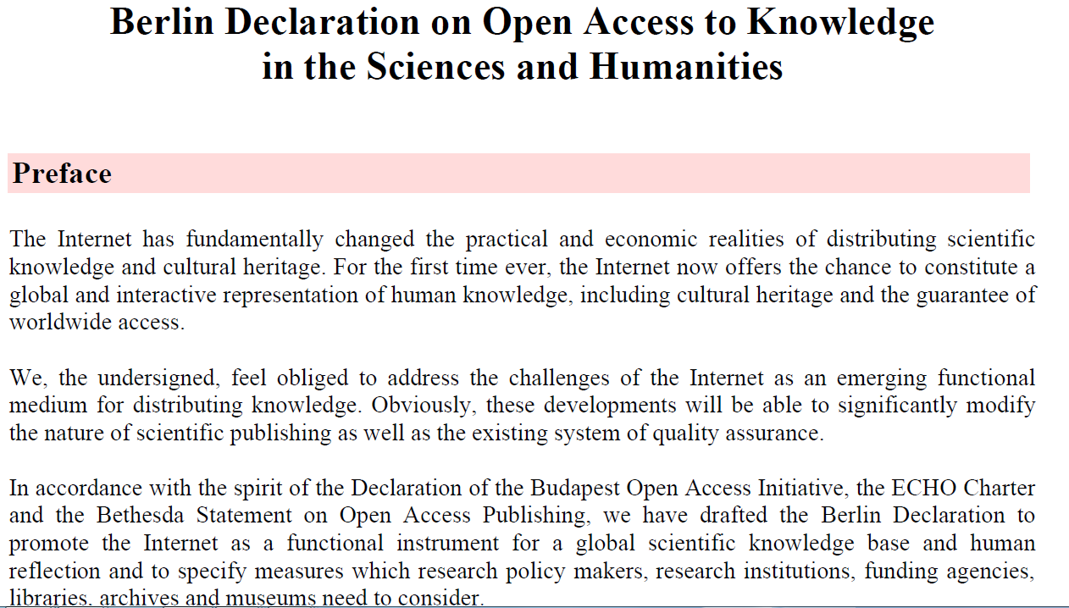
UCT signing

Slide 55

Thank you
Laura.Czerniewicz@uct.ac.za
Eve.Gray@uct.ac.za

