Slide 1


OPEN
SOURCE INITIATIVES

Slide 2
EBSCO is a philanthropic family-owned company, providing major donations to libraries, universities, cultural institutions and charities

Slide 3
EBSCO provides high quality indexing for more than 11,000 open access journals
This goes far beyond the indexing of open access journals by other organizations
Other than Google, EBSCO is
the top provider (origination site) of traffic to many open access journal websites

Slide 4
EBSCO’s full-text database model has dramatically increased access to journal literature worldwide in a cost effective way
More than fifty developing nations have national licenses to EBSCO full-text database packages, which has helped bridge the digital divide
And… EBSCO supports
open source ILS in libraries

Slide 5
KOHA & EBSCO
EBSCO is funding enhancements to Koha
Strategic upgrade of Koha’s core indexing to ElasticSearch
Increased flexibility and accuracy of facets
Development of a browse function
MARC to RDF crosswalk to allow for extended linking
Expanding metadata schemas beyond MARC21
Improved system speed

Slide 6
KOHA & EBSCO
EBSCO WILL CONTINUE TO INVEST IN KOHA ENHANCEMENTS
EBSCO is also building its systems to interoperate
with Koha, including:
  Koha OPAC functionality into EDS
  SSD integration into Koha
  (i.e., journal subscription services)
  YBP integration into Koha (i.e., book ordering &
  collection development services)

Slide 7
Announcing a new COLLABORATION

Slide 8







FOLIO: OPEN SOURCE LSP
Rethinking the ILS

Slide 9
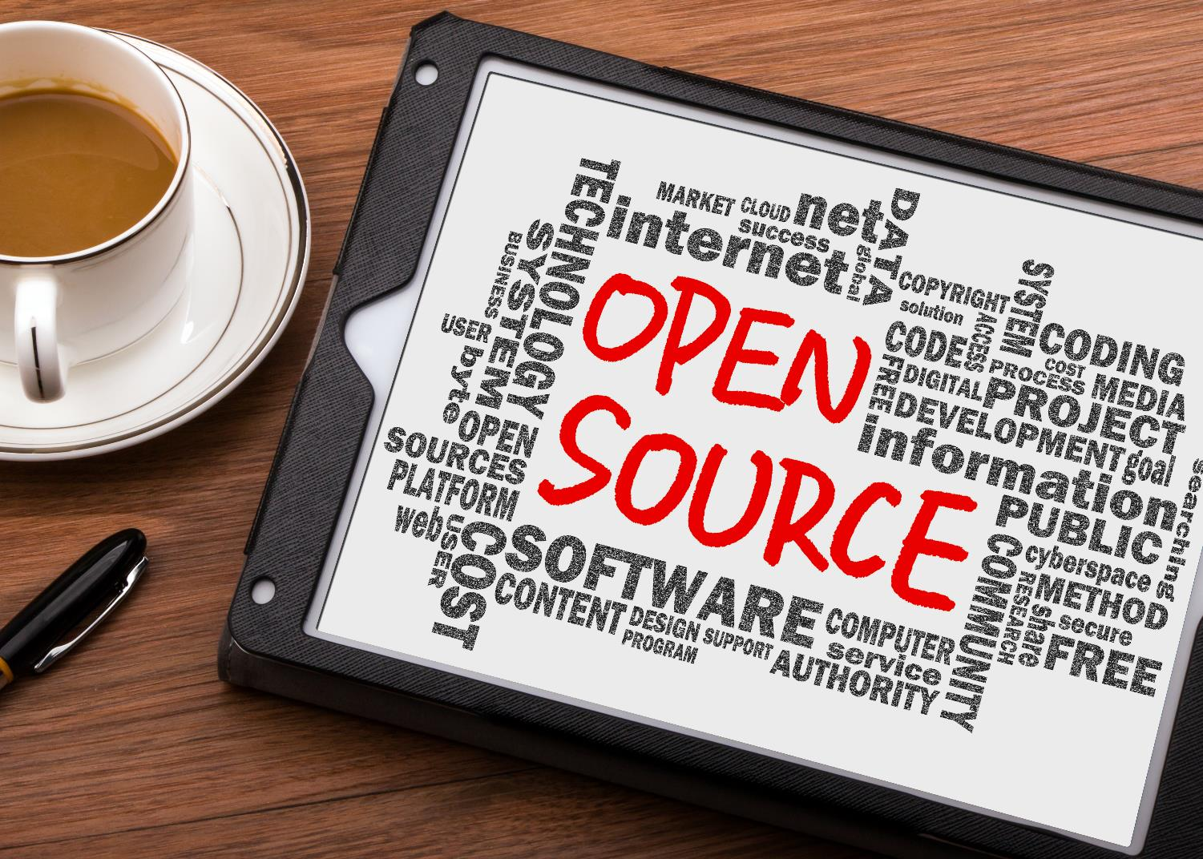
EBSCO is funding the creation of an open source LSP: FOLIO
FOLIO will include
full-featured ILS/LMS functionality
and will be extensible
to support add-on modules.

Slide 10
Our industry has witnessed a trend toward vendor consolidation, resulting in: closed systems less choice less innovation higher costs
The FOLIO goal is open systems, more choice, more innovation, lower costs

Slide 11





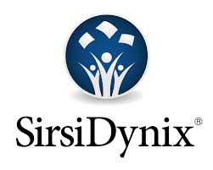

FOLIO is a
COMMUNITY of peers including: academic libraries,
OLE Partners, Index Data, EBSCO & others

Slide 12







FOLIO:
The Engaged Community is Growing

Slide 13








FOLIO:
The Engaged Community is Growing

Slide 14

Choose applications from a marketplace
MODULAR

Slide 15
Acquisitions
Cataloging
Circulation
Data Conversion Tools
Knowledgebase
OPAC Functionality
Resource Sharing
Serials Check-In
Union Catalog
App
App
App
App
BASE APPLICATIONS

Slide 16
Content Management Systems
Data Mining
Grant Management
Institutional Repositories
Learning Management Systems
Linked Data Triplestore
Predictive Analytics
Research Data
App
App
App
App
App
App
EXTENSIBLE
Extend into new areas

Slide 17


APIs throughout
Completely open
Anyone can build apps
PLATFORM
of choice

Slide 18
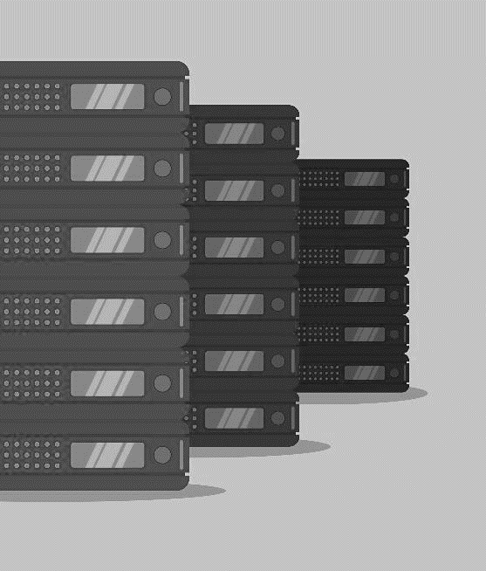
Any library may load
and operate FOLIO
code locally
Completely free for the library,
except for staff and hosting/server expenses
HOSTING
by libraries

Slide 19
EBSCO and others will provide hosting, services and support for FOLIO
Supported Open Source

Slide 20

“SirsiDynix is thrilled about the FOLIO project. We will be providing hosting, service and support for FOLIO at approximately half the cost of Alma.”
— Bill Davison
Chief Executive Officer
SirsiDynix

Slide 21

“ByWater Solutions has a long history of being deeply involved with open source library software. We are 'all in' with FOLIO and looking forward to providing development, hosting and support.”
— Nathan A. Curulla
Co-Owner & CRO
ByWater Solutions

Slide 22
In addition to
SirsiDynix and ByWater,
EBSCO will offer hosting, service and support for libraries that want a fully supported open source solution: FOLIO

Slide 23
EBSCO Services
Implementation
will be a
one-time fee
in the first year
of adoption
1

Slide 24
EBSCO Services
Hosting, service
& support
is anticipated to be roughly half the cost
of commercial offerings
2

Slide 25
EBSCO Services
Training will be available
upon request at
an hourly rate plus travel expenses
3

Slide 26

Global Infrastructure Will Be Available for Hosting
Discrete data centers
Redundant power, networking and connectivity

Slide 27

BENEFITS
Better products with library involvement
and more innovation
Greatly lowered annual ILS costs
More choice for libraries based on their particular needs

Slide 28

FOLIO will be available under an
APACHE 2 LICENSE
the most permissive license

Slide 29
FOLIO TIMELINE
OLF (Open Library Foundation)
Announced
Extended Apps
FOLIO
Announcement
Availability of FOLIO Apps to Run Library (ILS/LMS)
FOLIO
Pre-work idea phases, early partners
Open
Repositories
Platform and initial apps
2015
June
2016
Aug
2016
Sept
2016
2018
Regular code releases
Library Technology Reaching New Heights
PHASE 1
PHASE 2
2015: FOLIO development begins

Slide 30

2015: FOLIO development begins
Now
August-2016
2017
2018 >>
Community Engagement
Dev platform preview Github
Frequent release of code
FOLIO 1.0 release
Announce Collaboration
App dev begins
Community dev teams
App Marketplace
Community Forums
SIGs form
Community Growth
Community Growth
Foundation established
Timeline

Slide 31

FOLIO represents a true partnership between libraries and vendors in which we are each making real, substantive contributions based on our unique strengths.
For the first time, libraries will not only be customers but investors with vendor partners..
— David Carlson
Dean of Libraries
Texas A&M University

Slide 32

Different ways to participate
From staying informed to actual coding,
and everything in between:
Forums
Meet-ups
Newsletters
Wiki
And more
www.folio.org

Slide 33
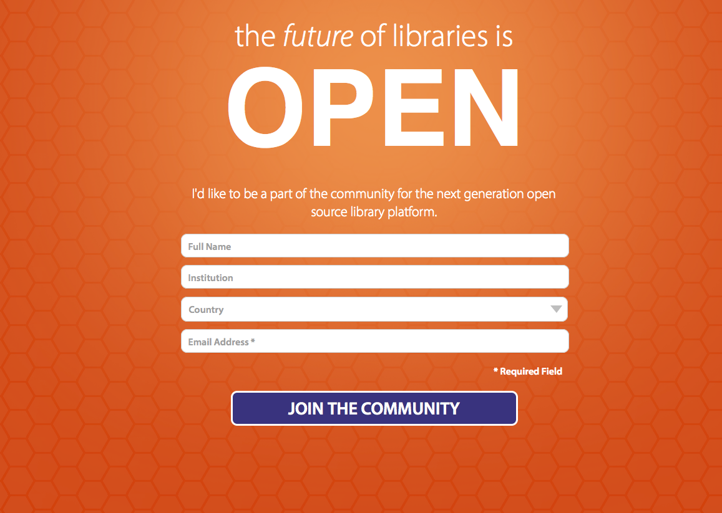
www.folio.org

Slide 34


THANK YOU
Colleen Mills | Vice President of Sales Sub-Saharan Africa
cmills@ebsco.com
+27 11 380 1800

