Slide 1
Physics 1025F
Heat & Properties of Matter
FLUIDS
Dr. Steve Peterson
Steve.peterson@uct.ac.za

Slide 2
Properties of Matter
The properties of matter depends on what phase they are in.
The three common phases of matter are solid, liquid, and gas, based on atomic structure.

Slide 3
Behavior of Matter
Solid -> definite shape and size.
Liquid -> fixed volume but can be any shape.
Gas -> any shape and can be easily compressed.
Solids and liquids are incompressible.
Liquids and gases both flow, and are called fluids.

Slide 4
Overview
FLUIDS
(Gases & Liquids)
Audit: Density & Pressure
Hydrostatics
Hydrodynamics
Pressure exerted by a Liquid
Buoyancy:
Archimedes Principle
Eqn of Continuity
Bernoulli’s Eqn
What affects
pressure?
Pascal’s
Principle
Measuring
pressure

Slide 5
Chapter 10: Fluids
What are fluids?
Liquids and gases that can flow and are easily deformable.

Slide 6
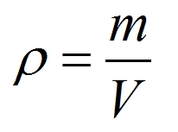

Hydrostatics: Density
Density gives a measure of how closely stuff/matter is packed together.
Equation SI Unit

Slide 7
Example: Density
How much does a cubic meter (1 m³) of ice, water and steam weigh?

Slide 8
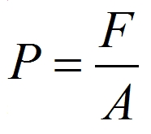
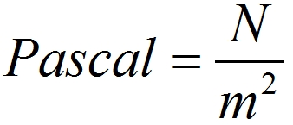
Hydrostatics: Pressure
Pressure is the force applied to a surface. The force is perpendicular to the unit of surface area. Pressure is a scalar; the units of pressure in the SI system are pascals
Equation SI Unit

Slide 9
Hydrostatics: Pressure in a fluid
The pressure inside a fluid is the same in all directions

Slide 10
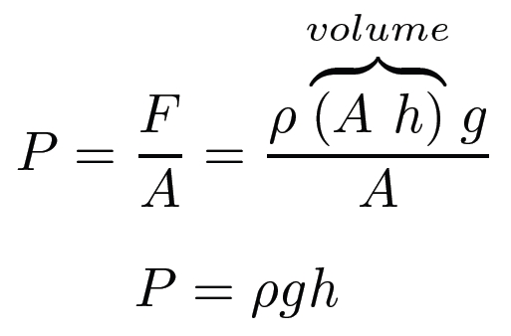
Hydrostatics: Pressure in a fluid
The pressure at a depth h below the surface of the liquid is due to the weight of the liquid above it.

Slide 11
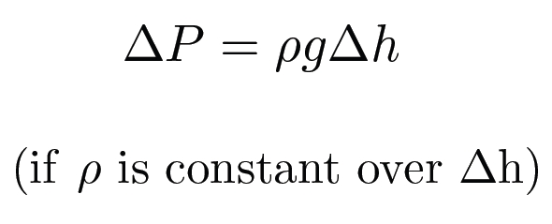
Hydrostatics: Pressure in a fluid
Because the fluid has weight the pressure in the fluid is not the same throughout the volume

Slide 12

Hydrostatics: Pressure in a fluid
The pressure in a fluid depends only on the distance from the surface. There is no horizontal dependence!

Slide 13
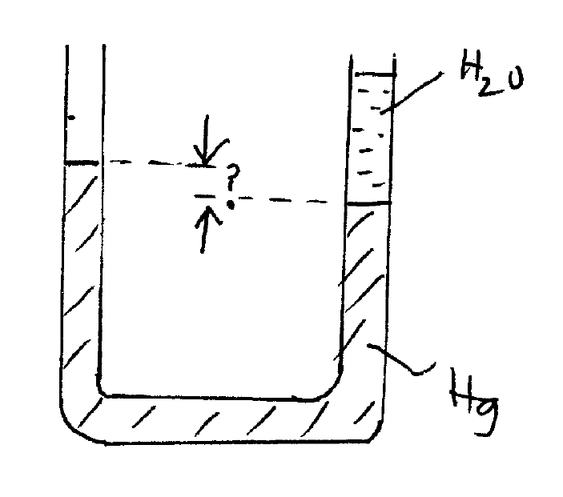
Example: Manometer
A simple U tube contains Hg (mercury). 15.0 cm of H₂O is then poured into the right-hand arm of the U tube. What is the difference between the level of the surface in the left-hand and right-hand arms?
Notes:
CHANGE THE WORDING TO MATCH THE PICTURE!!!!
INCLUDE DENSITIES OF WATER AND LEAD

Slide 14
Hydrostatics: Pascal’s Principle
Any change in the pressure applied to a completely enclosed fluid is transmitted undiminished to all parts of the fluid and enclosing walls.
If an external pressure is applied to a confined fluid, the pressure at every point within the fluid increases by that amount.

Slide 15

Hydrostatics: Measuring Pressure
Pascal’s principle can also be used to measure pressure, like with the open-tube manometer
The pressure being measured will cause the fluid to rise until the pressures on both sides at the same height are equal.

Slide 16


Hydrostatics: Gauge Pressure
The absolute pressure is:
Pressure in excess of the atmospheric pressure is the gauge pressure.

Slide 17
Example: Gauge Pressure
Patients suffering from decompression sickness may be treated in a hyperbaric chamber filled with oxygen at greater than atmospheric pressure. A cylindrical chamber with flat end plates of diameter 0.75 m is filled with oxygen to a gauge pressure of 27 kPa. What is the resulting force on the end of plate of the cylinder?

Slide 18

Hydrostatics: Atmospheric Pressure
At sea level the atmospheric pressure is:
this is called one atmosphere (atm).
Another unit of pressure is the bar:
Standard atmospheric pressure is
Just over 1 bar.
Equivalent to holding approximately
4200 kg in one hand!

Slide 19
Hydrostatics: Atmospheric Pressure
Why does this atmospheric pressure not crush us?
The cells in our body maintain an internal pressure that balances it.

Slide 20
Hydrostatics: Blood Pressure
Blood pressure measurement is an example of a pressure gauge.
The pressure in the air-filled jacket squeezes the arm with the same pressure, thus compressing the brachial artery.
A typical blood pressure might be 120/80 mm-Hg.
(systolic / diastolic)

Slide 21
Hydrodynamics: Flow
Hydrodynamics is the study of fluids in motion.
If the flow of a fluid is smooth, it is called streamline or laminar flow .
Above a certain speed, the flow becomes turbulent . Turbulent flow has eddies; the viscosity of the fluid is much greater when eddies are present.

Slide 22
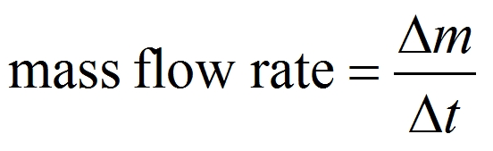
Hydrodynamics: Mass Flow Rate
Consider a steady laminar flow of fluid.
The mass flow rate is the mass that passes a given point per unit time. The flow rates at any two points must be equal, as long as no fluid is being added or taken away.

Slide 23
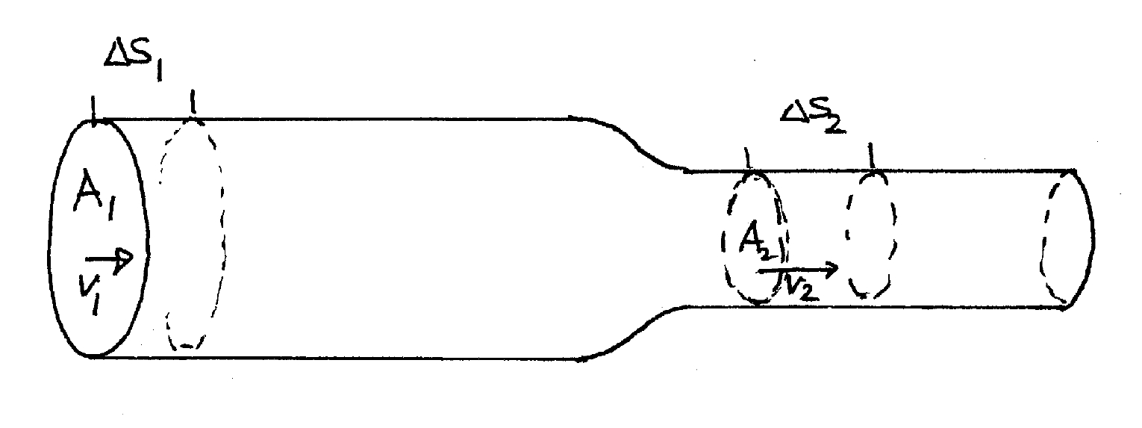
Hydrodynamics: Continuity Equation
Consider fluid flowing through a portion of a tube with cross sectional areas A₁ and A₂. Let the speed of the fluid at these sections be v₁ and v₂, respectively.
Notes:
NEED TO DO THIS DIFFERENTLY

Slide 24

Hydrodynamics: Continuity Equation
For an incompressible fluid (ρ = 0), continuity equation is
and becomes
which is the equation for volume flow rate (Q)

Slide 25
Example: Continuity Equation
A garden hose has an inside diameter of 16 mm. The hose can fill a 10 L bucket in 20 s. What is the speed of the water out of the end of the hose?

Slide 26
Example: Blood Flow
Example 10-11: The radius of the aorta is 1.2 cm and the speed of the blood in the aorta is 40 cm/s.
A typical capillary has a radius of 4 x 10⁻⁴ cm and the blood flows through it at a speed of 5 x 10⁻⁴ m/s.
Estimate the number of capillaries in the body.

Slide 27
Hydrodynamics: Bernoulli’s Principle
The continuity equation tells us that as a pipe gets narrower, the velocity of the fluid increases, thus describing the moving fluid, but not why the fluid is in motion.
In order for there to be a change in velocity, there must be an acceleration

Slide 28
Hydrodynamics: Bernoulli’s Principle
According to Newton’s second law, there must be a net force acting on the fluid element in order to accelerate it.
Where does this force come from?
The surrounding fluid exerts pressure forces on the fluid element.
A pressure difference (ΔP) or pressure gradient in the fluid produces an acceleration.

Slide 29
Hydrodynamics: Bernoulli’s Principle
An ideal fluid accelerates whenever there is a pressure gradient.
As a result, the pressure is higher at a point where the fluid is moving slower and lower where the fluid is moving faster.
Note: It is important to realize that it is the change in pressure from high to low that causes the fluid to speed up. A high fluid speed doesn’t cause a low pressure any more than a fast-moving particles causes the force that accelerated it.

Slide 30
Hydrodynamics: Bernoulli’s Principle
This property of fluids was discovered in the 18th century by the Swiss scientist Daniel Bernoulli and it is called the Bernoulli effect

Slide 31
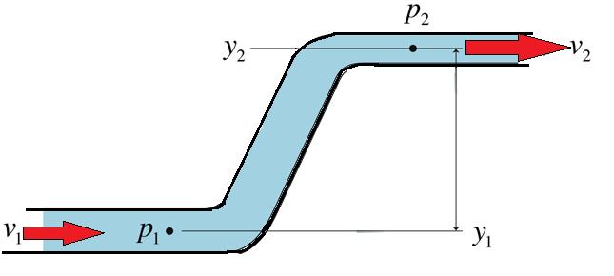
Hydrodynamics: Bernoulli’s Principle
A pressure gradient is also produced when a pipe changes height. Due to gravity, there will be a higher pressure at p₁ then at p₂.
This pressure gradient will not produce a change in velocity because there is no resulting acceleration, only an increase in potential energy.

Slide 32
Hydrodynamics: Bernoulli’s Principle
In steady flow of a non-viscous, incompressible fluid, the pressure (P), the fluid speed (v), and the elevation (y) at two points are related by:
Bernoulli’s equation is basically a conservation of energy equation where:

Slide 33
Example: Bernoulli
In an agricultural irrigation system, water is pumped through a constant-diameter pipe up a 1.5-m-high embankment, where it empties into a field. If the farmer wants to pump water at a rate of 20 L/s, what pressure does his pump need to apply at the bottom of the pipe?

Slide 34
Hydrodynamics: Viscosity
Real fluids have some internal friction, called viscosity. If a viscous fluid flows through a tube, it tends to cling to the surface as it passes.

Slide 35
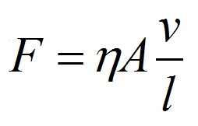
Hydrodynamics: Viscosity
The viscosity can be measured; it is found from the relation
where η (eta) is the coefficient of viscosity.

Slide 36
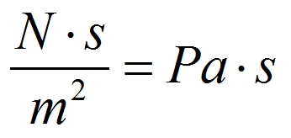
Hydrodynamics: Viscosity
The SI units for viscosity (η) are:
The viscosity of a fluid is usually temperature dependant
Gases are much less viscous than liquids

Slide 37
Hydrodynamics: Poiseuille’s Equation
In order to keep a viscous fluid flowing, a pressure difference is needed.
Otherwise, the internal friction will slow it to a stop.

Slide 38
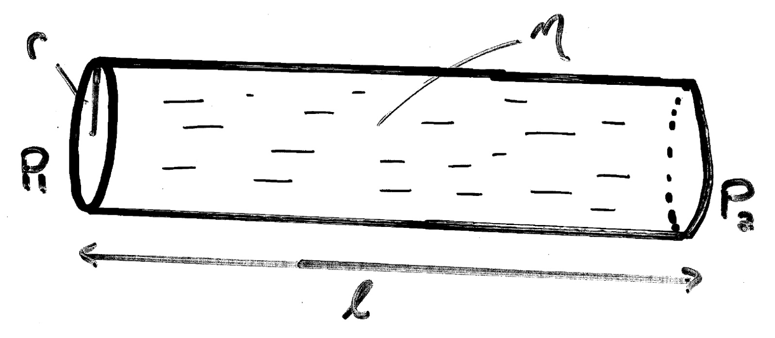
Hydrodynamics: Poiseuille’s Eq.
Consider a viscous fluid (η) flowing through a tube of radius R. Let the length of the tube be L and the pressure at either end be P₁ and P₂. The pressure gradient across the tube is therefore (P₁ - P₂).
How does the flow rate (Q) depend on these factors?

Slide 39
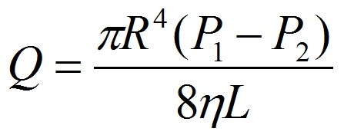
Hydrodynamics: Poiseuille’s Equation
The volume flow rate is proportional to the pressure gradient, inversely proportional to the fluid viscosity, and proportional to the fourth power of the radius of the tube.
Very dependant on radius. For example, halving the radius results of a flow rate drop by a factor 1/16!

Slide 40
Example: Poiseuille’s Equation
The measured flow rate leaving the heart is 5 L/min. Assuming the flow is divided among 3 x 10⁹ capillaries, what is the pressure drop across the capillaries?
A typical capillary is 1 mm long and 6 μm in diameter.

Slide 41
Hydrodynamics: Poiseuille’s Eq.
This has consequences for blood flow – if the radius of the artery is half what it should be, the pressure has to increase by a factor of 16 to keep the same flow.
Usually the heart cannot work that hard, but blood pressure goes up as it tries.

Slide 42
Example: Hydrodynamics
Problem 10-54: What diameter must a 21.0 meter long air duct have if the ventilation and heating system is to replenish the air in a room 9.0m x 12.0m x 4.0m every 10 min? Assume the pump can exert a gauge pressure of 0.71 x 10⁻³ atm.

