Slide 1
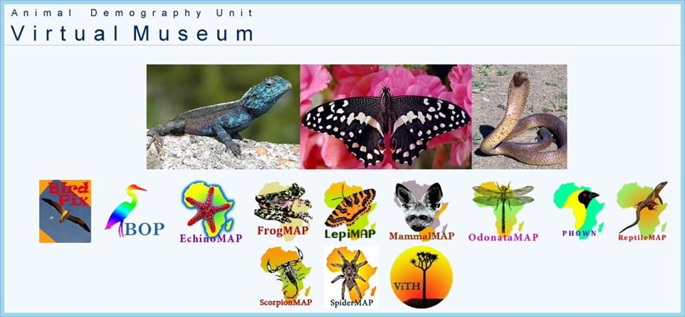
How to create a species distribution map in the Virtual Museum
Megan Loftie-Eaton – Animal Demography Unit – University of Cape Town

Slide 2
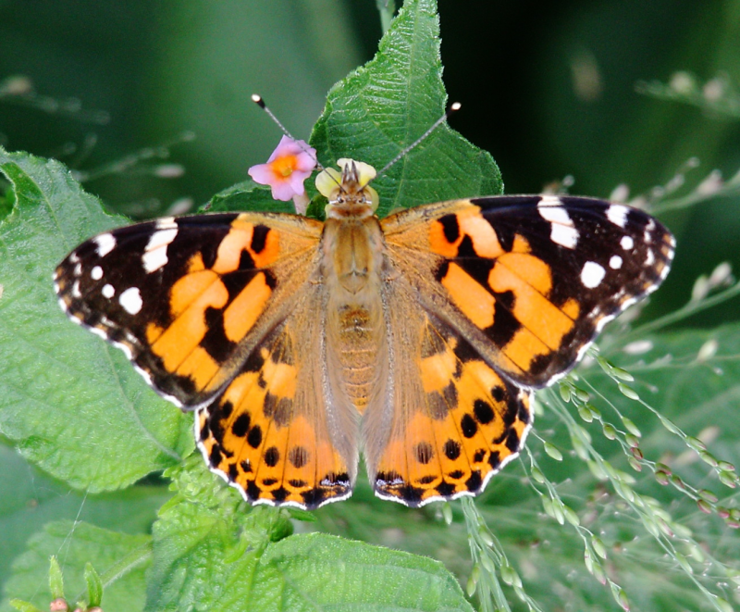
Today, we provide the recipe to creating a species map for a butterfly, the Painted Lady (Vanessa cardui), directly off the current and live data in the LepiMAP database. You don’t need to login to access the maps. They are available to you, free of charge, anywhere in the world --- AND the recipe is the same for ALL the projects in the Virtual Museum

Slide 3

Step 1: go to http://vmus.adu.org.za/

Slide 4
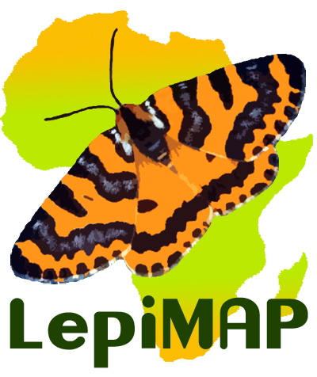
Step 2: Click on the LepiMAP logo
(or any other project logo from which you want to extract a map)

Slide 5
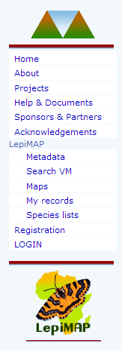
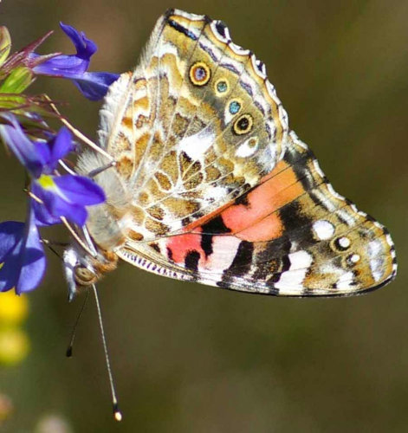
Step 3: Down the left hand side menu, click on “Maps”

Slide 6
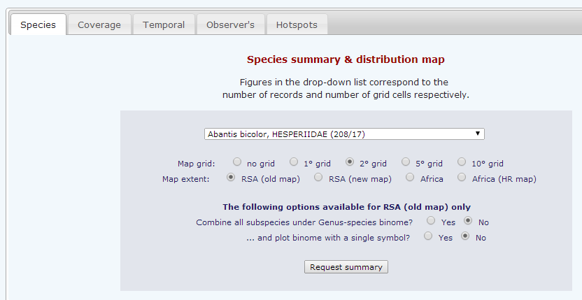
Step 4: From the drop down menu, scroll as far as Vanessa cardui, and click on the name
Then click on “Request summary”

Slide 7
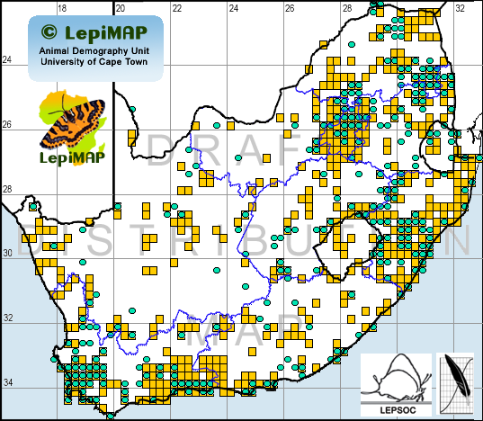
Our server searches the LepiMAP database to find the records of Vanessa cardui, and then creates the map and sends it to you. This takes a few seconds

Slide 8
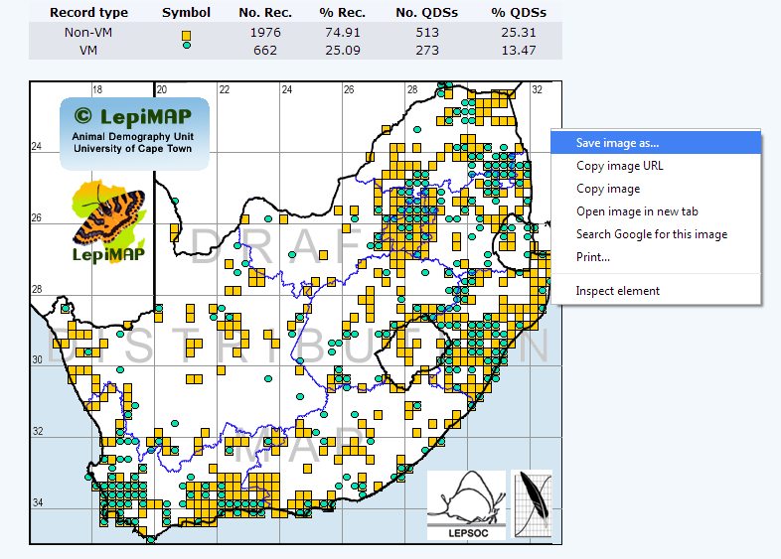
The map is delivered to you. You can right click on it and do a “save image”

Slide 9
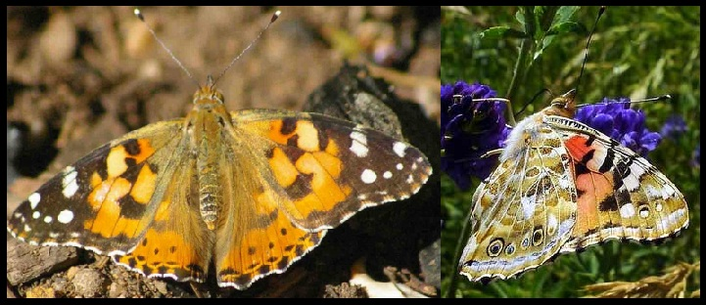
For the distribution maps for the butterflies, the turquoise circles represents Virtual Museum records, and the orange squares represent mainly specimen records. When you look at the map, you can immediately see why we launched LepiMAP. It is instantly clear that there are lots of grid cells where the Painted Lady must occur, but for which we do not have records yet!

Slide 10
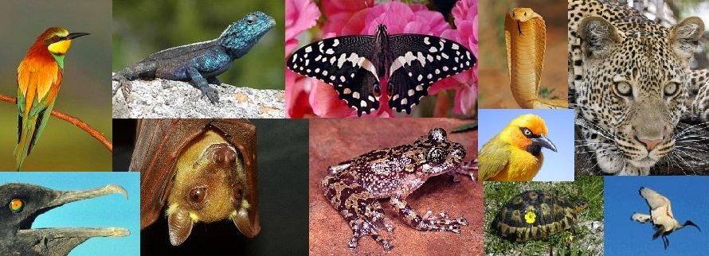
You can help us by making your photos count for biodiversity conservation and submitting them to the Animal Demography Unit’s Virtual Museum at http://vmus.adu.org.za and here is how: http://www.slideshare.net/meganloftieeaton/how-to-submit-records-to-the-animal-demography-units-virtual-museums-28710898

