Slide 1
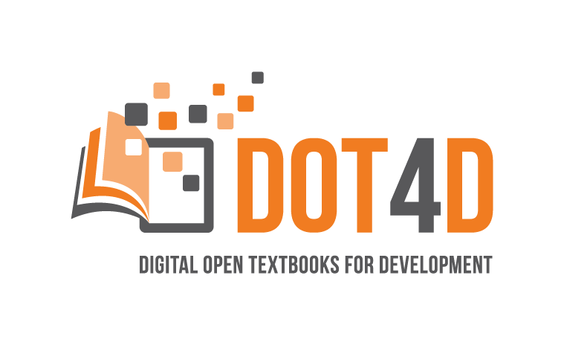
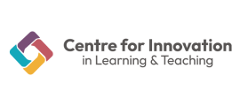

Open textbooks and the empowerment of students as partners in curriculum change
uct teaching and learning conference 2024
by Bianca Masuku & Michelle Willmers
Centre for Innovation in Learning and Teaching
20 November 2024

Slide 2
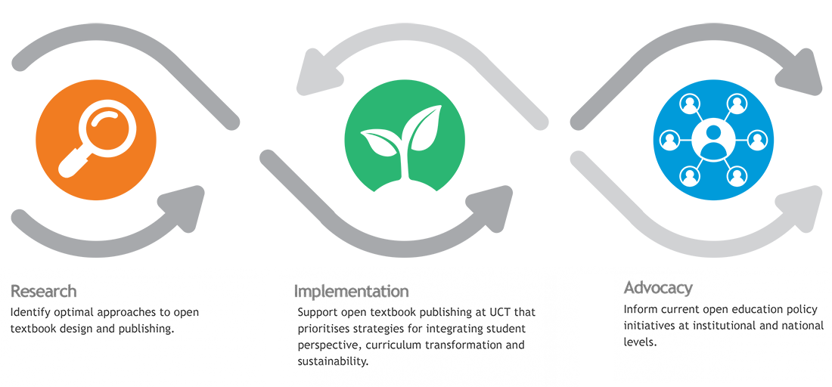
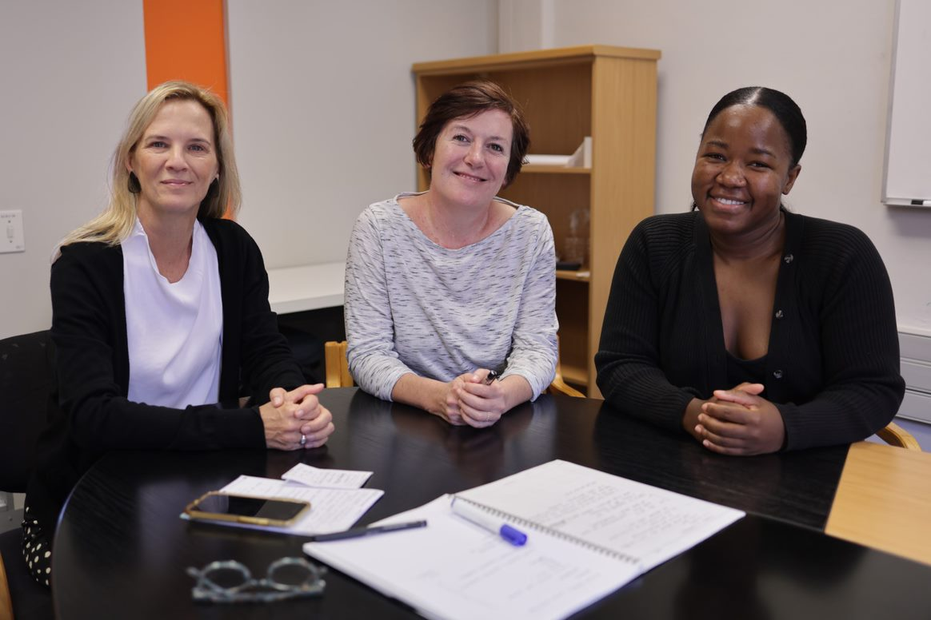
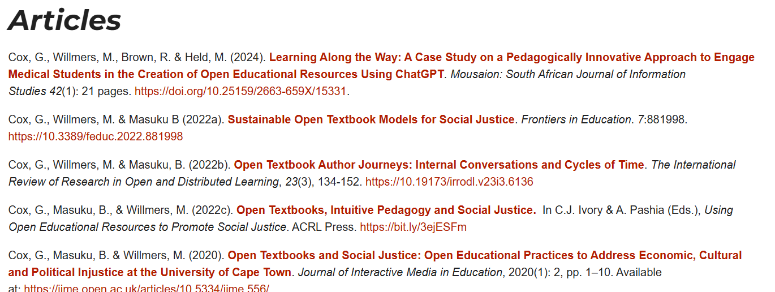
Digital Open Textbooks for Development (DOT4D)
Glenda Cox
Principal Investigator & UNESCO Chair in Open Education and Social Justice
Michelle Willmers
Publishing & Implementation Manager
Bianca Masuku
Researcher

Slide 3
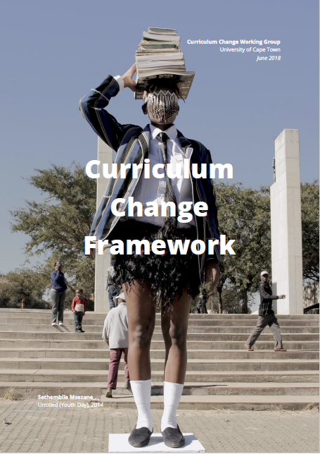
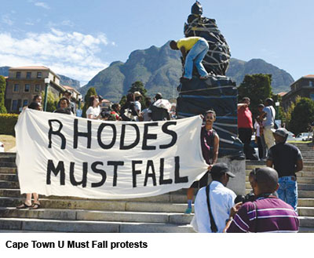
Open textbooks and social justice at UCT
Student protest: Fallist movement (2015–2016) foregrounded demand for (1) the decolonisation of higher education institutions and (2) the provision of free education.
The South African national HE system remains highly inequitable in general for the poor, for people of colour and for all marginalized groups, including women. Symptomatic of a broader, national condition of deep inequality deriving from a long history of colonialism and apartheid.
UCT has a long tradition of open scholarship and is exploring the role of open textbooks and other open educational resources to address social injustices related to curriculum change, multilingualism, access to education and inclusivity as part of it’s Vision 2030 transformation agenda.
Open textbooks provide one means through which to address the power imbalance in higher education by integrating students in curriculum articulation, textbook selection, production and peer review (Cox et al., 2023).
Notes:
Rhodes Must Fall image source: https://africanarguments.org/2021/06/fallisms-faultlines-the-paradoxes-of-fees-must-fall/

Slide 4
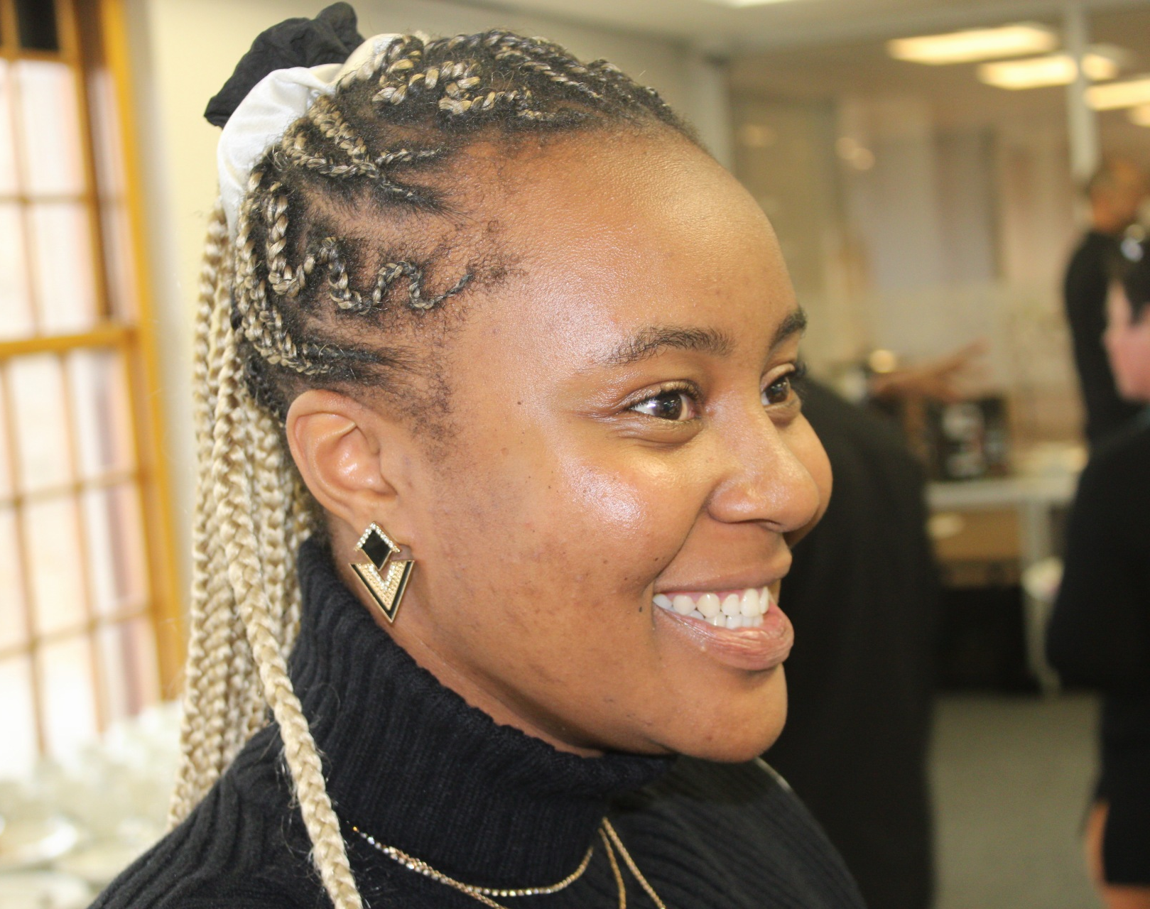
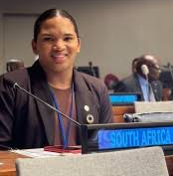
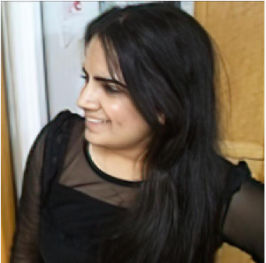
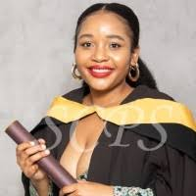
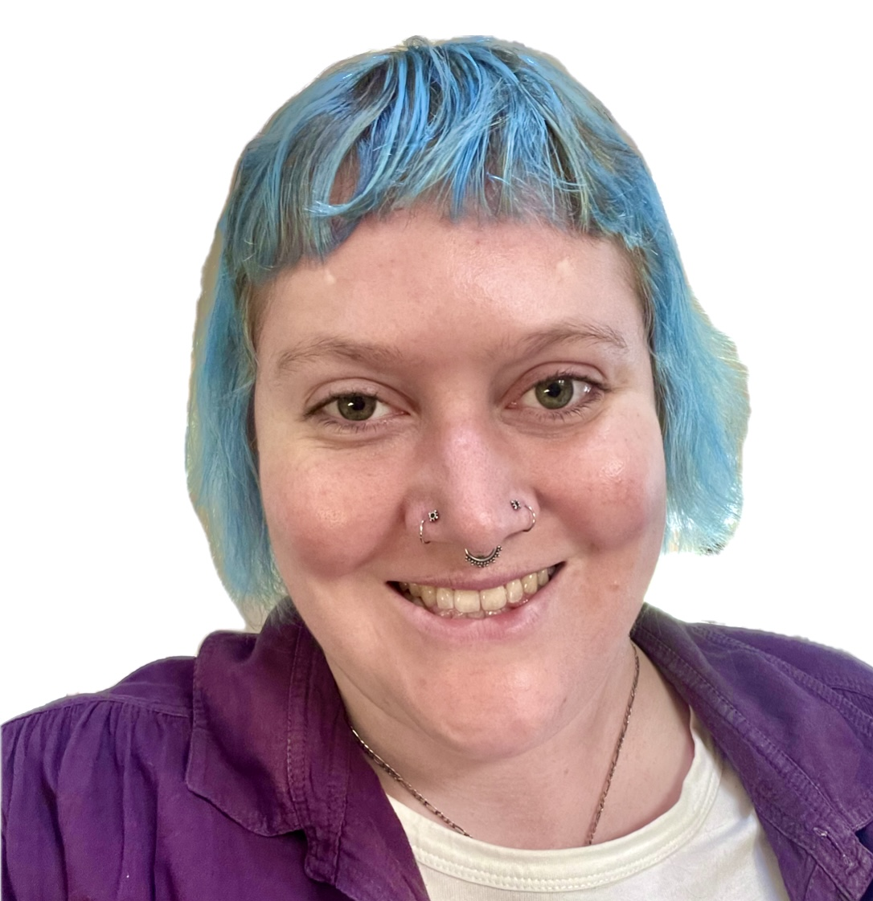
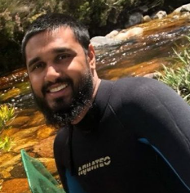
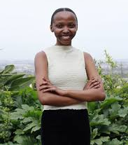
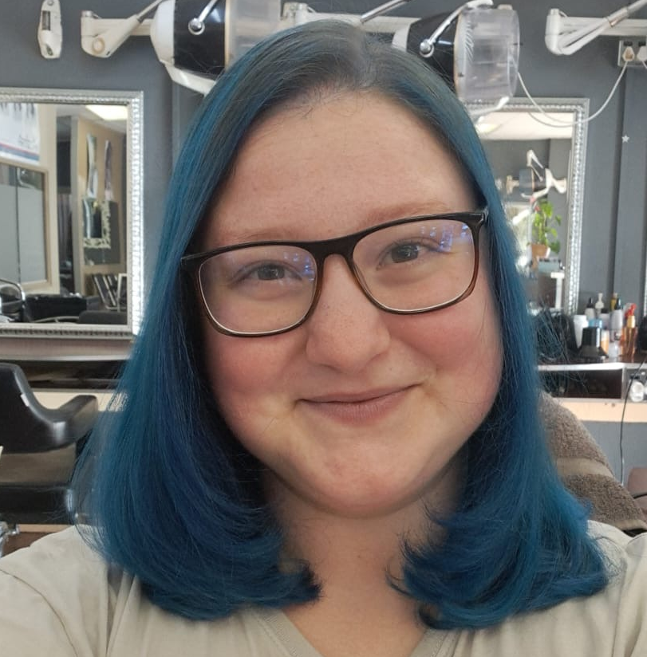
The DOT4D student fellowship initiative
Advocating for the role of student partners in the future of open education in South African higher education
Lauren Grootboom
PhD student, Feminist Studies
Tsatswani Mnisi
Computer Science graduate 2024
Nico Pampier
Master’s student
Naseera Moosa
PhD student & part-time lecuter, Science Faculty
Elizabeth Phahlamohlaka
Anthropology postgrad
Thabang Mara
Electrical Engineering undergrad
Jes Graham
Master’s graduate in Disability Studies, proudly bipolar accessibility designer
Mohammed Kajee
Science Faculty Development Human
Robyn Brown
4th year BSc student
Anthony Boetcher
Engineering undergrad
Lucky Geluk
Humanities undergrad

Slide 5

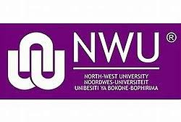
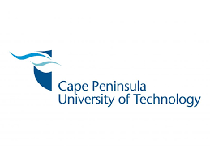
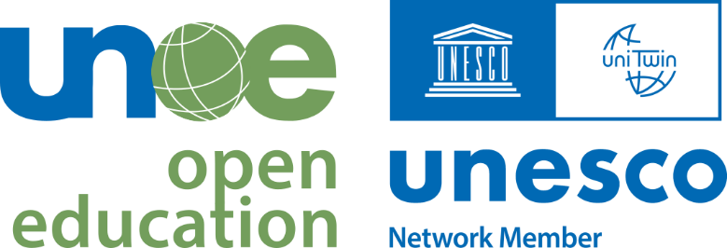

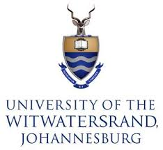
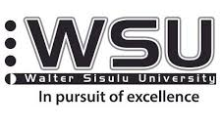
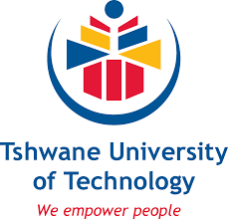

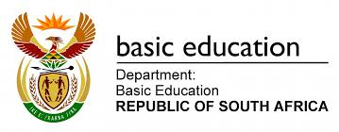

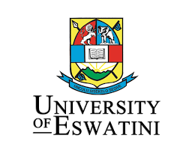
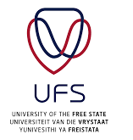
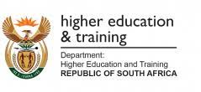
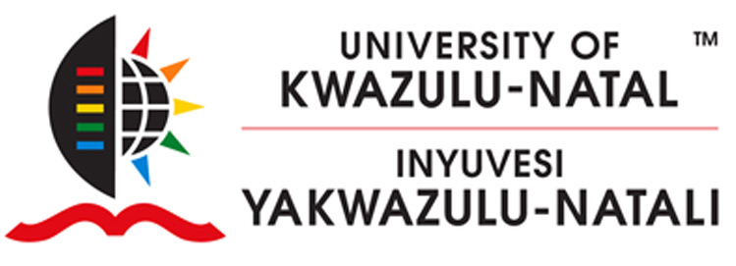
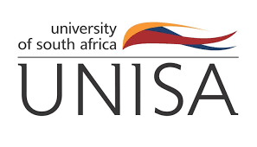
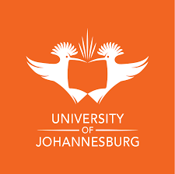

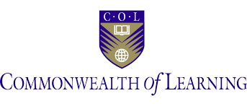
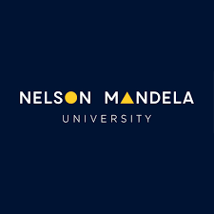

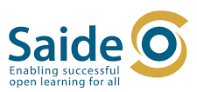



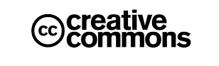
The DOT4D national stakeholder community
Advocating for the role of open education in addressing social injustice in South African higher education
Notes:
TUT, MUT, OEGlobal, WITS, UP, CPUT, UJ, Walter Sisulu, Falsebay college, African Institute for Mathematical Sciences Cameroon, Notre Dame University, DHET, Cape Higher Education Consortium, NMU, Saide, UNESCO, NWU, The Open University, UKZN, Walter Sisulu, Uganda management institute, Mangosuthu University, KFW Digital Constultancy, Unesco, Talarafy, Thekwini TVET College, SADiLaR, University of Fort Hare, Maskew Miller Learning, Gauteng Department of Education
Total of higher education institutions, including 2 colleges: 17 (see next slide for more)

Slide 6

What is a textbook?
A textbook is (to an extent) an embodiment of the curriculum.​ It proposes a structure, order and progression for the delivery of the curriculum.
It presents information relating to the learning outcomes that are mapped to assessment.​
It shapes the classroom experience
(Image source: opensource.com CC BY)
Or can the classroom experience shape the textbook?​
What is an open textbook?
An open textbook is a digital, freely available collection of scaffolded teaching and learning content published under a Creative Commons licence.
The open processes through which they are produced provide affordances for engaging students in collaborative, inclusive authorship, quality assurance and publishing activities.
An open textbook is a guide that can fill gaps in teachers' knowledge.​
An open textbook can accommodate multiple theoretical and epistemological voices/perspectives under an overarching framework.
An open textbook is available for future reference (in perpetuity).

Slide 7
Social justice drivers for open textbook production at UCT
Open textbook production at UCT is typically needs-based and driven by critical examination of current textbooks and other teaching and learning materials – not only in terms of cost, but also the degree to which they are fit for purpose for a diverse range of students in a diverse range of contexts.
Affordable access
Curriculum transformation
Multi-
lingualism
Localisation
Epistemic representation
Valuing IKS
Valuing ways of knowing
Valuing student voice
Global South
voice
Re-imaging of pedagogical approaches
Power-levelling through partnership
Notes:
Key imperatives map to the dimensions presented in Nancy Fraser’s (2005) work on social justice
In our context (DOT4D cohort of grantees), authors/ academics identified particular injustices within their classroom contexts that drove/ encouraged them to adopt open textbook development

Slide 8
Student partnership in open textbook co-creation
Class involvement approach
Whole class
Part of the class: selectively invited
Part of the class: open invitation
Before the textbook production process
In the textbook production process
After the textbook production process
Other
Student roles
Author
Co-editor
Translator
Proposer
Tester
Reviewer
Designer
Typesetter
Illustrator
Proofreader
Editorial assistant
Technical assistant
Curation assistant
Admin assistant
Other
Engagement approach
Structured
Freeform, but with specific roles
Invited everyone, see what happens
Other
Institutional challenges
Publishing expertise
Publishing infrastructure
Support in copyright and licensing
Institutional culture
Student recognition and reward
Financial compensation
Author/editorship status
Marks for coursework
Other
Notes:
Student partnerships in co-creation can extend across all aspects of teaching and learning, from student feedback on aspects of course materials to students co-creating, co-researching and co-designing course materials

Slide 9

Social justice as a framework to understand the potential of open textbooks in curriculum transformation
Numerous studies have highlighted the affordances provided by open textbooks for collaboration, student empowerment and transformation of the curriculum.
(Cox et al. 2020; Cox et al. 2022(a); Bliss et al., 2013; Hilton & Wiley, 2011; Verwoord & Smith, 2020)

Slide 10
Disrupting traditional hierarchies through student partnership in the co-creation of open textbooks
Important practice in acknowledging and promoting student voice in higher education (Cook-Sather, 2014).
Provides social justice opportunities that can “disrupt(s) the reductive teacher-student power hierarchy by granting agency and power to both sides to shape the classroom experience”.
Disruption emphasises student voice and, in doing so, is an act of social justice, particularly in contexts where these same students have been historically marginalised.
In student-staff partnerships, students are invited into a broad range of co-creation activities within their learning environments, they are required to take on different roles with varying degrees of agency, providing an opportunity for them to contribute to knowledge production and curriculum transformation.
These collaborations have the potential to include the perspectives and experiences of students who previously had no voice in higher education. Students are seen, listened to, nurtured, empowered and become creators of knowledge (Gibson & Cook-Sather, 2020). The partnerships open up spaces for dialogue between lecturers and students, and many initiatives compensate students who are in dire need of financial support (Jack, 2019).
“Power, whether discussed or left unspoken, is always a factor in [student partner] interactions” (Matthews, 2017)

Slide 11
Not all partnership roles are equal … and not all roles are equally empowering.
Lecturers have options as to how much agency they hand to students and what roles they will be given.
(Bovill, 2020)
 | AFFIRMATIVE REMEDY |  | TRANSFORMATIVE REMEDY
None | Participatory design | Engagement | Co-creation | Partnership
Parternships shaped by shared values
Trust
Reciprocity
Respect
Shared responsibility
(Cook-Sather et al., 2014)
The advantages of student co-creation are increasingly well documented, but it is important to note that partnerships do not automatically result in equitable and inclusive practices, some students do not feel able to participate (Marquis, Jayaratnam, Mishra & Rybinka, 2018) and not all partnerships are empowering (Healy, Lerczak, Welsh & France, 2019).

Slide 12
DOT4D student co-creation study method
Research study driven by the need to better understand the processes and potential impact of these collaborations if they are to be harnessed and scaled in order to achieve more inclusive higher education.
Cohort
11 student partners who worked with academics in open textbook initiatives at UCT (2019–2024)
Aim
Explore experiences and perspectives of students as partners in open textbook initiatives
Data collection
Nine semi-structured interviews with student partners and two student video reflections
Disciplines
3 x Science
3 x Architecture
3 x Marketing
1 x Mathematics
1 x Orthopaedic surgery
Themes explored
Injustices experienced in the classroom
Potential of open textbooks to address classroom injustice
Values and attitudes
Belonging
Power dynamics
Textbook use
Reward and recognition
Institutional recommendations

Slide 13
Findings: Social injustices in the classroom
Theme | Insight
Economic maldistribution | Students reference societal inequality and income disparity “there's a big difference in what people can access and what opportunities they have” “money is not equal”
Cultural misrecognition | Students highlighted the challenges around language barriers “I started my journey as a senior tutor and got exposure to the way that the language barrier impacts our students; the way that lecturers treat students of colour who don't speak English fluently very differently; the way that the lecturers just go too quickly and there's no real support.”
Political misrepresentation | Students highlighted the challenging power relations that existed between students and their lecturers and how it affected their learning experiences Lacked confidence to voice their concerns, opinions and struggles in class Classrooms were recognised as locations of power hierarchies, in which privileged students had easier access to social belonging, while others were excluded.

Slide 14
Findings: The power of open textbooks to address injustice in the classroom
Theme | Insight
Improving skills | Deeper understanding of course content and better critical thinking skills.
Teaching strategies | Open textbook processes exposed students to more participatory teaching styles, that enabled them to learn in new ways. “It was kind of more like you teach the maths to them, but you teach it through a story, and this story tells them why it's important to do what they're doing, which is always like important to know when in university.”
Empowerment | - Collaboration allowed for the creation of a safe space. - Open textbook partnerships and skills gained gave them the ability to grow their ability to speak their own ideas, building their sense of agency. - Awareness and critiquing of Global North content. “once you know how to think and how to speak and how to get your voice across, then you can take this Global North and then reinterpret it”

Slide 15
Findings: The power of partnership in publication
Theme | Insight
Student confidence and the (in)ability to challenge authority | Struggles with challenging authority in the student-staff partnership and navigating power dynamics with regards to speaking up in their collaborative endeavours. “I struggle with authority figures and … speaking up. […] So then I just stay quiet, because it never feels like it's like a polite time to say anything. And then before you know, the whole conversation's moved on.”
Expectations of reward as relates to power dynamics | Some had little or no expectation of financial remuneration, seeing participation in the textbook process as a beneficial experience remuneration = ”a nice added thing” However, some feel that they made substantial contributions remuneration = “only fair” /“provide financial relief” Advocating for students to be given co-authorship for any contribution they made in a textbook partnership process

Slide 16
The power of partnership in publication (cont.)
Theme | Insight
Expectations of reward as relates to power dynamics | Student positions on remuneration and recognition reflected their negotiations of power in student-staff partnerships and were shaped by their experiences, needs, understandings and politics around the partnerships they were engaged in.
The power of being acknowledged in publication | Recognition in the textbook process allowed them to “bring their story to the table”. Power in being acknowledged by name as an author, editor or collaborator in publication, in that it reflected their participation and provided them with a sense of ownership and being able to claim kudos from being part of process.

Slide 17

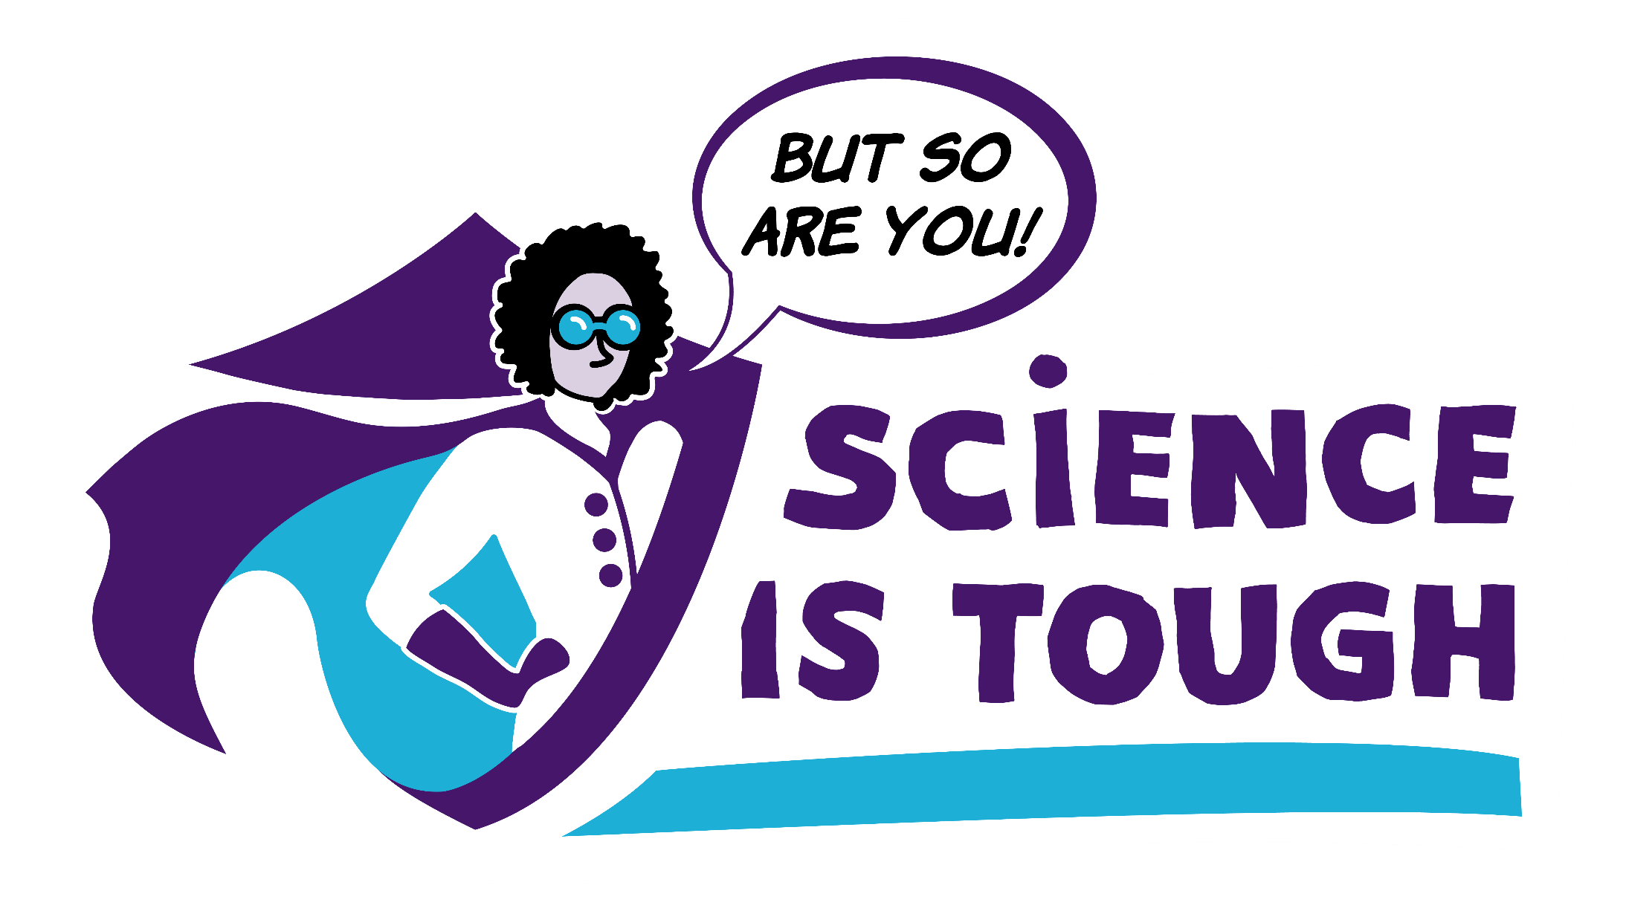
Case study

Slide 18

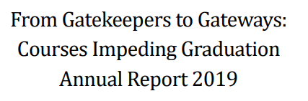

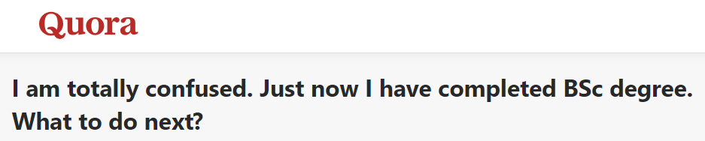
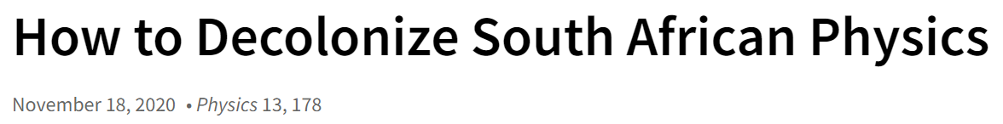
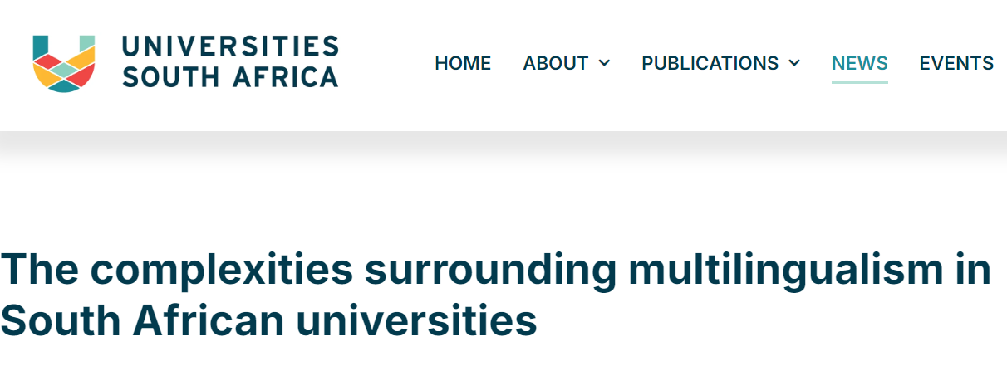
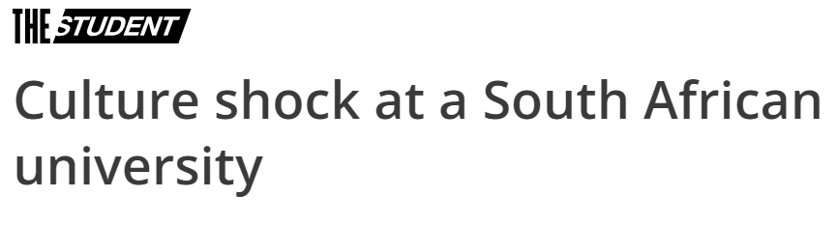
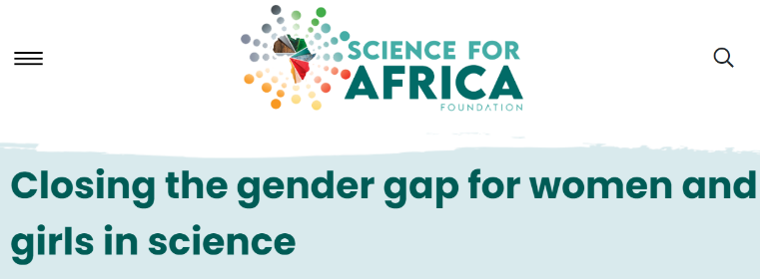
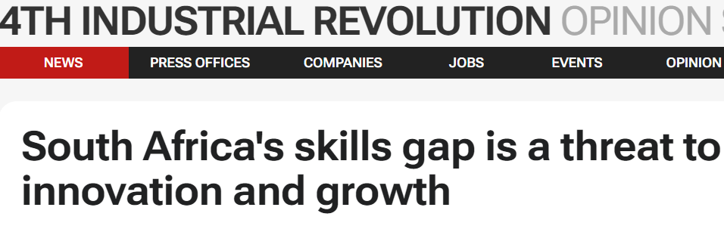
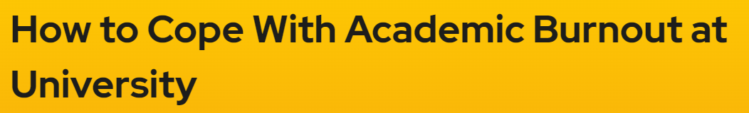
What is the problem we are trying to address?
Notes:
https://futurumcareers.com/six-ways-to-overcome-the-stem-crisis-in-south-Africa
https://www.timeshighereducation.com/student/blogs/culture-shock-south-african-university
https://www.topuniversities.com/student-info/health-support/how-cope-with-academic-burnout-university
https://scienceforafrica.foundation/media-center/closing-gender-gap-women-and-girls-science

Slide 19

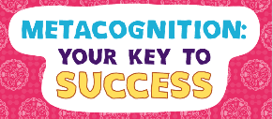
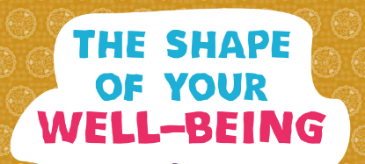
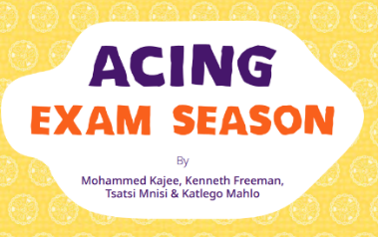
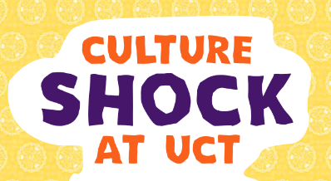


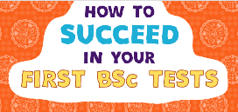

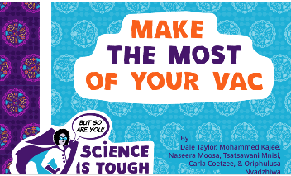
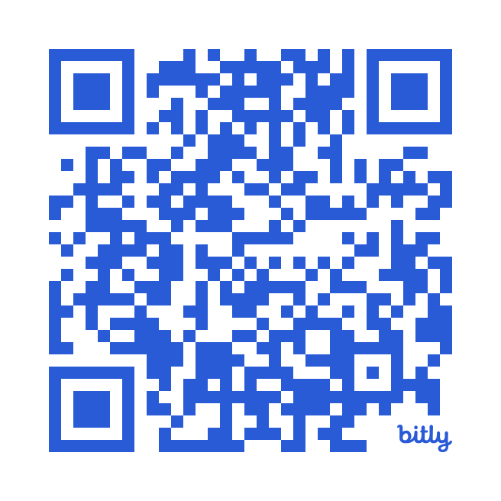
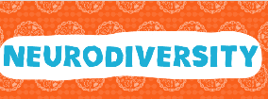

Aim
Inspire first-year BSc students to take charge of their learning, stay engaged and connect conceptual knowledge to real-life experiences
“student co-authorship to bring lived realities into the resource and highlight student voice on challenging topics”
Notes:
Led by A/Prof Dale Taylor as part of a UCDG-funded initiative on ‘Tutoring Towards Academic Resilience’ (linked to curriculum development)
Linked to Orientation Week guidance programme focused on intersectionality and building students’ sense of belonging

Slide 20
Student participation in co-creation activities (n = >70)
WRITING WORKSHOPS FOCUSED ON SCOPING TOPICS
(voluntary, topics self-selected)
SCOPING
WORKSHOP
EDITORIAL REFINEMENT
PUBLICATION
LANGUAGE TRANSLATION
REVIEW
IMAGE PRODUCTION

Slide 21
Textbook
Textbook
Curriculum
Curriculum
Classroom
Classroom
Student
Student
The textbooks as a vehicle for curriculum received vs curriculum co-created

Slide 22
Case study insights
Values and attitudes
“…that's one aspect I think like if you're doing an open textbook and you're including students, then you need to actually walk the walk, right? You can't say like, ‘oh, it's my book. I'm going to tell you what goes in there.’ If the student voice wants it to be changed, then it should change.”
“We're going out of our way to try to make sure that this journey is inclusive. And I think all educational textbooks have to do that. You cannot study science or humanities or engineering or medicine without understanding the political context in which those fields were created.”
Experience of collaboration and power of authorship/attribution)
“[I’ve gained] quite a lot of self-confidence in having a job that I'm like proud of and everything. So, taking that away and a lot of independence from earning money, [I] honestly… encountered quite a lot of like joyfulness and enjoying what I'm doing and like I think very fondly of my [open textbook] work… And maybe going forward, I'll learn how to hold my own in meetings with people that talk a lot if I work on that. And also, I really appreciate having the experience, and to be like given this experience, so that I could like learn new skills and practice new skills and be able to apply it in the future like you know, put on my CV.”

Slide 23
Conclusion
Higher education systems and procedures are in opposition to partnerships and there would need to be a shift in underlying power dynamics.
There are powerful benefits relating to curriculum change and transformation experienced when the traditional hierarchies between students and lecturers are challenged and diffused through collaborative open textbook development processes.
Open textbook co-creation partnerships provide opportunities for dialogue, safety and reciprocity, where students feel empowered and heard.
Attribution through authorship in textbook processes is appreciated by students. It becomes part of their professional identity (“part of their lives”) and enables them to “own” their academic journeys.

Slide 24
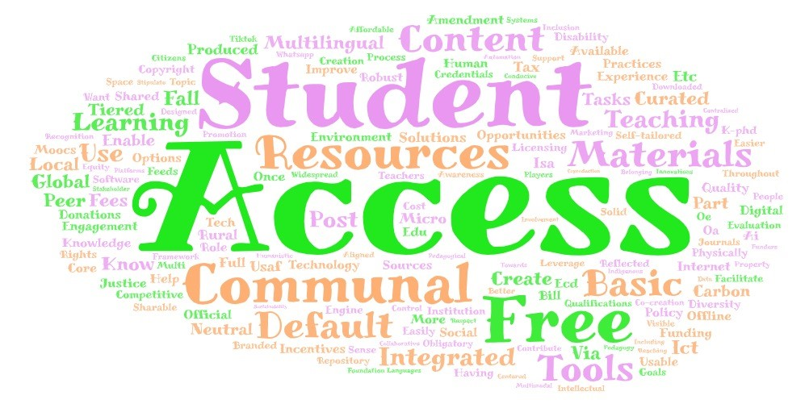
New visions and future directions…
“The classroom remains the most radical space of possibility in the academy” in terms of levelling power dynamics and promoting inclusion of marginalised voices”
“openness of mind and heart”
“collectively imagine ways to move beyond boundaries”

Slide 25
References
Cox, G., Masuku, B. & Willmers, M. (2023). Student Co-Creation of Open Textbooks: Reflections on Power Dynamics and Building a Sense of Belonging in Higher Education. Open/Technology in Education, Society, and Scholarship Association Journal, Vol. 3(2) 1-15.
Cox, G., Masuku, B. & Willmers, M. (2020). Open Textbooks and Social Justice: Open Educational Practices to Address Economic, Cultural and Political Injustice at the University of Cape Town. Journal of Interactive Media in Education, 2020(1): 2, pp. 1–10. Available at: https://jime.open.ac.uk/articles/10.5334/jime.556/
Cox, G., Willmers, M. & Masuku B (2022a). Sustainable Open Textbook Models for Social Justice. Frontiers in Education. 7:881998. https://10.3389/feduc.2022.881998
Bliss, T., Hilton, J., Wiley, D., and Thanos, K. (2013). The cost and quality of online open textbooks: perceptions of community college faculty and students. First Monday 18. doi: 10.5210/fm.v18i1.3972
Hilton, J., and Wiley, D. (2011). Open access textbooks and financial sustainability: a case study on Flat World Knowledge. Int. Rev. Res. Open Distance Learn. 12, 18–26. doi: 10.19173/irrodl.v12i5.960
Verwoord, H., & Smith, H. (2020). The P.O.W.E.R. framework. In L. Mercer-Mapstone & S. Abbot (Eds.), The power of rwoord & Smith, 2020partnership: Students, staff, and faculty revolutionizing higher education. Elon University Center for Engaged Learning. https://doi.org/10.36284/celelon.oa2.
Cook-Sather, A. (2014). Student-faculty partnership in explorations of pedagogical practice: a threshold concept in academic development. International Journal for Academic Development, 19(3), 186–198. https://doi.org/10.1080/1360144X.2013.805694
Gibson, S., & Cook-Sather, A. (2020). Politicised compassion and pedagogical partnership: A discourse and practice for social justice in the inclusive academy. International Journal for Students as Partners, 4(1):16–33. https://10.15173/ijsap.v4i1.3996
Jack, A. A. (2019). The privileged poor: How elite colleges are failing disadvantaged students. Harvard University Press.
Marquis, E., Jayaratnam, A., Mishra, A., & Rybkina, K. (2018). “I feel like some students are better connected”: Students’ perspectives on applying for extracurricular partnership opportunities. International Journal for Students as Partners, 2(1), 64–81. https://doi.org/10.15173/ijsap.v2i1.3300
Matthews, K.E. (2017). Five propositions for genuine students as partners practice. International Journal of Students as Partners, 1(2):1–9.
Healey, R. L., Lerczak, A., Welsh, K., & France, D. (2019). By any other name? The impacts of differing assumptions, expectations, and misconceptions in bringing about resistance to staff-student partnership. International Journal for Students as Partners, 3(1) https://doi.org/10.15173/ijsap.v3i1.3550
Bovill, C. (2020). Co-creation in learning and teaching: the case for a whole class approach in higher education. High. Educ. 79, 1023–1037. doi: 10.1007/s10734-019-00453-w

