Slide 1
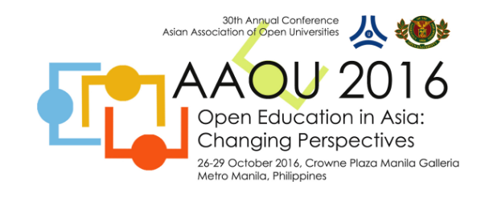



Publishing in the open
Laura Czerniewicz
@czernie
26 October 2016

Slide 2
Which discipline do you work in?
Is research part of your job?
What online profile do you have?
What publishing have you done?
Journal articles? Conference proceedings?
How important is publishing to you?
How important is being online to you?

Slide 3
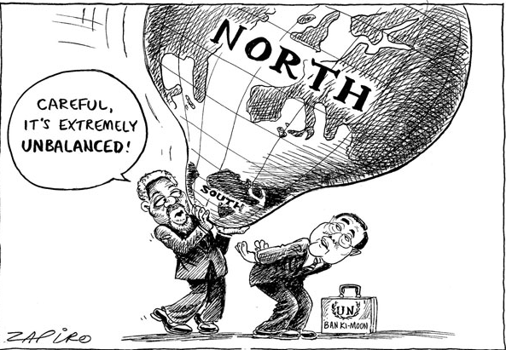
The context
http://www.un.org/en/events/humanrightsday/udhr60/exhibit.shtml
A very unequal world

Slide 4
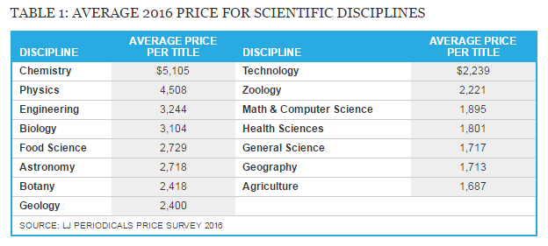
The context
Extremely expensive & increasingly expensive research publications
Notes:
http://lj.libraryjournal.com/2016/04/publishing/fracking-the-ecosystem-periodicals-price-survey-2016/#_
Fracking the Ecosystem | Periodicals Price Survey 2016
By Stephen Bosch and Kittie Henderson on April 21, 2016

Slide 5
All scholarship is becoming more open

Slide 6
The scholarship process
Conceptualisation
Data Collection
Findings
Engagement
Translation
Data Analysis
Discipline- specific forms

Slide 7
Scholarship forms
Conceptualisation
Data Collection
Findings
Engagement
Translation
Data Analysis
Scholarship of teaching
Scholarship of discovery
Scholarship of engagement
Boyer, E (1990) Scholarship Reconsidered
Notes:
Boyer's model of scholarship is In the 1990 publication "Scholarship Reconsidered", Ernest Boyer introduced an academic model advocating four types of scholarship.^{[1][2]} According to Boyer, traditional research, or the scholarship of discovery, had been the center of academic life and crucial to an institution's advancement but it needed to be broaden and made more flexible to include not only the new social and environmental challenges beyond the campus but also the reality of contemporary life. His vision was to change the research mission of universities by introducing the idea that scholarship needed to be redefined.
He proposed that scholarship include these four different categories:
The scholarship of discovery that includes original research that advances knowledge.
The scholarship of integration that type involves synthesis of information across disciplines, across topics within a discipline, or across time.
The scholarship of application (also later called the scholarship of engagement) that goes beyond the service duties of a faculty to those within or outside the University and involves the rigor and application of disciplinary expertise with results that can be shared with and/or evaluated by peers.
The scholarship of teaching and learning that the systematic study of teaching and learning processes. It differs from scholarly teaching in that it requires a format that will allow public sharing and the opportunity for application and evaluation by others.

Slide 8
Content & audiences
Student
Literature Reviews
Conceptual Frameworks
Bibliographies
Conceptualisation
Data Collection
Findings
Engagement
Translation
Data Analysis
Proposals
Notes
Recorded interviews
Lectures
Data sets
Presentations
Images
Reports
Audio records
Community
Interviews
Books
Conference papers
Journal articles
Technical papers
Scholar

Slide 9
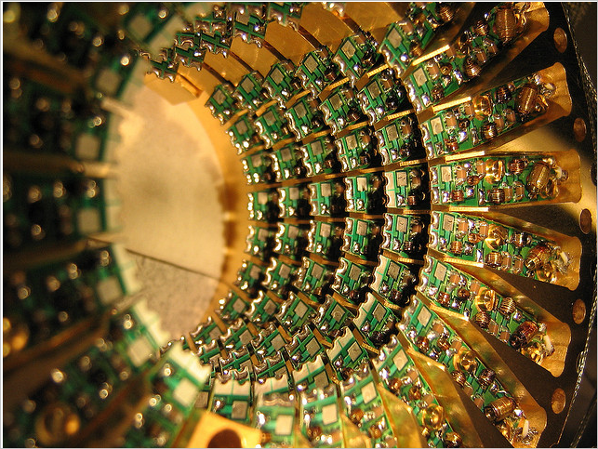
Change
In all phases & processes
http://www.flickr.com/photos/jurvetson/373985022/in/set-53754
Notes:
http://www.flickr.com/photos/jurvetson/373985022/in/set-53754

Slide 10
Changing scholarship: conceptualisation
Individual
Private
Literature Reviews
Conceptual Frameworks
Bibliographies
Conceptualisation
Data Collection
Findings
Engagement
Translation
Data Analysis
Proposals
Notes
Recorded interviews
Lectures
Data sets
Presentations
Images
Reports
Audio records
Interviews
Books
Conference papers
Journal articles
Technical papers

Slide 11
Changing scholarship: conceptualisation
Individual
Private
Literature Reviews
Conceptual Frameworks
Bibliographies
Shared and shareable
Eg social bookmarking,
(Delicious, CitULike, Mendeley)
Conceptualisation
Data Collection
Findings
Engagement
Translation
Data Analysis
Proposals
Notes
Recorded interviews
Lectures
Data sets
Presentations
Images
Reports
Audio records
Interviews
Books
Conference papers
Journal articles
Technical papers

Slide 12
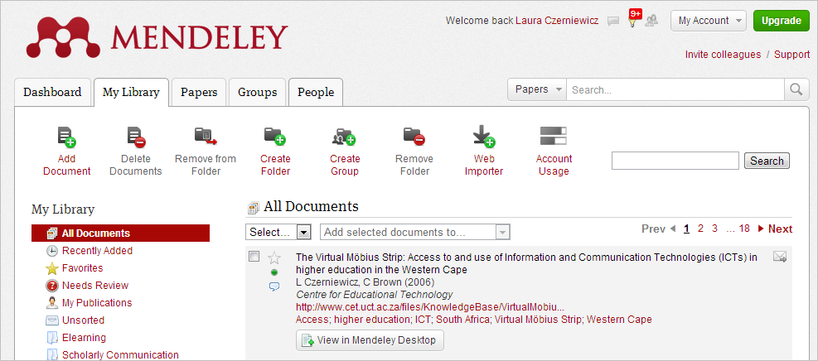
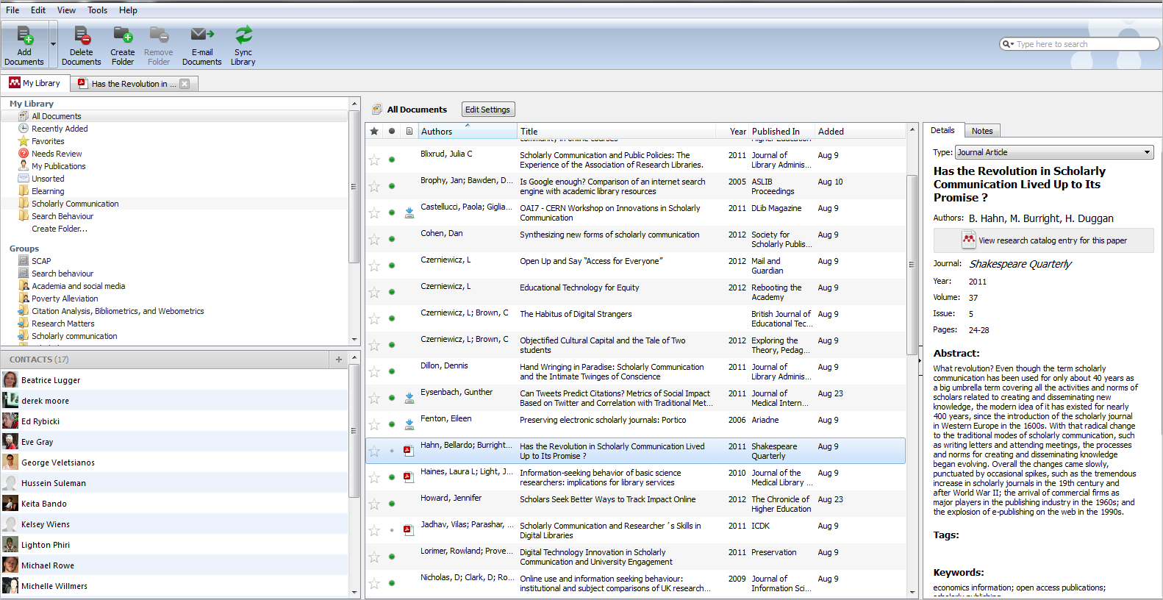
Example: Mendeley

Slide 13
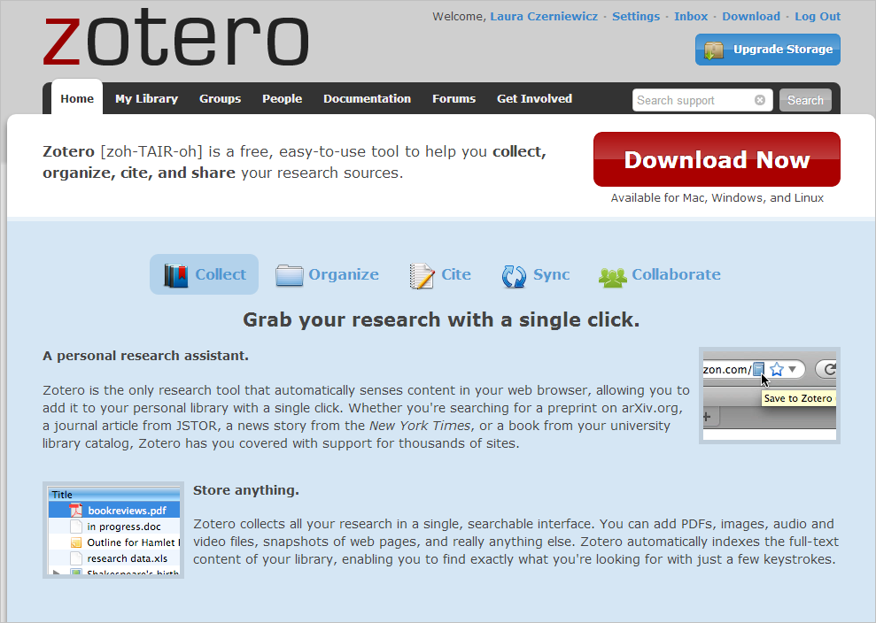

Slide 14
Changing scholarship: data collection & analysis
Not in a shareable form
Possibly not digitised
Data not curated
Scholars collect data
Literature Reviews
Conceptual Frameworks
Bibliographies
Conceptualisation
Data Collection
Findings
Engagement
Translation
Data Analysis
Proposals
Notes
Recorded interviews
Lectures
Data sets
Presentations
Images
Reports
Audio records
Interviews
Linked data
Curated data
Shareable data
Text mining
Big data
Digital humanities
Crowd sourcing
Books
Conference papers
Journal articles
Technical papers

Slide 15
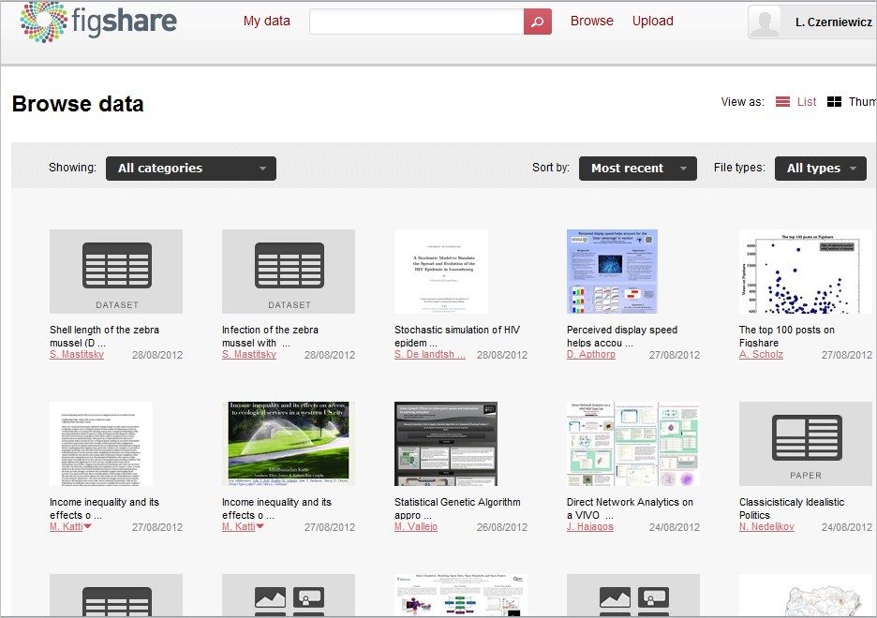
Notes:
figshare allows researchers to publish all of their research outputs in seconds in an easily citable, sharable and discoverable manner. All file formats can be published, including videos and datasets that are often demoted to the supplemental materials section in current publishing models. By opening up the peer review process, researchers can easily publish null results, avoiding the file drawer effect and helping to make scientific research more efficient. figshare uses creative commons licensing to allow frictionless sharing of research data whilst allowing users to maintain their ownership.
figshare gives users unlimited public space and 1GB of private storage space for free.
figshare is based in based in London and is supported by Digital Science. Digital Science’s relationship with figshare represents the first of its kind in the company’s history: a community- based, open science project that will retain its autonomy whilst receiving support from the division.

Slide 16
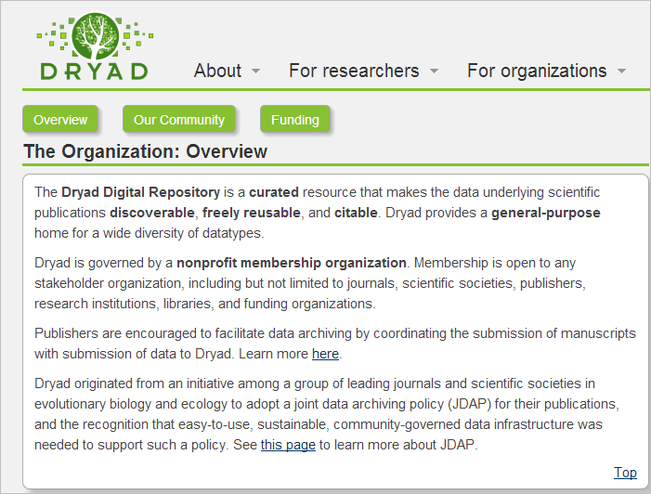
Notes:
As of Apr 14, 2013, Dryad contains 3015 data packages and 8629 data files, associated with articles in 209 journals.

Slide 17
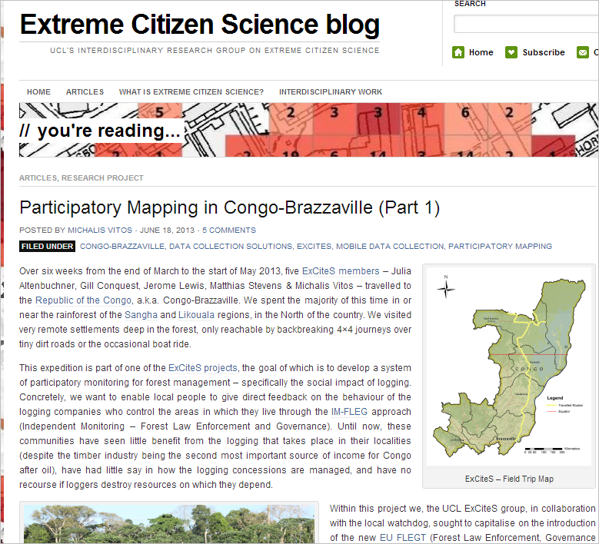
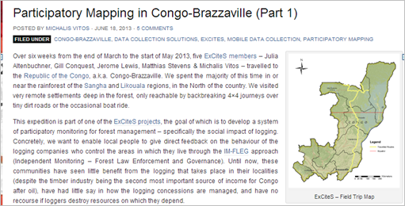
Citizen science

Slide 19
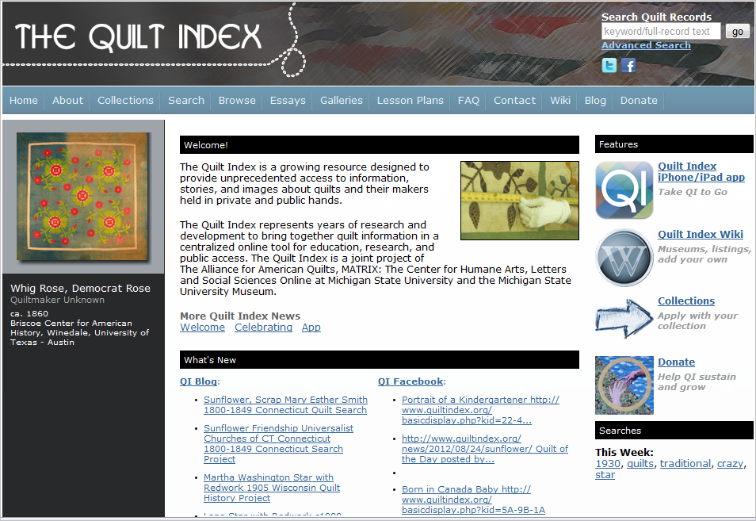
Analyse 52 000 quilts from four centuries
Notes:
Here at the Quilt Index, tradition meets technology head-on, allowing you to use your computer to see and study more than 52,000 quilts from four centuries.

Slide 20
Changing scholarship: findings
Literature Reviews
Conceptual Frameworks
Bibliographies
Conceptualisation
Data Collection
Findings
Engagement
Translation
Data Analysis
Proposals
Notes
Recorded interviews
Lectures
Data sets
Presentations
Images
Reports
Audio records
Interviews
Stable authoritative text-based versions
Books
Conference papers
Journal articles
Technical papers
Dynamic multimodal versions, the rise of rich media

Slide 21
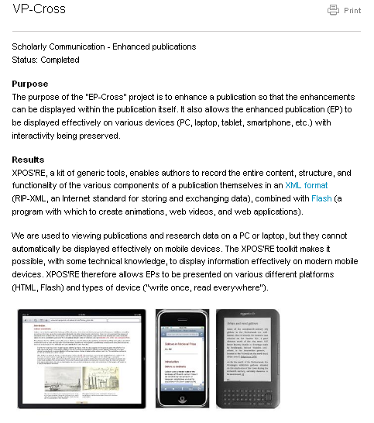
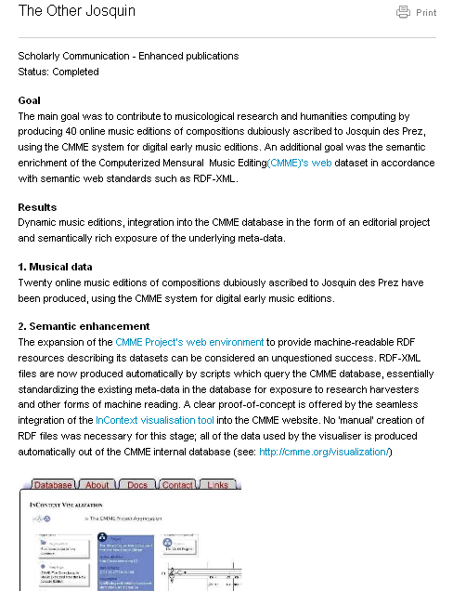
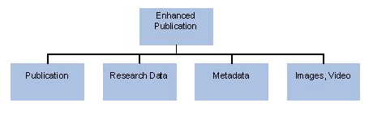
New kinds of articles
http://www.surffoundation.nl/en/themas/openonderzoek/verrijktepublicaties/Pages/default.aspx

Slide 22
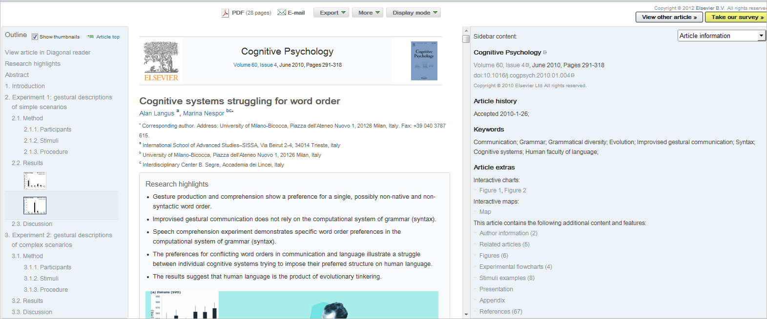
New kinds of articles

Slide 23
New kinds of Journals
Notes:
http://survivingmyphd.blogspot.co.uk/2012/04/post-journal-era.html
Priem, J., & Hemminger, B. (2012). Decoupling the
The PLoS One model
PLoS One is an open access journal which publishes work not according to what the editors and reviewers consider significant, but consider only the paper's methodological quality. They decoupled the significant approval from the methodological approval. PLoS One also decoupled copy-editing: they warn in advance that they don't copy-edit in details, and instead provide a list of services which do just that. This model has proven to be profitable: PLoS One published more than 5,000 papers in 2010 at 1350$ each (and the other PLoS journals charge even more). The flaws here, beyond the price, are the exclusivity: authors publish only in one journal, and the danger of a future with only a few mega-journals. Post-publication review services There are a few existing post-publication peer review services, the best-known of them are Faculty of 1000 (F1000) and Mathematical Reviews. F1000 "...identifies and evaluates the most important articles in biology and medical research publication." F1000 is supposed to function as additional help for researchers in managing their reading. It has actually been shown to identify quality papers which were overlooked by leading journals (Allen et al., 2009).
scholarly journal Frontiers in Computational Neuroscience, 6 DOI: 10.3389/fncom.2012.00019

Slide 24
Changing scholarship: engagement & translation
Expensive textbooks
Online resources access limited to course students only
Lectures limited (time, place, audience)
Literature Reviews
Conceptual Frameworks
Bibliographies
Conceptualisation
Data Collection
Findings
Engagement
Translation
Data Analysis
Proposals
Notes
Recorded interviews
Lectures
Data sets
Presentations
Images
Reports
Audio records
Interviews
Books
Conference papers
Journal articles
Technical papers

Slide 25
Changing scholarship: engagement & translation
Expensive textbooks
Online resources access limited to course students only
Literature Reviews
Conceptual Frameworks
Bibliographies
Conceptualisation
Data Collection
Findings
Engagement
Translation
Data Analysis
Proposals
Notes
Recorded interviews
Lectures
Data sets
Presentations
Images
The rise of open education resources (OERs), open etextbooks, open lectures etc
Reports
Audio records
Interviews
Books
Conference papers
Journal articles
Technical papers

Slide 26
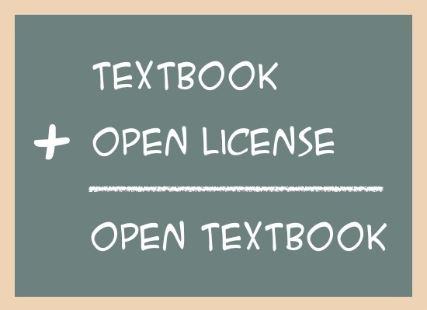

Slide 27








Open sources for textbooks
Notes:
10 Sources for Free Textbooks Online
http://currikiblog.wordpress.com/2010/08/31/10-sources-for-free-textbooks-online/
Posted on August 31, 2010 by Curriki |
School days are upon us again, and for many this means gaping holes in our wallets; not because of back-to-school clothes shopping, but because of a much more essential element of education: textbooks. For many students, the greatest impediment to learning is the price of these required books.
Here are 10 websites that have collected hundreds of textbooks and are providing them for free, giving every child an equal opportunity to lean!
Bookboon provides free online textbooks for students in PDF format. A range of subjects are available, and content is presented at a university level.
Curriki is a hub for free, open course materials. Find thousands of course materials in a variety of subjects and grade levels, including free courses and textbooks.
Flat World Knowledge has free online textbooks in business, the humanities and the sciences that are available to both teachers and students.
Flexbooks are free, easy to update and easy to customize. The CK-12 Foundation provides FlexBooks free to anyone who wants to use them.
Free High School Science Texts are just that: an extensive collection of free science and mathematics texts that are available to students, world wide.
Free Digital Textbook Initiative has a collection free and open textbook resources that are aligned to California content standards.
Open Culture has a collection of 150 free textbooks from Art History to Physics and Business. Stay tuned for more additions!
Open Textbooks provided by the Community College Consortium for Open Educational resources include more than 500 open textbooks in a variety of subjects.
Project Gutenberg is the place where you can download 33,000 free books! This is a great resource for Literature classes and books for young children.
Worldwide Mathematics offers free mathematics textbooks in Calculus and Mutli-Variable Calculus, and includes free lecture series to accompany the content.

Slide 28
Changing scholarship audiences & dissemination
Literature Reviews
Conceptual Frameworks
Bibliographies
Conceptualisation
Data Collection
Findings
Engagement
Translation
Data Analysis
Proposals
Notes
Recorded interviews
Lectures
Data sets
Presentations
Images
Reports
Audio records
Interviews
Books
Conference papers
Journal articles
Technical papers
Clearly demarcated audiences
Online content
available to all & open process
Scholar
Community
Student

Slide 29
Example: PubMed Central
2 million full-text articles
420,000 unique users per day
25% universities
18% government (& related)
40% citizens
17% companies
NIH repository for peer-reviewed primary research reports in the life sciences.
August 2012

Slide 30
Changing scholarship: engagement & translation
Literature Reviews
Conceptual Frameworks
Bibliographies
Conceptualisation
Data Collection
Findings
Engagement
Translation
Data Analysis
Proposals
New ways of measuring impact and influence
Notes
Recorded interviews
Lectures
Data sets
Presentations
Images
Reports
Audio records
Interviews
Books
Conference papers
Journal articles
Technical papers

Slide 31
Scholarly processes The emergence of open research
Conceptualisation
Data Collection
Findings
Engagement
Translation
Data Analysis
Discipline- specific forms

Slide 32
Open Research
Replicable (transparency - method)
Reusable (results free for re-use and appropriation)
Replayable (tools available for appropriation)
Referenceable

Slide 33
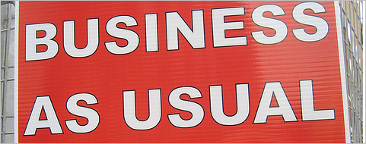

Slide 34
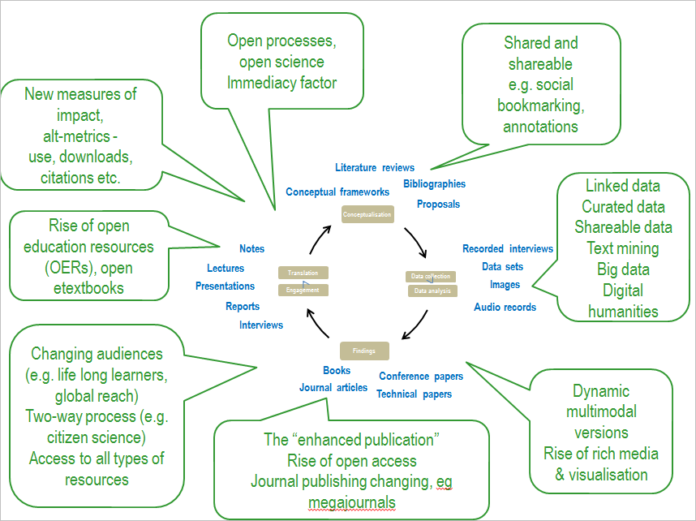

Slide 35
What experiences do you have of open scholarship?

Slide 36
Open access publishing

Slide 37
What have your experiences with open access publishing been to date?
What are your concerns about open access publishing?

Slide 38
What is open access?
Open Access (OA) scholarly resources are free of charge to the reader
OA is supported by open licensing
OA often refers to journals, can apply to all scholarly content

Slide 39
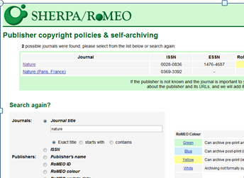
Types of Open Access The Green Route
Self archiving
Institutional Repositories
Subject Repositories
Departmental, research project, individual websites
Archiving of a version
Check Sherpa Romeo
http://www.sherpa.ac.uk/romeo/index.php
http://blogs.lse.ac.uk/impactofsocialsciences/2016/09/19/ what-it-means-to-be-green-exploring-publishers-changing- approaches-to-green-open-access/
Notes:
RePEc (Economic science)
E-LIS (Library and information Sciences & documentation)

Slide 40
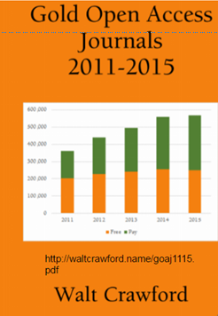
Types of Open Access The Gold Route
Publishing in OA journals
Commercial
Society (numerous)
Universities
Rapid growth of open access publishing
Many (most) do not charge APCs

Slide 41
How to Judge a Journal
(and what about predatory journals?)

Slide 42
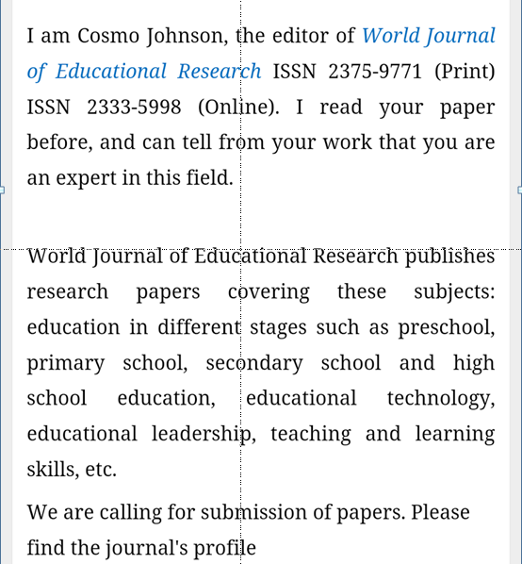
A typical example
What do you think?
Thanks to Maha Bali for this example

Slide 43
From “how to recognise a sham journal”
Searching in the box marked “Search this journal” on the journal web page for the name of an author of an article in a recent issue of the journal does not return any hits.
Clicking on a link like this on the journal web site leads to a spoof site
No specific person is identified as the editor of the journal or the person who appears to be identified as the journal’s Editor on the web site says he is not the editor.
Google Maps searches for the address of journal shows its headquarters is in a suburban bungalow.
The journal’s mission on its home page is described in vague, generic terms.”
When you call the local phone number for the journal office listed on the web page, any of these happen: 1. No one answers. 2. Someone answers “hello?” on what sounds like a cell phone and hangs up as soon as they hear you speaking. 3. The call is forwarded to the 800 phone bank for the publisher, and the person on the other end cannot tell you the name of the editor of the journal.
The journal issues and posts online certificates with hearts around the border that certifies you as “the prestigious editorial board member of [name of journal here].”
How to recognise a sham journal - http://blogs.plos.org/mindthebrain/2014/09/24/top-eleven-ways-tell-journal-fake/

Slide 44
Why does it matter?
Open Access

Slide 45
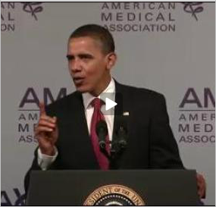
Value of open access
Openness enables development
“….too many doctors and patients are making decisions without the benefit of the latest research.”
Obama 2009
Notes:
http://www.righttoresearch.org/learn/whyOA/index.shtml

Slide 46
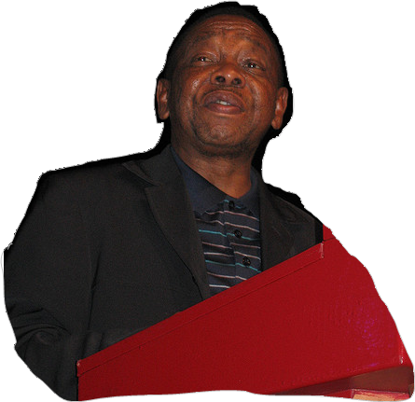
Value of open access
Openness enables participation
African universities are essentially consumers of knowledge produced in developed countries.
Minister of Higher Education, Blade Nzimande UNESCO Conference on Higher Education, 2009

Slide 47

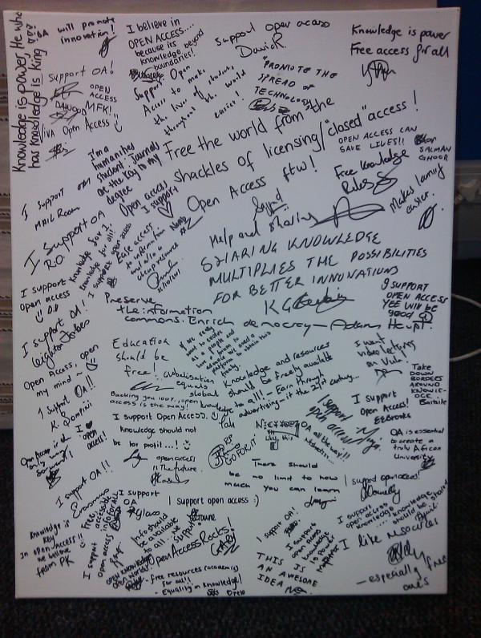
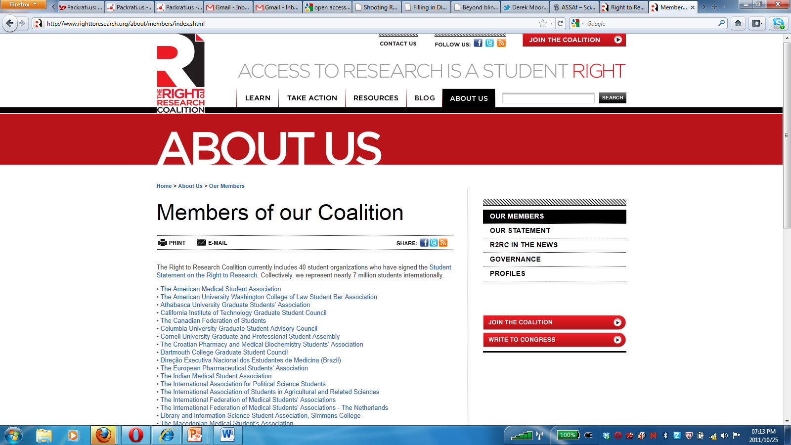
Value of open access
Openness is essential for all students & ex-students
Notes:
7 million students internationally, canvas on right University of Cape Town students during Open Access Week October 2011

Slide 48
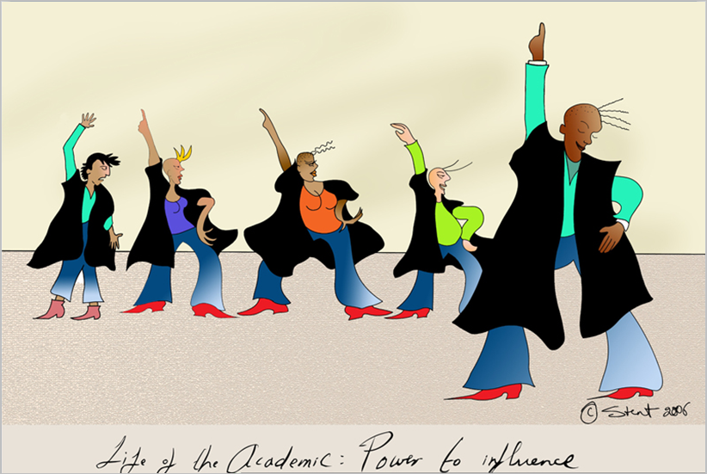
Openness enables visibility
Notes:
Stacey Stent

Slide 49
The OA advantage
(a) A General OA Advantage: the advantage that comes from citable articles becoming available to audiences that had not had access to them before, and who would find them citable
(b) An Early Advantage: the earlier an article is put before its worldwide potential audience may affect subsequent citation patters
(c) A Selection Bias: authors make their better articles Open Access more readily than their poorer articles
(d) A Quality Advantage: better articles gain more from the General OA Advantage because they are by definition more citable than poorer articles
Swan A (2010) The Open Access Citation Advantage: Studies and Results to Date. Available at http://eprints.ecs.soton.ac.uk/18516/

Slide 50
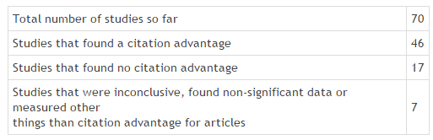
Open Access citation advantage
See all studies at http://sparceurope.org/oaca_table/

Slide 51
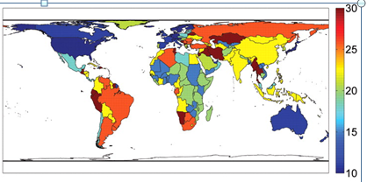
OA impact: developing countries
The influence of free access on citations is twice as large for the poorer countries in the developing world compared to richer countries as measured by per capita GNI (Evans and Reimer 2009).
Notes:
(C) Global projection of percentage increase in citations for GNI country deciles of the poorest country hosting a citing author after free online availability.
Evans and Reimer
J A Evans, J Reimer Science 2009; 323:1025-1025

Slide 52
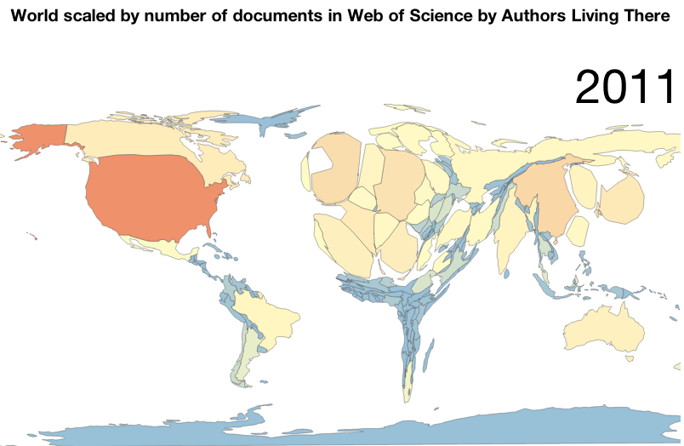
World scaled by the number of documents in Web of Science by authors living there (2011)
http://jalperin.github.io/d3-cartogram/

Slide 53
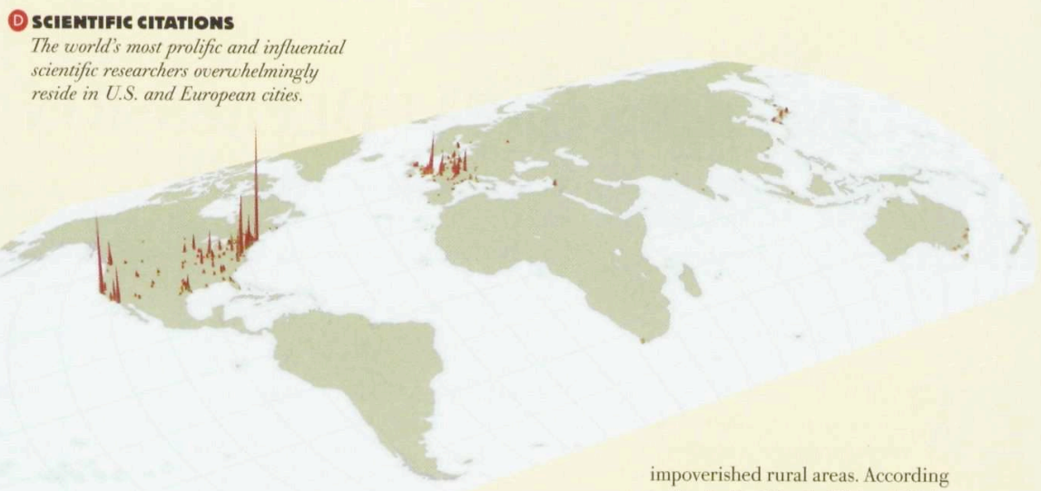
(Florida, 2005)

Slide 54
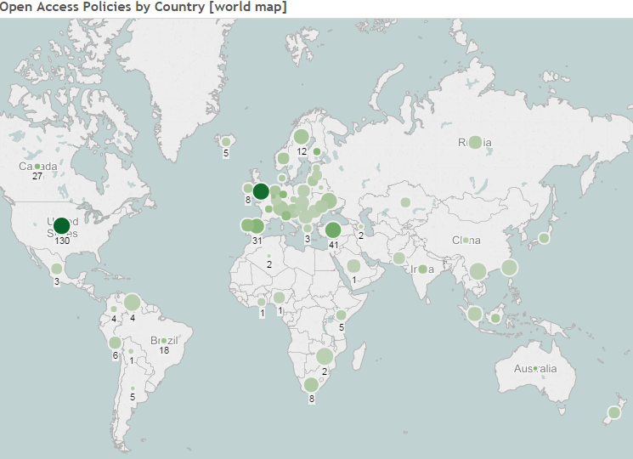
Open access
Leveraging the power of the Internet?
http://roarmap.eprints.org/dataviz2.html at 11 June 2016

Slide 55
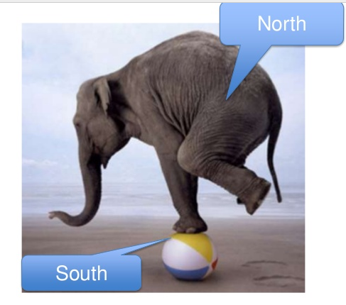
unintended consequences
Danger of increasingly drowning out scholarship from the global south
Thanks to Leslie Chan for image

Slide 56
Northern authors publish about the South
A study of 2 top African studies journals 1993 - 2013 found
the percentage of articles by Africa-based authors has declined
not lower submission rates from Africa but low and declining acceptance rates
Africa-based scholars are systematically cited less than others
(Briggs and Weathers, 2016)

Slide 57
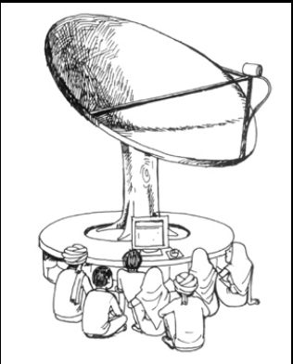
Open access is not just about passive receipt from the north
Need active engagement by all in the innovation space to avoid inadvertently deepening inequalities

Slide 58
Why this matters
Local knowledge
Needs to be available to others in similar conditions
Is a necessary and often missing contribution to global knowledge
A plurality of knowledge/s is good for science
A knowledge production & dissemination system that sidelines three quarters of the world is bad for everyone

Slide 59
What can you do?

Slide 60
Open everything
Journal Articles
Conference Papers
Technical Reports
Working Papers
Policy Briefs
Blog Posts
Tweets
E-mails
Collaborative Documents
Thanks to Michelle Willmers
Images & Videos
Animations & Simulations
Presentations
Lectures
Textbooks
Books
Courses
Curricula

Slide 61
What can you do?

Slide 62
Join AuthorAid http://www.authoraid.info/en/ AuthorAID is a global network that provides support, mentoring, resources and training for researchers in developing countries

Slide 63
Grow your open online presence
Academics' Online Presence: a four-step guide to taking control of your visibility - http://open.uct.ac.za/handle/11427/2652

Slide 64

Openness is like sunshine
http://www.flickr.com/photos/pixthepixie/188345043/sizes/z/in/photostream/

Slide 65
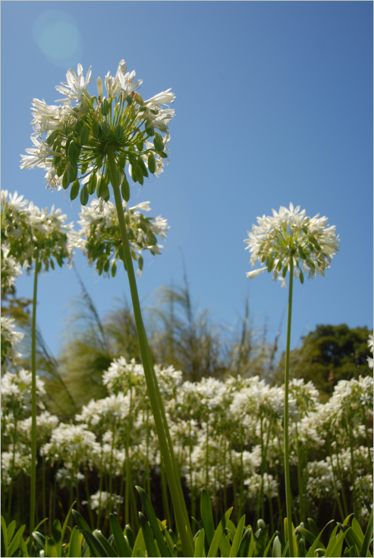
Openness exposes content
and communication online
to
enable growth
http://www.flickr.com/photos/planetina/405489316/sizes/o/in/photostream/
Thanks to Amber Thomas
Notes:
http://www.flickr.com/photos/planetina/405489316/sizes/o/in/photostream/

Slide 66
Useful resources
A Map through the Maze of Open Access Publishing (debunking myths): http://www.al-fanarmedia.org/2013/11/a-guide-to-the-maze-of-open-access-publishing/
Four step-by-step guides to scholarly communication for academics - See more at: http://www.cilt.uct.ac.za/cilt/guides#sthash.HpFEpVmn.dpuf
Academics' Online Presence: a four-step guide to taking control of your visibility - http://open.uct.ac.za/handle/11427/2652
Curation for Participation: an eight-step guide to curating open scholarly content - http://open.uct.ac.za/handle/11427/8431#sthash.HpFEpVmn.dpuf
Open Content Licensing: a three-step guide for academics - http://open.uct.ac.za/handle/11427/12937#sthash.HpFEpVmn.dpuf
Measuring Impact: a five-step guide for scholarly units - http://open.uct.ac.za/handle/11427/12936#sthash.HpFEpVmn.dpuf
Directory of Open Access Journals (DOAJ) https://doaj.org/ is a community-curated online directory that indexes and provides access to high quality, open access, peer-reviewed journals.

Slide 67
Useful resources
Sherpa Romeo: How to find journal policies regarding publishing copyright agreements and author manuscript information (and such) on personal websites/repositories with/without embargos so that your article is accessible even if it’s not in an OA journal http://www.sherpa.ac.uk/romeo/index.php
AuthorAid http://www.authoraid.info/en/ AuthorAID is a global network that provides support, mentoring, resources and training for researchers in developing countries
Education Open access journals - http://www.oajse.com/subjects/education.htm
Why Open Access? Maha’ s views for Arab world (applies to most developing countries) http://www.al-fanarmedia.org/2014/03/open-access/
How to recognise a sham journal - http://blogs.plos.org/mindthebrain/2014/09/24/top-eleven-ways-tell-journal-fake/
Assessing the scamminess of a purported open-access publisher http://gavialib.com/2012/04/assessing-the-scamminess-of-a-purported-open-access-publisher/

Slide 68
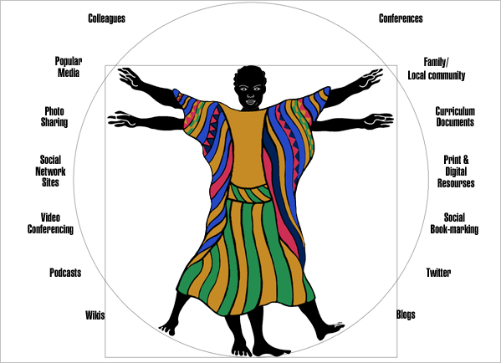
Thank you
Image: Stacey Stent

