Slide 1
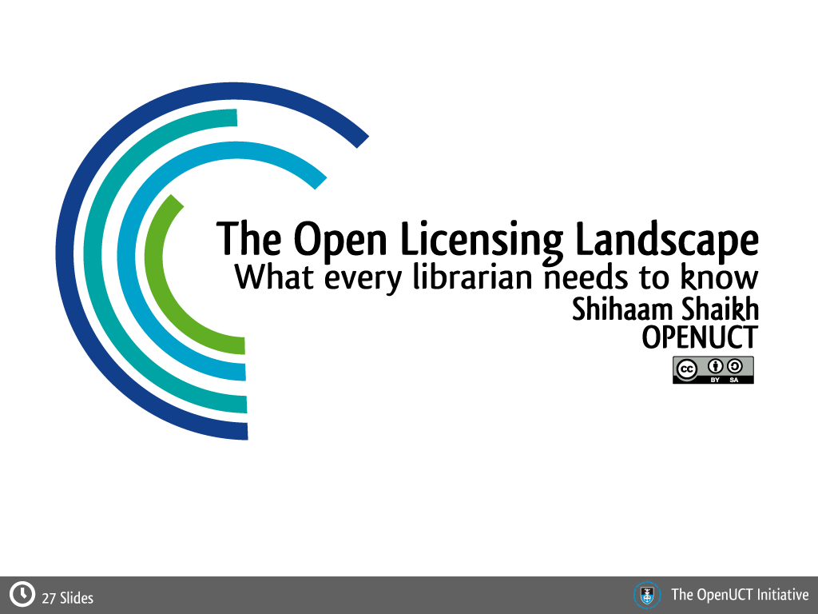
Notes:
The OpenUCT website: http://openuct.uct.ac.za
Open content licensing for educators (OCL4Ed) is a free micro Open Online Course (mOOC) designed for educators and students who want to learn more about open education resources, copyright, and Creative Commons licenses. The course is to be facilitated by the UNESCO OER Chair Network in collaboration with the OER Foundation and the Commonwealth of Learning.

Slide 2
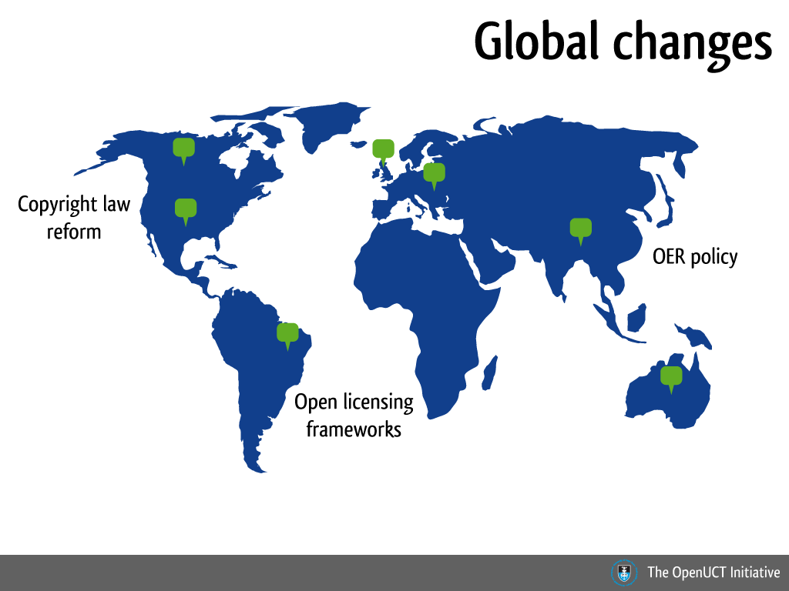
Notes:
Globally we seeing a surge in developments related to copyright law, open licensing and open access policies in countries like the USA, UK, China, Australia, New Zealand and Brazil.
Hot issue: provisions for access to audio visual materials by blind and deaf persons excluded from WIPO treaty

Slide 3
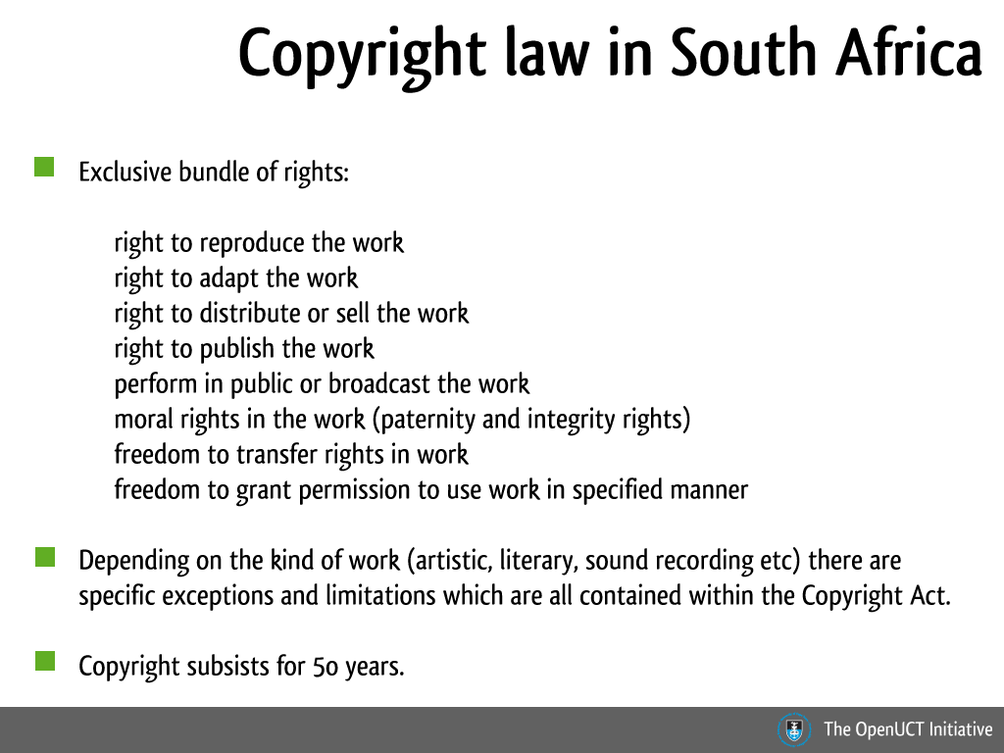
Notes:
For more detailed information go to http://education-copyright.org
Copyright law in South Africa can be traced back to the codification of copyright law in 1911 in Britain in the form of the Imperial Copyright Act. This Act applied to all British colonies including South Africa who was at the time a self governing dominion. Current copyright law in South Africa is governed by the Copyright Act 78 of 1978 which afford exclusive rights onto the author of an original work. For a history of SA copyright law: http://education-copyright.org/history-of-copyright/
Copyright applies automatically to original works that has been reduced to a tangible format – this means that by default everything that is on the internet falls under copyright protection unless specified otherwise. The default position therefore means that copying is not allowed unless permission has been granted or the copying falls under one of the exceptions. Copyright is essentially a set of rights granted to an author of an original work, including a bundle of exclusive rights. Copyright subsists for 50 years beginning either from the first date of publication or if not published, from the end of the year of the author’s death.
Upon expiration of copyright protection, the work usually passes into the Public Domain unless there has been a transfer or extension of protection - but more on that later. All copyright holders have moral rights in their works - The author has the right to object against distortion, mutilation or any other modification to a work that would prejudice their honour or reputation regardless of any transfer of copyright and as a user one cannot use the work in a manner that will be prejudicial or offensive to the author even if you have permission to use their work. Lastly, copyright owners have the right to transfer copyright to others by testamentary disposition, operation of law or assignment.

Slide 4
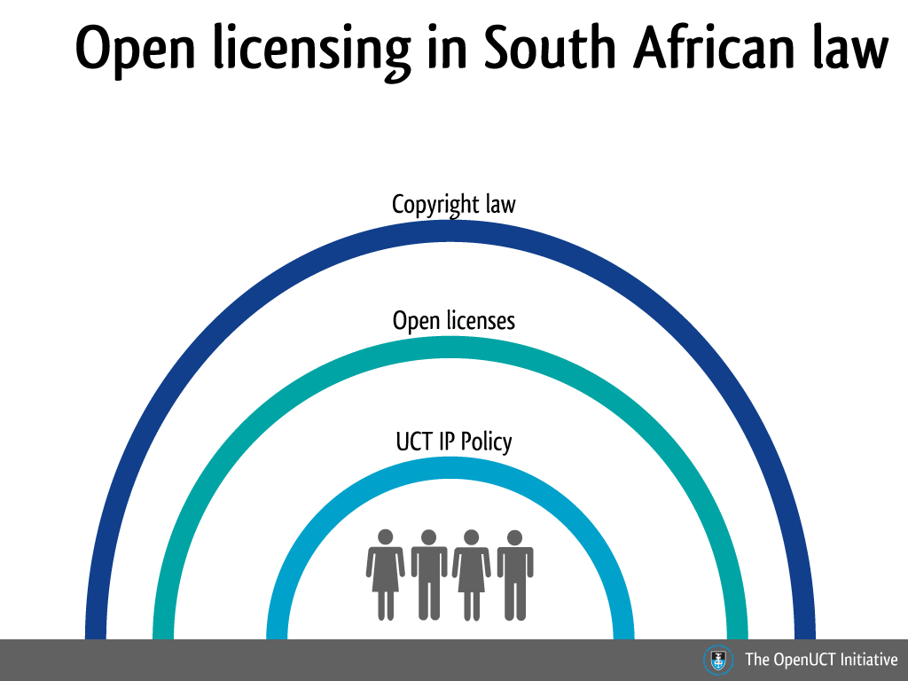
Notes:
You can think of copyright law as an overarching circle of protection around copyright holders and the immediate circle of protection is your institution’s IP policy. The open licensing solution fits in neatly between those in cases where your institution has assigned copyright to you as the author of certain materials. It also adheres to copyright law as it operates based on the exclusivity of the rights granted to copyright holders (in other words, you are free to grant permissions because you hold the rights).
Open licenses are enforceable in a court of law and it acts as an explicit indication to others as to how your resource can be used – failure to adhere to the terms of the license will constitute copyright infringement and the violator can be held liable.

Slide 5
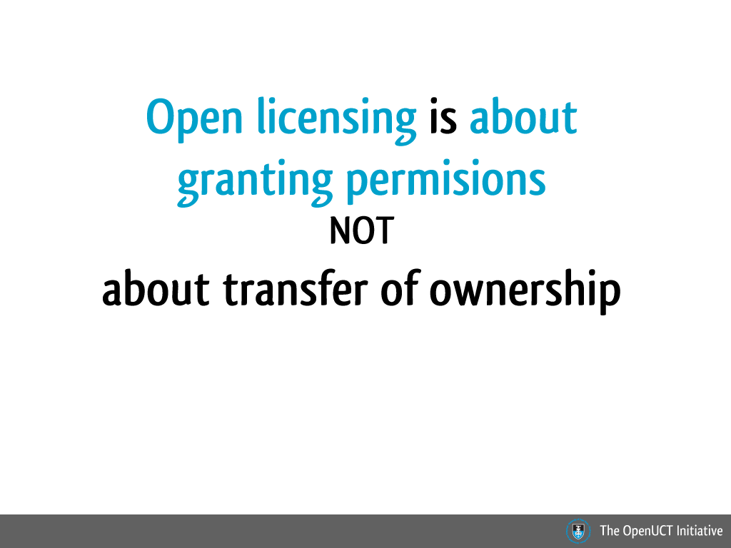

Slide 6
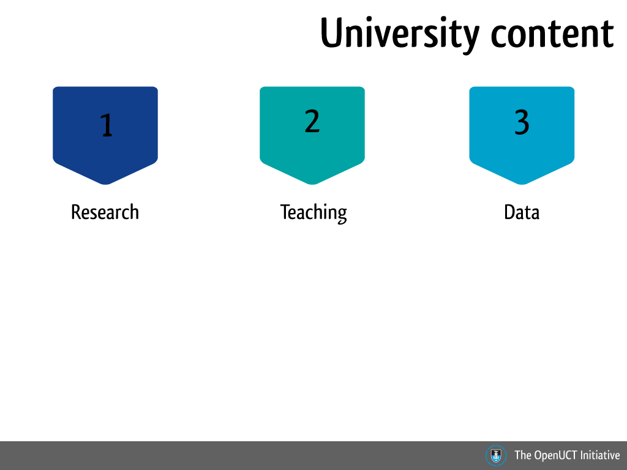

Slide 7
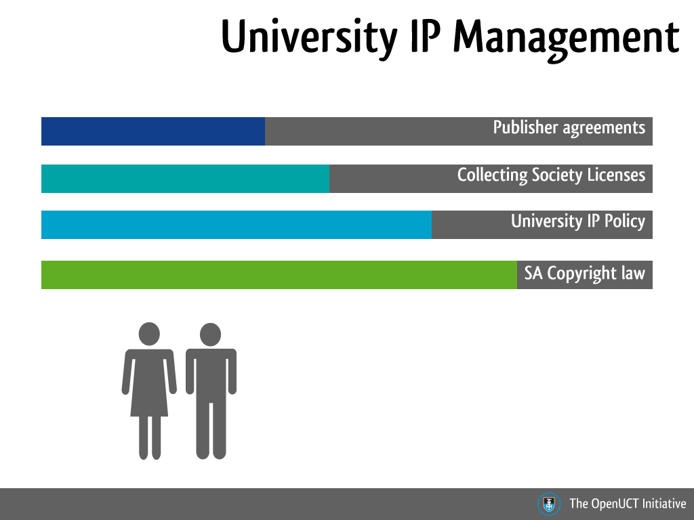

Slide 8
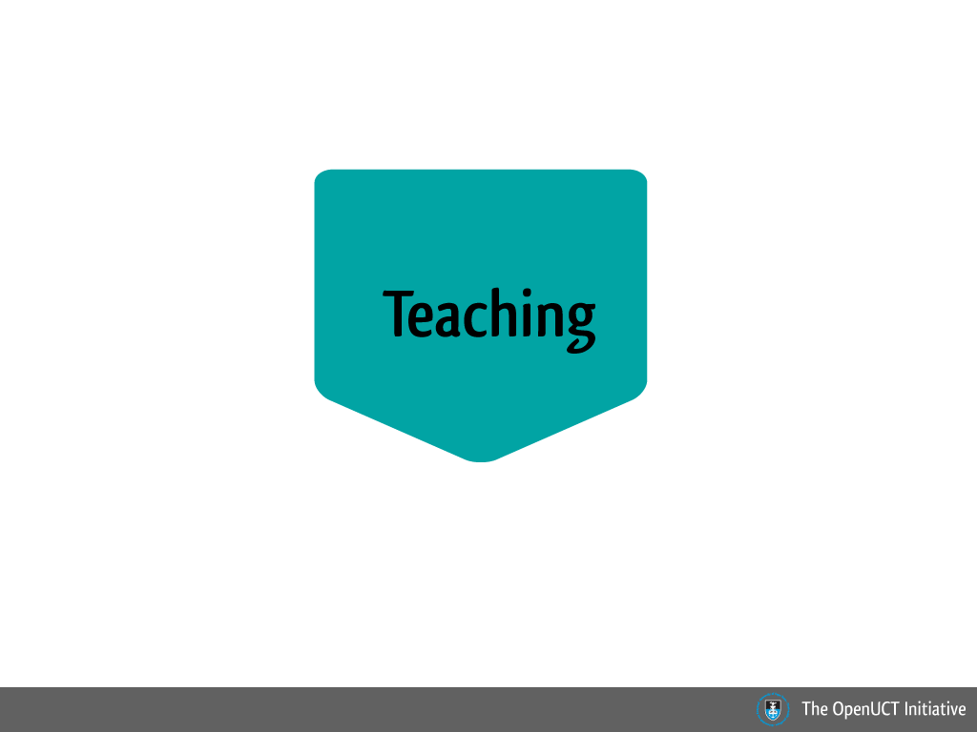

Slide 9
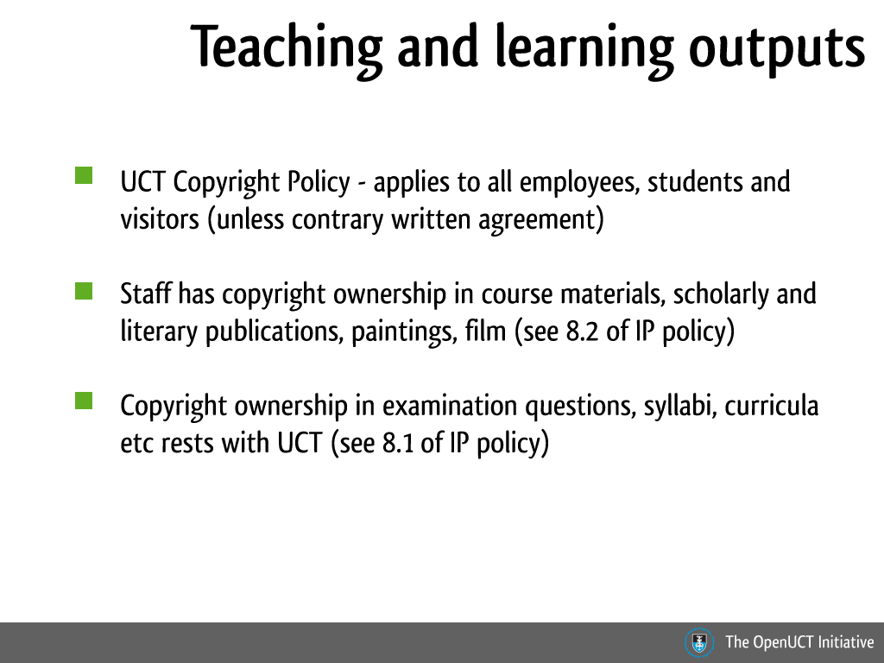
Notes:
Link to UCT IP policy: https://www.uct.ac.za/downloads/uct.ac.za/about/policies/intellect_property.pdf

Slide 10
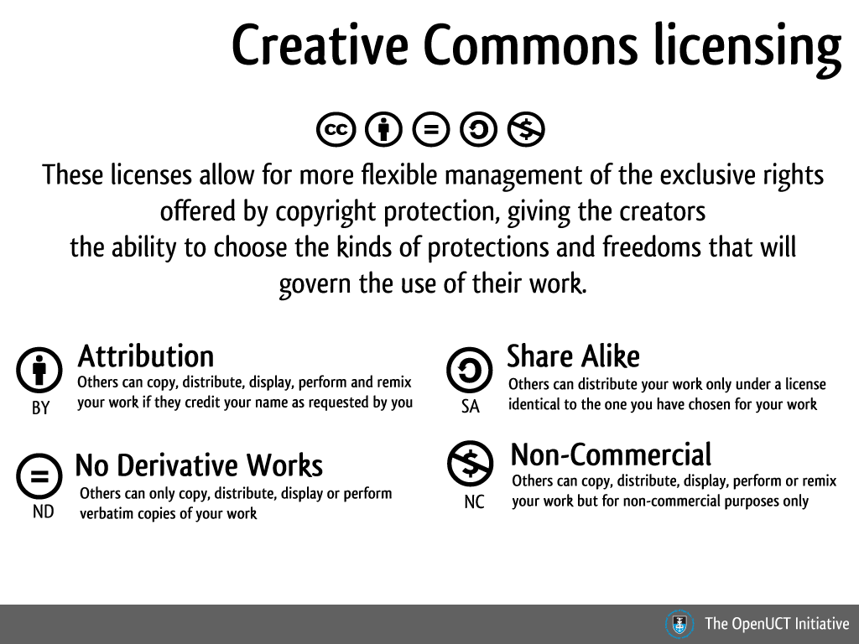
Notes:
Let's now focus our attention on Creative Commons. The Creative Commons licensing system allows for a more flexible management of the exclusive rights offered by copyright law, giving the creators the ability to choose the kinds of protections and freedoms that will govern the use of their work. It is often a misconception that Creative Commons is the opposite to copyright. Creative Commons can be thought of as a management solution for your copyright rights – every right you have as a result of being a copyright holder, you will have if you license work in terms of a Creative Commons license.
The true opposite to copyright is public domain. Materials that are in the public domain are not covered by any intellectual property rights and offers the creator of the materials no protection. Creative Commons licensing consists of 6 key licenses which consists of 4 main terms, namely, attribution, non-commercial, no derivative works and share alike.

Slide 11
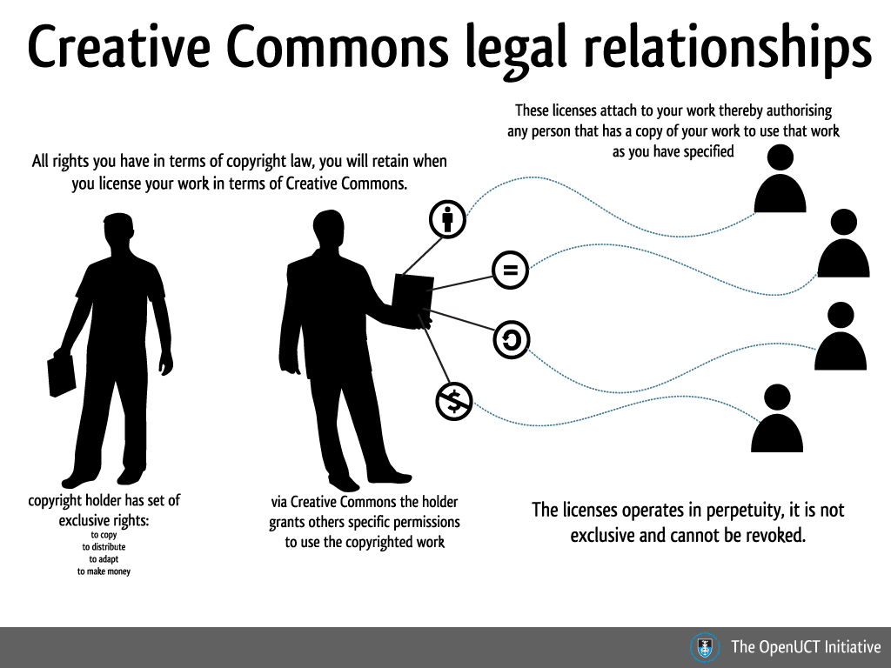
Notes:
The Creative Commons licensing system allows for a more flexible management of the exclusive rights offered by copyright law, giving the creators the ability to choose the kinds of protections and freedoms that will govern the use of their work.
It is often a misconception that Creative Commons is the opposite to copyright. Creative Commons can be thought of as a management solution for your copyright rights – every right you have as a result of being a copyright holder, you will have if you license work in terms of a Creative Commons license. The true opposite to copyright is public domain. Materials that are in the public domain are not covered by any intellectual property rights and offers the creator of the materials no protection.
You do not need to register or pay any fees for making use of this licensing system. All you would need is place the notice of your license on your work, either via text or a license badge. These notices can be placed on both online and offline work. The Creative Commons organisation has a license chooser that is easy to use – choose the appropriate answers in the form and you’re ready to go.

Slide 12
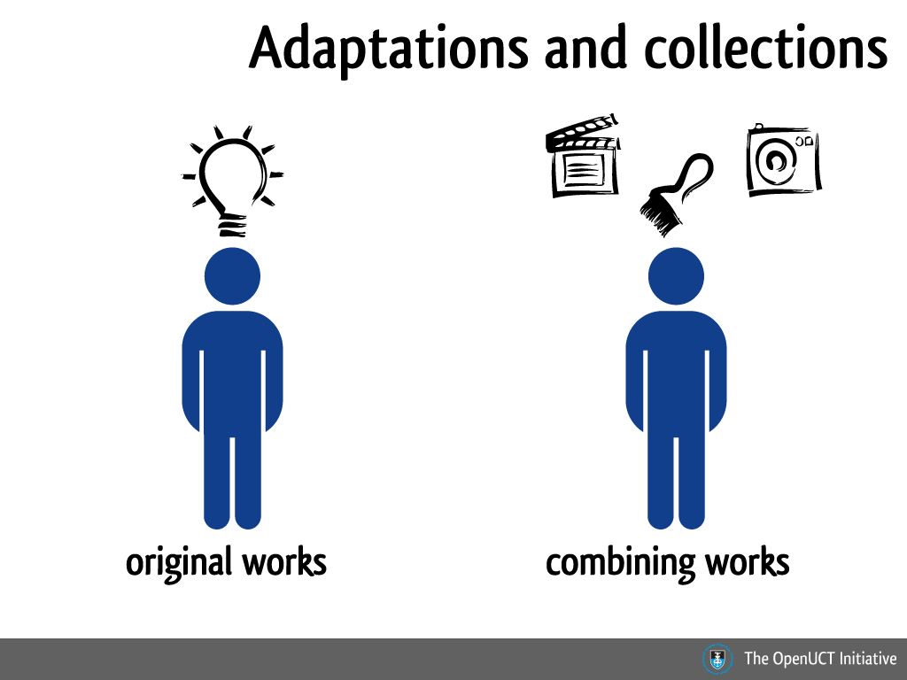

Slide 13
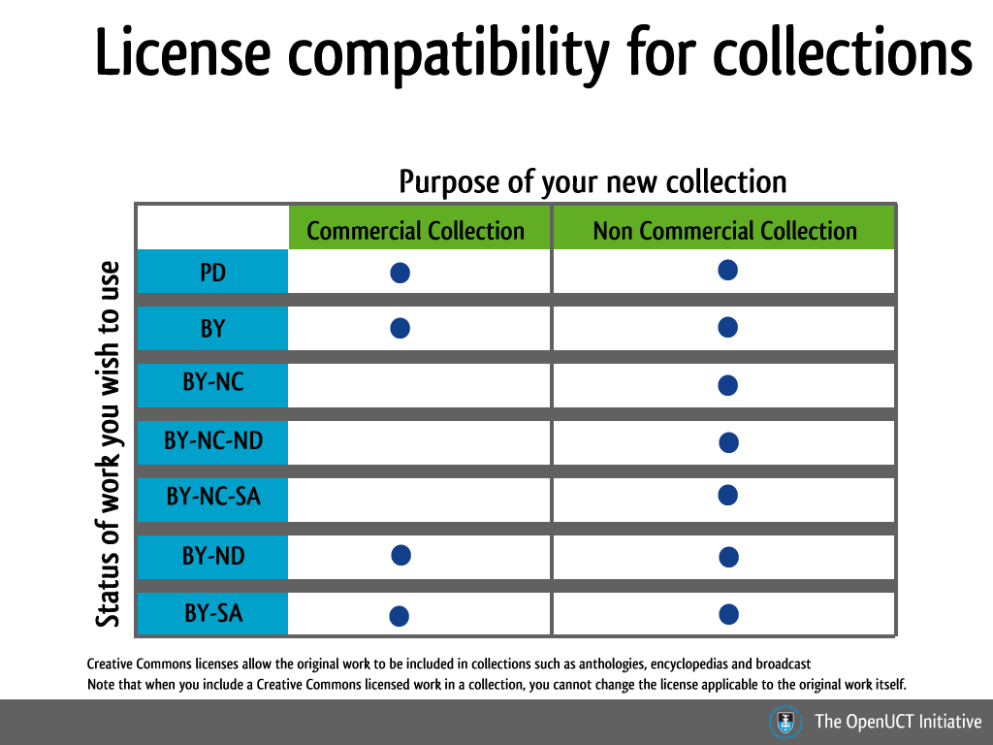

Slide 14
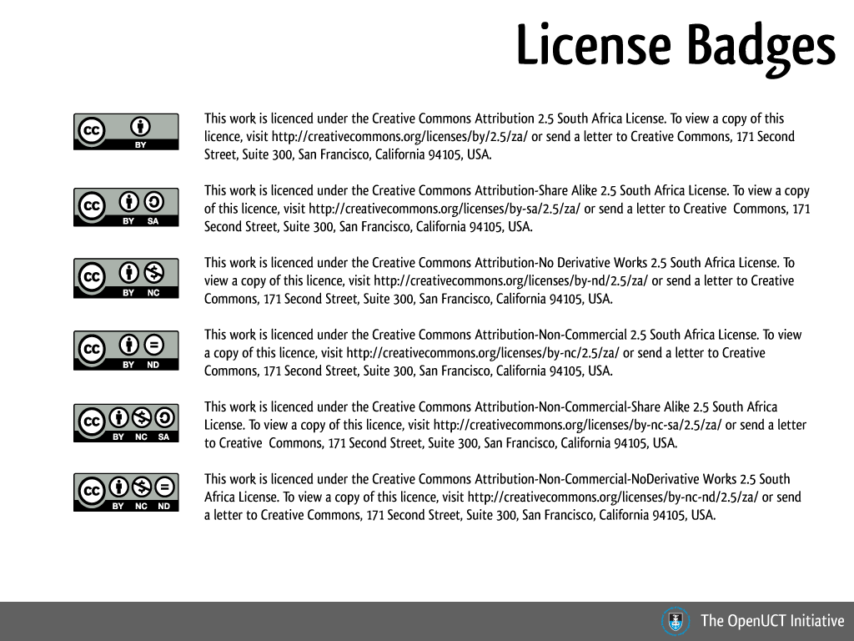

Slide 15


Slide 16
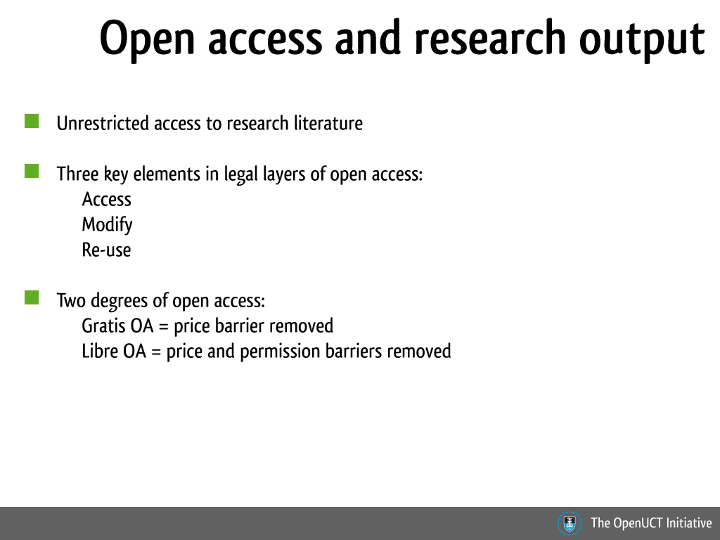

Slide 17
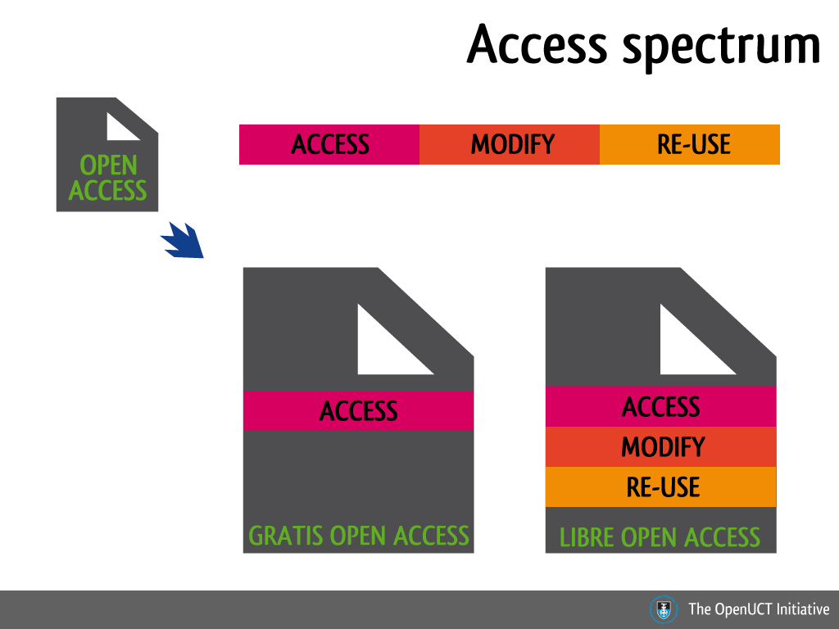

Slide 18
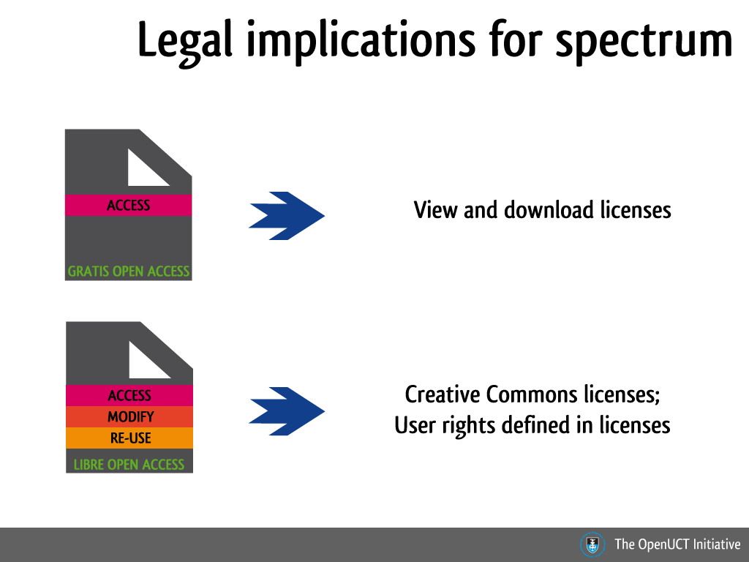

Slide 19
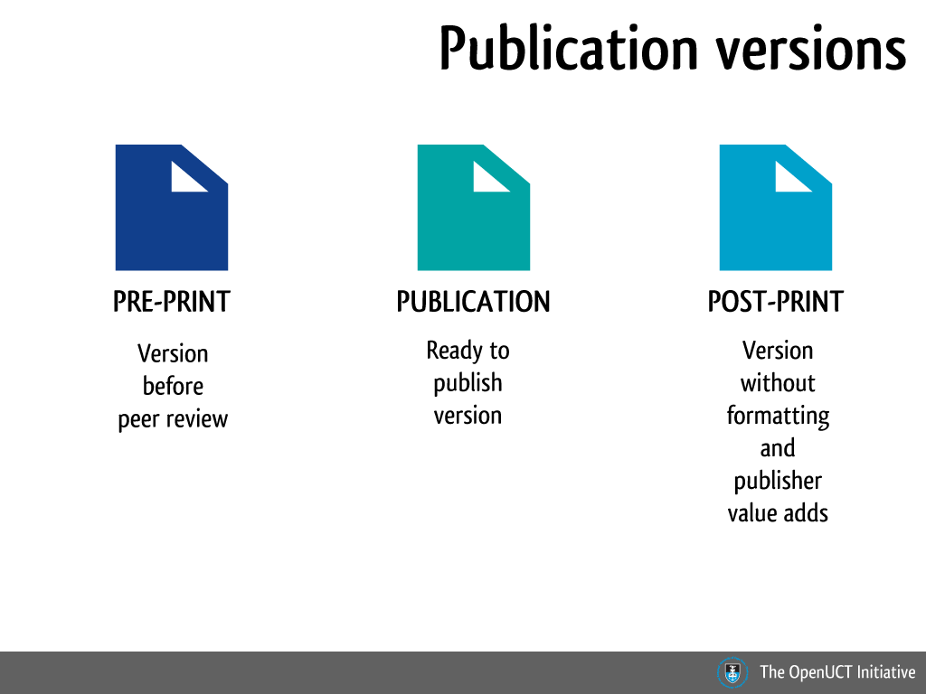

Slide 20
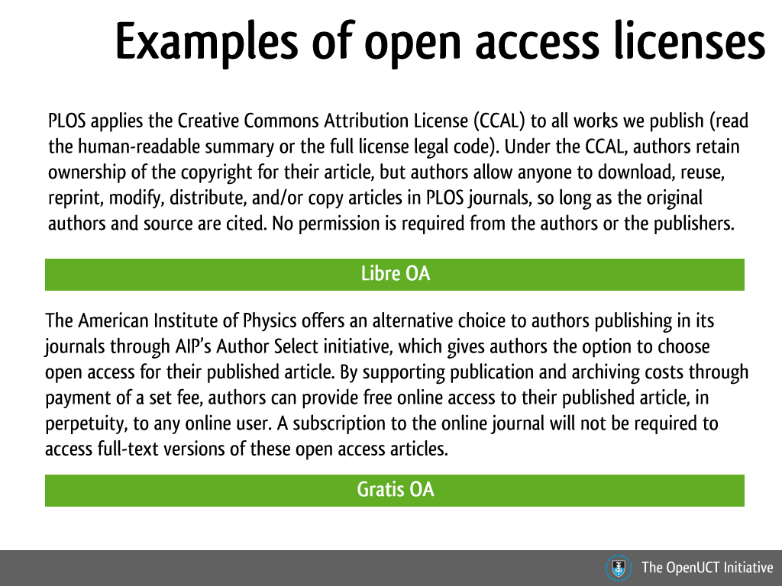

Slide 21
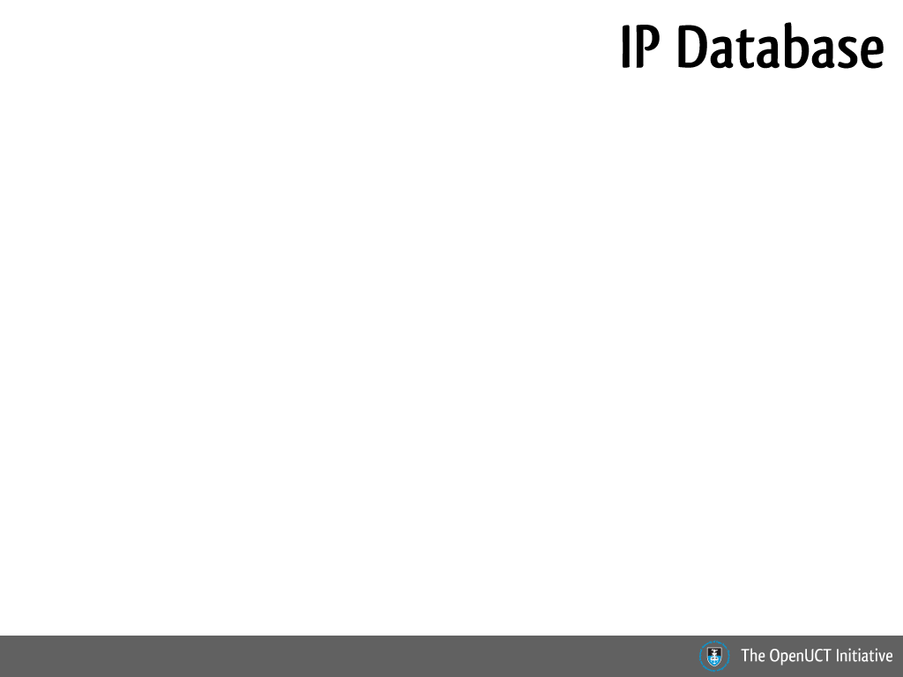
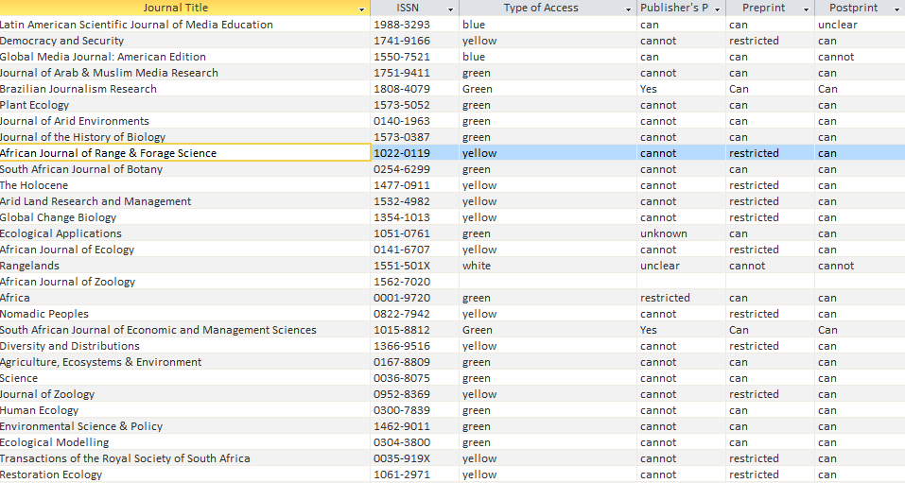

Slide 22
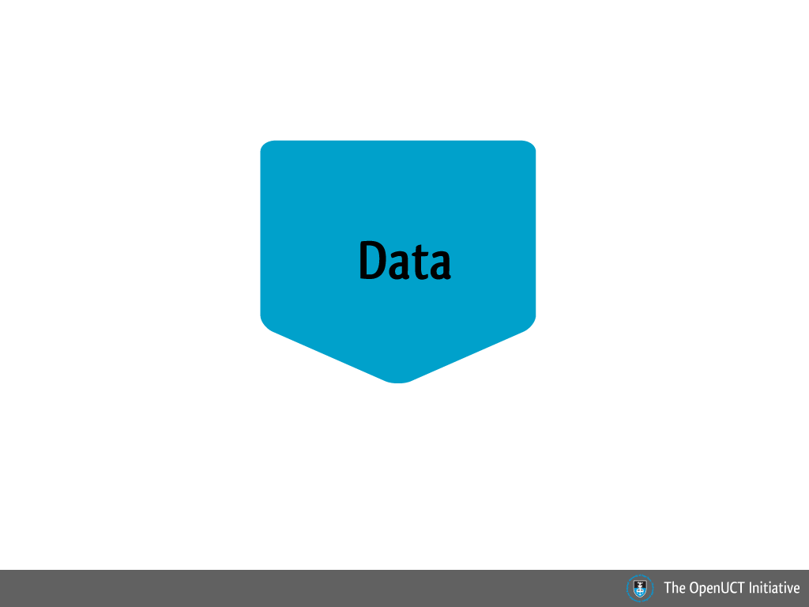

Slide 23
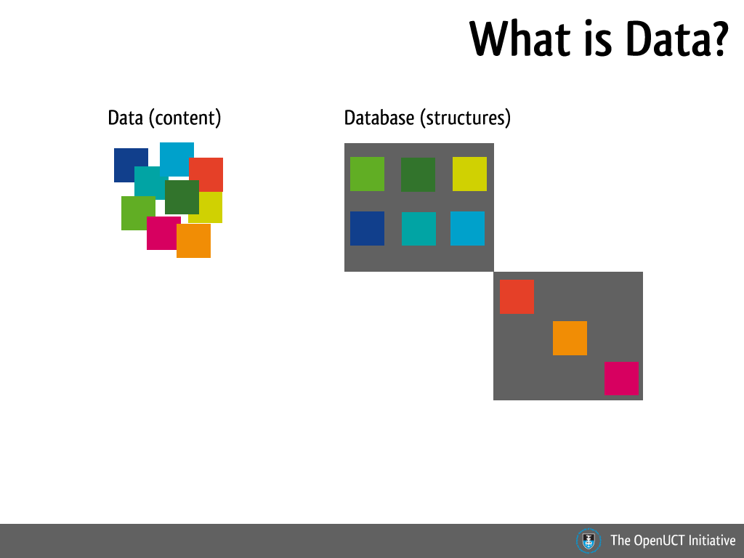
Notes:
Legally, there is a difference between data and databases. Data is the actual content and the database is the structure. Each can have its own legal ownership and hence own licenses. For example I can create a database of images I have sources from elsewhere, the images (data) would have separate legal rights and protections from my database, which will have its own rights.
In South Africa, copyright law states that “tables and compilations, including those of data stored or embodied in a computer or in a media used in conjunction with a computer” fall under copyright protection. Further, the 1997 amendment extended protection to databases as well.

Slide 24
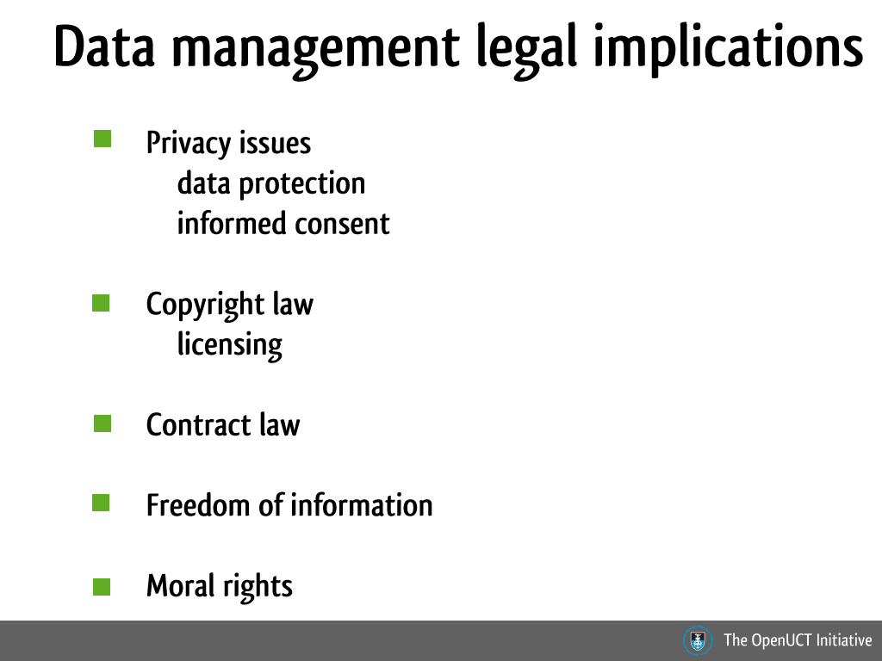
Notes:
As with all data management policies and practices, one has to take into account institutional policy and risk management as well. The above are some of the legal and ethical considerations that have to be take into account when dealing with data management.
Privacy issues: depending on the data collection methods and the data subjects, confidentiality, privacy and informed consent are the key legal considerations. Particularly with survey data collection and medical data collection.
Copyright law and licensing: look at your intended use of the data and by who the data will be used
Contract law: funder requirements for example and employment contracts
Freedom of information: people have the right to request certain information in South Africa. This has to be taken into account when you are looking at restricting access to data.
Moral rights: This is usually dealt with via contract law. Moral rights are held by individuals and includes the right to be attributed as the author of a work, not be falsely attributed and integrity of authorship (the right to not have the work treated in a derogatory or offensive manner)

Slide 25
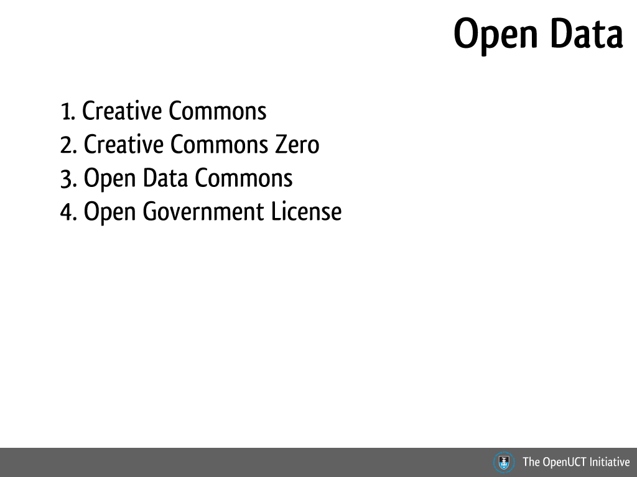
Notes:
The Open Data Handbook: http://opendatahandbook.org/

Slide 26
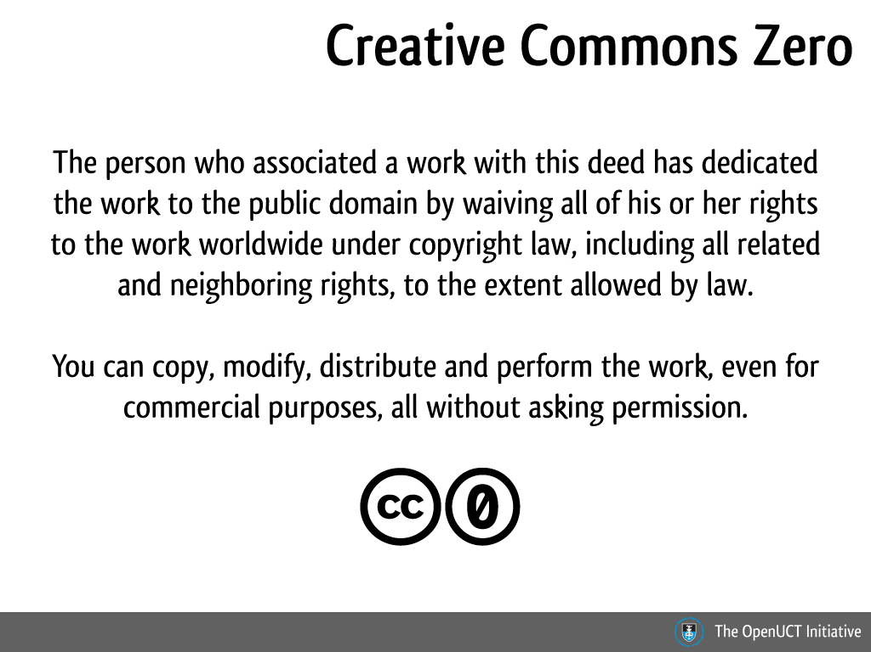
Notes:
To read the license, go here: http://creativecommons.org/publicdomain/zero/1.0/

Slide 27
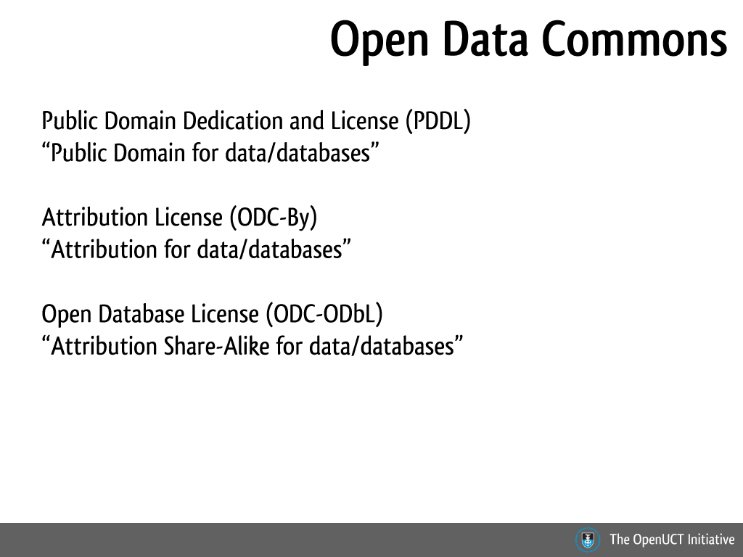
Notes:
For more information, go to: http://opendatacommons.org/

Slide 28
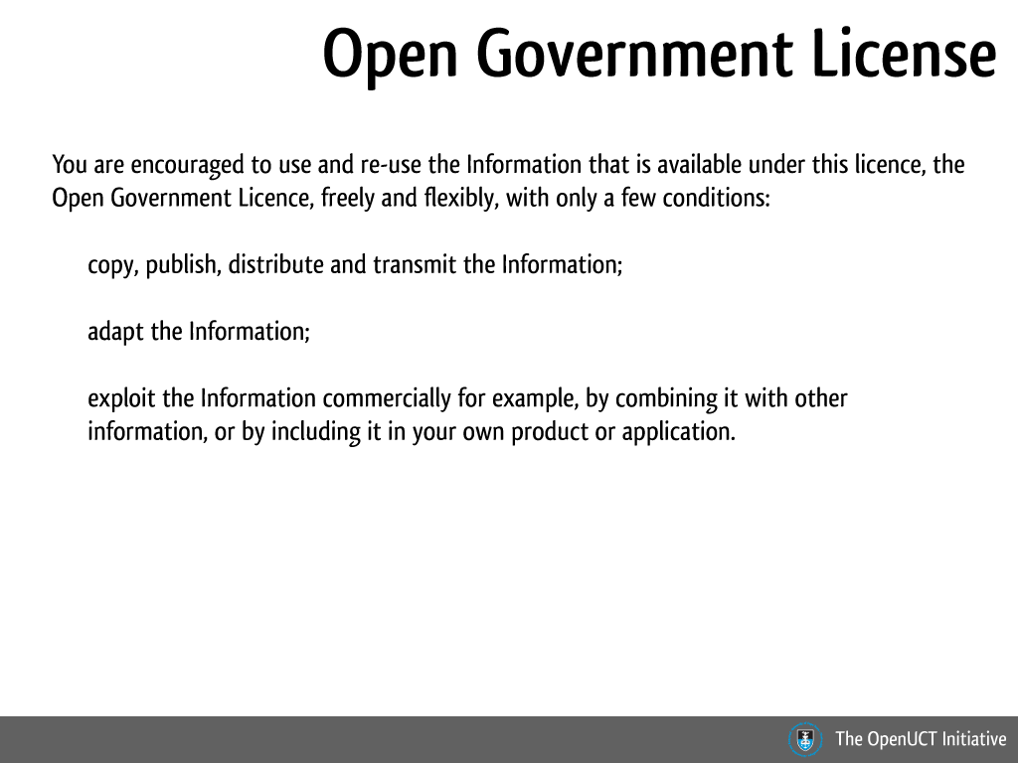

Slide 29
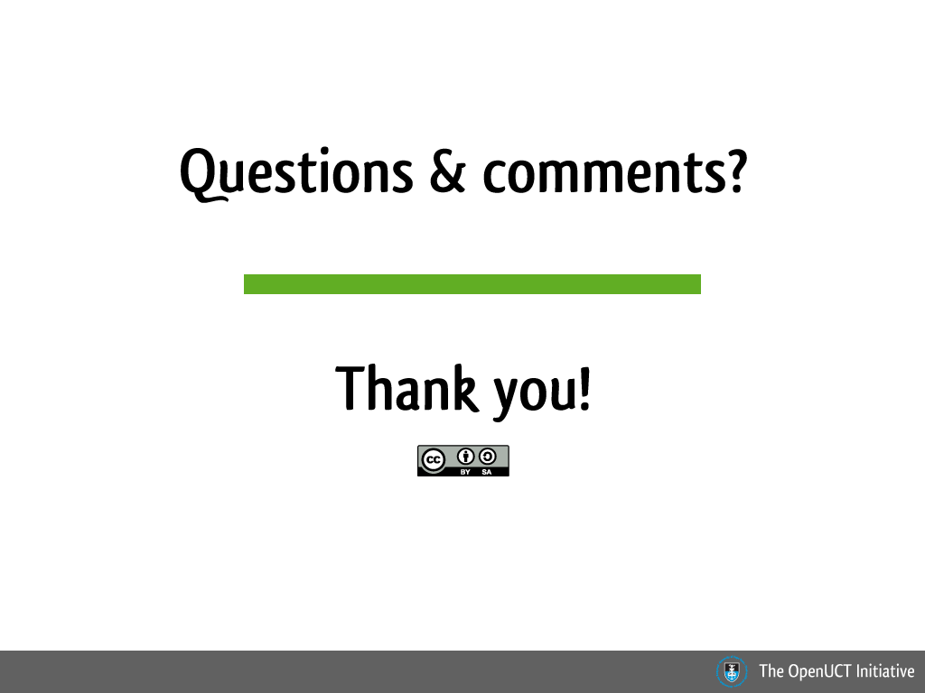
Notes:
This work is licensed under a Creative Commons Attribution-ShareAlike 2.5 South Africa License.
Email: shihaam.shaikh@uct.ac.za
Twitter: @shihaamd
Linkedin: za.linkedin.com/in/shihaamshaikh‎
Delicious: https://delicious.com/shihaam_shaikh

