Slide 1
PHY1012F
MOTION
Gregor Leigh
gregor.leigh@uct.ac.za

Slide 2
WHAT IS PHYSICS?
    Physics attempts to provide a description of the fundamental principles of the universe.
    Physics is based on experiment and measurement.
    Hypotheses proposed to explain phenomena are repeatedly tested; those which survive become our current theories which inform our models of reality – until further testing proves them inadequate or wrong!
    I.e. Physics provides transparent and reliable, yet still tentative, knowledge.
    Physics is the most fundamental of the sciences:
    it provides a basis for other sciences to build on.

Slide 3
NEWTON’S LAWS
  Physics is particularly interested in the measurement of change.
  One of the most dramatic examples of change is…
Motion

Slide 4
NEWTON’S LAWS
  Physics is interested in the measurement of change.
  One of the most dramatic examples of change is motion.
  The goals of Part I, Newton’s Laws, are to…
    Learn how to describe motion both qualitatively and quantitatively so that, ultimately, we can analyse it mathematically.
    Develop a “Newtonian intuition” for the explanation of motion: the connection between force and acceleration.

Slide 5
DESCRIBING MOTION
  Motion can be represented in multiple ways…
    Verbally, as in typical physics, or “story sum” problems.
    Physically, as in motion diagrams.
    Pictorially, showing beginning and ending points as well as coordinates and symbols.
    Graphically, using graphs of motion (velocity-time etc).
    Mathematically, through the relevant equations of kinematics and dynamics.

Slide 6
MODELLING
  Physics is NOT always about being exact!
  To cope with the complexities of reality, physicists often simplify situations by …
    isolating essentials
    ignoring unnecessary details
    making assumptions
    i.e. modelling reality

Slide 7
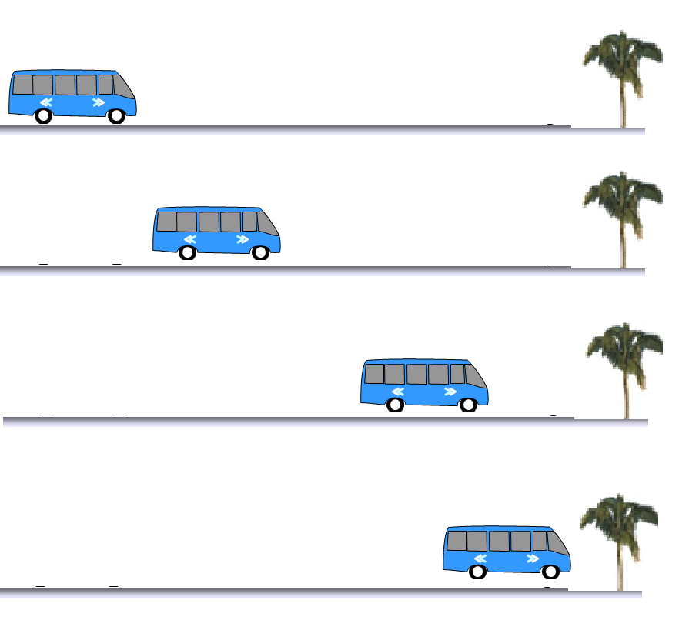

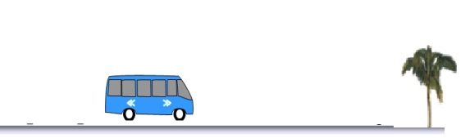
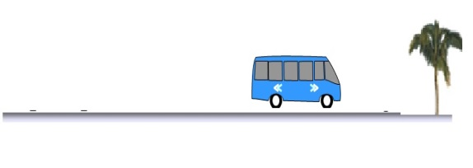

MAKING A MOTION DIAGRAM
  Essentially motion means a change of position with time.
  A film strip consists of single images taken at regular time intervals.
  If we cut out the individual frames…

Slide 8
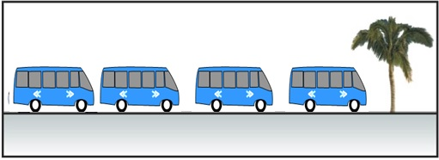
MOTION DIAGRAMS
  … and stack them on top of each other …
  … we get a motion diagram.
  Notes:
    Do not “pan”.
    Use regular time intervals.
    Choose an appropriate viewing angle.

Slide 9
PARTICLE MODEL
  For simple translational motion (not rotational motion, qv), we treat objects as if all their mass were at a single point.
  stop
  The stopping car becomes:
  0 1 2 3
    Numbers are used to show order. (NB Start at zero.)
    “Stop” is used to indicate a final position of rest
    (as opposed to mere slowing down).
    “Start” indicates an initial position of rest.
  start
  E.g. A horse out of a starting gate:
  3 2 1 0

Slide 10
MEASURING POSITION
  To give a quantitative description of the position of a body at a particular time (say t₅) we…
  y
  (m)
  5
  4 3 2 1
  3
  4
  2
  5
  1
  (5 m, 3.5 m)
  6
    overlay the motion diagram with an artificial grid,
    i.e. a coordinate system, and…
    either state the coordinates, (x₅, y₅) = (5 m, 3.5 m)…
  = (6.1 m, 35°)
  0
  35°
  1 2 3 4 5 6
  x (m)
    or specify the position vector, = (6.1 m, 35°).

Slide 11
SCALARS and VECTORS
Scalar
  A scalar is a physical quantity with magnitude (size) but no associated direction.
  E.g. temperature, energy, mass.
Vector
  A vector is a physical quantity which has both magnitude AND direction.
  E.g. displacement, velocity, force.
  Vectors are very useful tools for describing physical quantities in two and three dimensions.

Slide 12
VECTOR REPRESENTATION and NOTATION
  Graphically, a vector is represented by a ray.
  The length of the ray represents the magnitude,
  while the arrow indicates the direction.
  NB!! Directions and angles are ALWAYS measured at the TAIL of a vector!
  The position of the ray is unimportant. Provided its length and direction remain unchanged, it may be “shifted around”, i.e. drawn anywhere on the page, as required.
  Symbolically, to distinguish a vector from a scalar we will use an arrow over the letter. E.g. and .

Slide 13
DISPLACEMENT
  Changing position
  (i.e. moving) involves the displacement vector, .
  y
  (m)
  5
  4
  3
  2
  1
  3
  4
  2
  5
  1
  The displacement is what is added to the initial position, , in order to result in getting
  to the final position, .
  6
  0
  1 2 3 4 5 6
  x (m)
  Mathematically,
  Alternatively, displacement can be defined as the difference between one position and the previous one.

Slide 14
VECTOR ADDITION
  To add to :
  Draw .
  Drag until its tail lies on ’s head.
  The resultant, , is drawn from the tail of the first to the head of the last.

Slide 15
VECTOR ADDITION
  Simple geometry shows us that vector addition is commutative:

Slide 16
VECTOR SUBTRACTION
  To subtract one vector from another, we simply add the negative of the vector to be subtracted:
  …where is the vector with the same magnitude as , but pointing in the opposite direction:

Slide 17
VECTOR SUBRACTION
  To subtract from :
  Draw .
  Draw with its tail on ’s head.
  The resultant, , is drawn from the tail of the first to the head of the last.

Slide 18
MOTION DIAGRAMS WITH VECTORS
  By adding displacement vectors to motion diagrams the pictures become more informative, even though we can now omit the position numbers:
  stop
  This motion diagram illustrates a body moving to the right, initially at constant speed ( )…
  …then slowing down to a halt
  ( , and become progressively shorter).

Slide 19
MEASURING TIME
  In physics we are concerned with time intervals rather than actual times.
  The time interval Δt = t_{f} – t_{i} measures the elapsed time as an object moves from an initial position at time t_{i} to a final position at time t_{f}.
  The value of Δt is independent of the specific clock used to measure the actual times.

Slide 20
SPEED
  Speed is a measure of how fast an object moves, i.e. the amount of distance it covers during a given time interval.
  More formally:
  No attention is paid to the direction in which the object moves, so speed is a scalar quantity.
  Of more use to physicists (and aircraft carrier pilots) is the vector equivalent of speed: velocity…

Slide 21
VELOCITY
  Velocity is a measure of the rate of change of position.
  Mathematically:
  Notes:
    The velocity vector points in the same direction as the displacement vector, the “direction of motion”.
    For the moment we shall drop the “_{avg}” subscript and blur the distinction between average and instantaneous velocity (qv).
    Beware of regarding velocity as simply “speed plus direction”.

Slide 22
MOTION DIAGRAMS WITH VECTORS
  From now on we shall use velocity vectors in place of displacement vectors in motion diagrams:
  The hare
  The tortoise
  Notes:
    As in the case of displacement vectors, velocity vectors join successive positions together.
    The length of the velocity vector represents the body’s average speed between the two points.
    It’s sufficient (and easier) to label an entire sequence just once.

Slide 23
RELATING POSITION TO VELOCITY
  As we have seen, an object’s next position can be found by adding its displacement vector to its previous position:
  3
  4
  2
  5
  1
  6
  0
  From we get , and it follows that…
  I.e. an object’s velocity can be used to determine its future position. (Dead reckoning.)

Slide 24
ACCELERATION
  Velocity is a measure of the rate of change of position…
  Acceleration is a measure of the rate of change of velocity.

Slide 25
ACCELERATION
  Velocity is a measure of the rate of change of position…
  Acceleration is a measure of the rate of change of velocity.
  Velocity changes if…
    its magnitude (speed) increases:
    its magnitude (speed) decreases:
    its direction changes:

Slide 26
ACCELERATION
  Acceleration is a measure of the rate of change of velocity.
  Mathematically:
  Notes:
    For the moment we shall drop the “_{avg}” subscript and blur the distinction between average and instantaneous acceleration (qv).
    The acceleration vector points in the same
    direction as the vector , the change in velocity...

Slide 27
FINDING ACCELERATION VECTORS
ON A MOTION DIAGRAM
  The change-in-velocity vector, , is the difference between the final velocity, , and the initial velocity, .
  That is,
  So to find the change we…
    Draw the final velocity vector

Slide 28
FINDING ACCELERATION VECTORS
ON A MOTION DIAGRAM
  The change-in-velocity vector, , is the difference between the final velocity, , and the initial velocity, .
  That is,
  So to find the change we…
    Draw at the head of the final velocity vector

Slide 29
FINDING ACCELERATION VECTORS
ON A MOTION DIAGRAM
  The change-in-velocity vector, , is the difference between the final velocity, , and the initial velocity, .
  That is,
  So to find the change we…
    Draw , which lies in the same direction as
    Draw in at the point where changes to

Slide 30
FINDING ACCELERATION VECTORS
ON A MOTION DIAGRAM
  Notes:
    The magnitudes of and
    may differ (it’s the direction which is important).
    3 position dots ⇒
    2 velocity vectors ⇒
    1 acceleration vector.
    We cannot determine at
    the first and last points in a motion diagram.
    From and we get…

Slide 31
THE COMPLETE MOTION DIAGRAM
  A putt-putt (mini-golf) ball…
  rolls along a smooth, horizontal section at constant speed,
  passes over an edge, and then
  speeds up going down a uniform slope, before
  slowing down as it rolls up an equal but opposite slope.
  1.

Slide 32
THE COMPLETE MOTION DIAGRAM
  A putt-putt (mini-golf) ball…
  rolls along a smooth, horizontal section at constant speed,
  passes over an edge, and then
  speeds up going down a uniform slope, before
  slowing down as it rolls up an equal but opposite slope.
  2.

Slide 33
THE COMPLETE MOTION DIAGRAM
  A putt-putt (mini-golf) ball…
  rolls along a smooth, horizontal section at constant speed,
  passes over an edge, and then
  speeds up going down a uniform slope, before
  slowing down as it rolls up an equal but opposite slope.
  3.

Slide 34
THE COMPLETE MOTION DIAGRAM
  A putt-putt (mini-golf) ball…
  rolls along a smooth, horizontal section at constant speed,
  passes over an edge, and then
  speeds up going down a uniform slope, before
  slowing down as it rolls up an equal but opposite slope.
  4.

Slide 35
THE COMPLETE MOTION DIAGRAM
PHY1012F
  Acceleration is the amount by which velocity changes during each time interval.
    When is zero, velocity remains constant.
    If and point in the same direction, the object is speeding up.
    If and point in opposite directions, the object is slowing down.
    If and are not parallel, the object changes direction.
35
Notes:
35

Slide 36

What quantities are shown on a complete motion diagram?
A The position of the object in each frame of the film, shown as a dot.
B The average velocity vectors (found by connecting each dot in the motion diagram to the next with a vector arrow).
C The average acceleration vectors (there is one acceleration vector linking each two velocity vectors).
D All of the above.
Notes:
This RQ slide included especially for 2006. Perhaps use earlier in true RQ style.

Slide 37
THE COMPLETE MOTION DIAGRAM
  You toss a ball straight up into the air…
  stop/start

Slide 38
THE COMPLETE MOTION DIAGRAM
  You toss a ball straight up into the air…
  stop/start

Slide 39
THE COMPLETE MOTION DIAGRAM
  You toss a ball straight up into the air…
  stop
  /
  start

Slide 40
THE COMPLETE MOTION DIAGRAM
  You toss a ball straight up into the air…
  stop
  start
  The acceleration vectors are the same on the way up and the way down…
  and even at the top!!

Slide 41

THE COMPLETE MOTION DIAGRAM
  Putting the shot…
  45°

Slide 42
THE COMPLETE MOTION DIAGRAM
  Orbiting tennis ball…

Slide 43
THE COMPLETE MOTION DIAGRAM
  Orbiting tennis ball…

Slide 44
THE COMPLETE MOTION DIAGRAM
  Positions
  Velocity vectors
  Acceleration vectors
    When is zero, velocity remains constant.
    If and point in the same direction, the object is speeding up.
    If and point in opposite directions, the object is slowing down.
    If and are not collinear, the object changes direction.

Slide 45
DESCRIBING MOTION
  Motion can be represented in multiple ways…
    Verbally, as in typical physics, or “story sum” problems.
    Physically, as in motion diagrams.
    Pictorially, showing beginning and ending points as well as coordinates and symbols.
    Graphically, using graphs of motion (velocity-time etc).
    Mathematically, through the relevant equations of kinematics and dynamics.

Slide 46
PICTORIAL REPRESENTATIONS
  Sketch the situation: beginning, end, and any point where the motion changes.
  Establish an appropriate coordinate system.
  Fill in all variables, both known and yet-to-be-found.
  List known information in table form.
  Include desired unknowns in the table.

Slide 47
PICTORIAL REPRESENTATIONS
  A rocket sled accelerates at 50 m/s² for 5 s, then coasts for 3 s. What total distance does it travel?
  Sketch the situation:
  beginning, end, and where the motion changes.

Slide 48
PICTORIAL REPRESENTATIONS
  A rocket sled accelerates at 50 m/s² for 5 s, then coasts for 3 s. What total distance does it travel?
  y
  x
  Establish an appropriate coordinate system.

Slide 49
PICTORIAL REPRESENTATIONS
  A rocket sled accelerates at 50 m/s² for 5 s, then coasts for 3 s. What total distance does it travel?
  y
  a_{0x}
  a_{1x}
  x₀
  x
  , v_{0x}
  , t₀
  x₁, v_{1x}, t₁
  x₂, v_{2x}, t₂
  Fill in all variables, both known and yet-to-be-found.

Slide 50
PICTORIAL REPRESENTATIONS
  A rocket sled accelerates at 50 m/s² for 5 s, then coasts for 3 s. What total distance does it travel?
  y
  x₀ = v_{0x} = t₀ = 0
  a_{0x} = +50 m/s²
  t₁ = 5 s
  a_{1x} = 0 m/s²
  t₂ = t₁ + 3 s = 8 s
  x₂ = ?
  a_{0x}
  a_{1x}
  x₀, v_{0x}, t₀
  x₁, v_{1x}, t₁
  x₂, v_{2x}, t₂
  x
  List known and desired unknown information in table form.

Slide 51
The pictorial representation of a physics problem consists of
A a sketch
B a coordinate system
C symbols
D a table of values
E all of the above

Slide 52
MULTIPLE REPRESENTATIONS
  Physics problems can be represented in several ways…
    Verbally, as in typical physics, or “story sum” problems.
    Physically, as in motion diagrams, free-body diagrams…
    Pictorially, showing beginning and ending points as well as coordinates and symbols.
    Graphically, using graphs of motion (velocity-time etc), force curves, energy bar charts...
    Mathematically, through the relevant physics equations (equations of motion, Newton’s laws, conservation laws...)

Slide 53
A PROBLEM-SOLVING STRATEGY
  Visualise the situation and focus on the problem.
  Represent the physics with a physical diagram.
  Represent the situation with a pictorial diagram.
  Represent the problem graphically.
  Represent the problem mathematically and solve.
  Evaluate your solution.

Slide 54
A PROBLEM-SOLVING STRATEGY
  Visualise the situation and focus on the problem.
    Construct a mental image of the problem.
    Draw one or more pictures which show all the important objects, their motion and any interactions.
    Now consider: “What is being asked?”
    “Do I need to calculate something?”
    Think about what concepts and principles you think will be useful in solving the problem and when they will be most useful.
    Specify any approximations or simplifications which you think will make the problem solution easier, but will not affect the result significantly. I.e. model!

Slide 55
A PROBLEM-SOLVING STRATEGY
  Represent the physics with a physical diagram.
    Translate your pictures into one or more physical representations.
    If you are using kinematics concepts, draw a motion diagram specifying the object's velocity and acceleration at definite positions and times.
    If interactions or statics are important, draw
    free body (force) diagrams.
    When using conservation principles, draw “before” and “after” diagrams to show how the system changes.
    For circuit problems draw a circuit diagram.

Slide 56
A PROBLEM-SOLVING STRATEGY
  Represent the situation with a pictorial diagram.
    Sketch the situation, showing the beginning, end, and any point where the motion changes.
    Draw a coordinate axis (or a pair of axes) onto your picture (deciding carefully where to put the origin and how to orient the axes).
    Define a symbol for every important physics variable in your diagram, including target variables.
    List known and desired unknown information in table form.

Slide 57
A PROBLEM-SOLVING STRATEGY
  Represent the problem graphically.
    If it is appropriate, draw one or more graphs illustrating the relationship between variables.

Slide 58
A PROBLEM-SOLVING STRATEGY
  Represent the problem mathematically and solve.
    Only now choose a mathematical equation (formula) which relates the physics variables in your diagram to each other. Occasionally you may need to combine two or more equations into one formula.
    Substitute the values (numbers with units) into this formula.
    Make sure you are using only standard SI units.
    Calculate the numerical result for the target variable.

Slide 59
A PROBLEM-SOLVING STRATEGY
  Evaluate your solution.
    Do vector quantities have both magnitude and direction?
    Does the sign of your answer make sense? Have you interpreted a negative sign?
    Have you given the units, and do they make sense?
    Can someone else follow your solution? Is it clear (and easily visible)?
    Is the result reasonable and within your experience?

Slide 60
PHY1012F
MEASUREMENT
  Measurement is the comparison of a physical quantity (e.g. length) with a predefined unit, or fixed standard of measurement (e.g. the metre, or the foot, or the cubit, or the hand, or the furlong, or…)

Slide 61
Oops!
PHY1012F
  In December 1998, NASA launched the Mars Climate Orbiter to collect data.
  Nine months later, in September 1999, the probe disappeared while approaching Mars at an unexpectedly low altitude…
  An investigation pointed to the fact that one team was using the Imperial system of units while another was using the metric system.
  This little “misunderstanding” cost United States taxpayers approximately $124 million.

