Slide 1


Demystifying
Laura Czerniewicz
22 October 2012

Slide 2
What is open access?
Open Access (OA) scholarly resources are free of charge to the reader
OA is supported by open licensing
OA often refers to journals, can apply to all scholarly content

Slide 3
The changing terrain
Shared and shareable, open from the outset
New impact measures
Literature Reviews
Conceptual Frameworks
Bibliographies
Conceptualisation
Data Collection
Findings
Engagement
Translation
Data Analysis
Proposals
Notes
Recorded interviews
Lectures
Data sets
Open data
Presentations
Images
Open education resources
open etextbooks
Massive open online courses (MOOCs)
Reports
Audio records
Interviews
Books
Conference papers
Diff by discipline
Journal articles
Technical papers
Changing publishing models, new forms of open journals
Notes:
http://survivingmyphd.blogspot.co.uk/2012/04/post-journal-era.html
Priem, J., & Hemminger, B. (2012). Decoupling the
The PLoS One model
PLoS One is an open access journal which publishes work not according to what the editors and reviewers consider significant, but consider only the paper's methodological quality. They decoupled the significant approval from the methodological approval. PLoS One also decoupled copy-editing: they warn in advance that they don't copy-edit in details, and instead provide a list of services which do just that. This model has proven to be profitable: PLoS One published more than 5,000 papers in 2010 at 1350$ each (and the other PLoS journals charge even more). The flaws here, beyond the price, are the exclusivity: authors publish only in one journal, and the danger of a future with only a few mega-journals. Post-publication review services There are a few existing post-publication peer review services, the best-known of them are Faculty of 1000 (F1000) and Mathematical Reviews. F1000 "...identifies and evaluates the most important articles in biology and medical research publication." F1000 is supposed to function as additional help for researchers in managing their reading. It has actually been shown to identify quality papers which were overlooked by leading journals (Allen et al., 2009).
scholarly journal Frontiers in Computational Neuroscience, 6 DOI: 10.3389/fncom.2012.00019

Slide 4
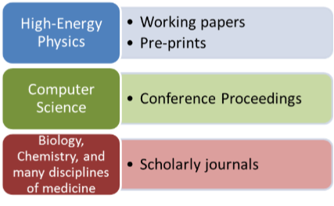
Content types
Articles (pre-print / post-print/official published version, depending on publishers’ agreements)
Conference proceedings
Reports
Books
Book chapters
Research data
Podcasts
Multimedia
Publication outputs by discipline
Research Information Network Report, (2009) Communicating Knowledge
Notes:
Research Information Network Report, (2009), Communicating Knowledge: How and why UK researchers publish and disseminate their finding, [Online] Available at: http://www.rin.ac.uk/system/files/attachments/Communicating-knowledge-report.pdf

Slide 5
History

Slide 6
2002
2001
 | An old tradition and a new technology have converged to make possible an unprecedented public good. The old tradition is the willingness of scientists and scholars to publish the fruits of their research in scholarly journals without payment, for the sake of inquiry and knowledge. The new technology is the internet. The public good they make possible is the world-wide electronic distribution of the peer-reviewed journal literature and completely free and unrestricted access to it by all scientists, scholars, teachers, students, and other curious minds. Removing access barriers to this literature will accelerate research, enrich education, share the learning of the rich with the poor and the poor with the rich, make this literature as useful as it can be, and lay the foundation for uniting humanity in a common intellectual conversation and quest for knowledge. For various reasons, this kind of free and unrestricted online availability, which we will call open access, has so far been limited to small portions of the journal literature….
Notes:
Open Access was defined in the Budapest Open Access Initiative, 2002.
http://www.soros.org/openaccess

Slide 7
Types of open access

Slide 8
Open Access The Green Route
Self archiving
Institutional Repositories
Subject Repositories
Departmental, research project, individual websites
Archiving of a version
Check Sherpa Romeo for publisher agreements
Notes:
RePEc (Economic science)
E-LIS (Library and information Sciences & documentation)

Slide 9
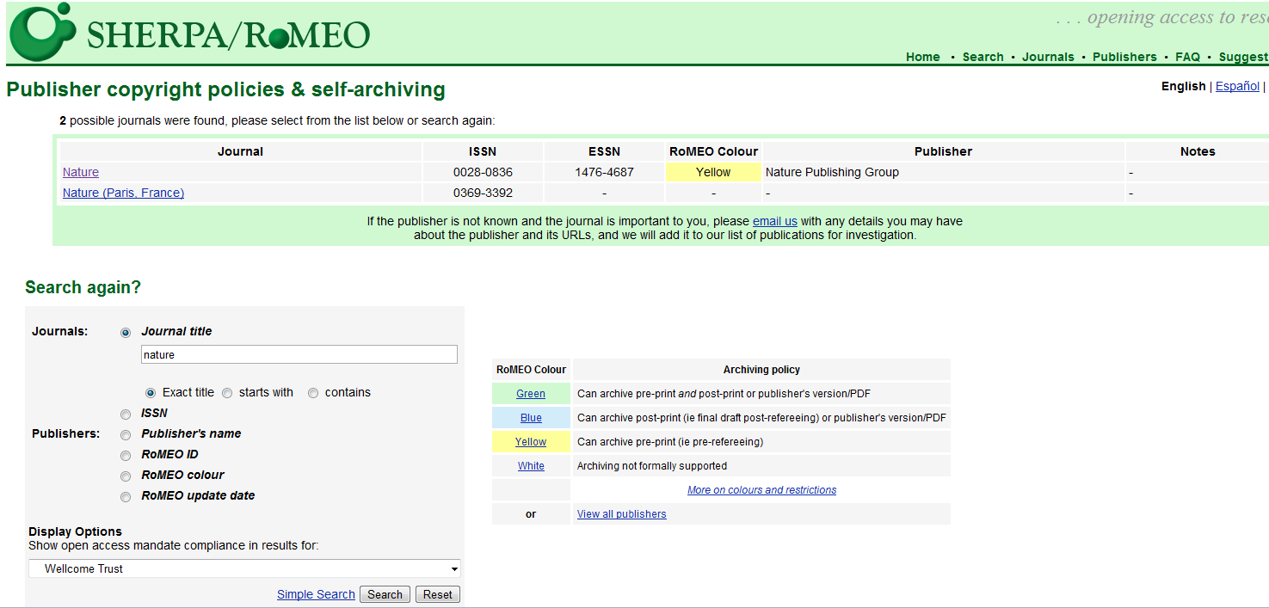

Slide 10
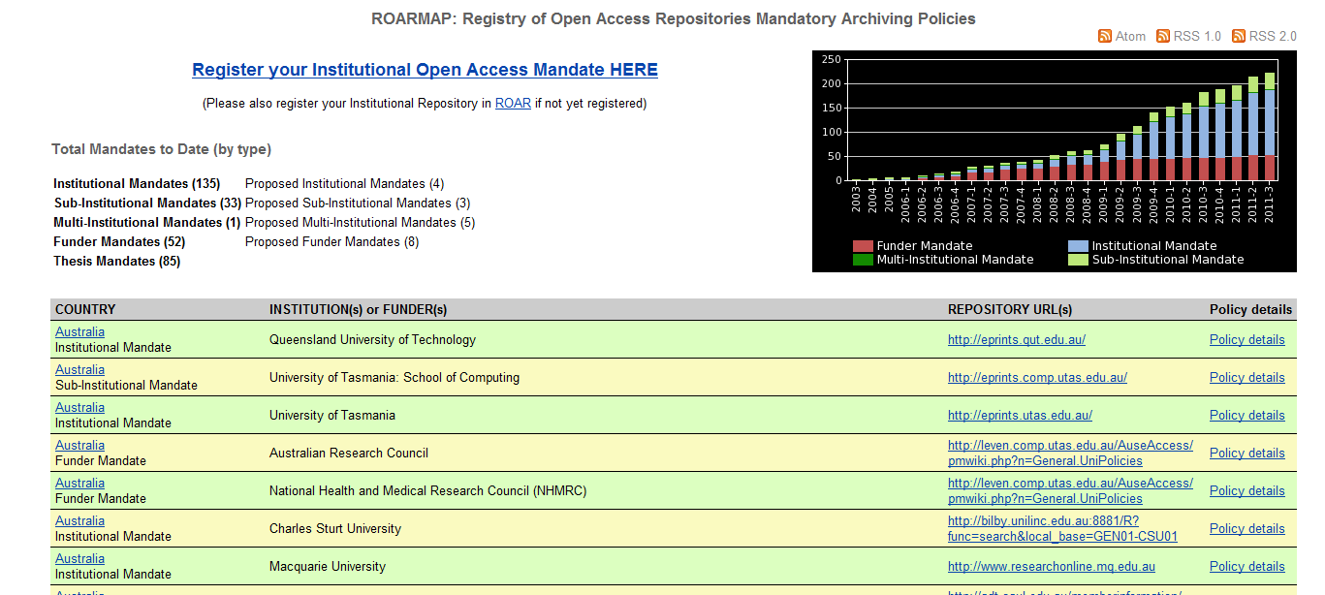

Slide 11
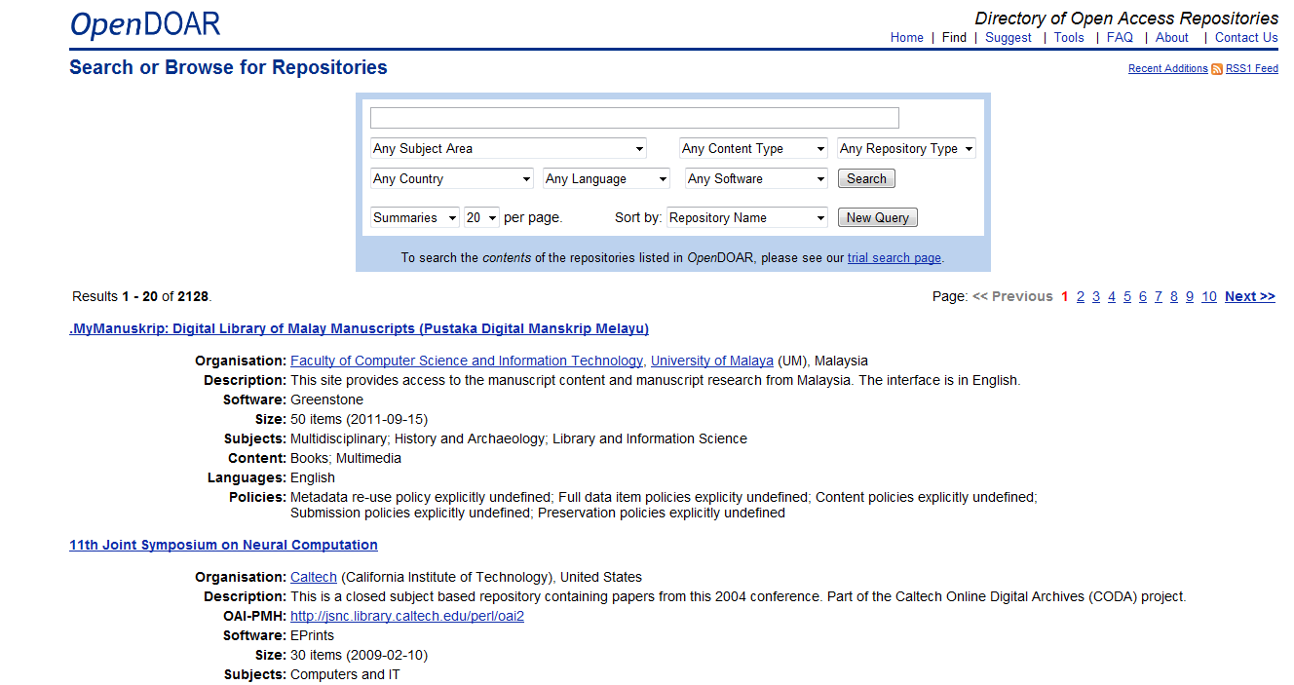
Notes:
The Directory of Open Access Repositories (DOAR) now lists 2,085 repositories globally, of which 51 repositories are found in 15 African countries.
Insert image of DOAR

Slide 12
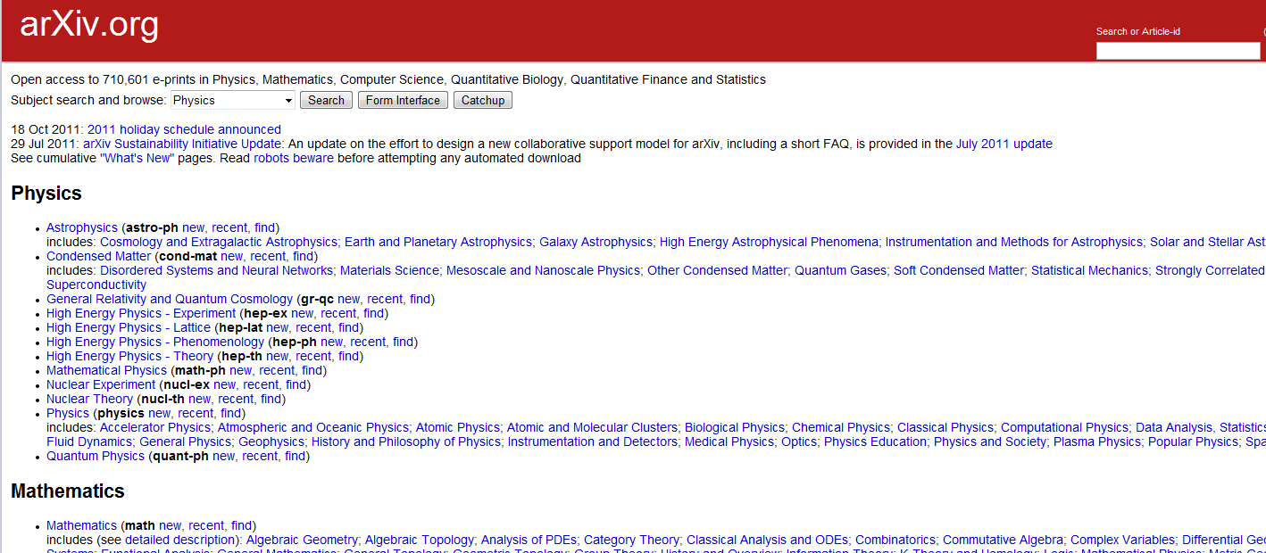
Notes:
ArXiv has been self archiving since 1980s (CS and physics, computational mathematics) 100k articles in physics, 10k in maths, 1k in CS

Slide 13
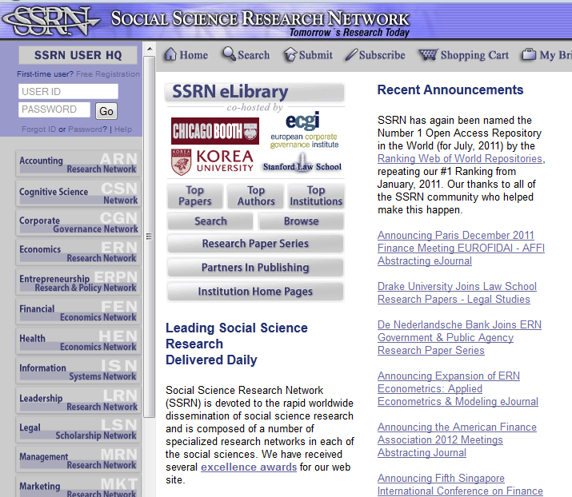

Slide 14
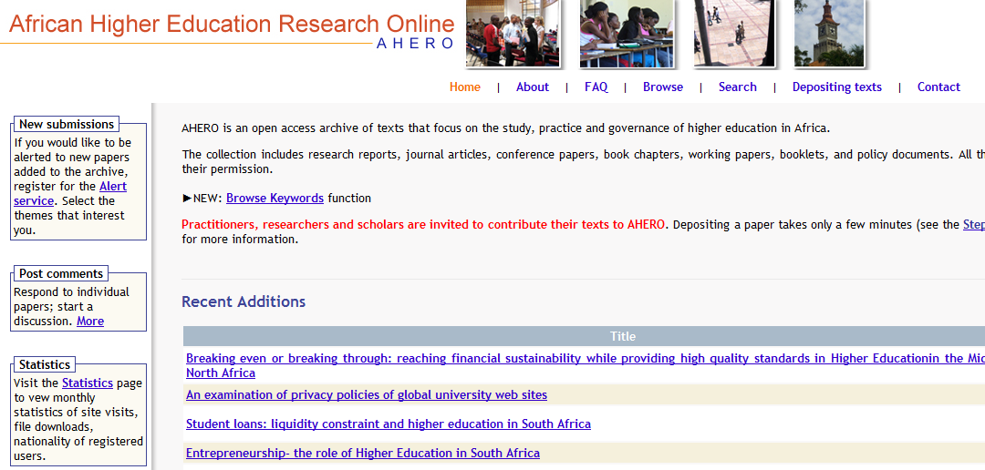

Slide 15
Open Access The Gold Route
Publishing in OA journals
Commercial (PLOS, Biomed Central)
Society (numerous)
Universities
Rapid growth of open access publishing
Estimated one third of academic journals now open access
Notes:
Traditional journal increased by 3% year for the past 300 years (hardly at all until the late 19th C mostly in the 20th C)
OA journals been around for the last decade, growth 30% in numbers of journals since inception; 38% for articles ;2009, 120k articles;
8% of yearly article production

Slide 16
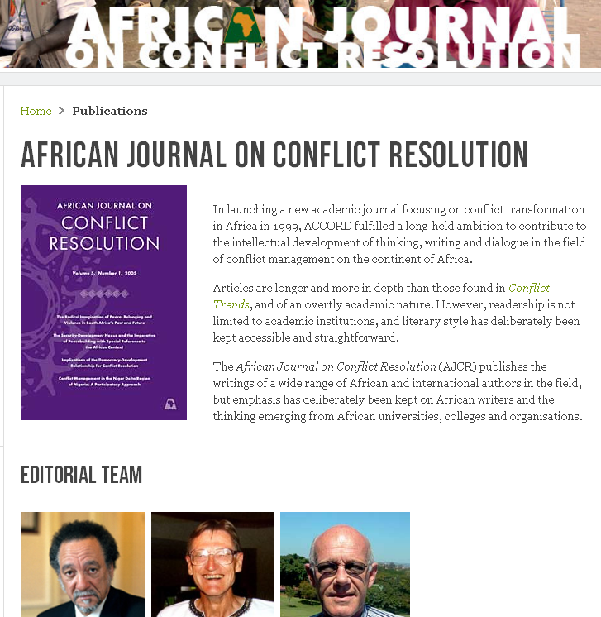
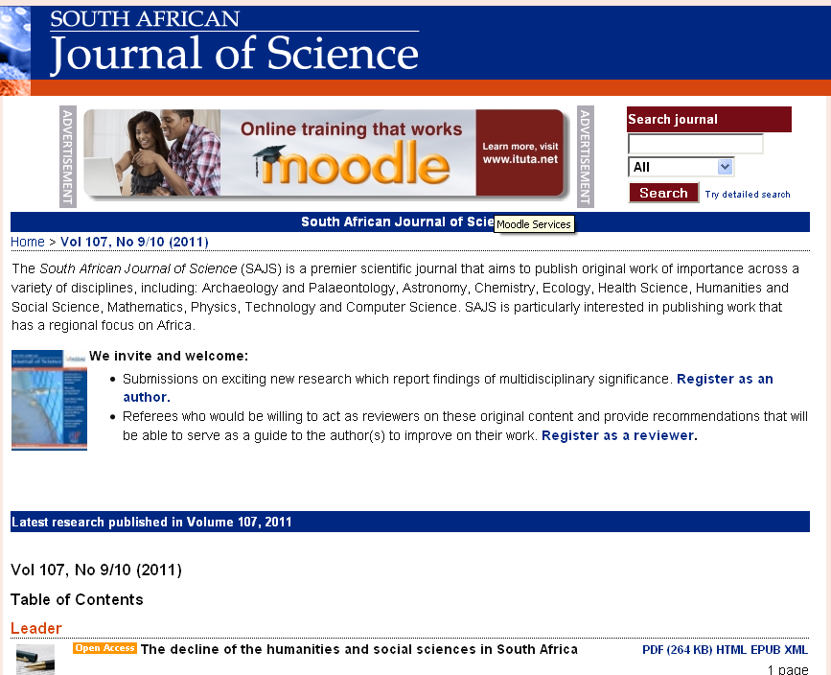
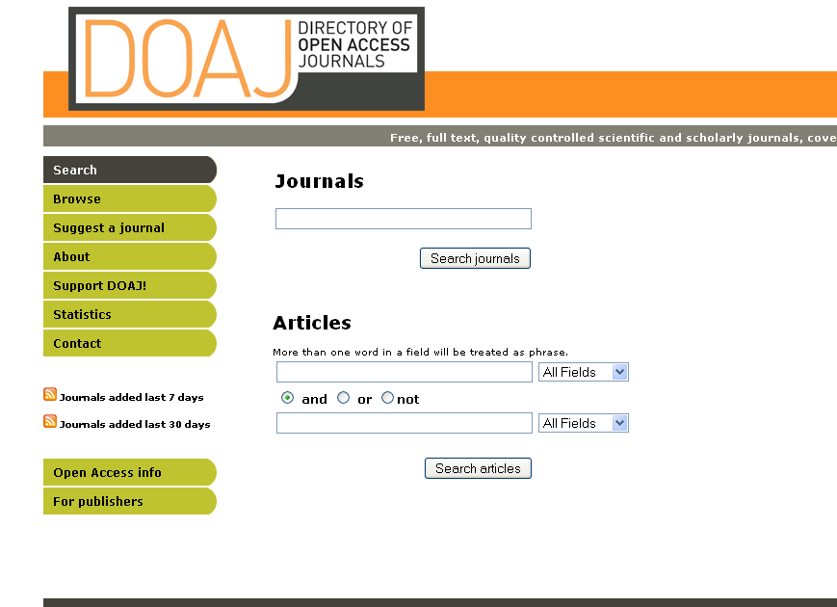
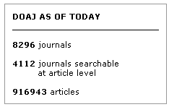
Notes:
DOAJ at 22 October 2012

Slide 17

Openness is like sunshine
http://www.flickr.com/photos/pixthepixie/188345043/sizes/z/in/photostream/

Slide 18
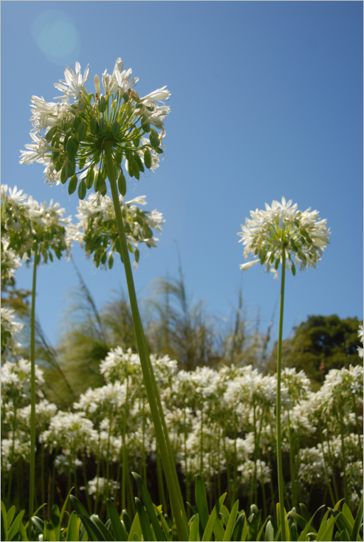
Openness exposes content online
and
enables growth
http://www.flickr.com/photos/planetina/405489316/sizes/o/in/photostream/
Thanks to Amber Thomas
Notes:
http://www.flickr.com/photos/planetina/405489316/sizes/o/in/photostream/

Slide 19
Openness provides access
Notes:
Knowledge production

Slide 20
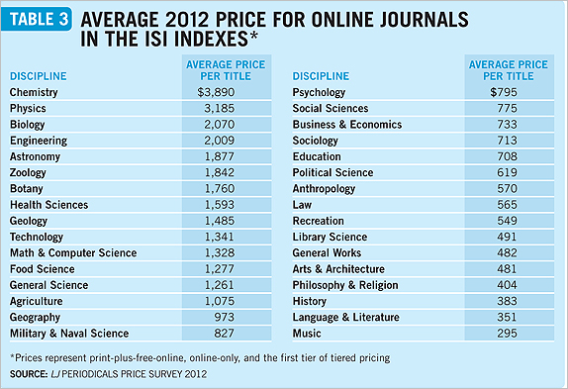
Notes:
http://lj.libraryjournal.com/2012/04/funding/coping-with-the-terrible-twins-periodicals-price-survey-2012/
Coping with the Terrible Twins | Periodicals Price Survey 2012
By LJ on April 30, 201

Slide 21
Openness enables Development
doctors, farmers, civil society, the public
government itself

Slide 22
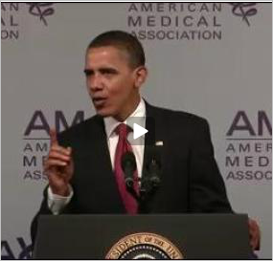
“….too many doctors and patients are making decisions without the benefit of the latest research.”
Obama 2009
Notes:
http://www.righttoresearch.org/learn/whyOA/index.shtml

Slide 23
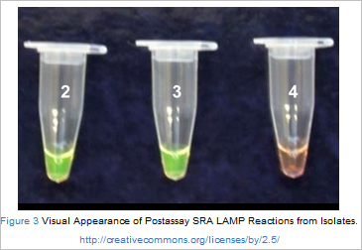
A case: the sleeping sickness test
Njiru ZK, Mikosza ASJ, Armstrong T, Enyaru JC, Ndung'u JM, et al. (2008) Loop-Mediated Isothermal Amplification (LAMP) Method for Rapid Detection of Trypanosoma brucei rhodesiense. PLoS Neglected Tropical Diseases 2(2): e147. doi:10.1371/journal.pntd.0000147
Notes:
If this test had been made available in a closed journal (the HS was 1600$ a title), the lead time for publication would be really slow , the lag means that lives are lost. Openess means immediacy . This literally means that open content can save lives.

Slide 24
Openness enables participation
Notes:
Knowledge production

Slide 25

African universities are essentially consumers of knowledge produced in developed countries.
Minister of Higher Education, Blade Nzimande UNESCO Conference on Higher Education, 2009

Slide 26
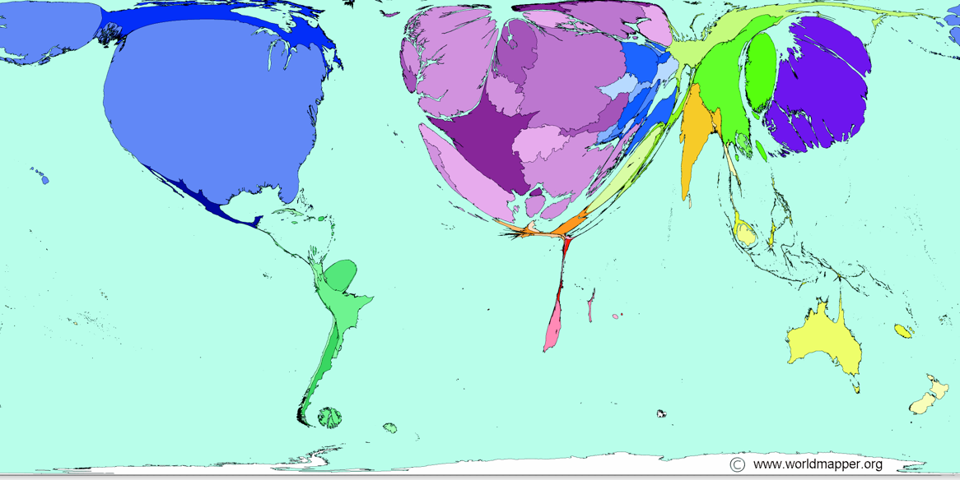
Books published
the opposite of open is “broken”
Notes:
Publishing and disseminating books in a print context is really difficult and expensive, and distributing across borders a vexed process.

Slide 27
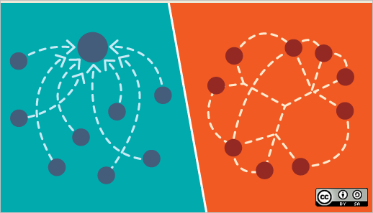
Conventional north – south relationships
Notes:
Explain!

Slide 28
…can be replaced with networked relationships
Notes:
ead the articles on opensource.com 2 reasons why the term "crowdsourcing" bugs me Why the open source way trumps the crowdsourcing way Do you aspire to build a brand community or a community brand? Does your organization think like Ptolemy? Ten ways our world is becoming more Sharable Crowdsourced ideas make participating in government cool again
Created by Libby Levi for opensource.com
http://www.flickr.com/photos/opensourceway/4370250237/in/set-72157623343013541

Slide 29
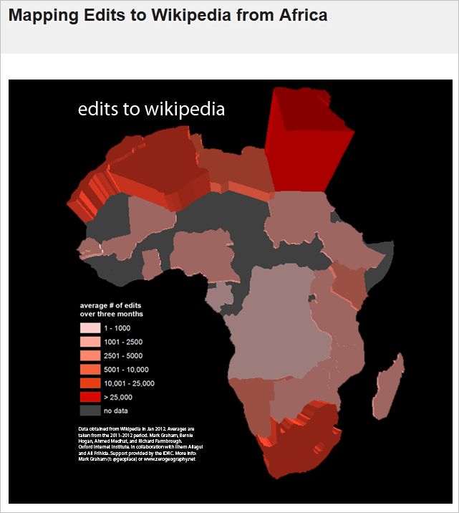

Notes:
Mark Graham March 2012
This is content being put online from the south.
Wikipedia content- 6th most popular web site etc

Slide 30
Openness enables Innovation

Slide 31
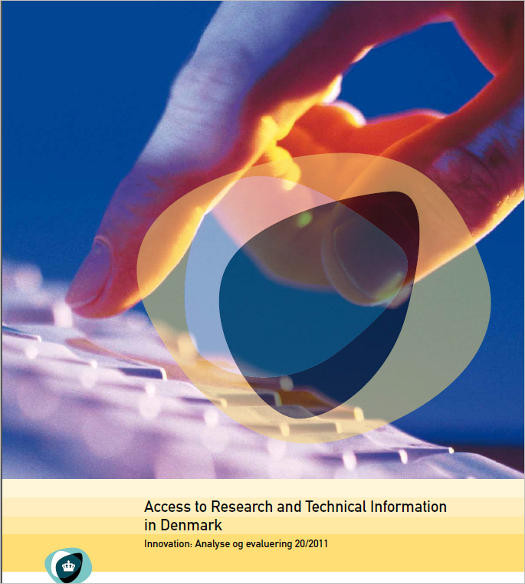
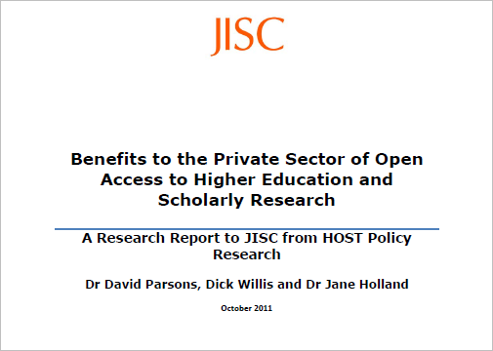
Open access benefits the private sector
Houghton, J; Swan, A & Brown, S (2011)
Notes:
“This and past studies show the importance of publicly funded and academic research for private sector innovation and …performance…”
Crisis of unemployment, SME touted as the solution, they don’t have R&D funds, open access to content is even more critical in South Africa.

Slide 32
Openness increases visibility
Notes:
Good news for academics

Slide 33

Notes:
Stacey Stent

Slide 34

My question is “Am I making an impact?”
http://www.flickr.com/photos/cindy_mc/6967806783/ Thanks to Sam Gross
Notes:
Thanks to Sam Gross’ New Yorker cartoon

Slide 35
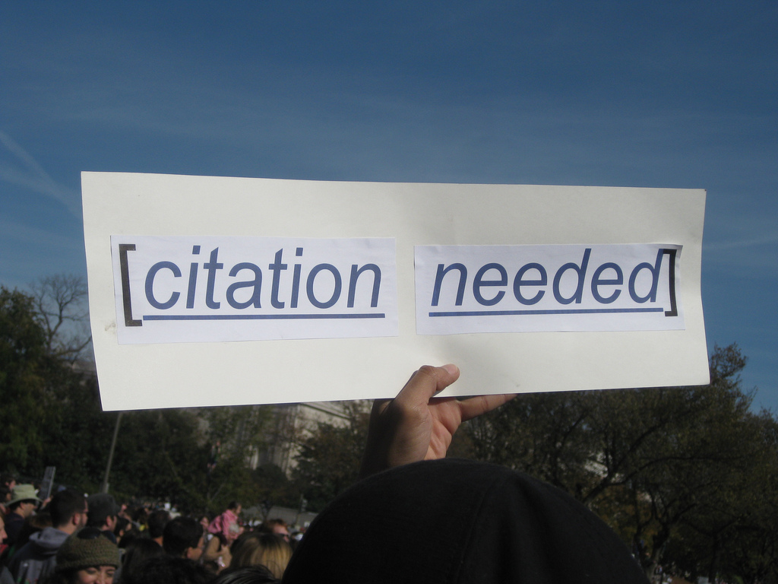
http://www.flickr.com/photos/87913776@N00/5129607997 CC-BY
Notes:
Academics need their work to be available and read in order to make this impact, read and citations are the measure of this

Slide 36
OA and impact
31 studies in a wide range of disciplines on OA and citations advantage
27 studies show up to 600% increase in impact
4 studies show no difference
Swan A (2010) The Open Access Citation Advantage: Studies and Results to Date. Available at http://eprints.ecs.soton.ac.uk/18516/
Notes:
Of the 35 studies surveyed, 27 have shown a citations advantage (the % increase ranges from 45% increase to as high as 600%), with only 4 showing no advantage

Slide 37
The OA advantage
(a) A General OA Advantage: the advantage that comes from citable articles becoming available to audiences that had not had access to them before, and who would find them citable
(b) An Early Advantage: the earlier an article is put before its worldwide potential audience may affect subsequent citation patters
(c) A Selection Bias: authors make their better articles Open Access more readily than their poorer articles
(d) A Quality Advantage: better articles gain more from the General OA Advantage because they are by definition more citable than poorer articles
Swan A (2010) The Open Access Citation Advantage: Studies and Results to Date. Available at http://eprints.ecs.soton.ac.uk/18516/

Slide 38
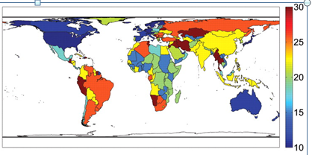
OA impact: developing countries
The influence of free access on citations is twice as large for the poorer countries in the developing world compared to richer countries as measured by per capita GNI (Evans and Reimer 2009).
Notes:
(C) Global projection of percentage increase in citations for GNI country deciles of the poorest country hosting a citing author after free online availability.
Evans and Reimer
J A Evans, J Reimer Science 2009; 323:1025-1025

Slide 39
Openness is essential for all students & ex-students
Notes:
Good news for academics

Slide 40


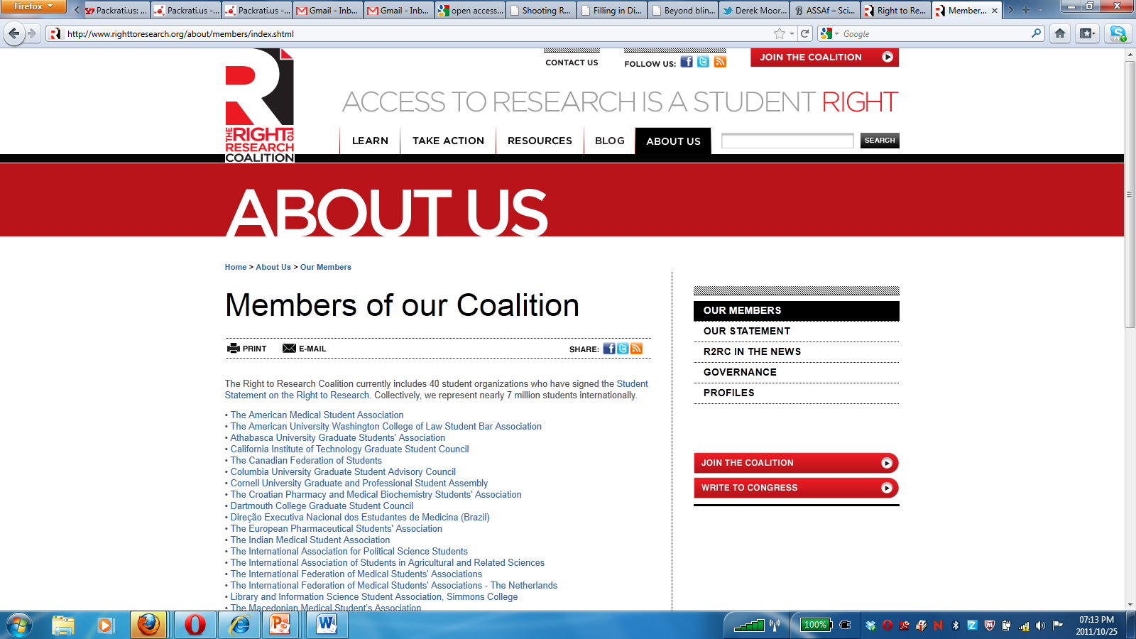
Student support
Notes:
7 million students internationally, canvas on right University of Cape Town students during Open Access Week October 2011

Slide 41
Open access is becoming mainstream
Changing policy environment

Slide 42
OA policy development
UNESCO has adopted OA to Scientific information – policy for national governments and institutions
The World Bank has created an OA policy for all its publications and encourages transformative use
The FAO promotes open agricultural information for development

Slide 43
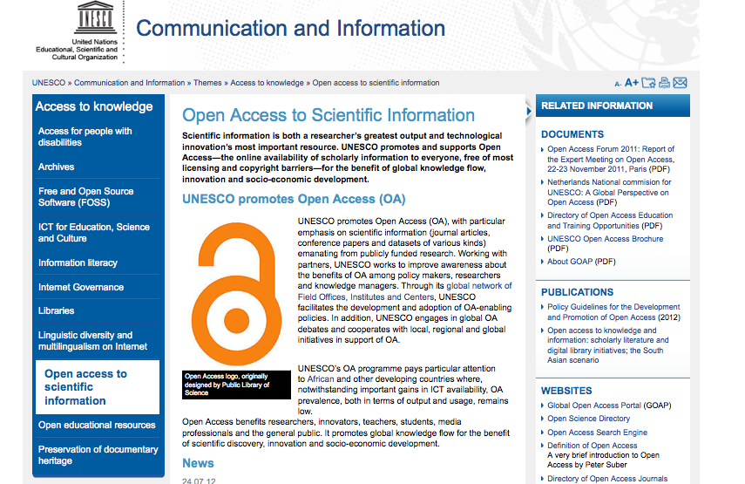
UNESCO - OA to scientific information…

Slide 44
The World Bank

Slide 45
National and regional governments
The European Commission recently launched Horizon 2020, with €8 billion dedicated to support for research communication infrastructure
The Finch Report recommendations were accepted by UK government, with £10 million dedicated to Article Processing charges for publicly funded research

Slide 46
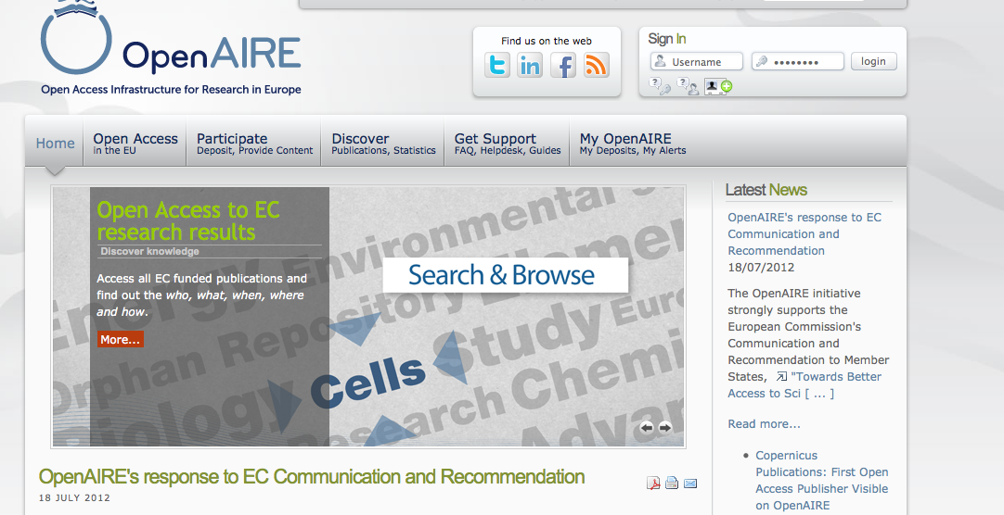

Slide 47
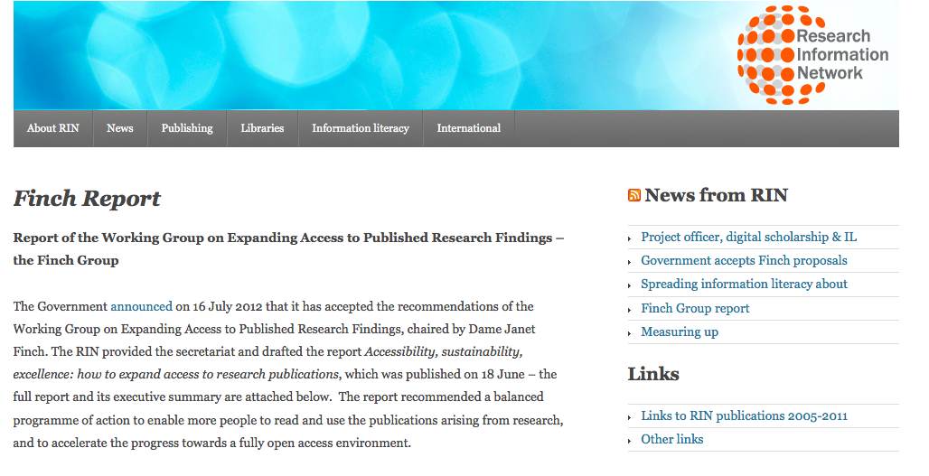
http://www.researchinfonet.org/publish/finch/

Slide 48
Research councils and funders
RCUK mandates publication in OA journals with a block grant to cover APCs
The Wellcome Trust requires deposit in Pubmed Central for articles on research it funds
Financial and reputational penalties for non-compliance
DFID requires OA publication in support of the developing world access

Slide 49
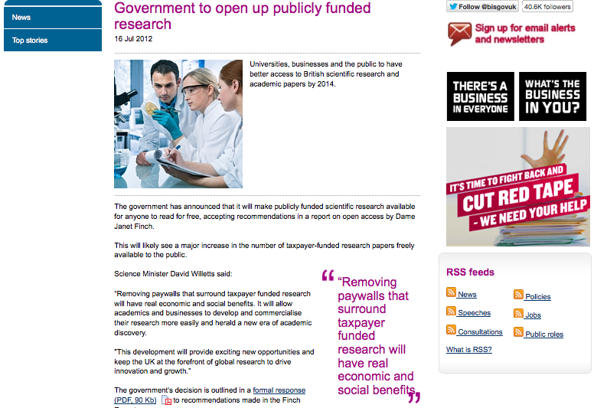

Slide 50
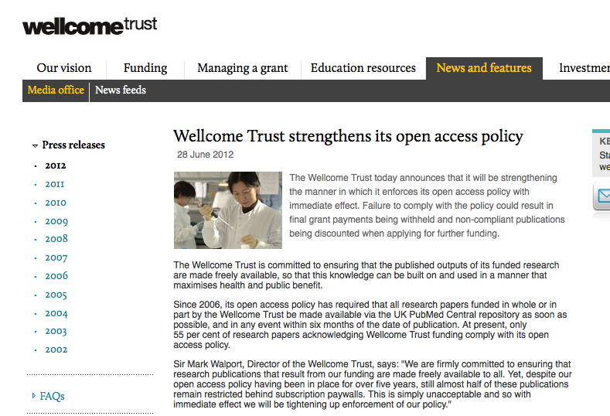

Slide 52
the developing world
SciELO in Latin America - 800 journals, 300,000 articles
SCiELO South Africa, supported by the DST, run by the Academy of Science of SA
Bioline International provides a platform for developing country journals
Swan, A 2011, http://www.wsis-community.org/mod/file/download.php?file_guid=37146

Slide 53
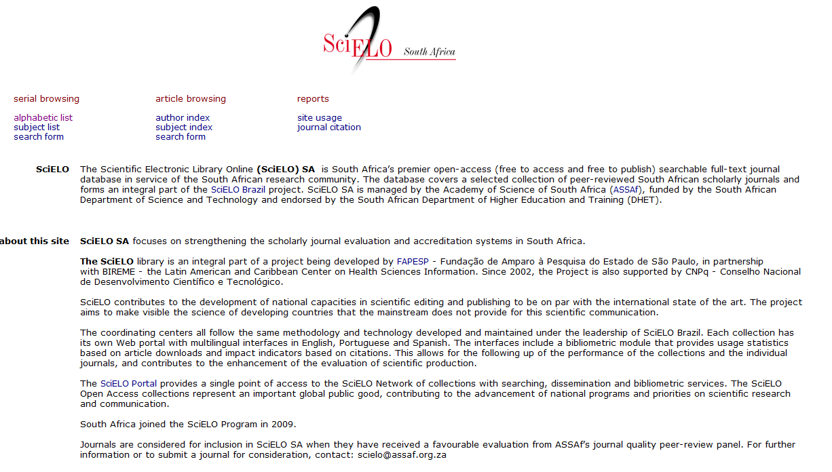

Slide 54
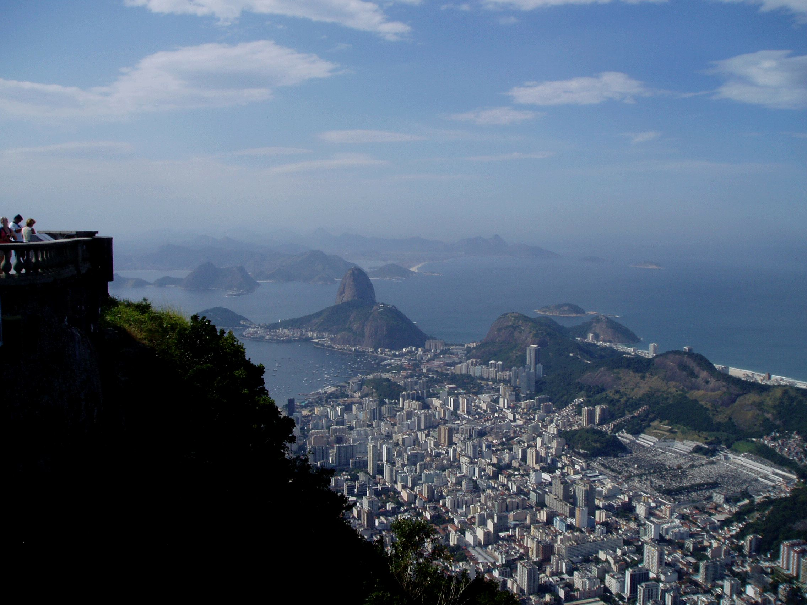
Brazil is now the 3rd largest publisher of OA journals in the world, after USA and the UK
SciELO and SciELO SA are now in the Web of Science
Alperin et al., 2008, Open access and scholarly publishing in Latin America: ten flavours and a few reflections evista.ibict.br/liinc/index.php/liinc/article/view/269/167

Slide 55
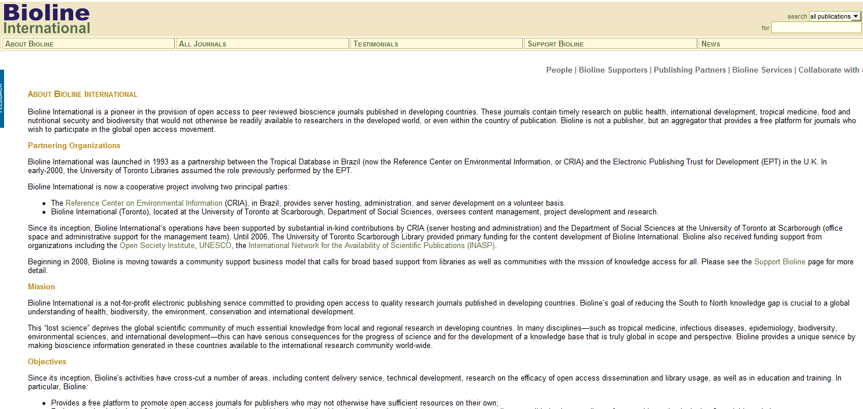
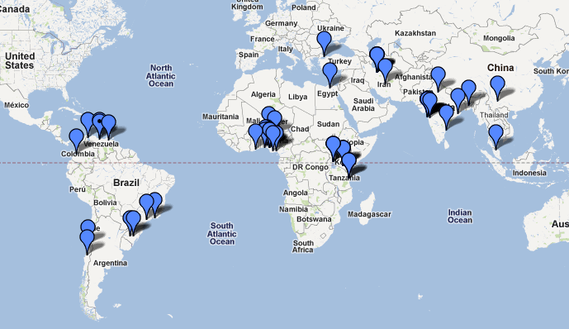

Slide 56
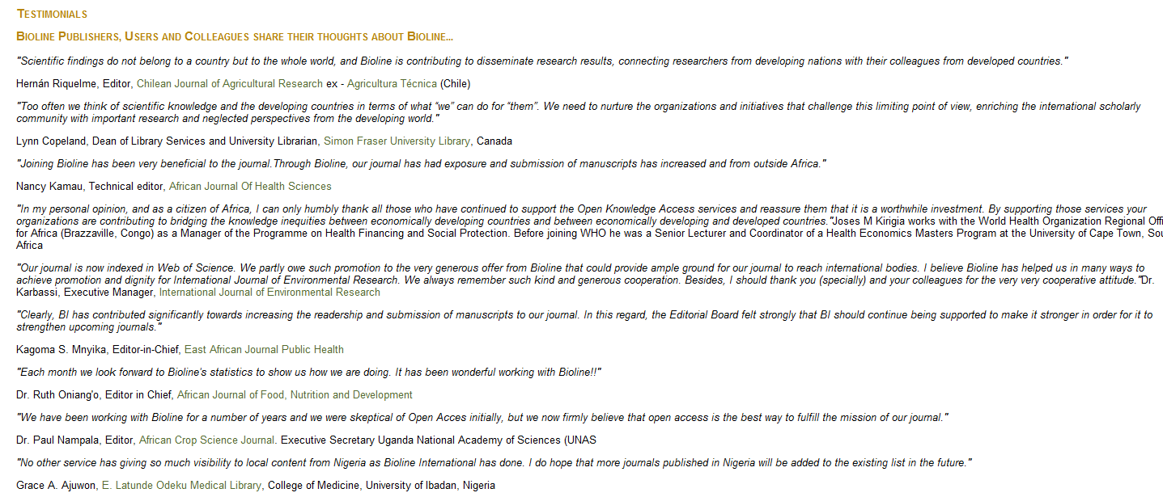

Slide 57
ISSUES
Myths, concerns, benefits

Slide 58
Concern: quality
OA= peer review
Peer review = editorial processes
Quality varies in usual way
Not vanity publishing
No quality control in VP
Some accredited journals

Slide 59
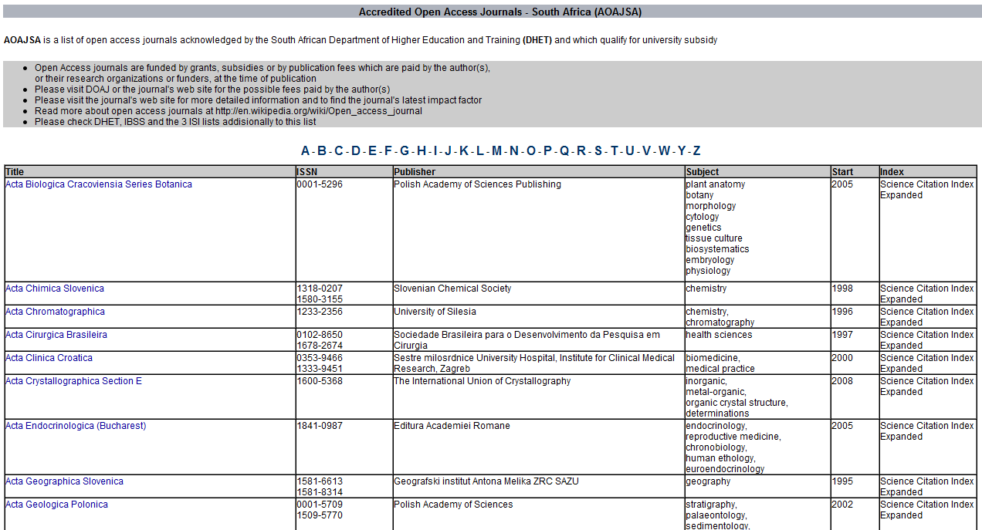

Slide 60
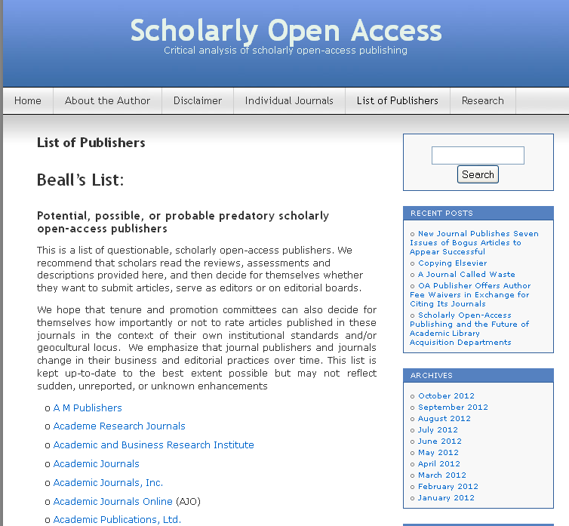

Slide 61
Concerns: not in my discipline
All disciplines
See DOAJ
But
The distribution of open access journals over disciplines is rather even. Grouped together, however, two thirds of the journals and three quarters of the articles are in STM
Dallmeier-Tiessen et al 2010
Notes:
OPEN ACCESS PUBLISHING -
MODELS AND ATTRIBUTES
July 8th, 2010
Suenje Dallmeier-Tiessen a, Bettina Goerner b, Robert Darby c Jenni Hyppoelae a,
Peter Igo-Kemenes a #, Deborah Kahn d, Simon Lambert c, Anja Lengenfelder e,
Chris Leonard c, Salvatore Mele a,*, Panayiota Polydoratou e, David Ross f,
Sergio Ruiz-Perez a, Ralf Schimmer e, Mark Swaisland g and Wim van der Stelt h

Slide 62
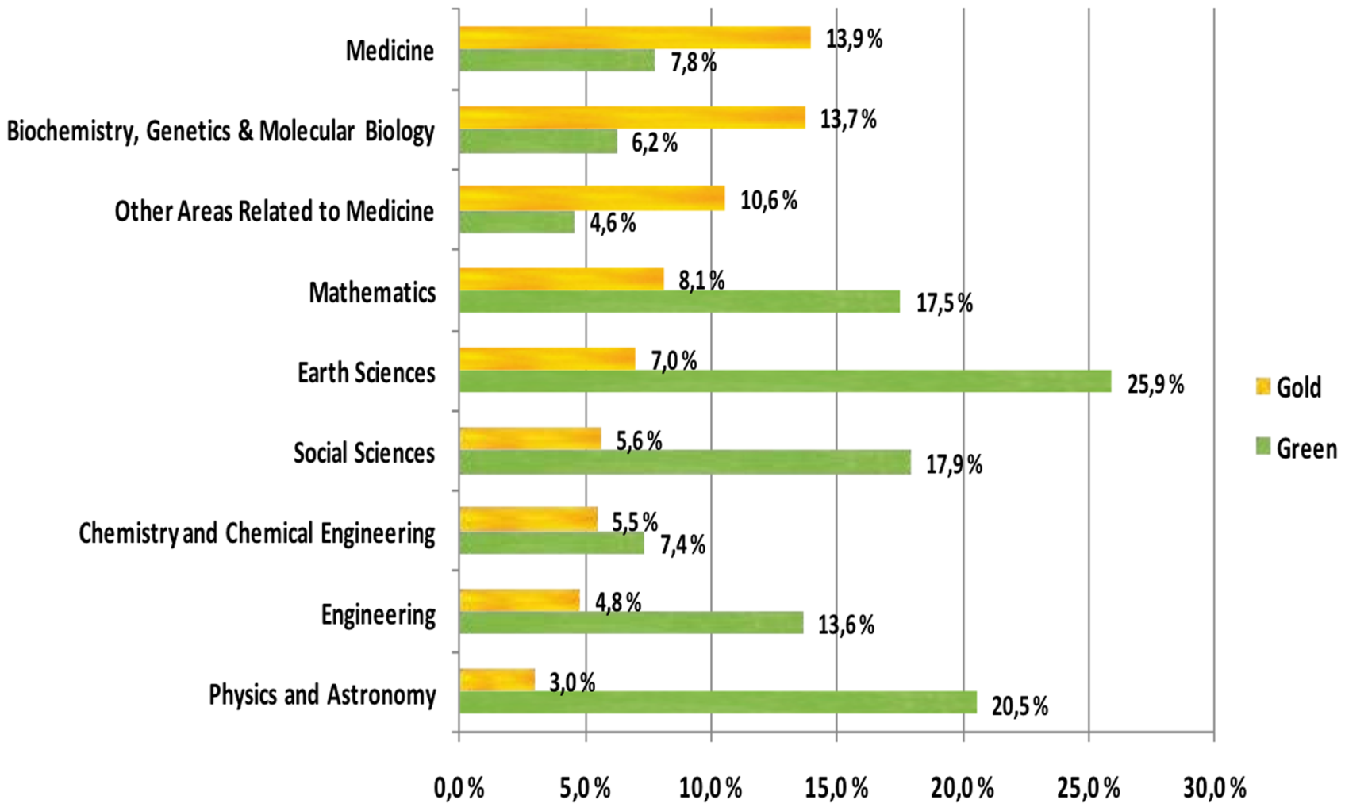
OA availability (by discipline)
An example of analyses of 2008 figures
Source: Open Access to the Scientific Journal Literature: Situation 2009. Björk B-C, Welling P, Laakso M, Majlender P, Hedlund T, et al. PLoS ONE 5(6): e11273. doi:10.1371/journal.pone.0011273 (2010)
Notes:
OA availability by scientific discipline
Based on the research conducted by Bjork et al., the availability of gold and green OA copies by scientific discipline are shown in the figure. The disciplines are shown by the gold ratio in descending order, rather than in alphabetical order. There is a clear pattern to the internal distribution between green and gold in the different disciplines studied. In all the life sciences, gold is the dominating OA access channel. The picture is reversed in the other disciplines where green dominated. The lowest overall OA share is in chemistry with 13% and the highest in earth sciences with 33%.

Slide 63
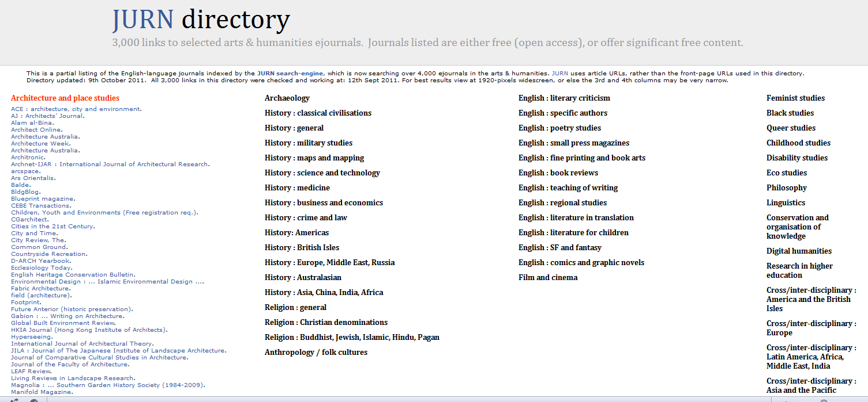
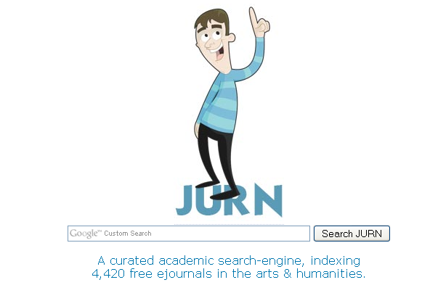

Slide 64

HSRC Press distributes in 11 countries
Downloads in 184 countries
Online titles visited 22.5 times more often than copies bought

Slide 65
Concern: lose control
Belief that open access = copyright, loss of ownership
But OA = public domain
Instead with OA scholars gain control
Open licensing

Slide 66



Enabling legal frameworks
Notes:
Open is not binary
It’s a continuum, a spectrum
Not Binary, Closed or open
Flexible model
Different levels of control
Spectrum members of the Open.Michigan team including
Garin Fons, Pieter Kleymeer, Kathleen Ludewig, Susan Topol, and Greg Grossmeier

Slide 67
Concern: Funding &costs
Free to the user
But
Costs to produce
Who pays?

Slide 68
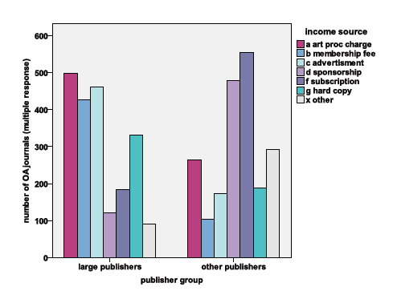
Dallmeier-Tiessen et al 2010
Notes:
Article Processing Charges (APC)
Funding agencies provide money to the author or establish agreements with publisher
Via Open Access funds
Via institutional membership
APC waved by publisher
OPEN ACCESS PUBLISHING -
MODELS AND ATTRIBUTES
July 8th, 2010
Suenje Dallmeier-Tiessen a, Bettina Goerner b, Robert Darby c Jenni Hyppoelae a,
Peter Igo-Kemenes a #, Deborah Kahn d, Simon Lambert c, Anja Lengenfelder e,
Chris Leonard c, Salvatore Mele a,*, Panayiota Polydoratou e, David Ross f,
Sergio Ruiz-Perez a, Ralf Schimmer e, Mark Swaisland g and Wim van der Stelt

Slide 69
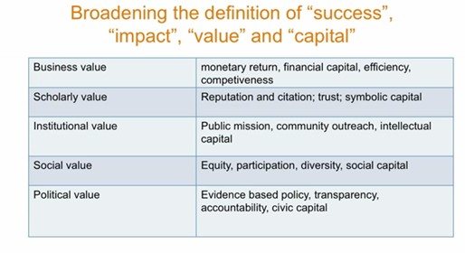
Costs & benefits
Chan, L 24 October 2011 Opportunities for Scholarly Communications in Africa www.vimeo.com/30922669

Slide 70
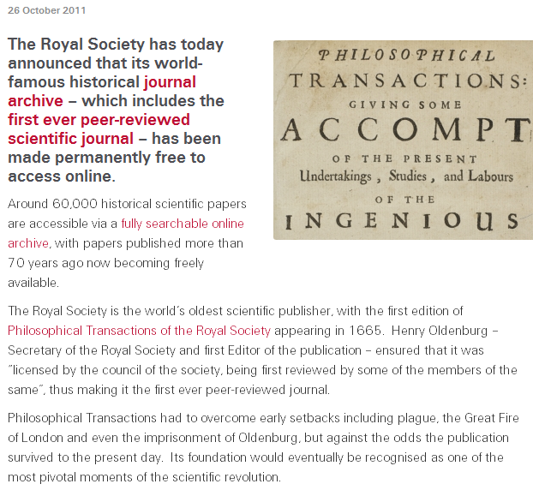
Full circle?

Slide 71
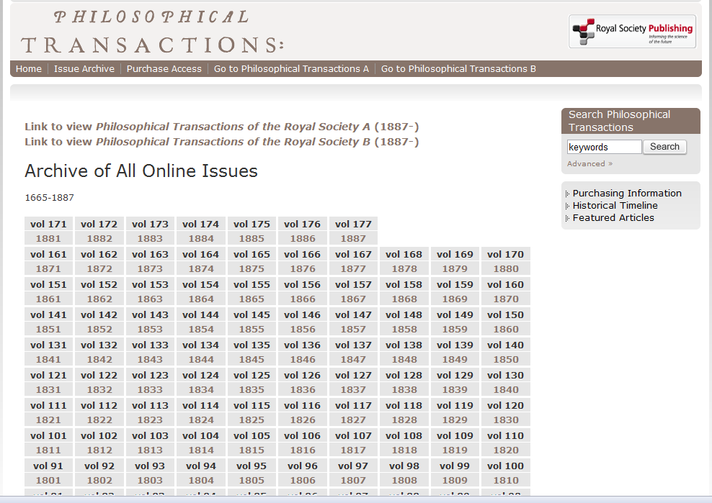

Slide 72

Thank you
Laura.Czerniewicz@uct.ac.za
http://openuct.ac.za

