Slide 1




Addressing Academic Profile:
New Tools and Services for Boosting Online Visibility
Sarah Goodier
OpenUCT
10 October 2013
OpenUCT Initiative
Notes:
…about online visibility tools and services that academics use and how these can potentially feed into the monitoring and assessment processes at the institutional level.

Slide 2
Workshop Overview
Part 1:
  Overview of current online tools and services for boosting academic visibility and profile
Part 2:
  Supporting academics in the utilisation of new online presence tools and platforms
Notes:
This WS is in two parts: an overview of the tools and services, with a focus on measuring impact of scholarly outputs; & discussion around supporting academics regarding these.

Slide 3
Part 1:
Overview of current online tools and services for boosting academic visibility and profile

Slide 4
eResearch
“e-research is a form of scholarship conducted in a network environment utilizing Internet-based tools and involving collaboration among scholars separated by distance, often on a global scale.”
from e-Research: Transformation in Scholarly Practice (available online at http://scholarly-transformations.virtualknowledgestudio.nl/)

Slide 5
eResearch
“e-research is a form of scholarship conducted in a network environment utilizing Internet-based tools and involving collaboration among scholars separated by distance, often on a global scale.”
from e-Research: Transformation in Scholarly Practice (available online at http://scholarly-transformations.virtualknowledgestudio.nl/)
Notes:
Taking a broad definition – network and internet based tools enabling collaboration on a large scale;
This includes how ICTs help researchers to collect, manage, share, process, analyse, store, find, and re-use information
“incorporation of a wide variety of new media and electronic networks in the research process”

Slide 6


Researcher’s online visibility
+
Academics need to:
  have their publications & most up to date information available, accessibly & discoverable online
Notes:
With journals, networking and sharing going increasingly online; and with search engines as the first place to start for most people looking for (scholarly) information in our digital world, online visibility is nb for academics – and becoming increasingly NB if they want their work to be found, read and cited;
Universities often don’t have their own in-house tools & services available, beyond static (and often outdated) academic profiles OR if they are there they aren’t easy to use/access – academics don’t feel like they own the space, so they go outside as they feel they need to have online presence to showcase their work & collaborations, etc – which is likely to help them attract recognition, prestige etc. and even aid them in working towards funding, promotions…

Slide 7
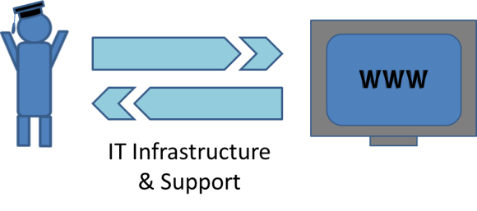
Researcher’s online visibility
+
Academics need to:
  have their publications & most up to date information available, accessibly & discoverable online
Notes:
…so, they go outside… that’s where IT comes in as it’s the IT infrastructure & support that connects academics to the network and internet.

Slide 8
eResearch & the academic
Rise of the digital scholar:
    “highly connected scholar, creating multimedia outputs and sharing these with a global network of peers”
from The Digital Scholar: How Technology Is Transforming Scholarly Practice (available online at: http://www.bloomsburyacademic.com/view/DigitalScholar_9781849666275/chapter-ba-9781849666275-chapter-001.xml)
Through online tools and services
Notes:
Working in our digital and increasingly connected environment had led to the rise of the digital scholar: a highly connected, …
Note: eResearch and digital scholarship is not a move away from “good research organizational practices” just good practise within an Internet environment

Slide 9
eResearch & scholarly communication
eResearch:
  Network; using internet-based tools in collaboration on a (potentially) global scale
*How ICTs can feed into & support the research and scholarly communication cycle*
Notes:
In the context of this broad definition of eResearch, this comes back to how ICTs can feed into and support the research and scholarly communication cycle

Slide 10
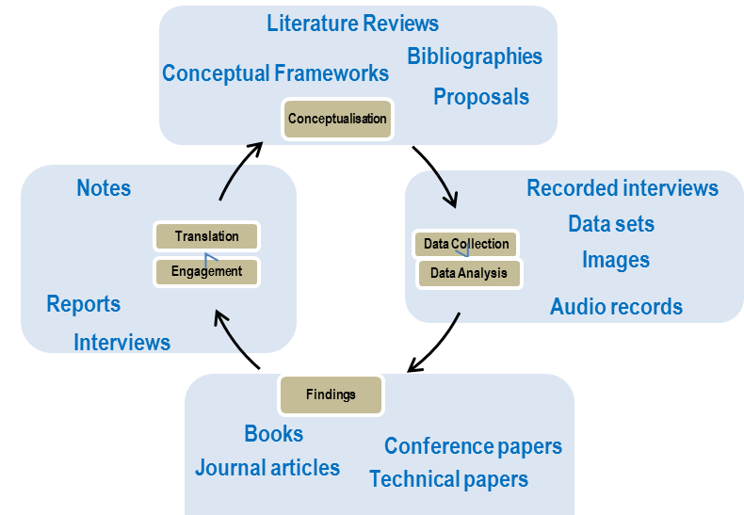
Research & scholarly communication cycle
Networking
& collaboration
Modified from Czerniewicz (2013)
Notes:
This is a representation of the scholarly communication cycle, indicating the major steps from conceptualisation of a research idea through data collection and analysis, findings and engagement and translation (in a T&L context); with the blue boxes indicating various outputs that can be associated with each stage.

Slide 11
Research & scholarly communication cycle
Management & administration;
Monitoring & assessment;
Curation & preservation
Networking
& collaboration
Modified from Czerniewicz (2013)
Notes:
An element around this cycle is the administration and monitoring processes associated with research activities, which are required as part of the management of the institution's research output record (and thus a link to the publishing element of the life cycle)

Slide 12
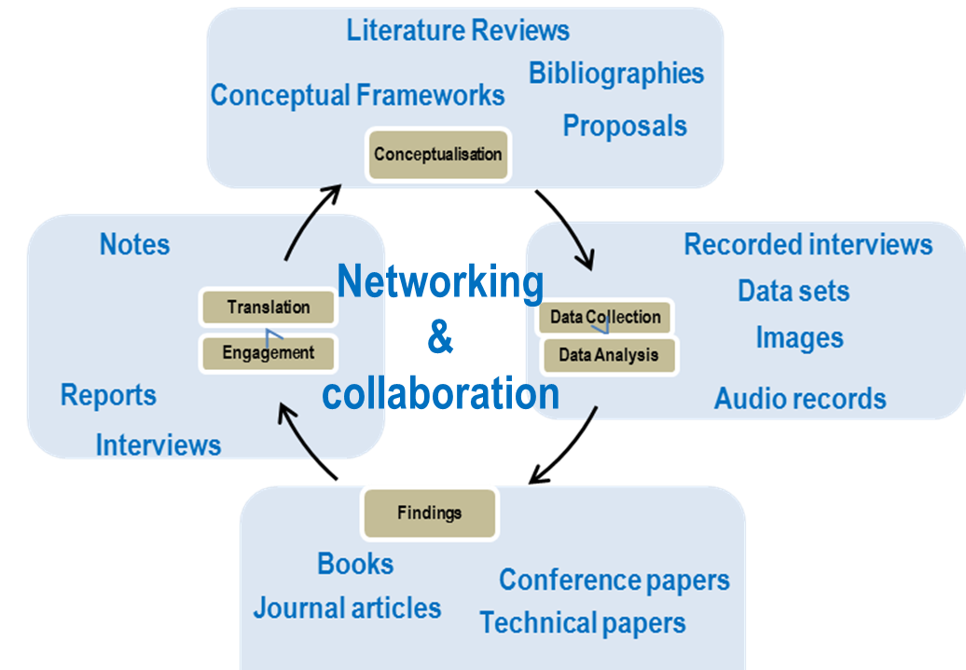
Online tools & services for boosting academic visibility & profile
Shareable Outputs
Shareable Outputs
Shareable Outputs
Shareable Outputs
Modified from Czerniewicz (2013)
OpenUCT Initiative
Notes:
And this can be seen as increasingly challenging in an environment enabled by the web, where outputs can potentially be published and shared at any point in the scholarly communication cycle – both within and beyond the university environment. Its not just journal articles!

Slide 13


An academics’ university-based online presence
University published outputs in repository
WWW
University profile page
Content on university site about/by the academic
University-based publications (scholarly & media)
University research data in repository
Notes:
In terms of online sharing of these outputs, there are some online presence and tools within institutions;
But if in-house tools & services are available, they often aren’t easy to use/access – a web content manager would often be required to added to/update the pages - academics don’t feel like they own the space…

Slide 14














An academics’ www online presence
Notes:
so they go outside the institution as they feel they need to have online presence to showcase their work & collaborations, etc – funding, promotions, recognition, prestige etc. that they can update;
And this raises a Q: Is it necessary to have uni stuff or better to use outside and use tools already available – esp. for academic networking? Outside tools can be better in certain aspects for certain things.

Slide 15
Online tools & services for boosting academic visibility & profile
Networking & sharing
Academic
Social
OpenUCT Initiative
Notes:
Overview of current online tools and services for boosting academic visibility and profile:
In terms of networking & sharing tools, there are two broad categories:
Academic networking & sharing
Social networking & sharing with an academic purpose
Note the overlap – some tools could be classified as both

Slide 16
Online tools & services for boosting academic visibility & profile
Formal & informal scholarly communication
‘Formal’
‘Informal’
Academic
Social
OpenUCT Initiative
Notes:
Academic networking & sharing – of the more formal academic output
Social networking & sharing with an academic purpose – of the more informal outputs; still academic in nature
In the environment of the digital scholar, these are just different tools for connecting and communicating – social tools can serve the academics purpose for increasing their visibility and disseminating their work

Slide 17
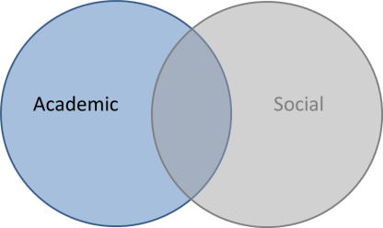
Academic
Data sharing
Networking and connection building
Publication sharing
Communication
Collaboration
Metrics
Notes:
Academic networking & sharing tools enable…

Slide 18
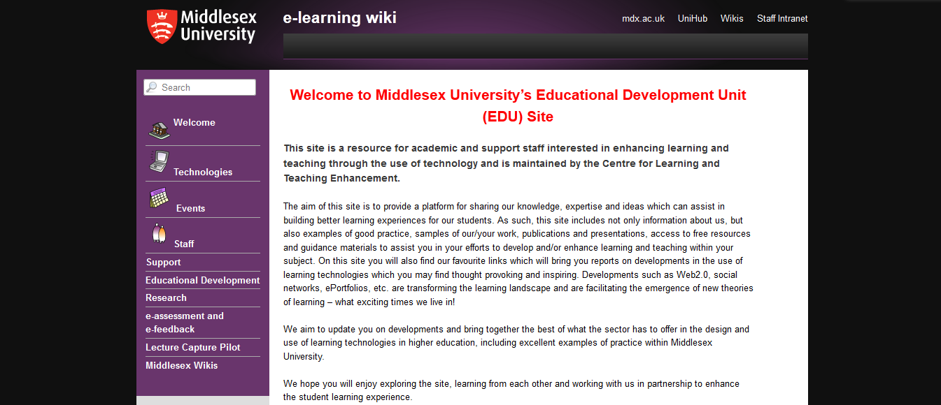
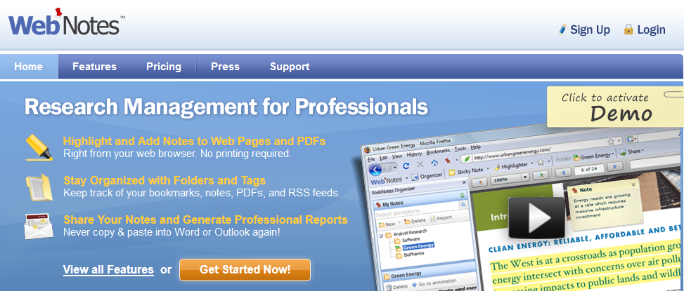
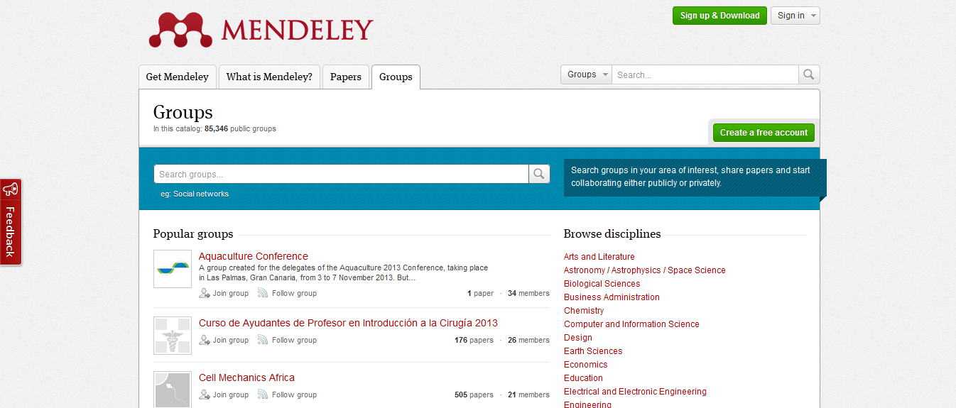
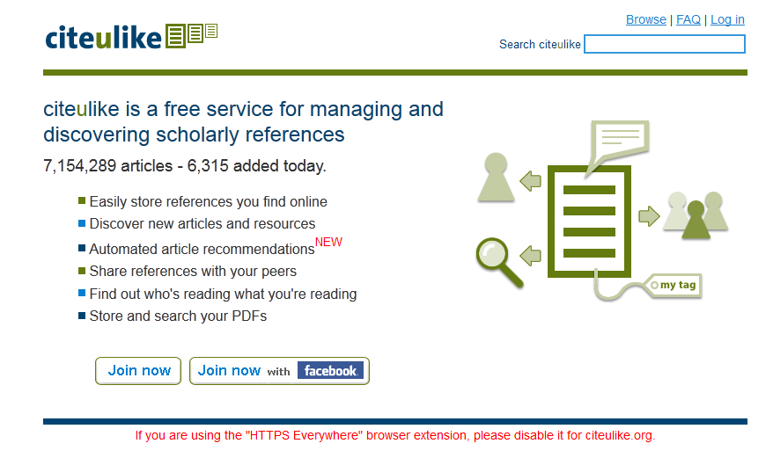
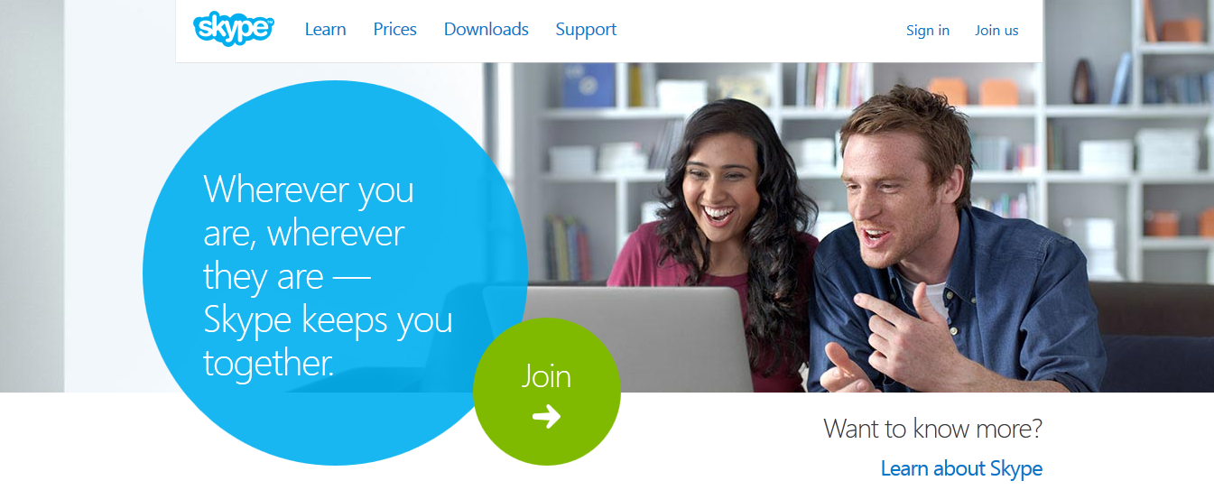
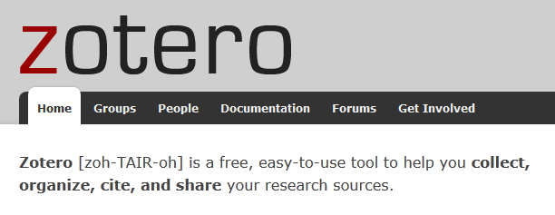
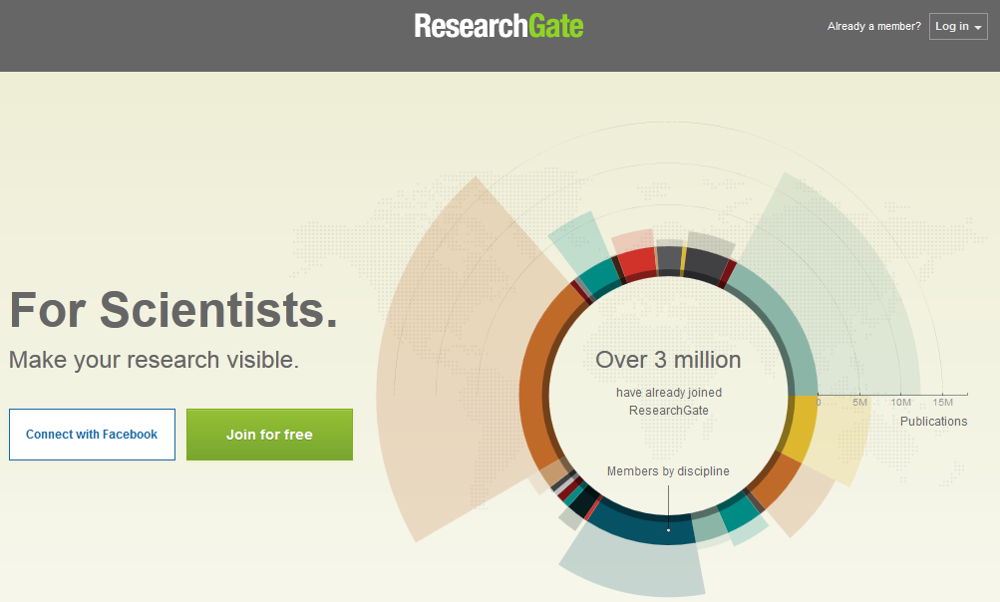
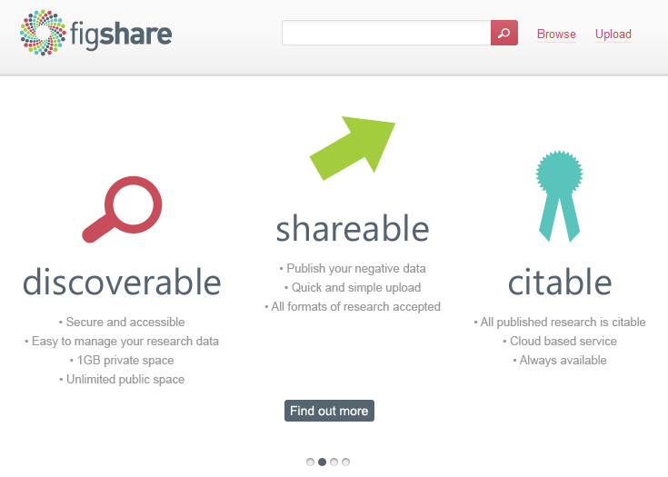
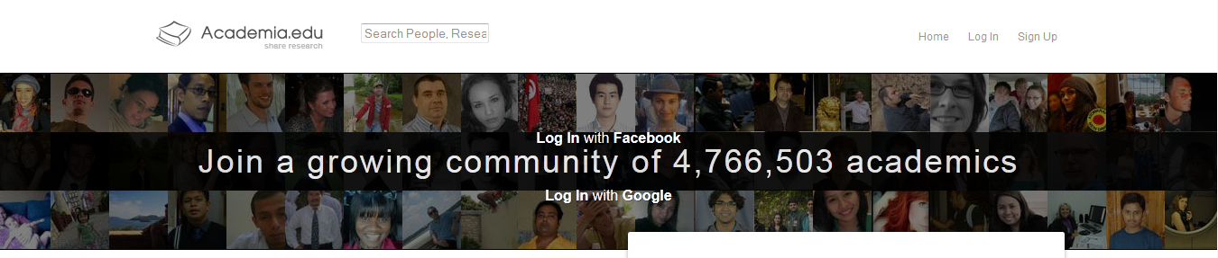
Examples
Notes:
Video conferencing - Skype
Data collection, processing & analysis -
Blogging – university based blogs
Wiki – uni based wikis; subject wikis
Bookmarking – citeUlike; Mendeley
Referencing & reference management – Mendeley; RefWorks
Academic networking – Mendeley; LinkedIn; ResearchGate; Academia.edu
Publication sharing – Mendeley; Zetoro; Citeulike
Data sharing - Figshare
Lab books online – OpenNotebook
And many more!

Slide 19
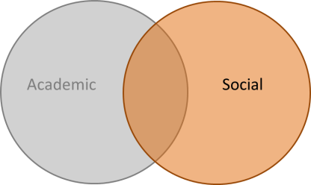
Social
(Data sharing)
Networking and connection building
Publication sharing
Communication
Collaboration
Metrics
Notes:
Social networking & sharing tools enable…
Note: these are the same as what academic tools and services enable!

Slide 20
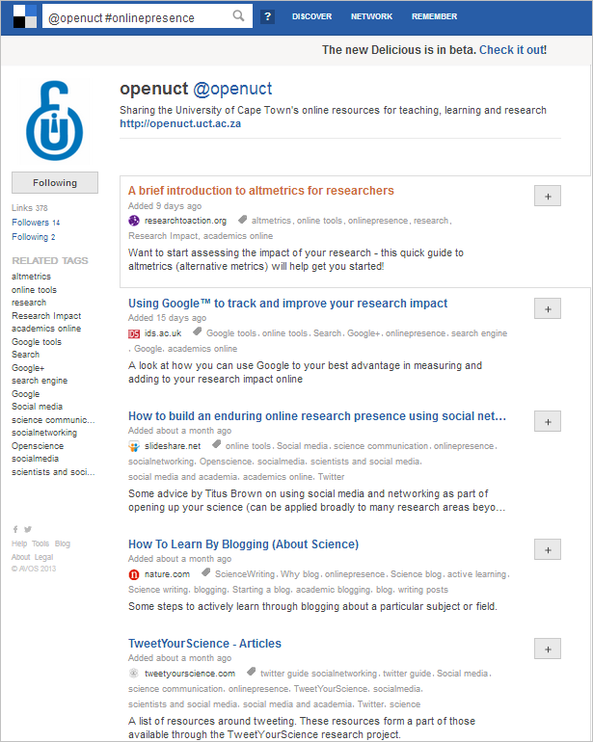
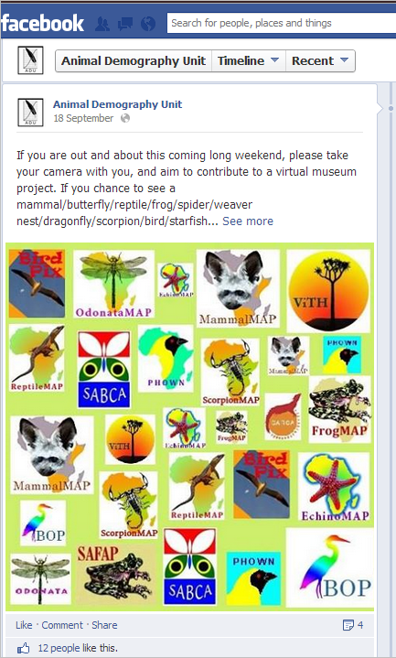
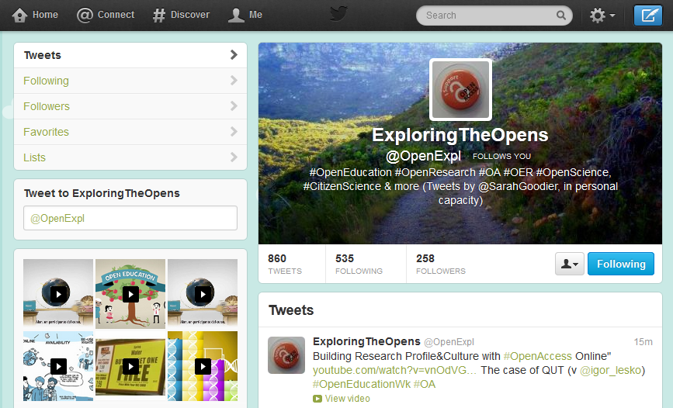
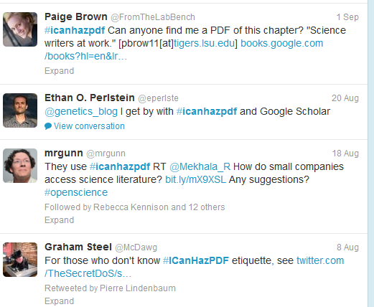
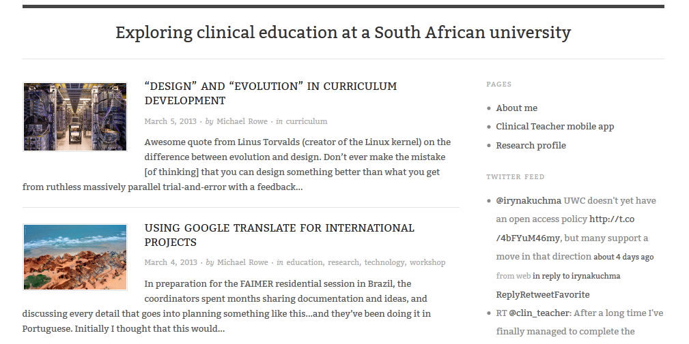
Examples
Notes:
Archiving
Blogging – Wordpress; Blogger
Tweeting - Twitter
Social bookmarking - Delicious
Social networking – Twitter; FB; etc
Publication sharing (#Icanhazpdf)
And many more!

Slide 21
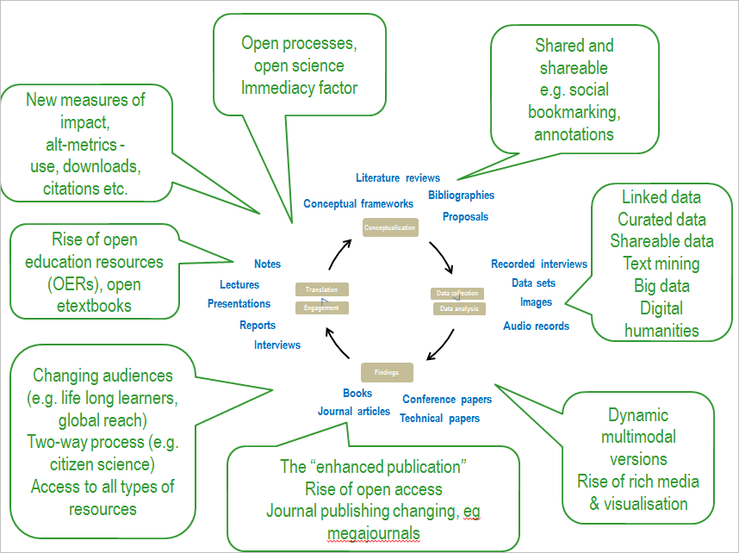
Modified from Czerniewicz, 2013
Notes:
So, researchers are using these tools and services to promote themselves and their work - potentially sharing outputs at many steps in the scholarly communication cycle, as well as networking & engaging…

Slide 22
Modified from Czerniewicz, 2013
Monitoring & assessment
Monitoring & assessment
Monitoring & assessment
Monitoring & assessment
Notes:
…and the Q arising: how can the impact of these outputs feed into monitoring and assessment? …

Slide 23
Online tools & services for boosting academic visibility & profile
Monitoring & assessing:
Academic
Social
OpenUCT Initiative
Notes:
…a new bibliometric model emerges.
(bibliometric = set of methods used to study or measure texts and information; = "the application of mathematics and statistical methods to books and other media of communication“ - http://en.wikipedia.org/wiki/Bibliometrics)

Slide 24
Online tools & services for boosting academic visibility & profile
Monitoring & assessing:
Altmetrics
Academic
Social
OpenUCT Initiative
Notes:
You can use altmetrics to look at the academic and social sharing of outputs – linking the academic and social , in terms of monitoring and measuring research impact

Slide 25
What are Altmetrics?
Alternative metrics/Article level metrics
A novel way to measure research impact and reach of:
  Traditional scholarly works online
  Other outputs (e.g. blogs, news articles, etc.)
Can be incorporated into monitoring and assessment
Notes:
What are altmetrics?

Slide 26
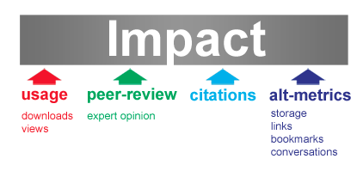
What are Altmetrics?
Image from the altmetrics manifesto; available at: http://altmetrics.org/manifesto/
Notes:
A different and complementary way to measure the impact of the research work… fitting into a broader picture of impact. Immediate picture.
(NOTE: exactly what is reflected by shares, tweets, bookmarks, etc. part of an ongoing conversation – the landscape is changing and evolving)

Slide 27



Altmetrics service providers
And more…

Slide 28
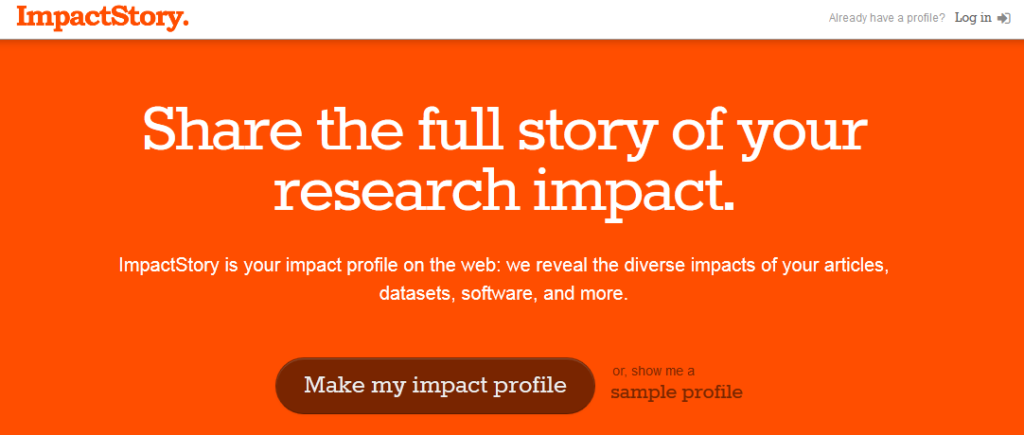
Using ImpactStory
http://impactstory.org/
Notes:
See the full presentation on Using ImpactStory here: http://www.slideshare.net/SarahG_SS/using-impactstory-an-introduction

Slide 29
What is ImpactStory?
“an open-source, web-based tool that helps researchers explore and share the diverse impacts of all their research products” http://www.impactstory.org/faq
You can use it to get an idea who is bookmarking, recommending, saving and citing papers as well as other outputs (e.g. software and blog posts) and where this is happening online
Notes:
This tool can help monitoring of sharing the impact of many of research products – not just for peer reviewed articles.

Slide 30
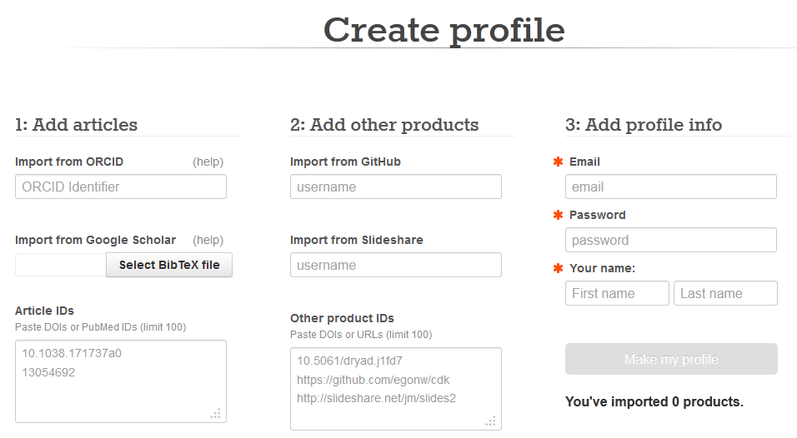
This is where you can add your published outputs to create your profile:

Slide 31
Add articles using your ORCID ID/importing your Google Scholar profile outputs/by listing article DOIs or Pubmed IDs

Slide 32
You can also add other products: from GitHub & Slideshare by including your usernames

Slide 33
You can also add other products: using product IDs –> DOIs & URLs

Slide 34
To make your profile, you need to fill in your email address, a password and your name (all required):

Slide 35
Then click on “Make my profile” to view the altmetrics of the outputs you’ve added

Slide 36
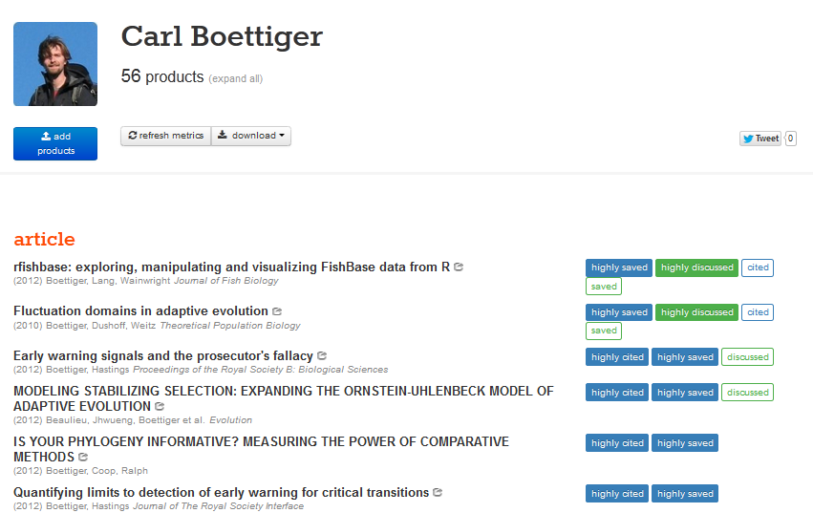
The results of a sample collection showing the altmetrics of a few outputs:
Available at: http://www.impactstory.org/CarlBoettiger

Slide 37
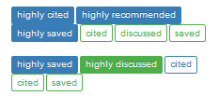

The results of a sample collection showing the altmetrics of a few outputs:
Available at: http://www.impactstory.org/CarlBoettiger
In the summary of the altmetrics results, BLUE blocks indicate a measure of scholarly impact
While GREEN blocks indicate a measure of public impact

Slide 38
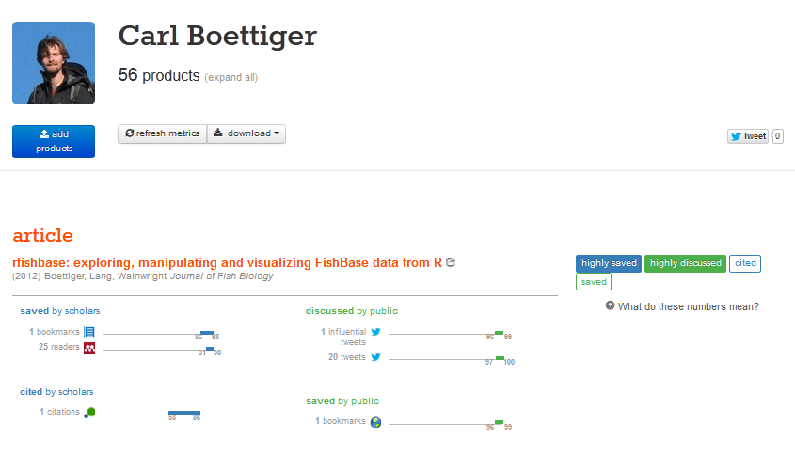
You can click through to see more details on, for example, the readers on Mendeley
To see the altmetrics for each article, you can expand the results by clicking on the output title or the altmetrics summary:
Available at: http://www.impactstory.org/CarlBoettiger

Slide 39
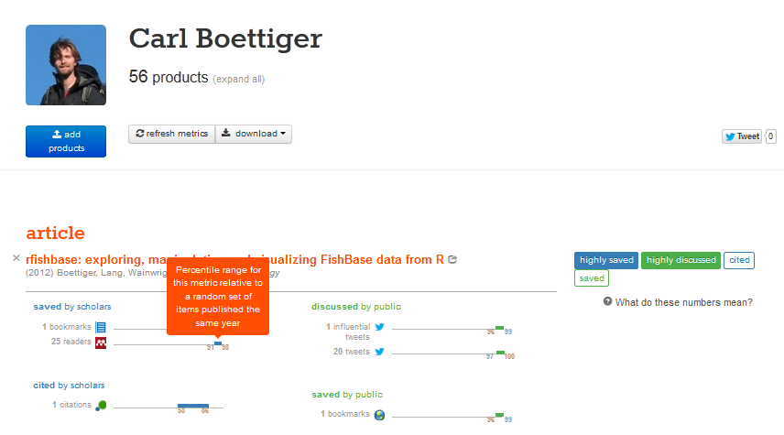
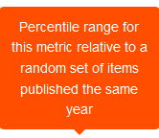
This particular article has been saved 25 times on Mendeley.
This article has more saves on Mendeley than 91% of a random set of articles published in that same year.
The percentile range that the metric for a
specific article falls into is also shown:
Available at: http://www.impactstory.org/CarlBoettiger

Slide 40
Give it a try!
http://impactstory.org/ or http://www.impactstory.org/CarlBoettiger
Notes:
Interactive section 1

Slide 41
Part 2:
Supporting academics in the utilisation of new online presence tools and platforms

Slide 42
An academics’ www online presence
Notes:
Academics can and do utilise many Web 2.0 tools and service for research, collaboration and sharing outside of the institutional environment.

Slide 43
Monitoring & assessment
Monitoring & assessment
Monitoring & assessment
Monitoring & assessment
Notes:
…and altmetrics is a part of the toolkit to measure impact and monitor and assess shared research outputs at all points of the research cycle.

Slide 44
Supporting academics
Find out what academics use, why & what they would like to use in the future
Integration into university-based services (e.g. altmetrics in IR; social media buttons)
Training (on outside services)
Notes:
The above raises the Q: who’s job in uni is it? To provide training, integration? In line with university policy (?)

Slide 45
Supporting academics
What is needed?
Library
Infrastructure
IT
Capacity
Faculties
Research
Office
Cohesiveness
External providers
Notes:
If supporting academics with regard to external services is undertaken, it will require infrastructure, capacity and a degree of institutional cohesiveness – involves many different parts of a university: IT, RO, Lib, Faculties and Departments; others?

Slide 46
Discussion
Supporting academics:
  Are academics supported in using (external) online tools and service at your institution?
  Who/which institutional entities are involved in providing this support?
Notes:
Interactive section 2

Slide 47
Conclusion

Slide 48
Supporting academics
Feedback:
What are academics using?
What are we offering as an institution?
External tools & services
Improving usability & usefulness
Notes:
Academics are reaching outside the institution – using external tools and services for their research, including profiling themselves, their work and networking.
Looking at the tools they are utilising can potentially provide valuable feedback to the institution and help to improve the usability and usefulness of inhouse tools

Slide 49
Assisting institutional needs
Feedback:
What are academics using?
What do we as an institution need?
External tools & services
Monitoring & assessment
Notes:
As new external tools and services continue to be developed, and these tools are used by academics, these could (and should) be investigated by institutions to see what fits into the processes in terms of the research (& scholarly communication cycle)
One particular aspect of this is that aligns with the overall management process layer is with regard to monitoring and assessment
As altmetrics can be seen to form part of and feeding into the monitoring and assessment layer fitting around the research & scholarly communication cycle; something that institutions (and IT) could consider in the near future; as an avenue to better support academics, their online visibility and looking at the impact of their work in the digital world.

Slide 50

Thank you
Excluding images, screenshots and logos and/or unless otherwise indicated on content
All screenshots used purely for illustrative purposes
sarah.goodier@uct.ac.za
@SarahGoodier
http://openuct.uct.ac.za
@OpenUCT

Slide 51
References
Czerniewicz, L. 2013. The changing digitally-mediated scholarship landscape. Available online at: http://docs.lib.purdue.edu/cgi/viewcontent.cgi?article=1982&context=iatul

Slide 52
Extra slides…on Altmetrics

Slide 53
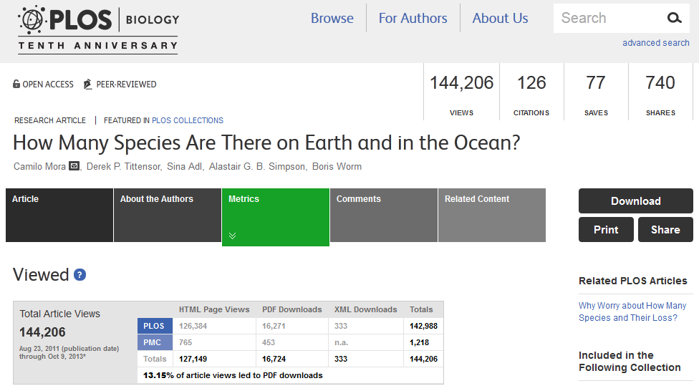
Altmetrics on the rise
http://www.plosbiology.org/article/info:doi/10.1371/journal.pbio.1001127
Notes:
Plos journals have detailed article level metrics (ALMs)
http://article-level-metrics.plos.org/institutions/

Slide 54
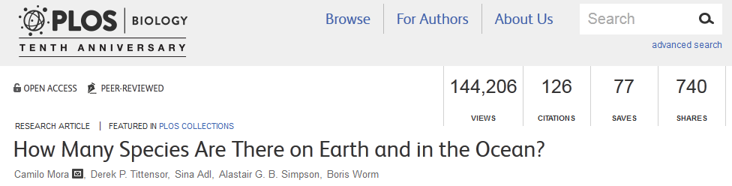
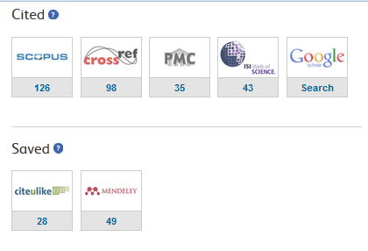
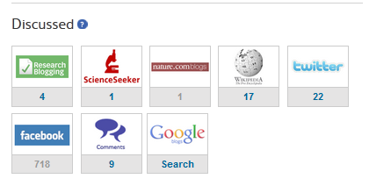

Altmetrics on the rise
http://www.plosbiology.org/article/info:doi/10.1371/journal.pbio.1001127
Notes:
Showing views, downloads, citations, shares, discussions, saves, mentions and reccomendations

Slide 55
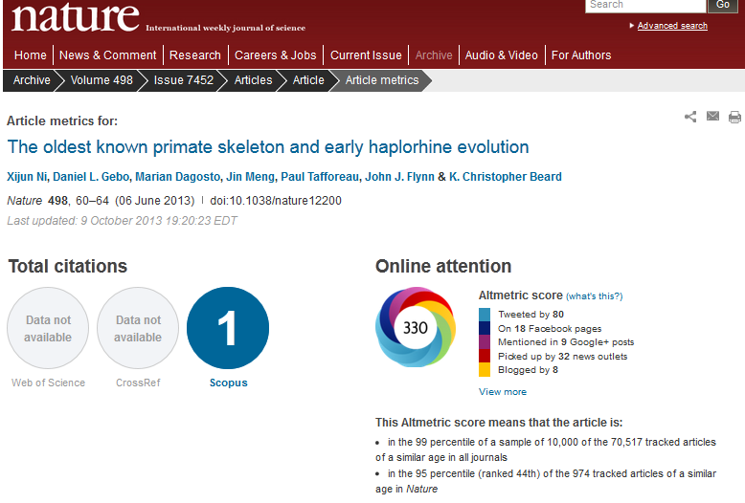
Altmetrics on the rise
http://www.nature.com/nature/journal/v498/n7452/full/nature12200.html
Notes:
Nature is another journal publisher that displays altmetrics data

Slide 56
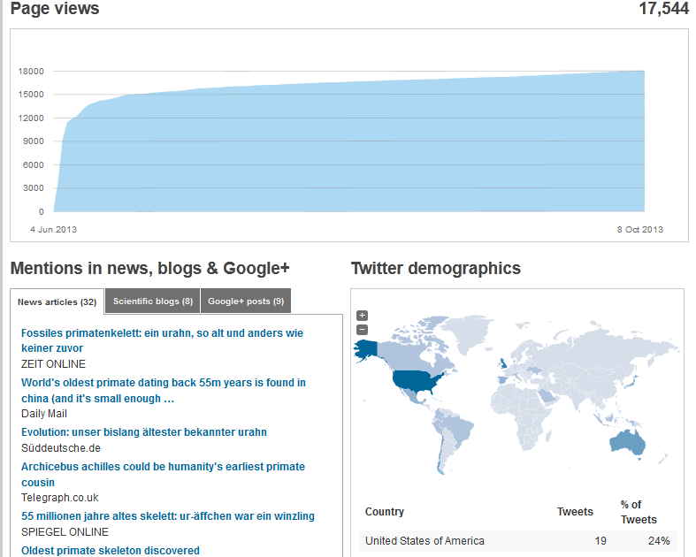

Altmetrics on the rise
http://www.nature.com/nature/journal/v498/n7452/full/nature12200.html

Slide 57
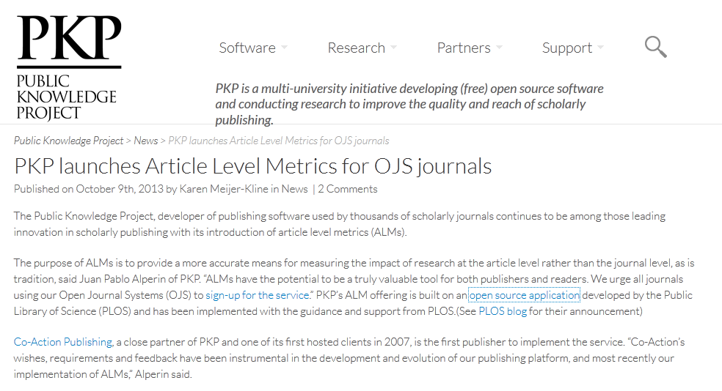
Altmetrics on the rise
http://pkp.sfu.ca/pkp-launches-article-level-metrics-for-ojs-journals/
Notes:
The public knowledge project, which developed the OJS, has launched ALMs for the OJS.
PKP = a multi-university initiative developing (free) open source software and conducting research to improve the quality and reach of scholarly publishing. - See more at: http://pkp.sfu.ca/pkp-launches-article-level-metrics-for-ojs-journals/#sthash.88dAC94V.dpuf,

Slide 58
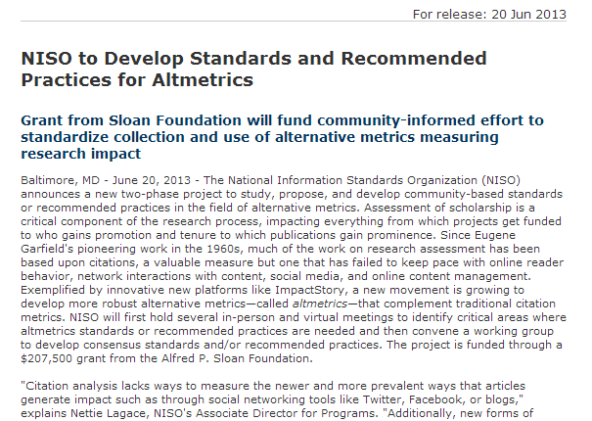

Altmetrics on the rise
http://www.niso.org/news/pr/view?item_key=72efc1097d4caf7b7b5bdf9c54a165818399ec86
Notes:
The NISO has set up an altmetrics steering group to develop standards and recommended practises for Altmetrics.
National Information Standards Organization is a United States non-profit standards organization that develops, maintains and publishes technical standards related to publishing, bibliographic and library applications.

Slide 59
Altmetrics on the rise
Not just for journal articles – e.g. ImpactStory
Performance reviews
CVs
Repositories
etc.

Slide 60
Research & scholarly communication cycle
Management & administration;
Monitoring & assessment;
Curation & preservation
Modified from Czerniewicz, 2013
Notes:
As altmetrics can be seen to form part of and feeding into the monitoring and assessment layer fitting around the research & schol comm cycle; something that institutions (and IT) should consider supporting in the near future; as an avenue to better support academics, their online visibility and looking at the impact of their work in the digital world.

