Slide 1
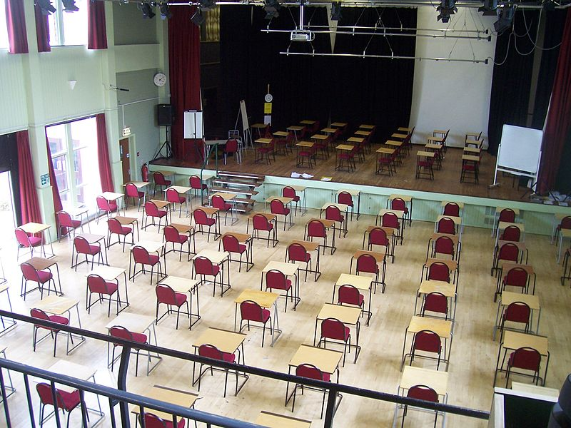
Revision and exam tips
The Technique of Exam Writing

Slide 2

Outline
Revision
Exam structure
Exam tips

Slide 3

1. Revision
Lecture notes
Reading
Exam questions
Make a revision timetable
A cautionary note on spotting

Slide 4
Revision technique: put yourself under exam conditions:
Take a previous exam question or question from the course outline. Give yourself the allotted time in the exam to answer the question, i.e. put yourself under exam conditions. If you can, do this with a partner/group. Read over and give feedback to others in the group. Assess one another’s work on the basis of: Did they answer the question set? Was there an argument? Did the argument build logically? Was the argument persuasive? Is there a strong introduction and conclusion? Is the writing clear and with academic vernacular?

Slide 5
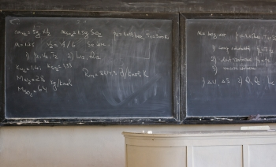

1. Revision
Lecture notes
Reading
Exam questions
Make a revision timetable
A cautionary note on spotting

Slide 6

2. Exam Structure
Two questions in two hours; choice of 5 questions
Time; date; venue
Rules of exams
Procedure of exams
Practical advise
The deferred exam

Slide 7

3. Exam Tips
Which questions should you choose?
Exam questions: class exercise
The formula to exam writing:
  Read the question
  Plan your argument
  Demonstrate your knowledge
Timing

Slide 8
Class exercise: exam questions
[Insert previous exam questions or questions from the course outline]

Slide 9

3. Exam Tips
Which questions should you choose?
Exam questions: class exercise
The formula to exam writing:
  Read the question
  Plan your argument
  Demonstrate your knowledge
Timing

Slide 10
Conclusion
How to prepare for exams:
  Thorough and strategic revision – mock-exam conditions
  Choose questions carefully
  Have a plan: structure and argumentation
  Be aware of the practicalities

