Slide 1
Critical Reading
Recognising the value of written material

Slide 2
Lecture Structure
Academic Reading
  Reading for Content
  Context/Purpose/Structure/Evidence/Conclusion
  Logical Fallacies
  Language
Research Sources
  News Media/Theorists
Evaluating Sources
Summary

Slide 3
Academic Reading
How is this different to reading for pleasure?

Slide 4
Academic Reading
Maximise comprehension.
How does this scholar relate to others I have read?
How will this information be useful to my understanding of the topic?
Critical thinking: Reading for content.

Slide 5
Reading for Content/Context
Who?
What?
Where?
Why?
When?
& How?

Slide 6
Reading for Content/Context
Headings, bold, italicized, and underlined text.
Introduction and conclusion
Skimming.
Scanning.

Slide 7
Context
What is the genre?
Who is the author?
What is the author’s context? (time, location, setting)
What is the author’s purpose for writing the text?
How does the author position themselves in the text?
Who is the intended audience?

Slide 8
Purpose
Why has the author written this?
What does the author expect the reader to learn?
Who is the author’s audience?
How does the author’s tone and positioning reveal their purpose?
Is the author’s tone authoritative or conversational?
How does the author refer to other scholars; to prove or disprove their points?

Slide 9
Structure
Identify the claim (thesis statement).
Logical progress from claim to evidence to conclusion.

Slide 10
Evidence
What evidence is used?
Contradicts/confirms previous evidence?
Valid examples?
Reliable sources?
Countering opposing evidence?

Slide 11
Conclusion
Justified by evidence presented?
Convincingly linked to original claim?
Unevidenced claims?
Sufficient evidence?
Logical fallacies?

Slide 12
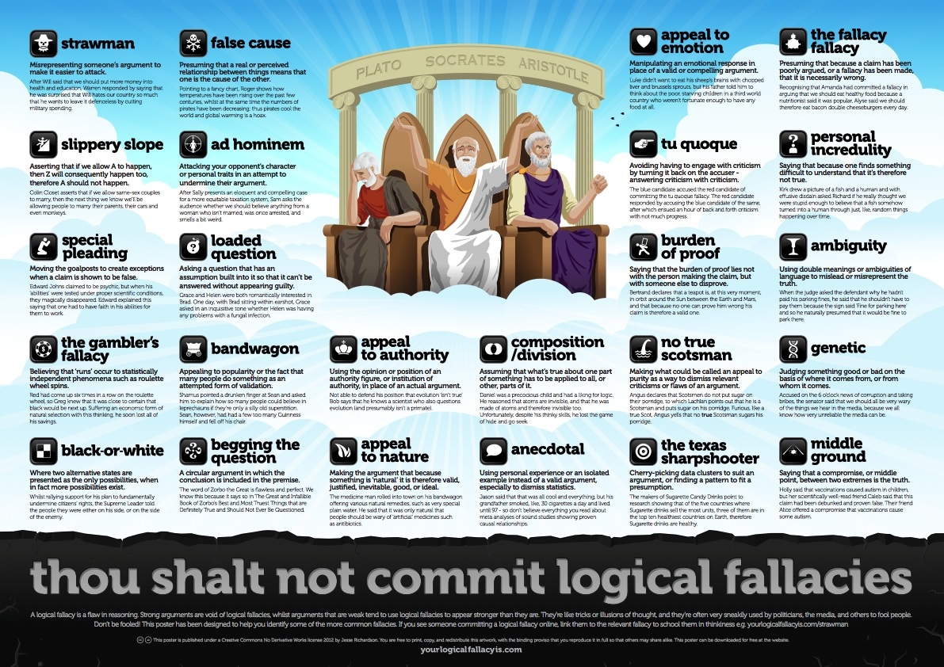

Logical Fallacies
Created by Jesse Richardson, Andy Smith and Som Meaden
Go to https://yourlogicalfallacyis.com/ for further fallacies and examples.
http://creativecommons.org/licenses/by-nc/3.0/

Slide 13
Language
Tone predetermined.
Hyperbole
  “A giant leap forward for …the Goldman Sachs Project” (Foley, 2011)
Emotion.
Colloquialisms
  “This is the Goldman Sachs Project. Put simply, it is to hug governments close.” (Foley, 2011)
Foley, S. 2011. What price the new democracy? Goldman Sachs conquers Europe. The Independent. 18 November. Available: www.independent.co.uk/news/business/analysis-and-features/what-price-the-new-democracy-goldman-sachs-conquers-europe-6264091.html [06 September 2013]

Slide 14
Exercise: Reading For Context
What price the new democracy? Goldman Sachs conquers Europe. The Independent. Foley, S.
18 November 2011.
Available: www.independent.co.uk/news/business/analysis-and-features/what-price-the-new-democracy-goldman-sachs-conquers-europe-6264091.html [06 September 2013]

Slide 15
Exercise: Reading For Context
What is the text about ? Where was it published/genre ? What is the historical context ? Have there been any significant changes politically and culturally since the article was written ? Who is the author? Why do you think the author is writing this particular text ? What is the argument and why is the argument significant ? What other positions/argument does the author mention (or leave out) and how is this significant? Who is the audience ? What sources/evidence does the author rely on to support his claims?

Slide 16
Research Sources

Slide 17
Exercise: Research Sources
What are the different sources of information you might expect to use in your research?

Slide 18
Research Sources
Books
  Political Encyclopaedias/Handbooks
  Single-author volume
  Multi-author (i.e. edited) volumes
Journal Articles
Laws, Constitutions & other legal documents
Academic Research Papers
Government Publications & Manifestos
Reports
Media
Presentations

Slide 19
News Media
BBC World
Fox News
Al Jazeera

Slide 20
Theorists
Kenneth Waltz
John Mearsheimer
Immanuel Wallerstein
Robert Keohane
Susan Strange

Slide 21
Evaluating Sources

Slide 22
Evaluating Sources
What is a reputable source in the social sciences?
Expert
Peer-reviewed
If quantitative, methodology must be transparent and replicable.

Slide 23
Evaluating Sources: Citations
GoogleScholar for any type of source.
ISI Citation Database for journal articles.

Slide 24
Summary

Slide 25
Summary
Critical reading is essential for understanding.
Contextualise the text.
Interpret and assess the claim, evidence and conclusions.

Slide 26
This presentation is licenced under the Creative Commons Attribution-Non-Commercial 2.5 South Africa License. To view a copy of this licence, visit http://creativecommons.org/licenses/by/2.5/za/
Or
send a letter to Creative Commons, 171 Second Street, Suite 300, San Francisco, California 94105, USA.

