Slide 1
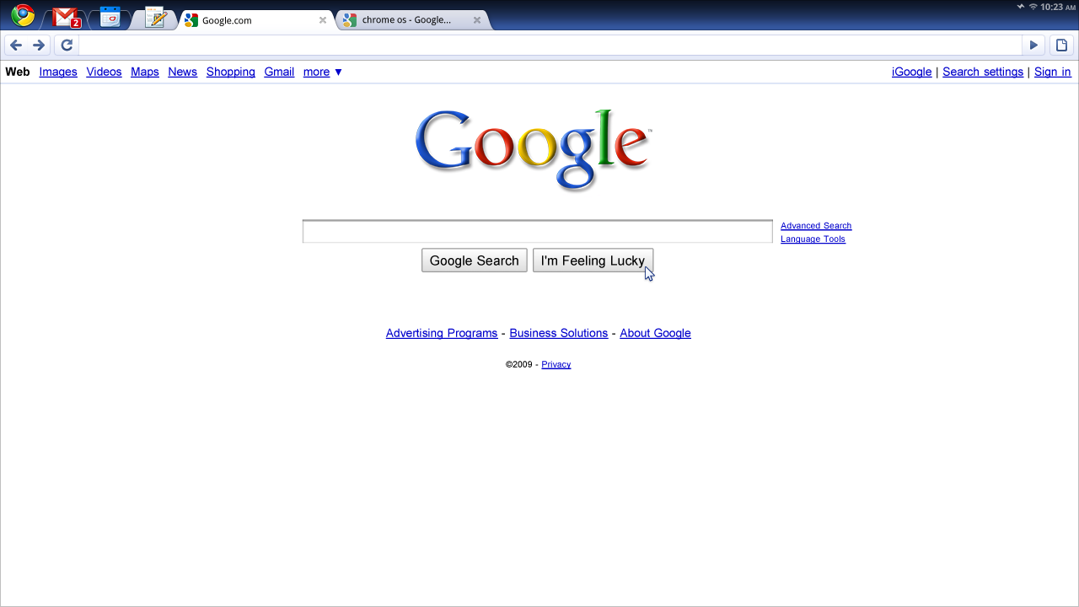
Critically Evaluating Websites
Lecturer: Eduard Campbell
E-mail: CMPEDU001@myuct.ac.za
October 2015
This work by Eduard Campbell is licensed under aCreative Commons Attribution-NonCommercial-ShareAlike 4.0 International License.

Slide 2
What do you think of when you think about “the internet”?

Slide 3
After your two practicals, what is your opinion about “digital natives”? How did your view change?

Slide 4
“…the extent to which South African learners… can be viewed as digital natives is “heterogeneous” with “varying levels of access to and use of technology’” (Tinyane, 2010)
More recently, research done by Czerniewicz and Brown in 2013, also in South Africa, has revealed what they term “a subgroup of ‘digital strangers’” and argue that “the concept of the ‘digital native’… is a myth” in South Africa and that “students across a range of contexts have varied skills, experience and interest in using technology”

Slide 5
Why should we allow the learners’ digital literacy practices in the English classroom?

Slide 6
How could we minimize our learners’ feelings of being overwhelmed by the internet?

Slide 7
Example of a guided tutorial (“treasure hunt”) to do in groups and discuss:
The goal for this search: FIND OUT WHAT THE LAST “W” IS OF WEBSITE EVALUATION.
Guided tutorial:
Use your phone or laptop to search for Kathy Schrock’s website and go to it.
Go to her homepage and search for “Critical Evaluation of Information” and click on it.
Go to “The 5 W’s of website evaluation”
Search for the answer…

Slide 8
Example of a semi-guided tutorial (“treasure hunt”) for discussion:
The goal for this search: DESCRIBE IN YOUR OWN WORDS WHY CYBER BULLYING IS A SERIOUS MATTER.
Semi-Guided tutorial:
Use any credible news website to find out what the latest news is on the topic
You can look at the abstracts of articles on Google Scholar to substantiate
In this case, you may not use Wikipedia

Slide 9
Example of an unguided tutorials (“treasure hunt”) for discussion:
The goal for this search: HOW CAN WE INTEGRATE SOCIAL MEDIA INTO A SENIOR PHASE LANGUAGE STRUCTURES AND CONVENTIONS CLASSROOM?
Unguided tutorial:
Use any credible website to find out what the latest “atmosphere” is on the topic
You may use multimodalities: video, images, podcasts, twitter, tumblr, Facebook and more…

Slide 10
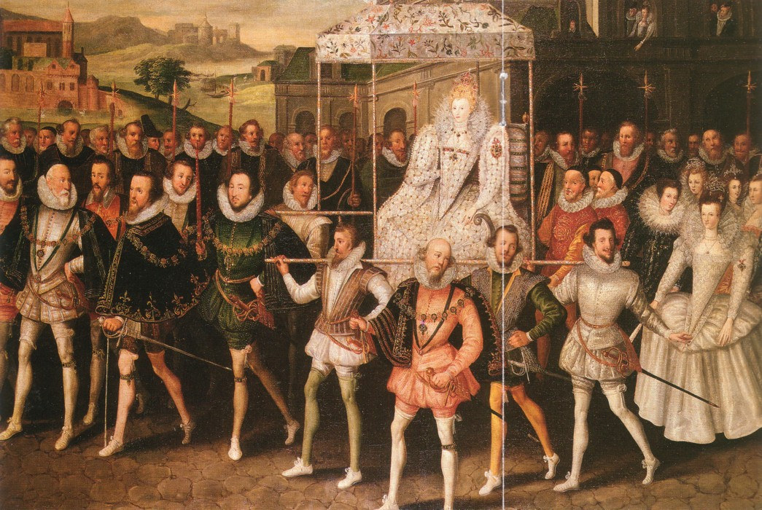
Group work:
Use your phone or laptop to search for two appropriate sources pertaining to Shakespeare and the Elizabethan context (use Google)
Discuss why you think these websites are good sources to use when you want your class to write a paragraph on the social context of “Macbeth” and use proper sources to reference what they are saying
Image attributed to Robert Peake the elder - Tudor and Elizabeth portraits

Slide 11
Using a checklist to critically evaluate websites…

Slide 12
The Checklist:
Every aspect of the website is scrutinised and marks are awarded
Use it when finding sources for your class
Adapt your own version of it and give to students to help them evaluate sources

Slide 13
Using the checklist:
Go to DL4TB.blogspot.co.za and find my checklist (click on it if it is too small). Keep it open – you will be using it throughout this activity.
Find two sources on “The Writing Process” in groups using any search engine you like
One source must be a good source (according to the checklist), the other must be a bad source
Report to the class how you made your decisions

Slide 14
Make comments on the blog…

Slide 15
Something to reflect upon:
‘Research resources are not always just text text text…’ what do you think?
‘Multimedia sources can be used as well and learners should be encouraged to use them…’ debate this…
Class discussion: How do we teach learners when to use a multimedia source and when to rather opt for the good old fashioned text-based resource?

Slide 16
A good resource for critical evaluation and much more:
Schrockguide.net

Slide 17
References:
Thinyane, H. 2010, "Are digital natives a world-wide phenomenon? An investigation into South African first year students’ use and experience with technology ", Computers & Education, vol. 55, no. 1, pp. 406-414.
Czerniewicz, L. Brown, C. 2013, "The habitus of digital “strangers” in higher education", British Journal of Educational Technology, vol. 44, no. 1, pp. 44-53.

